Slide 1
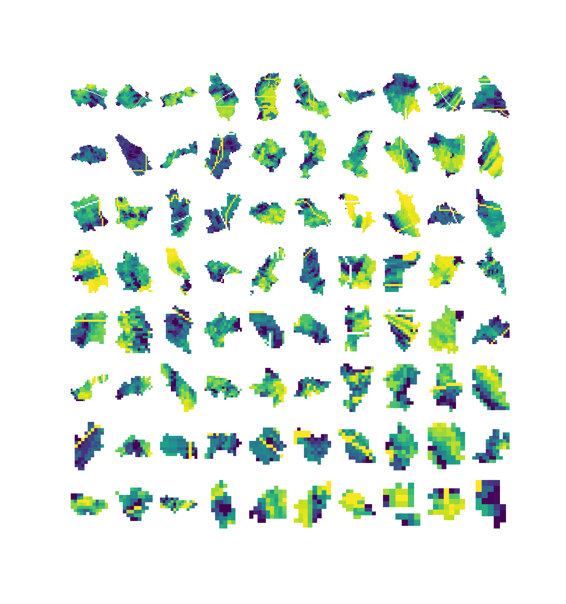
An Analysis of the
Spatial Distribution of Precipitation and Orographic Effect in BC and AB
EOSC 510 (Winter 2020)
Dan Kovacek (35402767)

Slide 2
Motivation
Ungauged watersheds are hard to characterize
  Regionalize
Regionalization is difficult
  Measure precip
Point precip. measurements = poor accuracy
  Adjust for elevation difference
Orographic effect rule-of-thumb
  How accurate is this? Seasonality?

Slide 3
Research Question
Can radar be used to identify similarities in precipitation between catchments?

Slide 4
Data

Slide 5
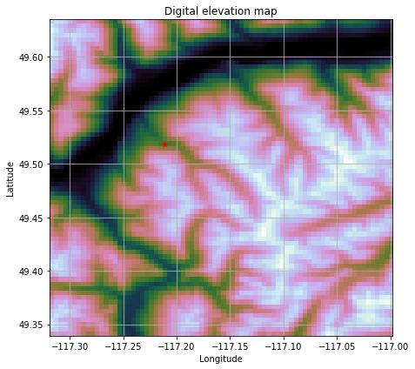
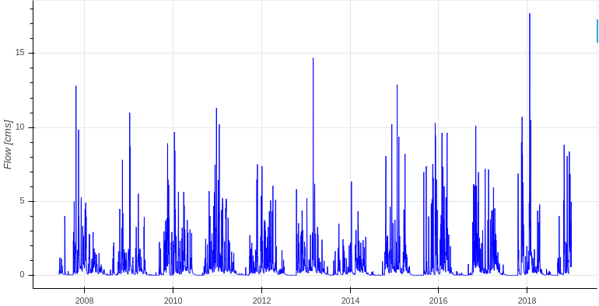
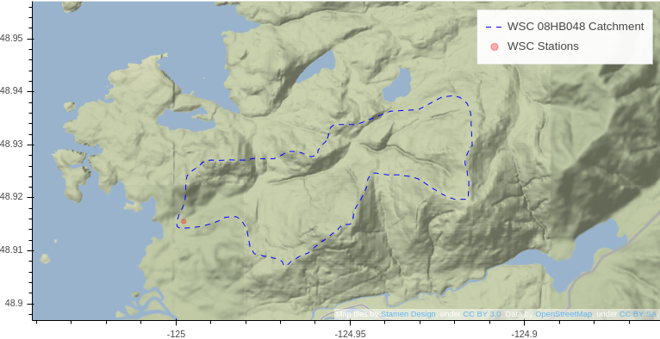
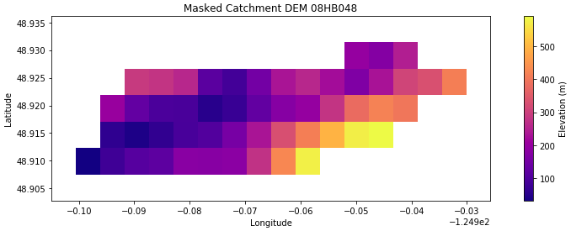

Data

Slide 6
Data Preprocessing
Minimize the number of radar images
  Find single runoff events (summer/fall)
Project coordinate system onto radar image px
Project elevation onto radar image px
Mask radar images with catchment geometry
Map pixel colour value to precip. intensity

Slide 7
Methodology
Sum precipitation in each cell (pixel)
Remove demonstrably poor quality radar
Sum precipitation by elevation band (100m)
Fit curve to elevation vs. precipitation
Group catchments by agglomerative clustering

Slide 8
Results
Within-catchment precipitation distribution may invert wrt orographic effect in certain regions
PCA useful in Anomaly Detection
  Autoencoder NN not measurably better, harder to interpret

Slide 9
Conclusions
Within-catchment precipitation distribution may invert wrt orographic effect in certain regions
Many issues with radar data, but could be useful in certain areas if reliability can be assesse
Large attrition in sample due to the intersection of several independent imperfect data sources

