Slide 1

What did you do with your last vacation photos?

Slide 2


Amotz Levy | Dan Kovalsky | Eran Kan | Amit Gabso

Slide 3

Easy
To use
To remember
To share

Slide 4
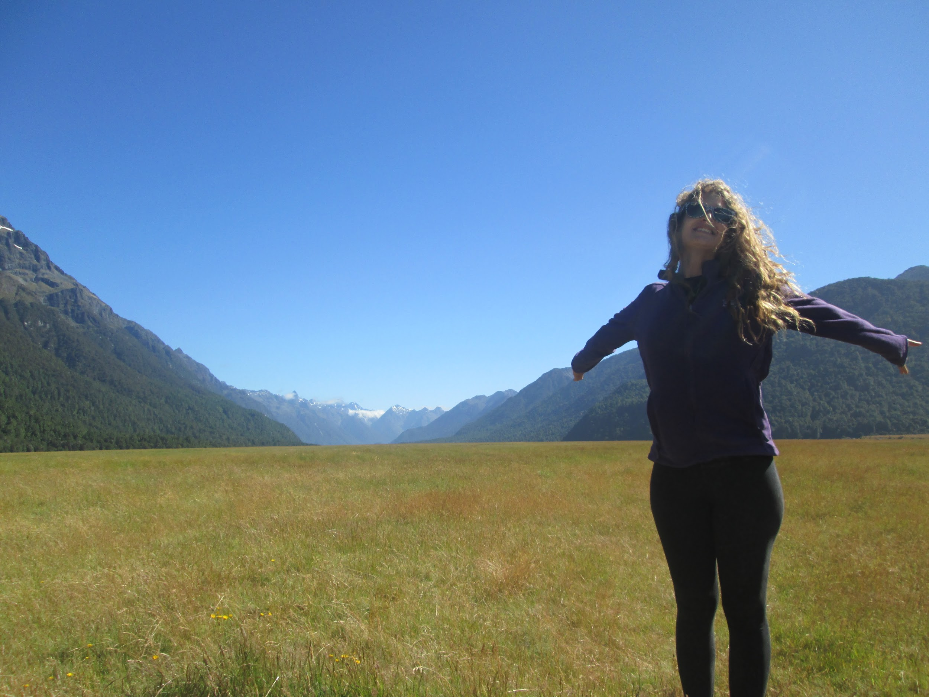
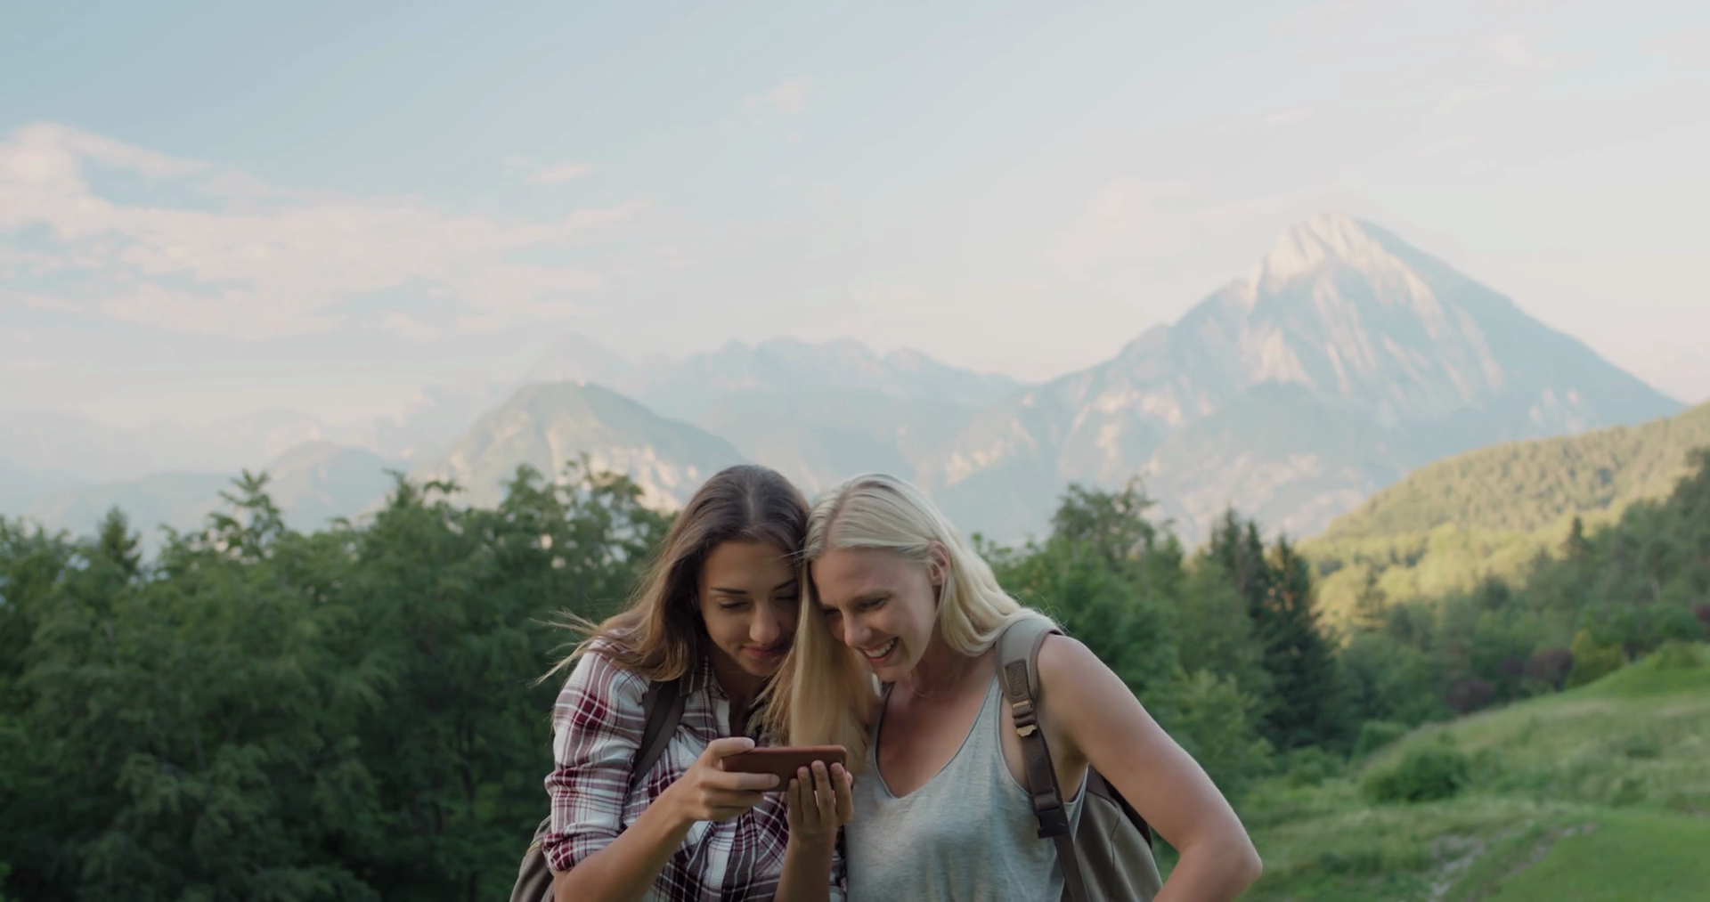
Target Audience
Anyone who likes to travel

Slide 5




Flow
Create story
Travel
Get a souvenir

Slide 6
Main Features
Build a route on a map
Associate images to locations
Classify images (ML)
Create a Souvenir (GIF)

Slide 7
Live Demo

