Slide 1
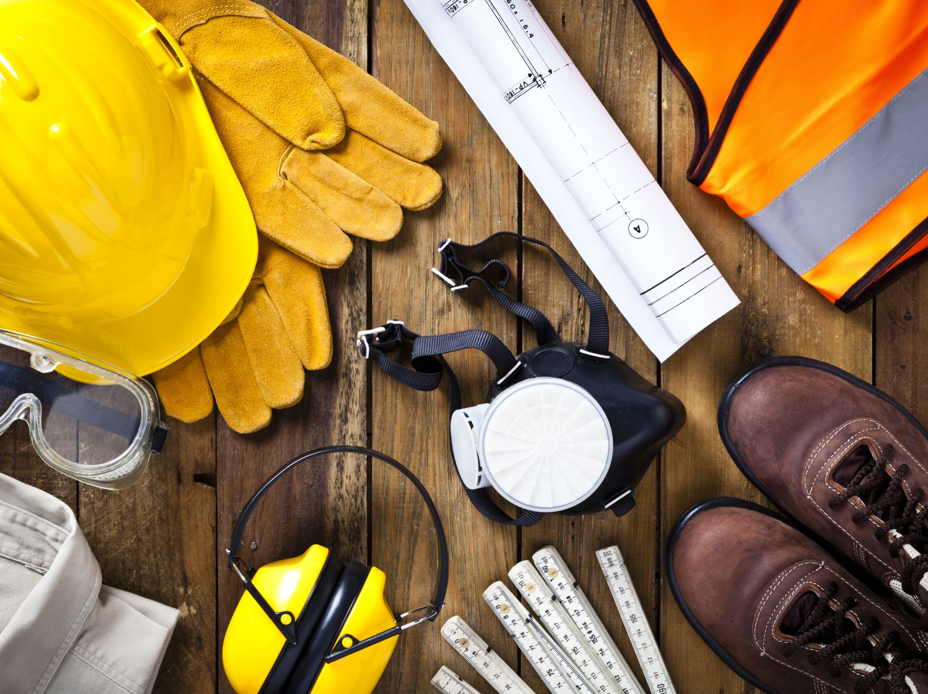
HelmetGuard: Safety Classification of Construction Site Images
Detecting unsafe construction situations based on workers wearing helmets.
Student: Dan Koenkas, Nadav Golche Faragian
Course: Generative AI for Computer Vision
We propose a vision system that classifies construction images as safe or unsafe based on helmet usage.

Slide 2
Motivation & Real-World Use Case
  Construction sites are high-risk environments with frequent accidents.
  Some accidents are due to workers not wearing helmets.
  Large companies cannot manually monitor all camera feeds.
  Cameras already exist on many sites.
  An automated system can support safety officers and improve compliance.
Target user: a safety officer receiving automatic alerts for unsafe images.

Slide 3
ML Task: Image-Based Safety Classification
Input: RGB image from site cameras.
Output: safe / unsafe (or no_workers).
Task: supervised image classification.
Example: all helmets → safe; missing helmet → unsafe.

Slide 4
Dataset: Real + Synthetic Images
  Real images: 50–200 labeled photos for validation/test.
  Synthetic images: generated using diffusion models (SDXL).
  Prompts vary workers, background, lighting, angles.
  Optional: inpainting to remove helmets.
Text prompt → GenAI → Synthetic images → Training set.

Slide 5
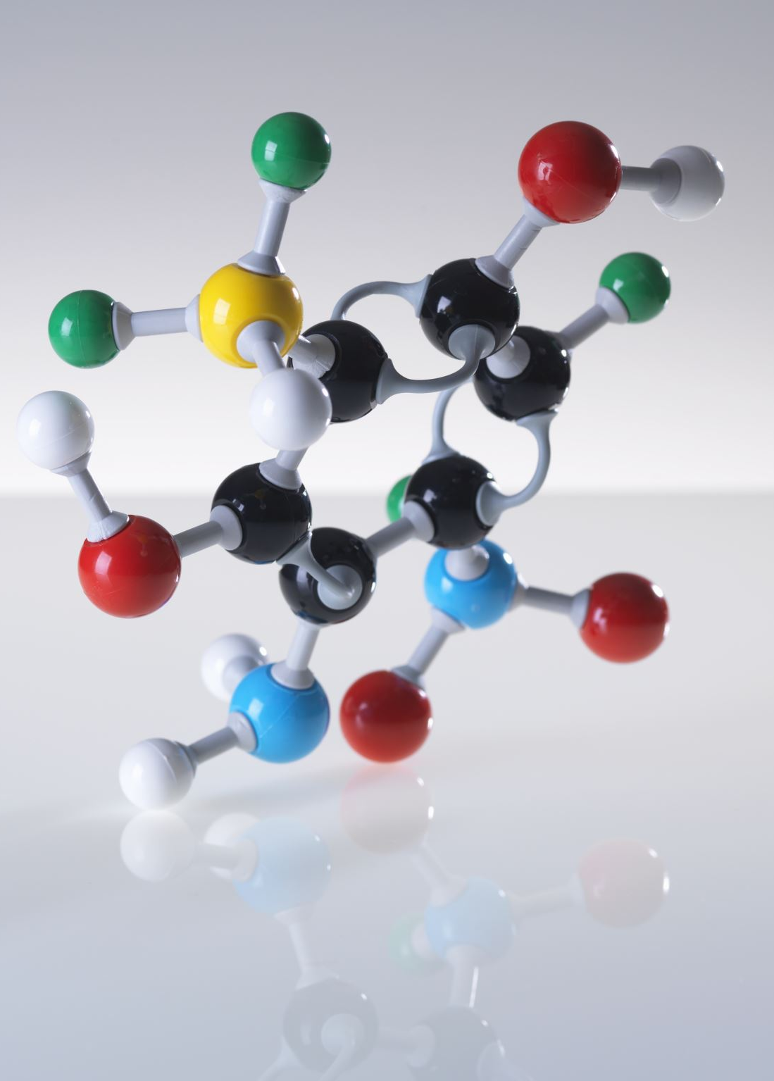
Models & Methods
  Preprocessing: resize, normalize, augmentation.
  Baseline: pretrained features + classifier.
  ResNet50 fine-tuning on synthetic data.
  Optional: ViT for advanced modeling.
Synthetic + real images → ResNet50/ViT → prediction.

Slide 6

Evaluation & Project Plan
Metrics: accuracy, precision, recall, F1.
Critical: catching unsafe images.
Confusion matrix analysis.
Weeks 1–2: define task, collect images.
Weeks 3–4: generate synthetic dataset.
Weeks 5–6: train models.
Weeks 7–8: evaluate & prepare report.

