Slide 1
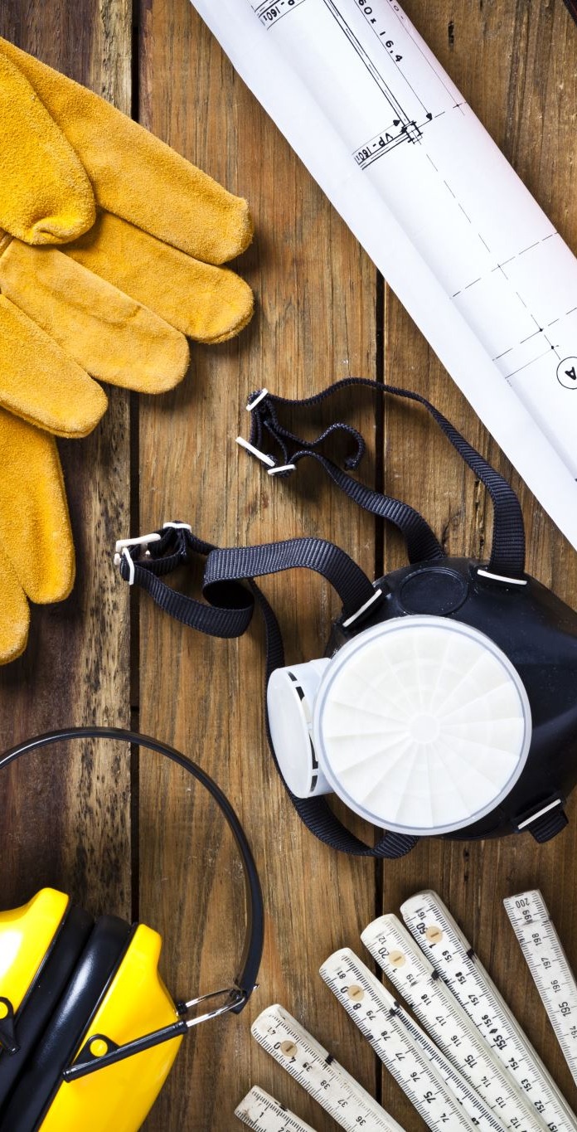
HelmetGuard: Safety Classification of Construction Site Images
Using synthetic and real data for helmet safety detection
Names : Dan Koenkas – 322890542 ,
Nadav Golche Faragian - 212166235

Slide 2
Motivation & Use Case
Construction sites are dangerous environments.
  Helmets are mandatory but not always used.
  Safety officers cannot monitor all cameras manually.
  Goal: automatic detection of unsafe images.
  Target user: safety officer receiving automatic alerts.

Slide 3
Problem Definition
Input: image from a construction site.
  Output: label - safe / unsafe.
  Safe: all visible workers wear helmets.
  Unsafe: at least one worker without helmet.
  Binary image classification task.

Slide 4
Dataset: Synthetic + Real
Synthetic dataset:
  ~700 images generated with Stable Diffusion.
  Manually cleaned into safe / unsafe.
  Real dataset:
  40 safe, 19 unsafe images from the web.
  Real test set: 30 safe, 14 unsafe.

Slide 5
Synthetic Data Generation (GenAI)
Diffusion model: Stable Diffusion (Colab pipeline).
  Text prompts describe workers with or without helmets.
  Negative prompts to avoid unrealistic images.
  Manual review and cleaning of generated images.

Slide 6
Model & Training
Backbone: ResNet18 pretrained on ImageNet.
  Final layer replaced with 2-class head.
  Input size: 224x224.
  Data augmentation: crops, flips, color jitter.
  Loss: cross-entropy, Optimizer: Adam (lr=1e-4).

Slide 7
Results on Real Test Images
Experiment | Train data | Real acc | Safe acc | Unsafe acc
1 | Synthetic only | 31.5% | 12.5% | 85.7%
2 | Synth + few real | 63.6% | 76.7% | 35.7%
3 | Synth + real (oversampled) | 52.3% | 56.7% | 42.9%
-Results may vary slightly between runs.

Slide 8
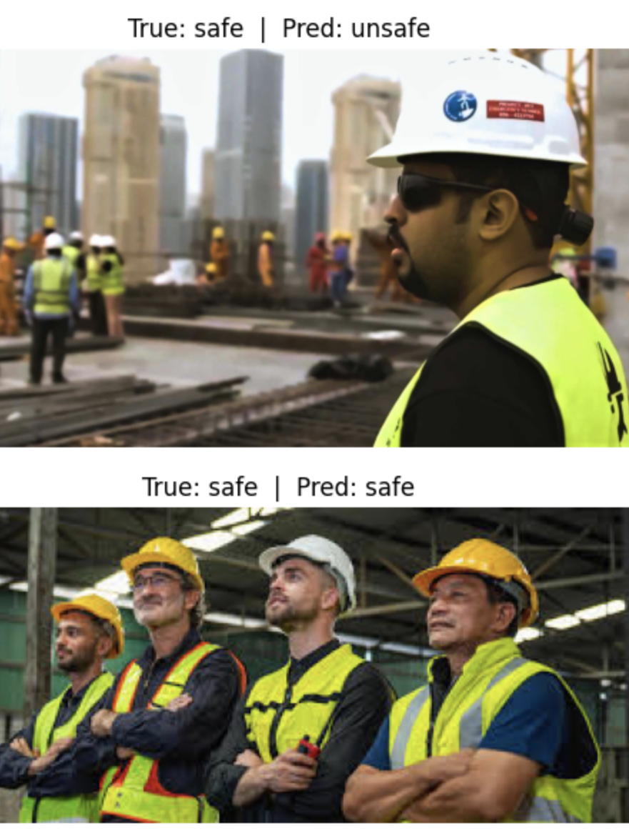
Example Predictions
Correct safe prediction.
  Correct unsafe prediction.
  Failure case example.
  Model focuses on helmet shape and color.
  Typical errors: crowded scenes, occlusions.

Slide 9
Discussion & Limitations
Synthetic-only model does not generalize well to real images.
  Small real dataset has a large impact on performance.
  Tradeoff between false alarms and dangerous misses.
  No localization of individual workers.
  Very small real test set (30 safe, 14 unsafe).

Slide 10
Conclusion & Future Work
HelmetGuard: image-based safety classifier.
  Synthetic data useful for bootstrapping.
  Real data is essential for deployment.
  Future work: more real data, better losses, object detection.

