Slide 1

HelmetGuard: Safety Classification of Construction Site Images
Combining synthetic and real data for helmet usage detection
Students: Dan Koenkas , Nadav Golche Faragian
Course: Generative AI for Computer Vision

Slide 2
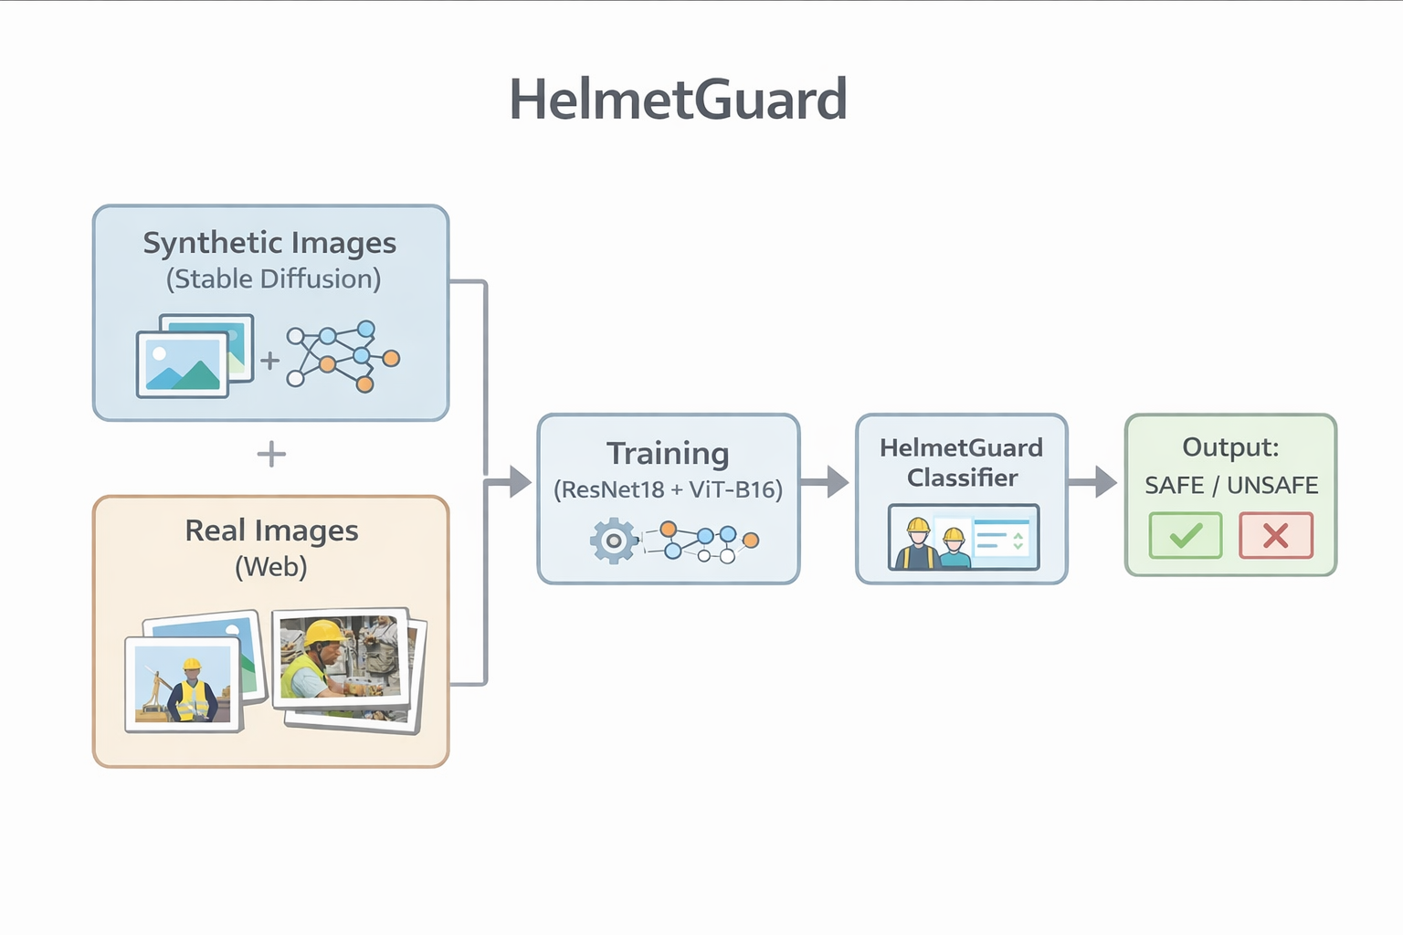
System Overview
Input: single image from a construction site camera.
Output: safe or unsafe based on helmet usage.
Training: synthetic + real images.
Models: ResNet18, ViT-B/16

Slide 3
Motivation
Construction sites are high-risk environments.
Helmets are mandatory but often ignored.
Hard to monitor all cameras in real time.
Goal: automatic alerts for unsafe scenes.

Slide 4

Problem Definition
Binary image classification.
Input: RGB image.
Output: safe / unsafe.
Scene-level only, no localization.

Slide 5
Dataset Overview
Synthetic: ~700 images.
Real: 40 safe, 19 unsafe.
Train: 10 safe, 25 unsafe.
Test: 30 safe, 14 unsafe.

Slide 6
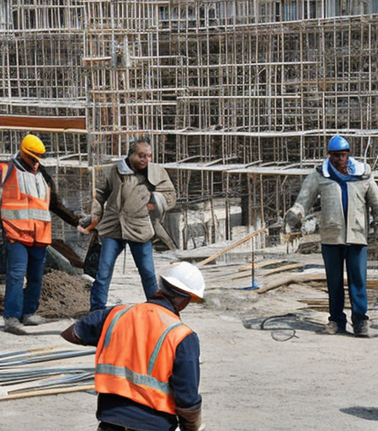

Synthetic Data Generation
Stable Diffusion in Google Colab.
Controlled prompts.
Negative prompts to reduce artifacts.
Manual cleaning and labeling.

Slide 7
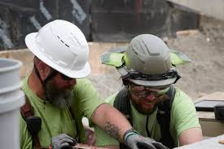
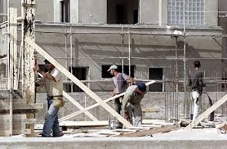
Real Data Examples
Collected from public web sources.
More cluttered and diverse.
Errors when workers are small or occluded.

Slide 8

Models & Training
ResNet18 and ViT-B/16.
Input size 224x224.
Adam optimizer, LR=1e-4.
Data augmentation applied.

Slide 9

Experiments
Synthetic only.
Synth + few real.
Synth + real with oversampling.
ViT with synth + real.

Slide 10
Quantitative Results
Synthetic only performs poorly on real data.
Adding real images improves accuracy.
ViT gives best trade-off.
Unsafe acc | Safe acc | Real acc | Train data | Model | Exp
31.5% | 12.5% | 85.7% | Synthetic only | ResNet18 | 1
63.6% | 76.7% | 35.7% | Synth + few real (10 safe, 5 unsafe) | ResNet18 | 2
52.3% | 56.7% | 42.9% | Synth + real (10 safe, 25 unsafe) | ResNet18 | 3
63.6% | 73.3% | 42.9% | Synth + real (10 safe, 25 unsafe) | ViT-B/16 | 4

Slide 11
Discussion & Limitations
Domain gap exists.
Small real dataset.
Scene-level only.
Trade-off between FP and FN.

Slide 12
Conclusion & Future Work
Synthetic data helps bootstrap.
Real data is essential.
Future: object detection, domain adaptation.

