Slide 1
Multi-Label Toxic Comment Classification
From CNN+GloVe to BERT Architecture · Data Efficiency · Rare Label Detection
CMPE 258 — Deep Learning | Kaggle Jigsaw Toxic Comment Classification Challenge
"Online platforms generate millions of comments daily. Human moderation doesn't scale — but can a model learn six different kinds of harm simultaneously?"
[Name 1] · [Name 2] · [Name 3] · [Name 4]
Spring 2026

Slide 2
Research Question
How much does model architecture and pretraining matter for multi-label toxicity detection — and how much training data do you actually need?
Three sub-questions that drove the full experiment chain:
• Can task-trained word-vector models (CNN, BiLSTM) achieve acceptable performance on rare toxicity labels?
• Do pretrained transformers (DistilBERT, BERT) overcome the rare-label ceiling — and why?
• What is the minimum training data needed for each model family to reach competitive performance?
6 labels: toxic · severe_toxic · obscene · threat · insult · identity_hate

Slide 3
Dataset Overview
DATA
• 159,571 Wikipedia talk-page comments — no missing values, no duplicate IDs
• Multi-label binary classification: each comment independently belongs to any subset of 6 toxicity categories
• Labels are NOT mutually exclusive — a single comment can be toxic, obscene, and an insult simultaneously
• Fixed train / val split held constant across all experiments:
◦ Train: 143,613 samples
◦ Validation: 15,958 samples (iterative stratification, random_state=42)
• 6 binary label columns: toxic · severe_toxic · obscene · threat · insult · identity_hate
The same 15,958-sample validation set is used in every single experiment across all four models.

Slide 4
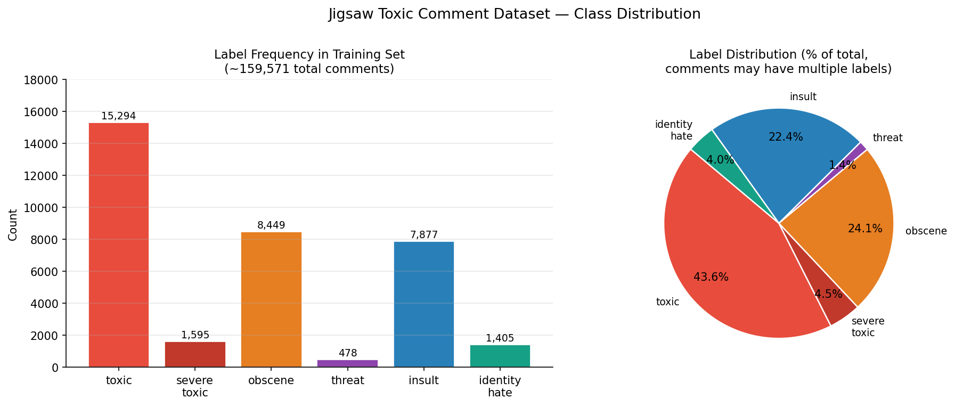
Label Distribution
EDA
~89.8% of comments are completely clean · only ~10.2% have at least one label
Label | Count | Prevalence | Note
toxic | ~15,294 | ~9.6% | Most common
obscene | ~8,457 | ~5.3%
insult | ~7,819 | ~4.9%
severe_toxic | 1,595 | ~1.0% | Always co-occurs with toxic
identity_hate | ~1,405 | ~0.88%
threat | 478 | ~0.30% | Rarest — 32:1 ratio vs toxic
Per-label class prevalence

Slide 5
Label Co-occurrence
EDA
Among the 16,225 labeled comments — how many toxicity labels does each carry?
# Labels Active | Comment Count
1 label | 6,360
2 labels | 3,480
3 labels | 4,209
4 labels | 1,760
5 labels | 385
6 labels (all) | 31
Key Co-occurrence Findings
• severe_toxic ⊂ toxic: 0 rows with severe_toxic=1 and toxic=0
• toxic – obscene – insult form a tight cluster: Pearson ρ ≈ 0.65–0.74
• P(toxic=1 | obscene=1) = 93.81%
• P(toxic=1 | insult=1) = 93.23%
• P(toxic=1 | obscene=1 AND insult=1) = 96.73%
• threat weakly correlates with all others (ρ ≈ 0.12–0.16)
◦ High average AUC can completely hide a full threat failure
Source: EDA.ipynb — Pearson correlation heatmap + conditional probability heatmap P(B=1|A=1)

Slide 6
Text Length Characteristics
EDA
Statistic | Characters | Words
Median | 207 | 36
Mean | 397 | 67
90th pct | 895 | 152
95th pct | 1,364 | 230
99th pct | 3,471 | 567
Max | 5,000 | 1,411
Design Implications
• Toxic comments are shorter at the median (~94–123 chars) vs. clean (~206–216 chars)
◦ Length is a misleading proxy — do not use it as a standalone feature
• Heavy right tail: max 1,411 words — set max_length deliberately for all sequence models
• Linguistic noise: slang, misspellings, abbreviations
◦ Affects word-level tokenisers (CNN, BiLSTM) more than WordPiece (BERT, DistilBERT)
• Practical limits chosen:
◦ max_len = 100 (BiLSTM) — covers 36-word median with headroom
◦ max_len = 256 (CNN)
◦ max_length = 128 → 192 (BERT/DistilBERT) — key design decision
Source: EDA.ipynb — comment length KDE (clean vs. any-toxic) + median char length by label value

Slide 7
EDA → Design Decisions
EDA
EDA Finding | Design Response
32:1 imbalance (toxic vs. threat) | pos_weight per label in BCE loss + per-label threshold tuning
threat has only 478 positives in 143k rows | Training size sweep 10k→143k · Macro F1 as primary metric
severe_toxic ⊂ toxic on train | Separate head + own threshold; expect unstable F1
threat weakly correlated with other labels | Evaluate threat explicitly — average AUC hides failure
Length variance: 36 median → 1,411 max words | max_len=100 (BiLSTM) · 256 (CNN) · 128→192 (BERT)
66% of this vocabulary has no GloVe vector | WordPiece subword tokenisation for transformers handles OOV via decomposition
Label co-occurrence structure in splits | Iterative stratification (skmultilearn) instead of random split

Slide 8
Overall Methodology — Metrics
METHODOLOGY
Metric | What It Is | Why We Use It
Tuned Macro F1 (PRIMARY) | Unweighted average of per-label F1 across all 6 labels, after threshold optimisation | Weights all 6 labels equally — a complete failure on threat penalises the score the same as a failure on toxic
Baseline Macro F1 | Same metric but with fixed threshold t=0.5 for all labels | Measures raw model calibration before any threshold adjustment
Tuning Gain (Tuned − Baseline) | Difference between tuned and baseline macro F1 | Large gain = model discriminates well but outputs miscalibrated probabilities
ROC-AUC per label (secondary) | Probability the model ranks a positive above a negative — threshold-independent | Confirms whether poor F1 is a calibration problem or a discrimination problem
Per-Label F1 | F1 for each of the 6 labels individually | Exposes which specific toxicity types each model struggles with

Slide 9
Overall Methodology — Types of Runs
METHODOLOGY
Run Type | What It Does | Which Models
Full-data training run | Train on all 143,613 samples; evaluate on fixed 15,958-sample validation set | All 4 models
Training size sweep | Train at 10k, 20k, 30k … up to full data; same fixed val set at every size | CNN (→61k) · BiLSTM (→140k) DistilBERT & BERT (→143k)
Hyperparameter grid search | Hold training size fixed at full data; vary lr / weight decay / warmup across 16 configs | BERT Exp04 only
Ablation study | Hold all settings fixed except one variable; isolate and measure the effect of that single change | DistilBERT Exp D (pos_weight) DistilBERT Exp E (loss function)
Per-label threshold tuning | Grid search over [0.05–0.995] per label on the validation set after every single run | Applied to ALL runs, ALL models
Fixed anchor: the same 15,958-sample validation set is used in every run — this is what makes all sweep curves directly comparable.

Slide 10
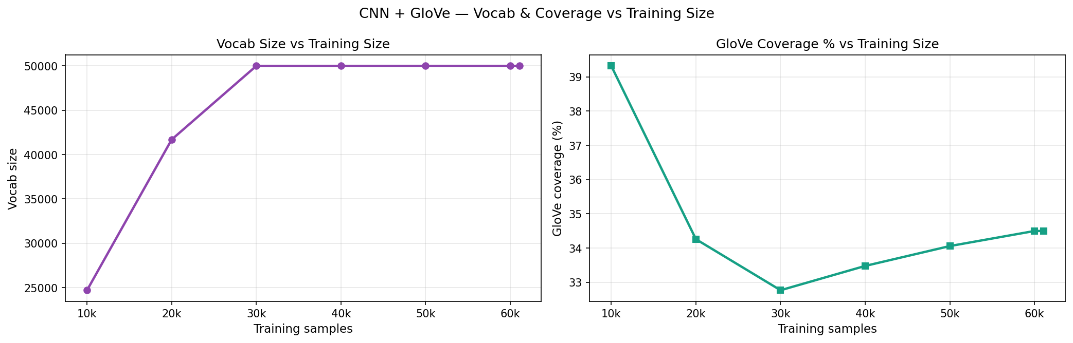
CNN + GloVe — Architecture
CNN + GLOVE
• TextCNN: parallel Conv1d filters for 2 / 3 / 4 / 5-gram patterns
◦ 128 filters per filter size · global max-pool · 512-dim concatenated output · Dropout(0.5)
• Parameters scale with vocabulary size:
◦ ~2.6M at 10k training samples (vocab = 24,700 unique tokens)
◦ ~5.1M at max_vocab = 50k (full training run)
• Embeddings: GloVe 6B 100-dim — fine-tuned during training (GLOVE_TRAINABLE = True)
◦ Only 34% vocabulary coverage — 66% initialise from random vectors
• max_len=256 · max_vocab=50k · min_freq=2 · BCEWithLogitsLoss + pos_weight
GloVe vocabulary coverage vs. training size (graph8_vocab_coverage.png)

Slide 11
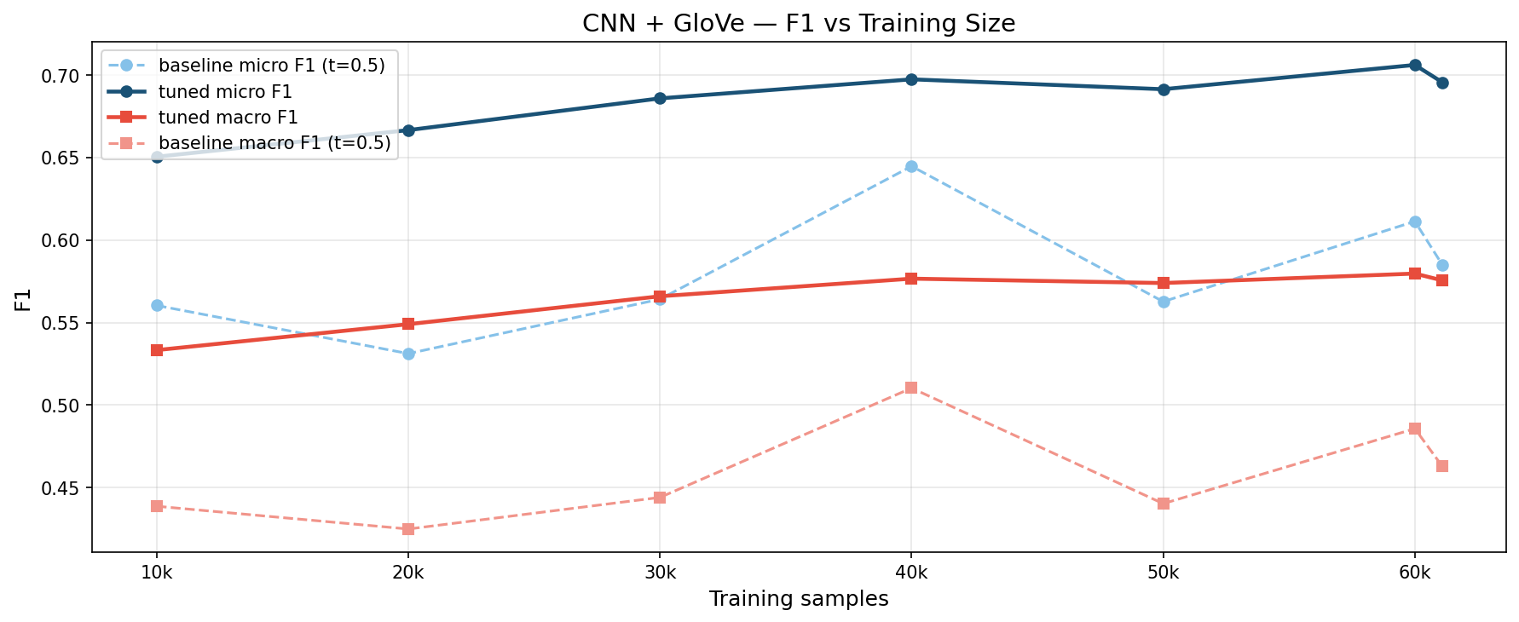
CNN + GloVe — Sweep & Outcomes
CNN + GLOVE
Full-data result (143,613 samples, rebalance_train=False):
Label | Tuned F1 | ROC-AUC
toxic | 0.753 | 0.961
severe_toxic | 0.498 | 0.985
obscene | 0.772 | 0.980
threat | 0.277 | 0.982
insult | 0.687 | 0.971
identity_hate | 0.379 | 0.963
Macro F1 | 0.561 | —
• Training time: 886s on CPU
• ROC-AUC is 0.96+ on all labels — model ranks toxic vs. clean well
• F1 for threat (0.277) and identity_hate (0.379) is very poor
◦ 66% OOV: slurs and toxic slang start from random init with very few examples
• Bottleneck is representation quality, not architecture
Macro F1 vs. training size (Colab sweep, rebalance_train=True)

Slide 12
BiLSTM + Attention — Architecture
BiLSTM
• Packed sequences — handles variable-length comments without padding overhead
• Spatial Dropout(0.2) on the embedding dimension — regularises at representation level
• Bidirectional LSTM (hidden=128) — reads sequence left-to-right and right-to-left simultaneously
• LayerNorm after BiLSTM · Learned attention with padding mask
◦ Attention weights each token's contribution — not limited to fixed n-gram windows like CNN
• ~2M parameters · max_len=100 (EDA: covers the ~36-word median with ample headroom)
• Learnable embeddings — NOT GloVe — the model learns toxic vocabulary directly from context
◦ Completely eliminates the 66% OOV problem — there are no unknown tokens
• BCEWithLogitsLoss + pos_weight · early stopping on val macro F1 (patience=3)
• Training size sweep: 20k → 140k (no 10k data point — sweep started at 20k)

Slide 13
BiLSTM + Attention — Outcomes
BiLSTM
Best result at 60k training samples (performance degraded beyond 60k — overfitting to noisy labels):
Label | Tuned F1 | ROC-AUC
toxic | 0.737 | 0.961
severe_toxic | 0.457 | 0.985
obscene | 0.745 | 0.968
threat | 0.462 | 0.998
insult | 0.659 | 0.960
identity_hate | 0.270 | 0.953
Macro F1 | 0.555 | —
• Threat F1 (0.462) much better than CNN (0.277) — learnable embeddings specialise on toxic vocab
• Identity_hate regressed vs. CNN (0.270 vs. 0.379) — fewer positives at 60k than full 143k
• Macro F1 (0.555) ≈ CNN (0.561) despite very different architectures
• Key finding: both models hit the same ceiling — word-level representation is the bottleneck
• Motivates transformers: WordPiece subword tokenisation handles OOV via decomposition — no true unknowns

Slide 14
DistilBERT — Exp B: Baseline
DISTILBERT
• distilbert-base-uncased: 6 transformer layers · 768 hidden · 12 heads · ~67M params
• WordPiece subword tokenisation: decomposes unknown words into known subwords — eliminates OOV entirely
• Config: max_length=128 · lr=2e-5 · warmup=0.1 · wd=0.01 · pos_weight=True · BCE
Training size sweep results:
Train Size | Tuned Macro F1
10k | 0.584
40k | 0.659
60k | 0.671
143k | 0.676
• Full data: macro F1 = 0.676 vs. CNN 0.561 → +0.115 purely from representation quality
• Curve is noisy — drops at 20k→30k before recovering — pos_weight may be fighting pretrained priors
→ Next: ablate pos_weight to isolate its effect on a pretrained model

Slide 15
DistilBERT — Exp D: Positive Weighting Ablation
DISTILBERT
Question: does pos_weight help or hurt DistilBERT?
6-variant ablation at full data — pos_weight × {none, clip20, clip50} × {baseline, rebalanced}:
Config | Tuned Macro F1
no pos_weight (baseline) | 0.7007
rebalanced + pw_clip20 | 0.6958
rebalanced + no_pw | 0.6923
pos_weight clip20 | 0.6923
pos_weight clip50 | 0.6906
rebalanced + pw_clip50 | 0.6887
• Finding: pos_weight hurts DistilBERT — +0.024 gain from simply removing it
• Pretrained models have internal class priors from pretraining on massive corpora
◦ Forcing external pos_weight fights those priors and distorts calibration
• Decision: drop pos_weight for all subsequent transformer experiments
→ Next: test whether focal loss can further improve rare-label calibration

Slide 16
DistilBERT — Exp E: Loss Function Comparison
DISTILBERT
Question: can focal loss beat BCE for class-imbalanced multi-label classification?
Config: lr=1.75e-5 · wd=0.015 · warmup=0.1 · no pos_weight · full data (143k):
Loss Function | Tuned Macro F1
BCE, no pos_weight | 0.7007
Focal γ=3 | 0.6965
Focal γ=1 | 0.6923
Focal γ=2 | 0.6870
• Finding: focal loss underperforms BCE across all γ values
• Focal loss and per-label threshold tuning both address calibration — using both is redundant
◦ Focal loss adjusts class weights during training
◦ Threshold tuning adjusts the decision boundary after training
◦ Stacking them attacks the same problem from both ends — they conflict
• Decision: BCE + per-label threshold tuning is the final recipe for all transformer experiments
→ Apply best config to full training-size sweep to measure DistilBERT data efficiency

Slide 17
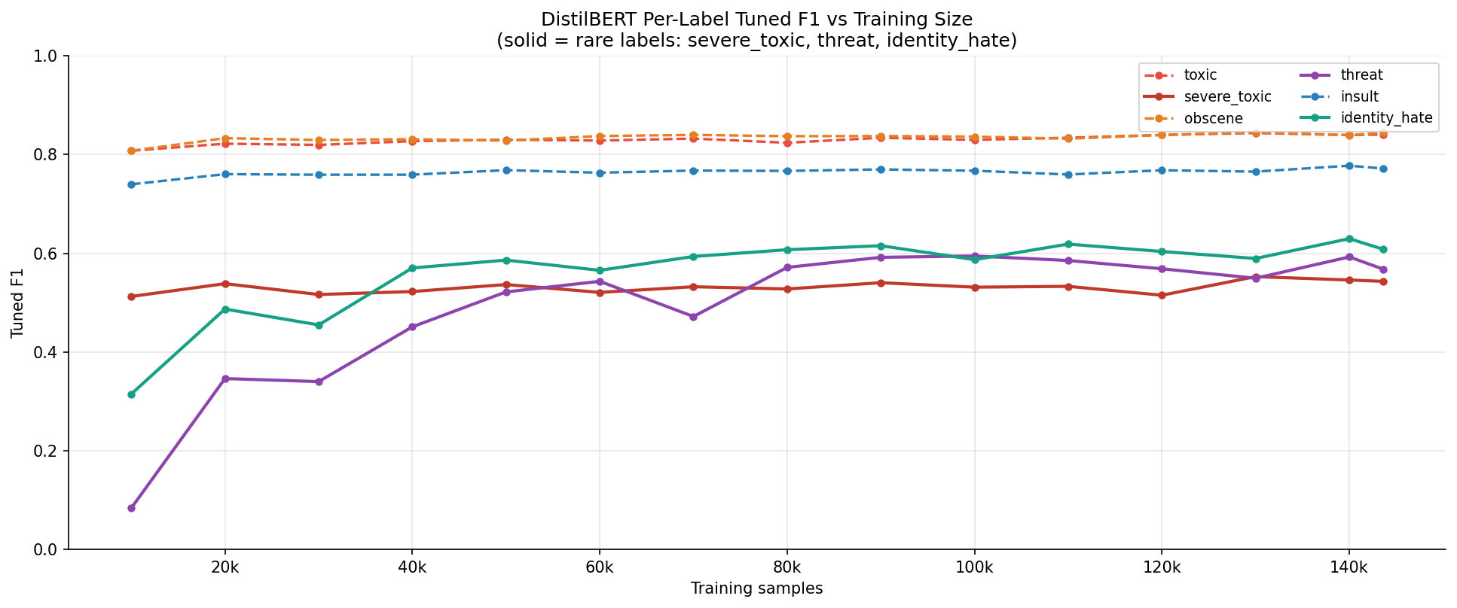
DistilBERT — Final Sweep & Outcomes
DISTILBERT
Best config: no pos_weight · BCE · lr=1.75e-5 · wd=0.015 · warmup=0.1 · max_length=128
Train Size | Tuned Macro F1
10k | 0.544
40k | 0.660
50k | 0.679
80k | 0.689
90k | 0.698
140k | 0.704
143k | 0.696
DistilBERT per-label F1 vs. training size
• Full data (143k): tuned macro F1 = 0.696 · training time = 1,403s on GPU
• +0.020 over Exp B (0.676) purely from dropping pos_weight
• Curve peaks at 140k (0.704) — noisy above 80k with no clean plateau
• Rapid gains 10k→50k; strong diminishing returns beyond 80k

Slide 18
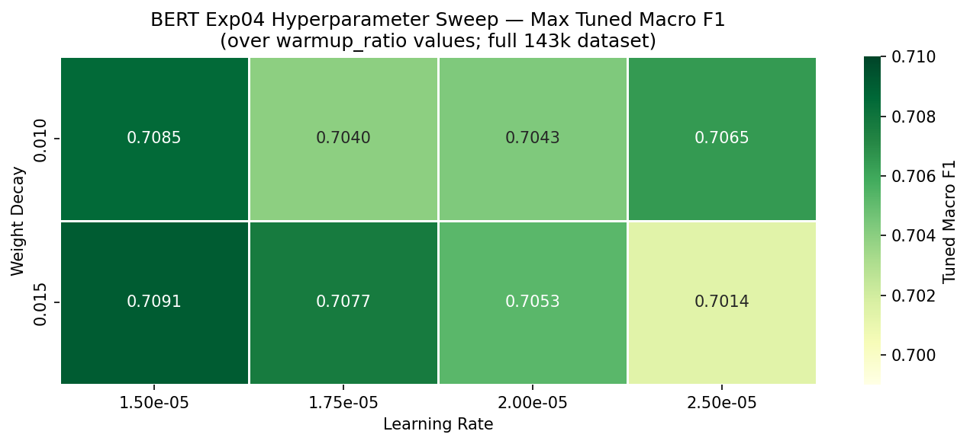
BERT — Exp04: Hyperparameter Grid Search
BERT
• bert-base-uncased: 12 transformer layers · 768 hidden · 12 heads · ~109M params · max_length=128
• 16-run grid: lr ∈ {1.5e-5, 2.0e-5, 2.5e-5, 3.0e-5} × wd ∈ {0.01, 0.015} × warmup ∈ {0.06, 0.10}
• All runs: BCE, no pos_weight, full data (143k)
Result range: 0.6986 – 0.7091 (spread of only 0.010)
Narrow spread — model quality drives performance more than hyperparameter tuning
Best config: lr=1.5e-5 · wd=0.015 · warmup=0.06 → Macro F1 = 0.7091
• Threat F1 = 0.537 — identified as the key bottleneck
• Hypothesis: max_length=128 may be truncating context in threat and identity_hate comments
◦ These comments often contain preamble before the actual threat — truncation cuts relevant signal
BERT Exp04 hyperparameter grid heatmap
→ Next: increase context window 128 → 192 tokens and measure the per-label impact

Slide 19
BERT — Exp05: Context Window Hypothesis
BERT
Hypothesis: increasing max_length 128 → 192 captures more context for threat and identity_hate
Best hyperparams from Exp04 · bf16 AMP · grad_accum_steps=2, batch=16 (effective batch=32)
Label | Exp04 (128 tok) | Exp05 (192 tok) | Δ
threat | 0.537 | 0.659 | +0.122
identity_hate | 0.534 | 0.597 | +0.063
severe_toxic | 0.533 | 0.552 | +0.019
toxic | 0.839 | 0.841 | +0.002
obscene | — | 0.849 | —
insult | — | 0.784 | —
Macro F1 | 0.709 | 0.714 | +0.005
• Full data: tuned macro F1 = 0.7135 — best single BERT result
• Training time = 2,937s on GPU (L4)
• Context window is a first-class design parameter for rare-label classification
→ Apply Exp05 config to full training-size sweep (Exp06) to measure BERT data efficiency

Slide 20
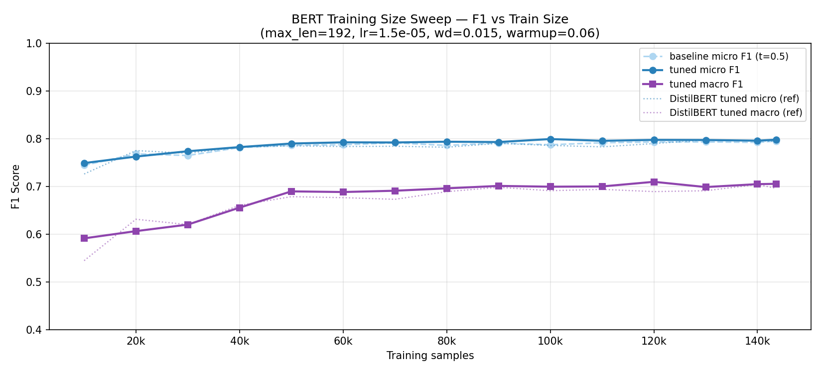
BERT — Exp06: Data Efficiency Sweep
BERT
Same config as Exp05 (max_length=192, lr=1.5e-5, wd=0.015, warmup=0.06) · 15 training sizes:
Train Size | Tuned Macro F1 | Train Time
10k | 0.591 | 254s
50k | 0.690 | 1,274s
80k | 0.696 | 2,041s
90k | 0.701 | 1,837s
120k | 0.710 | 2,450s
143k | 0.706 | 2,944s
BERT Exp06 — Macro F1 vs. training size
• BERT at 80k (0.696) = DistilBERT at full data (0.696) — same macro F1 at 56% of the data
• Peak at 120k (0.710) — full data (0.706) is not the single best point
• 50k → full data gain = only +0.016 — strong diminishing returns above 50k
• ~91% of total macro F1 gain (10k → full data) is captured at just 80k samples

Slide 21
Model Comparison — Per-Label F1 at Full Data
RESULTS
Label | CNN | BiLSTM (best @ 60k) | DistilBERT | BERT Exp05
toxic | 0.753 | 0.737 | 0.841 | 0.841
severe_toxic | 0.498 | 0.457 | 0.543 | 0.552
obscene | 0.772 | 0.745 | 0.845 | 0.849
threat | 0.277 | 0.462 | 0.568 | 0.659
identity_hate | 0.379 | 0.270 | 0.608 | 0.597
insult | 0.687 | 0.659 | 0.772 | 0.784
Macro F1 | 0.561 | 0.555 | 0.696 | 0.714
• BERT Exp05 leads overall (0.714) and on threat (0.659) — context window extension was decisive
• DistilBERT beats BERT on identity_hate (0.608 vs. 0.597) — smaller model, same context window
• Both task-trained models plateau at ~0.56 despite different architectures — representation ceiling

Slide 22
Model Comparison — At 10k Training Samples
RESULTS
How well does each model perform when given only 10,000 training examples?
Model | Macro F1 @ 10k | Note
BERT Exp06 | 0.591 | Best at low data — pretraining transfers immediately
DistilBERT (final) | 0.544 | Strong from 10k onward
CNN (rebalanced sweep) | 0.533 | Rebalanced preprocessing — not directly comparable
BiLSTM | no 10k data | Sweep started at 20k
• BERT leads at all observed training sizes — there is no crossover point where task-trained models win
• Both transformers already outperform CNN at 10k samples — pretraining transfers immediately
• CNN's 10k value uses rebalanced data (rebalance_train=True); BERT/DistilBERT use raw distribution
◦ Direct numeric comparison is inexact — CNN had access to fewer negative examples
• Practical implication: if you can afford even minimal GPU fine-tuning, a pretrained transformer always wins

Slide 23
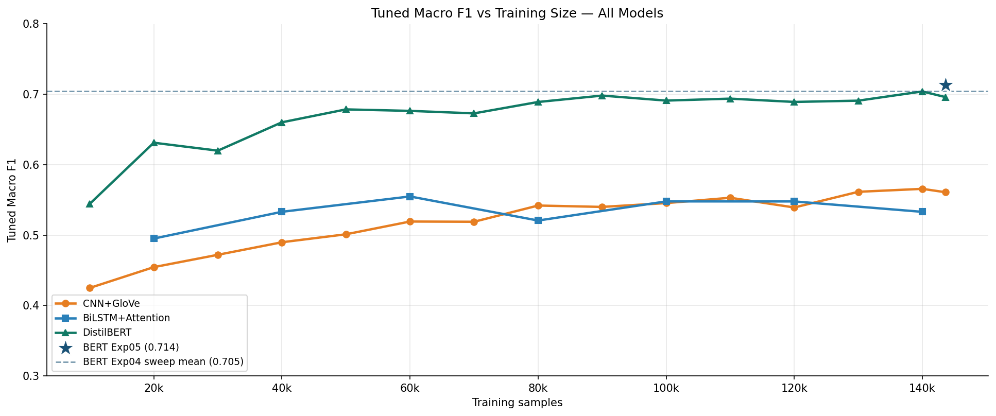
Data Efficiency — All Models
RESULTS
• CNN and BiLSTM plateau early — CNN peaks ~60k (macro F1 ≈ 0.58), no benefit from more data
• Both transformers show rapid gain 10k→50k; curve flattens above 80k
• BERT at 80k (0.696) = DistilBERT at full data (0.696) — same F1 at 56% of the data
• ~91% of BERT's total macro F1 gain (10k → full data) is captured at 80k samples
All-model tuned macro F1 vs. training size (fig03)

Slide 24
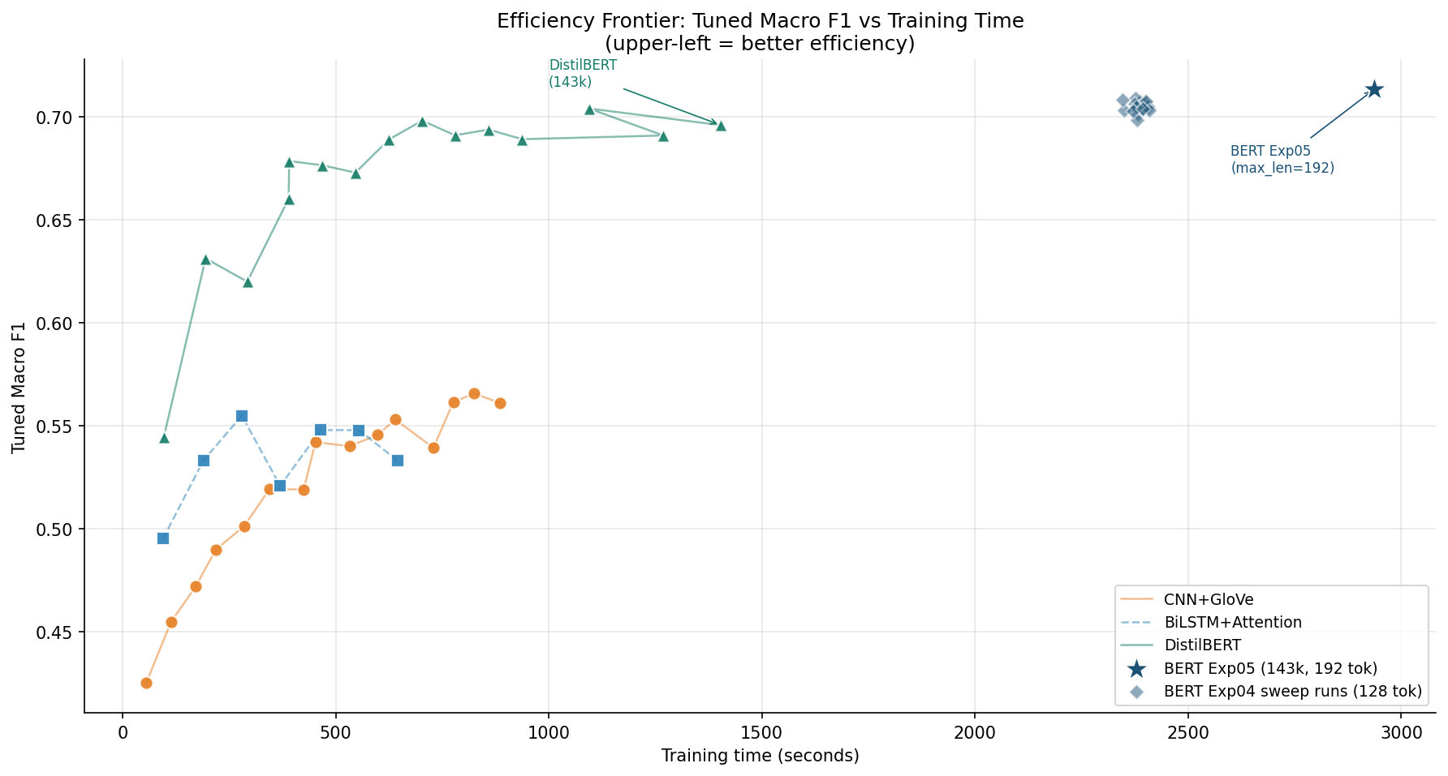
Training Cost vs. Performance
RESULTS
Model | Train Time @ Full Data | Hardware | Macro F1
CNN | 886s | CPU | 0.561
DistilBERT | 1,403s | GPU (L4) | 0.696
BERT Exp05 | 2,937s | GPU (L4) | 0.714
ROC-AUC note: all models score 0.95+ on all labels — the gap is entirely in calibration, not ranking ability.
Efficiency frontier: tuned macro F1 vs. training time (fig05)

Slide 25
Key Findings
CONCLUSION
• Representation is the bottleneck for task-trained models
◦ CNN and BiLSTM both plateau at ~0.56 macro F1; 66% OOV is a hard ceiling no architecture change can overcome
• WordPiece subword tokenisation accounts for most of the transformer advantage
◦ DistilBERT's +0.115 gain over CNN comes from handling OOV via decomposition, not from model depth
• Context window is a first-class design parameter for rare-label classification
◦ BERT 128→192 tokens gave +0.122 threat F1 — the single largest gain from a single change in this project
• pos_weight and focal loss hurt pretrained transformers
◦ Pretrained priors interact with external loss reweighting — per-label threshold tuning alone is the right approach
• BERT leads at all training sizes including 10k — no regime where task-trained models win
• Diminishing returns above 50k — 91% of BERT's macro F1 gain is captured at 80k samples

Slide 26
Limitations & Future Work
CONCLUSION
Limitations
• CNN sweep used rebalance_train=True — cross-model data efficiency comparison is inexact
• No cross-dataset evaluation — Wikipedia talk-page → Twitter / Reddit transfer is unknown
• Per-label threshold tuning on the fixed val set may slightly overfit to that 15,958-sample distribution
• BiLSTM early stopping on val macro F1 vs. CNN fixed 2 epochs makes their comparison slightly unfair
Future Work
• RoBERTa or DeBERTa — more robust pretraining for further rare-label gains
• Ensemble CNN + BERT as a fast-filter / deep-reranker pipeline
• Calibration via Platt scaling or temperature scaling — cleaner than brute-force threshold grid search
• Cross-lingual extension using mBERT or XLM-R for non-English toxic content

