Slide 1
The Psychology of Reinforcement Learning
PEN Group — 1.28.2020

Slide 2
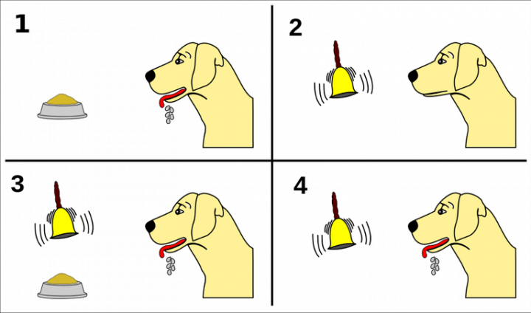

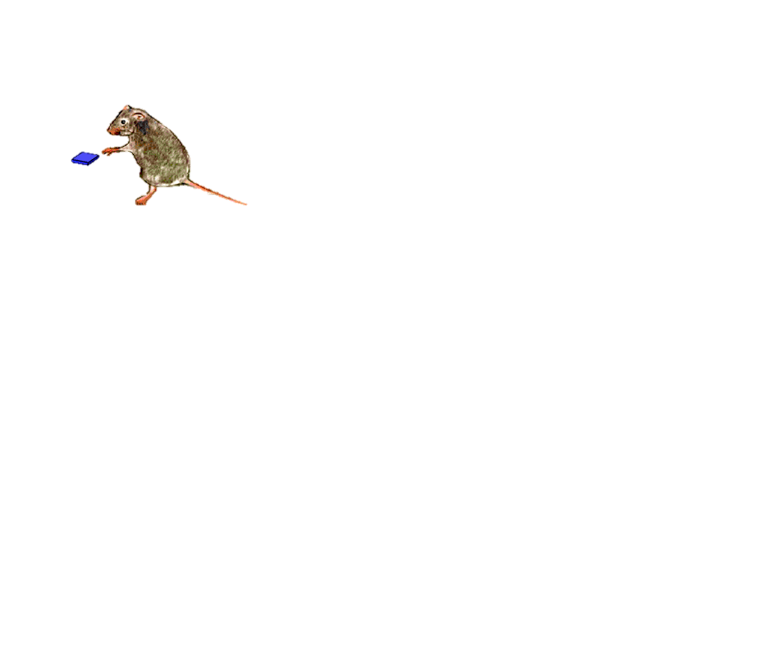
Behavioral Psychology & Animal Learning: Subfields of cognitive science that aim to understand three classes of behavior known as reflexes, Pavlovian behavior, and instrumental behavior.
Reflexes
Reactive deployment of evolved behaviors (e.g., salivating, approaching, avoiding), in response to survival-related stimuli (e.g., food, predators, potential mates).
Pavlovian Behavior
Anticipatory deployment of evolved behaviors in response to arbitrary cues that has been learned to predict survival-related stimuli in a particular context.
Instrumental Behavior
Anticipatory deployment of arbitrary behaviors (e.g., lever-pressing) that have been learned to predict rewards (e.g., food) in a particular context.

Slide 3
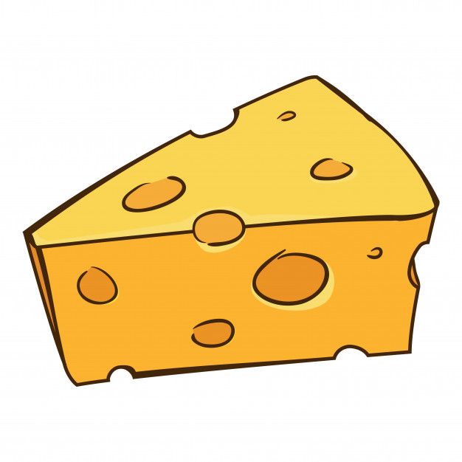
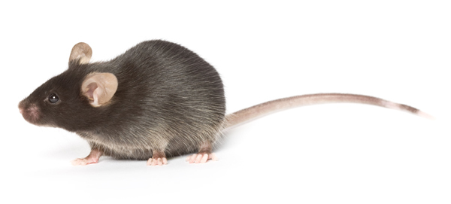
Instrumental Behavior vs. Reflexes: If an animal approaches food, should we conclude that food elicited an approach reflex, or that the animal learned that approaching food predicts reward?

Slide 4
Instrumental Behavior vs. Reflexes: If an animal approaches food, should we conclude that food elicited an approach reflex, or that the animal learned that approaching food predicts reward?

Slide 5
Instrumental Behavior vs. Reflexes: If an animal approaches food, should we conclude that food elicited an approach reflex, or that the animal learned that approaching food predicts reward?

Slide 6
Instrumental Behavior vs. Reflexes: If an animal approaches food, should we conclude that food elicited an approach reflex, or that the animal learned that approaching food predicts reward?

Slide 7
Instrumental Behavior vs. Reflexes: If an animal approaches food, should we conclude that food elicited an approach reflex, or that the animal learned that approaching food predicts reward?

Slide 8
Instrumental Behavior vs. Reflexes: If an animal approaches food, should we conclude that food elicited an approach reflex, or that the animal learned that approaching food predicts reward?

Slide 9
Instrumental vs. Pavlovian Behavior: If an animal presses a lever that delivers food, should we conclude that the animal learned that lever-pressing predicts reward, or that the lever is a Pavlovian cue that elicited an approach response?

Slide 10

Instrumental vs. Pavlovian Behavior: If an animal presses a lever that delivers food, should we conclude that the animal learned that lever-pressing predicts reward, or that the lever is a Pavlovian cue that elicited an approach response?

Slide 11
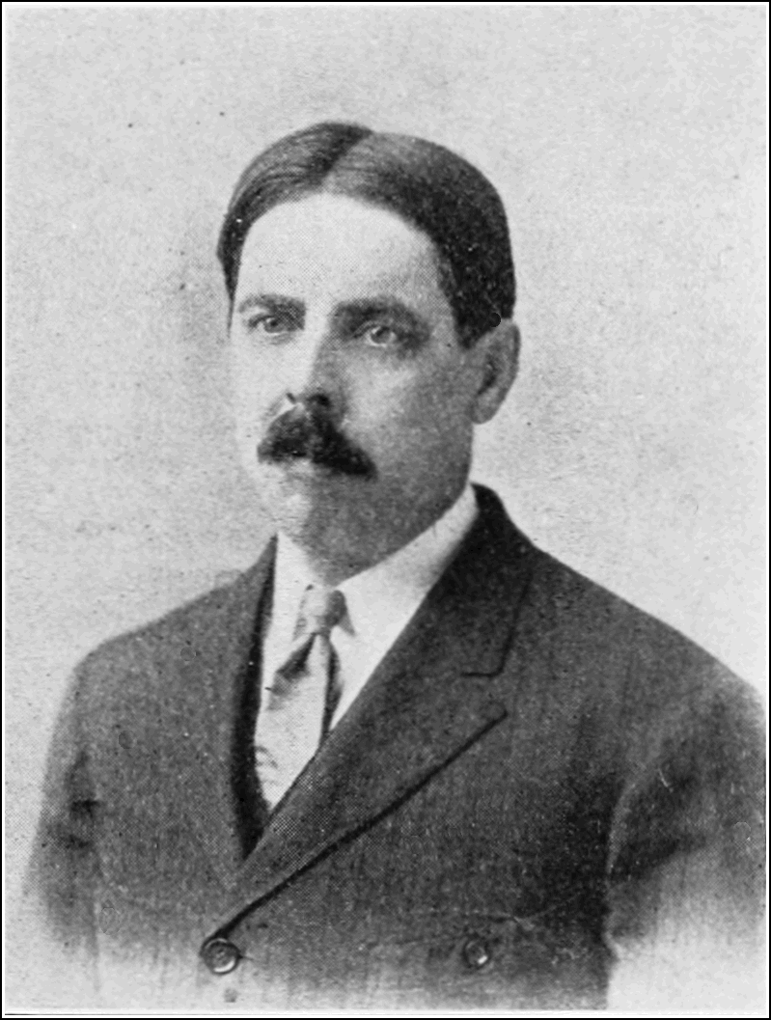
Edward Thorndike
(1874-1949)
According to Thorndike, instrumental behaviors reflect beliefs of the form: “If I perform action A in state S, I will be [rewarded/punished], because I have been [rewarded/punished] for performing action A in state S in the past.”
EXAMPLE: “If I press the lever (A) when the light is on (S), I will be rewarded, because I have been rewarded pressing the lever when the light is on in the past.”
To learn such beliefs, animals compute a recency-weighted average of how much reward/punishment they have received when taking action A in state S. This is called The Law of Effect.
$$Q_{t}\left(s,a\right)=Q_{t−1}\left(s,a\right)+α\left(r_{t}−Q_{t−1}\left(s,a\right)\right)$$

Slide 12
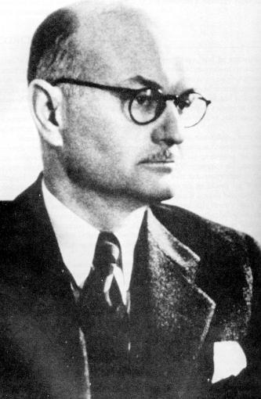
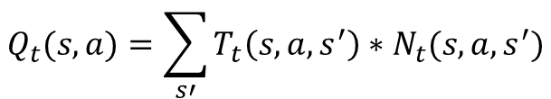
Edward Tolman
(1886-1959)
According to Thorndike, instrumental responses reflect beliefs of the following form: “If I perform action A in state S, I will be [rewarded/punished], because I will transition to state S’, which will [satisfy/intensify] my current needs.
EXAMPLE: “If I press the lever (A) when the light is on (S), I will be rewarded, because I will receive food (S’), which will bring my closer to satisfying my hunger.
To learn such beliefs, animals use a Cognitive Map consisting of:
A “Transition Model” mapping the current state S and possible actions A onto future states S’.
A “Reward Model,” that maps the current state S, available actions A, and future states S’ onto changes in levels of need.
$$Q_{t}(s,a)=\sum_{s′}{T_{t}\left(s,a,s^{′}\right)∗N_{t}(s,a,s^{′})}$$

Slide 13
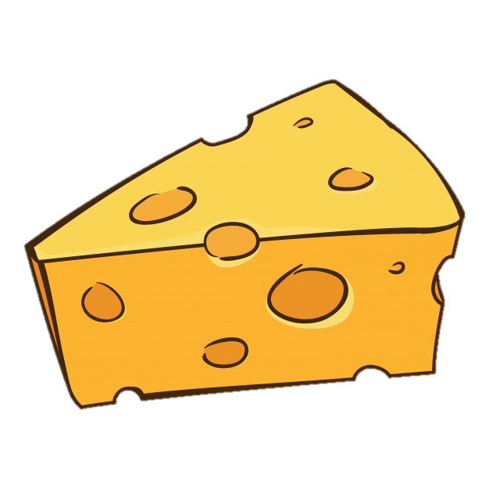




Latent Learning
Goal Box
$$s′$$
$$a_{1}$$
$$s$$
$$a_{2}$$
Start Box

Slide 14
Latent Learning
Goal Box
$$s′$$
$$a_{1}$$
$$s$$
$$a_{2}$$
Start Box

Slide 15
Latent Learning
Goal Box
$$s′$$
$$a_{1}$$
$$s$$
$$a_{2}$$
Start Box

Slide 16
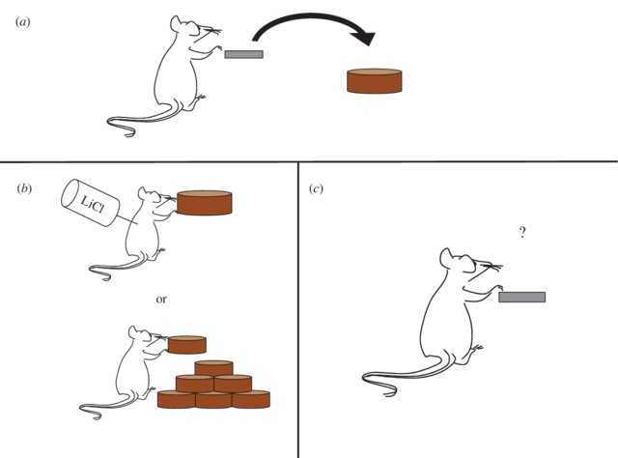
Outcome Devaluation

Slide 17
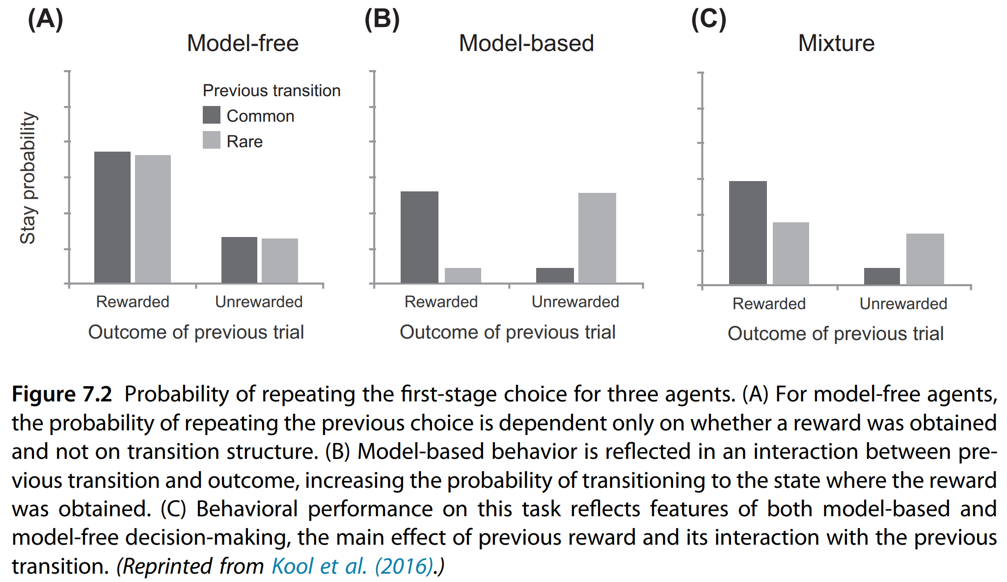
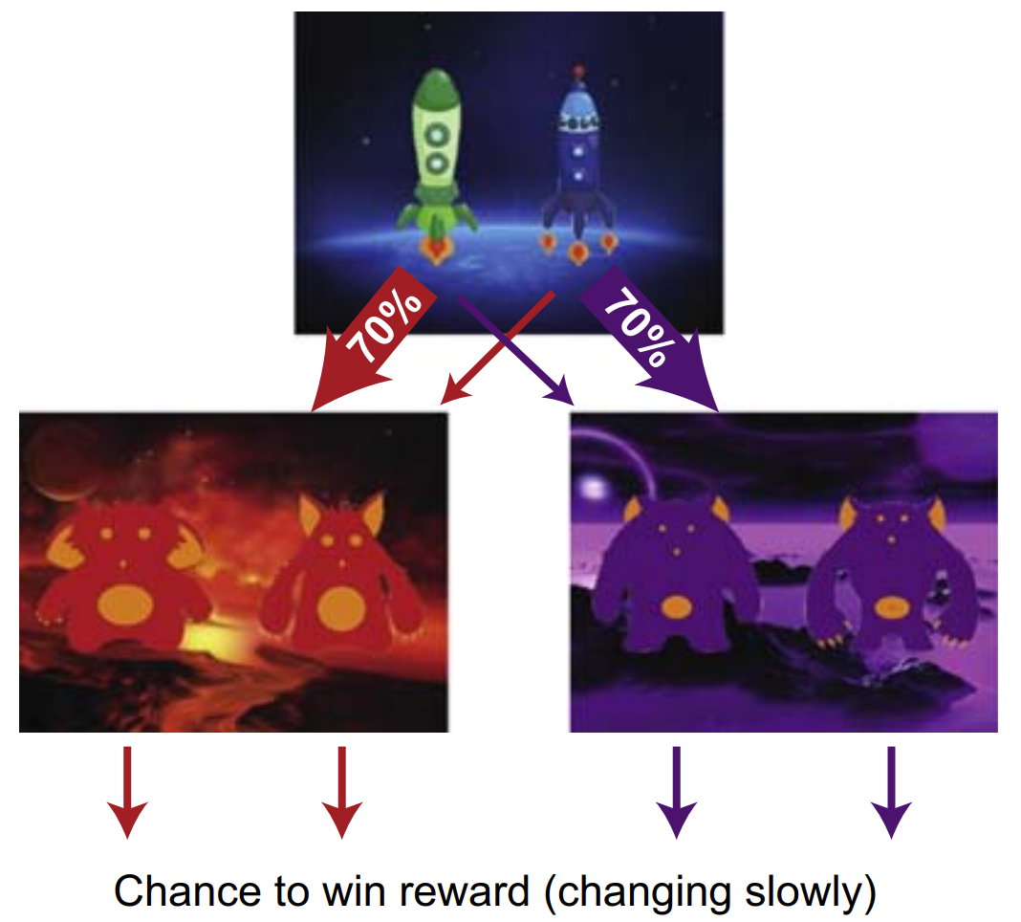
Two-Step Task
Cognitive Load

Slide 18
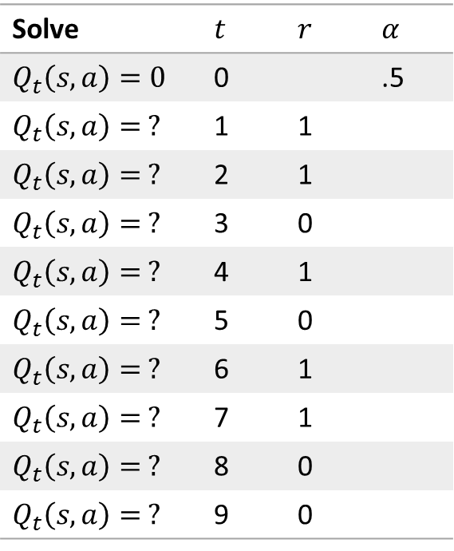
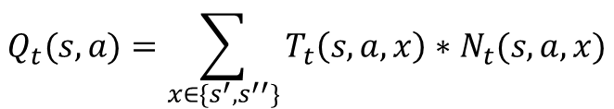
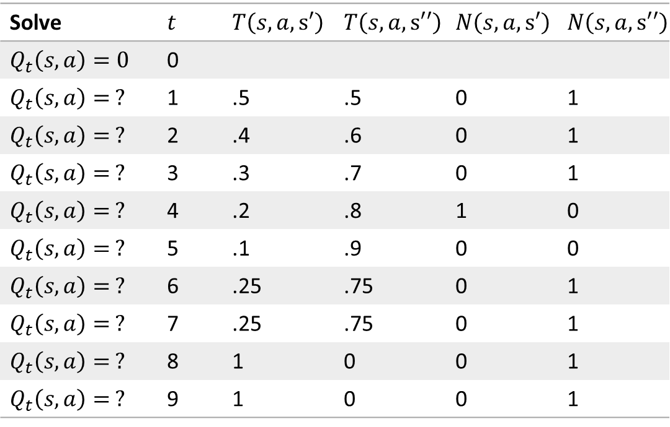
Instrumental Learning Using Law of Effect
(Model-Free)
Instrumental Learning Using Cognitive Maps
(Model-Based)
$$Q_{t}\left(s,a\right)=Q_{t−1}\left(s,a\right)+α\left(r_{t}−Q_{t−1}\left(s,a\right)\right)$$
$$Q_{t}(s,a)=\sum_{x∈\{s^{′}, s^{′′}\}}{T_{t}\left(s,a,x\right)∗N_{t}(s,a,x)}$$
Solve | $$t$$ | $$r$$ | $$α$$
$$Q_{t}\left(s,a\right)=0$$ | 0 |  | .5
$$Q_{t}\left(s,a\right)= ?$$ | 1 | 1
$$Q_{t}\left(s,a\right)= ?$$ | 2 | 1
$$Q_{t}\left(s,a\right)= ?$$ | 3 | 0
$$Q_{t}\left(s,a\right)= ?$$ | 4 | 1
$$Q_{t}\left(s,a\right)= ?$$ | 5 | 0
$$Q_{t}\left(s,a\right)= ?$$ | 6 | 1
$$Q_{t}\left(s,a\right)= ?$$ | 7 | 1
$$Q_{t}\left(s,a\right)= ?$$ | 8 | 0
$$Q_{t}\left(s,a\right)= ?$$ | 9 | 0
Solve | $$t$$ | $$T\left(s,a,s′\right)$$ | $$T\left(s,a,s′′\right)$$ | $$N\left(s,a,s′\right)$$ | $$N\left(s,a,s′′\right)$$
$$Q_{t}\left(s,a\right)=0$$ | 0
$$Q_{t}\left(s,a\right)= ?$$ | 1 | .5 | .5 | 0 | 1
$$Q_{t}\left(s,a\right)= ?$$ | 2 | .4 | .6 | 0 | 1
$$Q_{t}\left(s,a\right)= ?$$ | 3 | .3 | .7 | 0 | 1
$$Q_{t}\left(s,a\right)= ?$$ | 4 | .2 | .8 | 1 | 0
$$Q_{t}\left(s,a\right)= ?$$ | 5 | .1 | .9 | 0 | 0
$$Q_{t}\left(s,a\right)= ?$$ | 6 | .25 | .75 | 0 | 1
$$Q_{t}\left(s,a\right)= ?$$ | 7 | .25 | .75 | 0 | 1
$$Q_{t}\left(s,a\right)= ?$$ | 8 | 1 | 0 | 0 | 1
$$Q_{t}\left(s,a\right)= ?$$ | 9 | 1 | 0 | 0 | 1
For both types of instrumental learning, compute $Q_{t}\left(s,a\right)$ for each trial. Then figure out (1) which state the agent actually transitioned to on each trial, and (2) which experimental manipulations were employed.

Slide 19
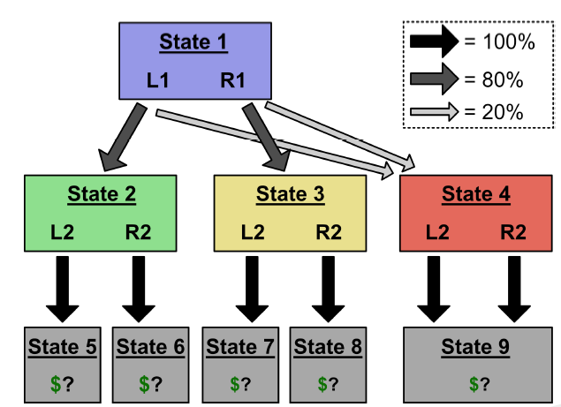
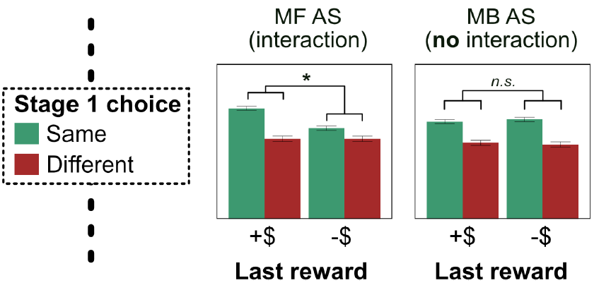
Suppose on Trial t, the agent ends up in State 9. For model-based and model-free agents, plot the probability of choosing the same (vs. different) State 1 action on Trial t+1 as a function of the outcome of Trial t.
Probability of State 1 Choice on Trial t+1
Outcome of Trial t

