Slide 1

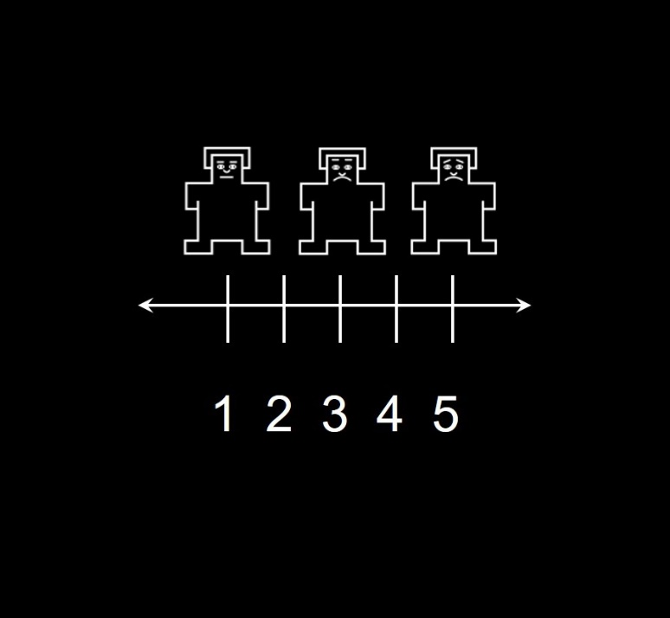



Acquisition phase
CS presentation
Expectancy
rating
Anticipation
Conceptual US
ITI
+
+
2 s
2 s
~ 1.5 s
3 s
~ 3.5 s
1 run of 30 (15 of each CS)
CS- reinforced with either unpleasant/neutral US 20/80%
CS+ reinforced with either unpleasant/neutral US 80/20%

Slide 2
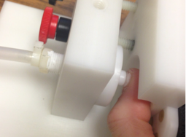
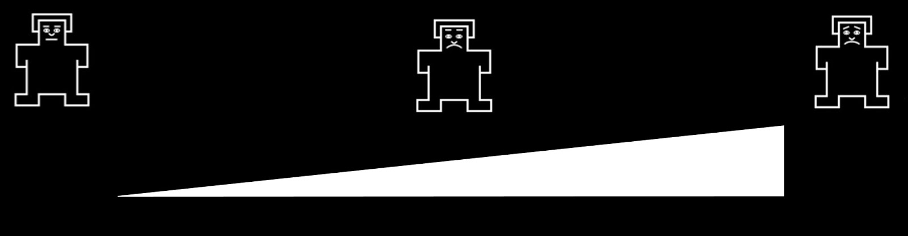
Test phase
CS presentation
Expectancy
rating
Anticipation
Physical US
ISI
Unpleasantness
rating
ITI
+
+
+
2 s
2 s
~ 3.5 s
3 s
~ 5.5 s
2 s
~ 7.5 s
1 run of 20 trials (10 of each CS)
CS+ reinforced with either high or low pressure (6/3 kg/cm²) US 50/50%
CS- reinforced with either high or low pressure (6/3 kg/cm²) US 50/50%

Slide 3



Avoidance phase
CS presentation
Decision period
Anticipation
Physical US
ITI
+
+
~3.5 s
2 s
~3 s
3 s
~ 9.5 s
5 runs of 24 trials each (12 active choices, 12 flipped CS positions)
CS reinforcement is based on random walks ranging from 20% to 80% reinforcement of high pressure (6 kg/cm²) as opposed to low pressure (3 kg/cm²)

Slide 4



