Slide 1
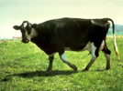

Encoding phase
the orthogonal task
detecting location of grey patch
– fixed on each image
Pair type
structured pairs
unstructured pairs
neg-neg (BB)
neg-neu (BN)
neu-neg (NB)
neu-neu (NN)
neg-neg (BB)
neg-neu (BN)
neu-neu (NN)
with 6 exemplars each
with 1 exemplars each
In total, there are 7 pair types, 27 exemplar pairs, and each repeats 18 times over 6 blocks
…
fixed ITI
= 0.5s
image duration
= 1.5s
each pair repeats 3 times per block
6 blocks in total with breaks in-between
the task takes less than 30m to complete

Slide 2

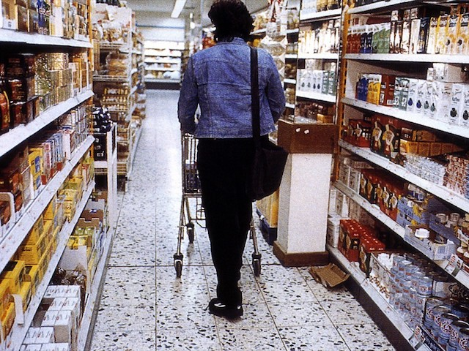
Testing phase
2AFC task
indicate which group of images of the two choices looks more familiar
– half of the exemplars have the foil image showing as the first image of a pair, and the half have the foil image as the second image of a pair
- the foil image used is always from another category of another pair
example of altering the second image of a pair to a different category foil image
Group A
Group B
example of altering the first image of a pair to a different category foil image
Group A
Group B

