Slide 1


Default Risk
How capable each applicant is of repaying a loan?
Danlei Qian, HungChun Lin, Chen Chen
DATS6202 Final Project
Notes:
Our project is about the default risk of repaying a loan for each applicant.

Slide 2
Introduction
Background
Home Credit B.V. is an international non-bank financial institution founded in 1997 in the Czech Republic.The company operates in 14 countries and focuses on lending primarily to people with little or no credit history. As of 2016 the company has over 15 million active customers, with two-thirds of them in Asia and 7.3 million in China. Major shareholder of company is PPF, a privately held international financial and investment group, which controls an 88.62% stake.In order to predict the repayment ability of their customers, Home Credit held a Kaggle competition to see what sort of models the machine learning community can develop to help them in this task.
Goal
How capable each applicant is of repaying a loan?
Data Source:
https://www.kaggle.com/c/home-credit-default-risk/data
Notes:
First, let me introduce Home Credit Company, our dataset provider. Home Credit is an international non-bank financial institution and operates in 14 countries and focuses on lending primarily to people with little or no credit history. In order to predict the repayment ability of their customers, Home Credit held a Kaggle competition to see what sort of models the machine learning community can develop to help them in this task.
The objective of this project is to use historical loan application data to predict whether or not an applicant will be able to repay a loan.

Slide 3
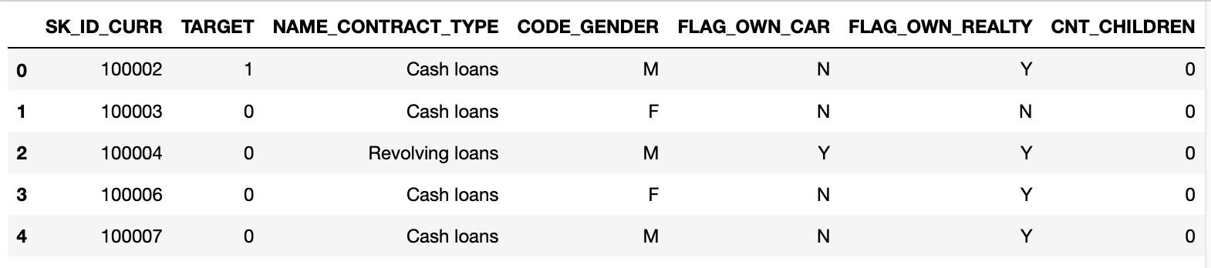
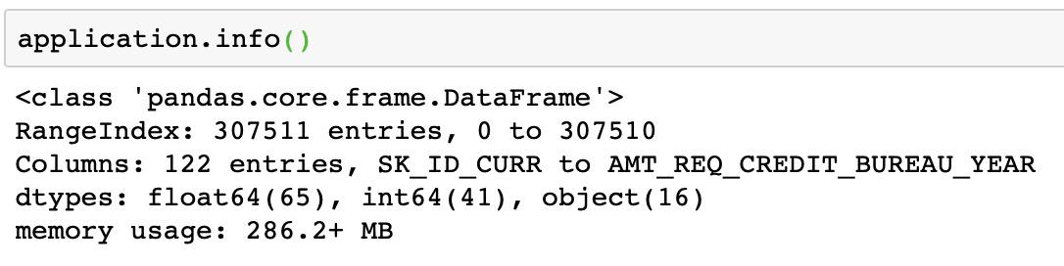
Dataset Description
307511 rows ✖ 122 columns
Notes:
We use the application_train data,which is the information about each loan application at Home Credit. And each row represents a loan application.
Let’s take a look at the data. The raw data has over 3 hundred thousands observationsand 122 features including the TARGET (the label we want to predict).

Slide 4


Dataset Description
Target
1 - client with payment difficulties: he/she had late payment more than X days on at least one of the first Y installments of the loan in our sample
0 - client with payment on time : the loan was repaid
Features
Categorical:
Gender - Gender of the client (M/F)
Own a car - Flag if the client owns a car（Y/N）
Own a house- Flag if client owns a house or flat（Y/N）
Living region - Our rating of the region where client lives (1,2,3)
Numercial:
Income - Income of the client
Credit of the loan - Credit amount of the loan
Price of the goods - For consumer loans it is the price of the goods for which the loan is given
Days of last day phone change - How many days before application did client change phone
Notes:
The data comes with the TARGET indicating 0: the loan was repaid or 1: the loan was not repaid.
And some of the features as shown, we can see some categorical features such as the gender, if the client owns a car or owns a house
And some numerical features such as the client’s income, the price of the goods that the loan is given for.

Slide 5
Procedure
Load Data
Deal with the missing values
Encode categorical features and target
Split the data into Train and Test
Over sampling
Data Preprocessing
Logistic regression
Multilayer perceptron
Decision tree
Random Forest
XGBoosting
Naive Bayesian
Model Training
Model Selection
F1 score
AUC
Feature importance
Random Forest Classifier
Notes:
Then let’s start our analysis. This is our procedure.
In this project, we will explore several models including Classification Models and Regression Models to predict the TARGET variable and Grid Search with combination of Pipeline for hyperparameter tuning.

Slide 6
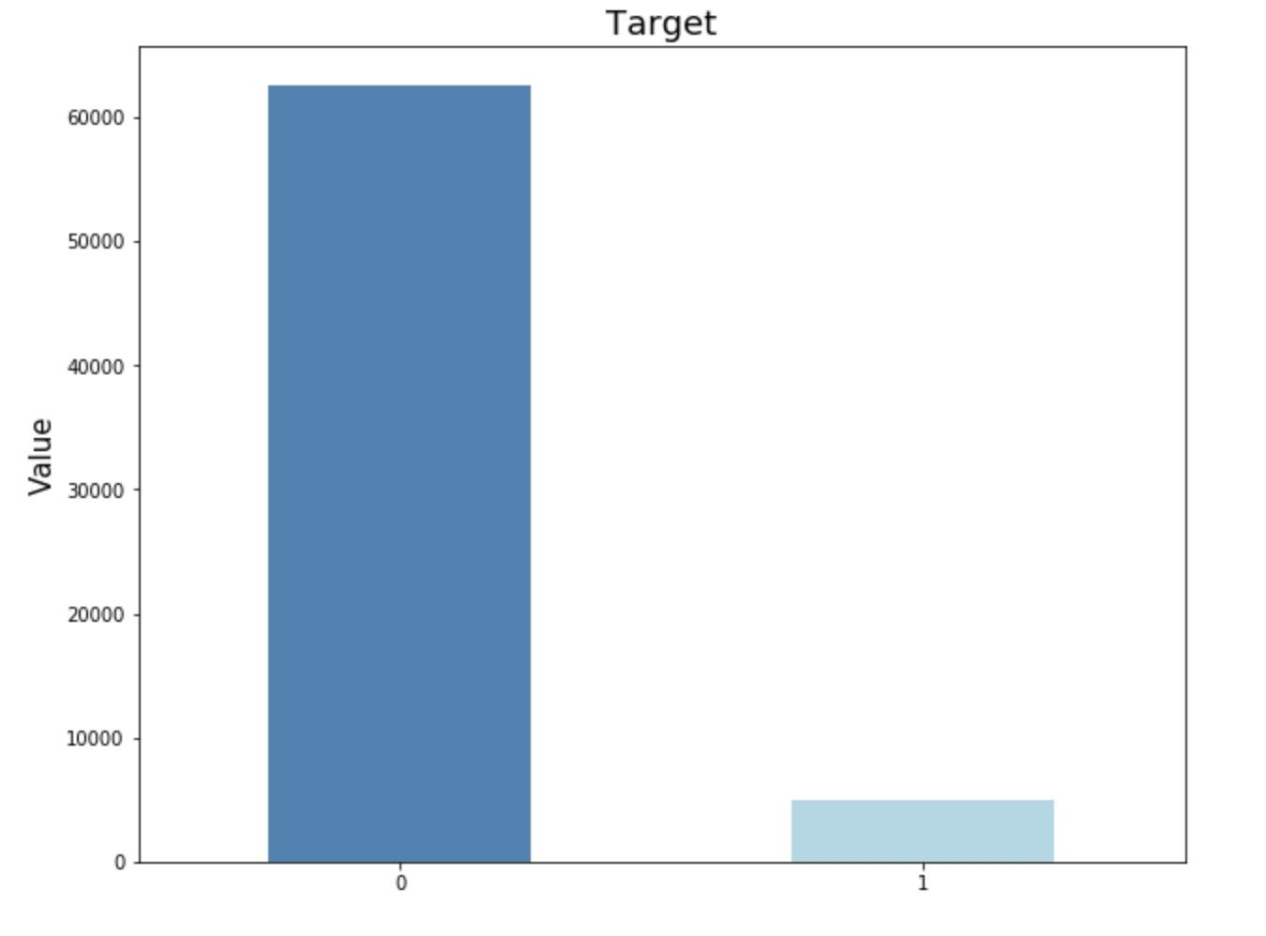
Preprocessing
Load Data
Deal with the missing values
Drop the columns which missing proportion > 50%
Drop the rows with missing value > 50%
Encode categorical features and target
One-Hot encoding
Split the data into Train and Test
Over sampling
Standardization
Imbalanced
→ The dataset became 125278 rows x 187 columns
Notes:
First, We did the data preprocessing. We check the missing values in each column.And then we drop the features with over 50% missing values and then drop the rows with missing values of left features.
And we use one-hot encoding method to encode categorical features and target.
Then we split our data into training with 80 percent and testing with 20 percent.
We get about 60 thousand target'0' and 5 thousand target'1'. As the bar chart shows, the two classes are quietly imbalanced.
Since most machine learning algorithms work best when the number of samples in each class are about equal, we need to deal with the imbalanced problem. Here we use over-sampling method.
Finally, The dataset became just over 100 thousands rows and 187 columns
And we did standardization in the each pipeline of model. And Hongchun will talk about model training part.

Slide 7
Model training
Models | Methods
Logistic regression Multilayer perceptron Decision tree Random Forest XGBoosting KNN | Hyper parameter tuning Cross validation 10 folds F1 score Confusion Matrix/ AUC/ROC
Notes:
For our project, we used six models to do the training, since our target is binary, so we choose these six to use. For each model, we do the four steps to find out the best parameters and to figure out the model is good or not to do prediction.

Slide 8
Why we use F1 score?
Precision
 | Predicted 0 | Predicted 1
Actual 0 | TN | FP
Actual 1 | FN | TP
Accuracy = (TP + TN)/Total Samples
Precision = TP / (TP + FP)
Recall = TP / (TP + FN)
F1 Score = 2 (Recall * Precision) / (Recall + Precision)
F1 score conveys the balance between the precision and the recall.
Recell
*TN : True negative
*TP : True positive
*FN : False negative
*FP : False positive
Notes:
In our model, we use f1 score to see how the model performance, but not the accuracy.
This is the confusion matrix, and the equation for each score is here.
And accuracy can be a useful measure if we have the same amount of samples per class but if we have an imbalanced set of samples, accuracy isn't useful at all.
About the Precision and Recall, High Precision indicates a large number of False Positives, and high recall indicate a large number of False Negative, so we use f1 which can conveys the balance between the precision and the recall.

Slide 9
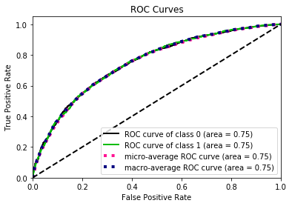
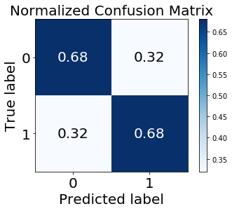
Logistic regression
Tuning parameter | Best parameters | Range
C | 0.01 | 0.0001 ~ 100000
multi class | multinomial | Ovr, multinomial
solver | newton-cg | newton-cg, lbfgs, liblinear, sag, saga
F1 score: 0.691
AUC score: 0.682
Notes:
Let’s dive into the first model, Logistic regression, we did the tuning for three parameters, and here is the result. After the training, we got f1 score, and after the prediction we got the AUC score. The two scores for logistic regression, they both NOT BAD. The ROC curve can tell us how much the model is capable of distinguishing between different classes. The range of AUC is between 0 and 1.
**AUC (Area Under The Curve) ROC (Receiver Operating Characteristics) curve.
An excellent model has AUC near to the 1 which means it has good measure of separability. A poor model has AUC near to the 0 which means it has worst measure of separability. And when AUC is 0.5, it means model has no class separation capacity whatsoever.

Slide 10
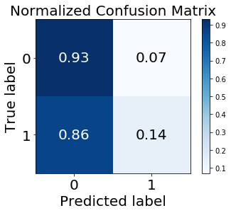
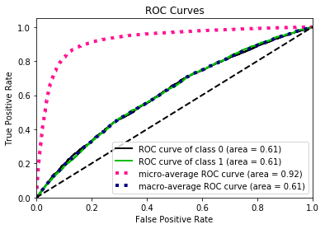
Multilayer Perceptron
Tuning parameter | Best parameters | Range
activation | logistic | identity, logistic, tanh, relu
hidden layer size | 100 | 10, 50, 100
F1 score: 0.961
AUC score: 0.534
Notes:
This is the MLP model. Here is the result of the tuning, the hidden layer size is the largest of our setting, it’s about 100 perceptrons. And here we can see a phenomenon. We got the pretty high score of f1, over 90%. but low score of AUC. It means our model might have overfitting.
(When AUC is 0.5, it means model has no class separation capacity whatsoever.)

Slide 11
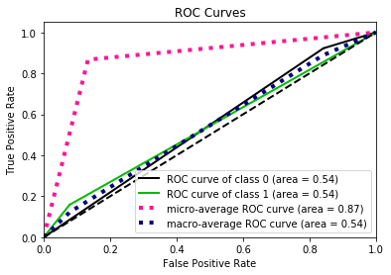
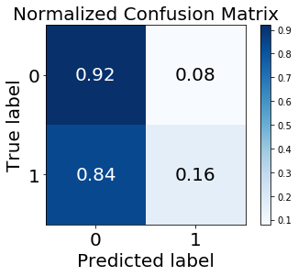
Decision tree
Tuning parameter | Best parameters | Range
Max depth | 90 | 10 ~ 90 (20)
min sample split | 10 | 10 ~ 90 (20)
F1 score: 0.958
AUC score: 0.540
Notes:
Here is the Decision Tree model, and we tune the Max depth and the minimum samples split. But this model has the same problem with MLP, both got high f1 score and low AUC.

Slide 12
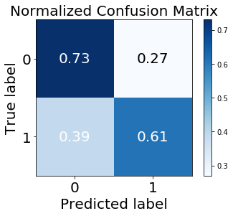
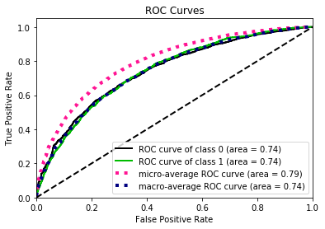
Random Forest
Tuning parameter | Best parameters | Range
Max depth | 90 | 50 ~ 130 (20)
Max leaf nodes | 130 | 50 ~ 130 (20)
n estomators | 90 | 50 ~ 110 (20)
F1 score: 0.747
AUC score: 0.671
Notes:
And then here is the Random Forest, it got the f1 score about 0.747, and AUC score 0.671, the scores are both not bad.

Slide 13
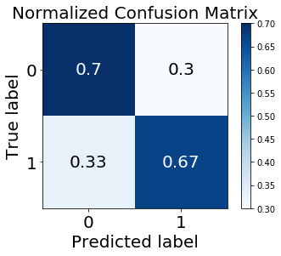
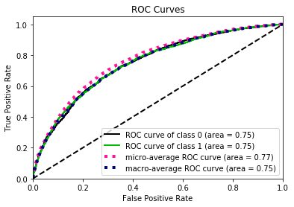
XGBoosting
Tuning parameter | Best parameters | Range
eta | 0.0001 | 0.0001~ 10
gamma | 10 | 0, 10, 100
lamba | 0.0001 | 0.0001 ~ 100000
F1 score: 0.703
AUC score: 0.685
Notes:
The fifth model is XGBoosting, the model score is not bad, 0.70 for f1 score and 0.68 for AUC score, the matrix and plot shows both the two levels get similar accuracy..

Slide 14
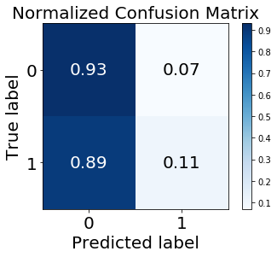
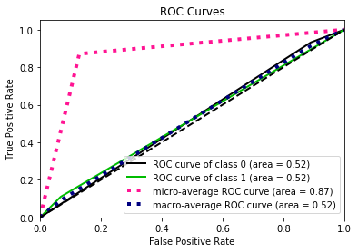
KNN
Tuning parameter | Best parameters | Range
n_neighbors | 1 | 1 ~ 10
F1 score: 0.964
AUC score: 0.520
Notes:
The final model we trained is KNN, we got really high f1 score for this one, 96%. But for our test data, we only got 52% accurate prediction. From the confusion matrix we can see, the data in class labeled 1 are almost all predicted wrong. This should be the problem of best tuning parameter for number of neighbors is only 1
横坐标：1-Specificity，伪正类率(False positive rate， FPR)，预测为正但实际为负的样本占所有负例样本的比例；
纵坐标：Sensitivity，真正类率(True positive rate， TPR)，预测为正且实际为正的样本占所有正例样本的比例。

Slide 15
Model Selection
Model | F1 score | std | AUC score | FN
KNN | 0.964 | 0.002 | 0.521 | 0.89
Multilayer Perceptron | 0.961 | 0.002 | 0.534 | 0.86
Decision Tree | 0.958 | 0.002 | 0.540 | 0.84
Random Forest | 0.747 | 0.005 | 0.671 | 0.39
XGBoosting | 0.703 | 0.003 | 0.685 | 0.33
Logistic regression | 0.691 | 0.004 | 0.682 | 0.32
The lower the FN score the better.
FN: the applicant not make the repayment but predicted as make the payment.
→ Logistic regression is the best model for our dataset.

Slide 16
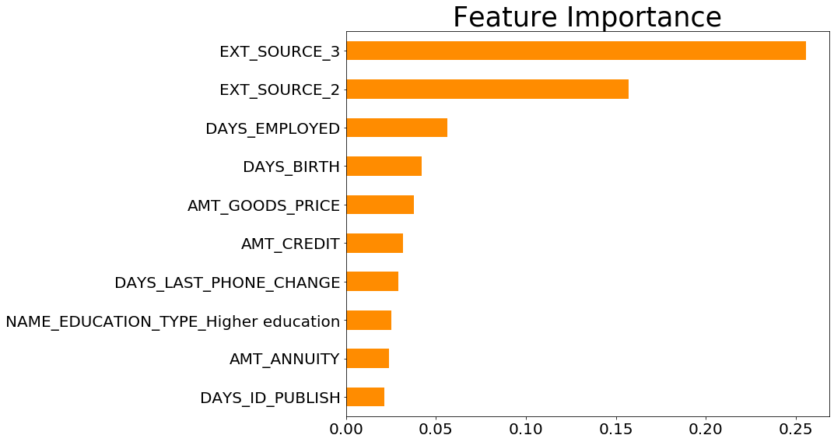
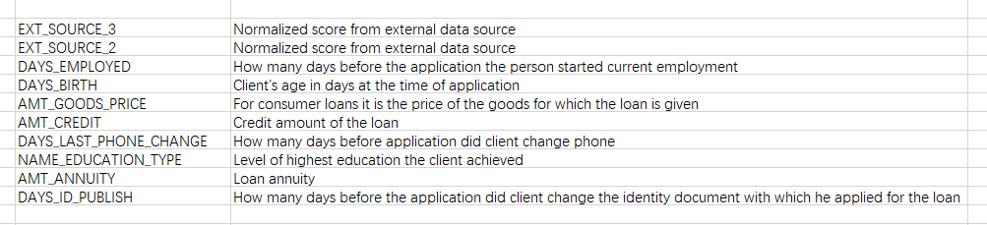
Feature Importance
Employment
Age
Education
Loan annuity
Loan amount
Loan fraud
Notes:
Finally, we use the Random forest classifier to find out the most important features for our model. From the plot, we can see, the top 2 important features are external_sources_3 and external_sources_2, these two features score are much higher than the other features, unfortunately the data provider does not give us any information about these feature. But we think they are something very secret such as saving amount, credit score and so on.
Employment, age in the third and fourth place, along with education and the loan annuity, these four features can estimate your income level and you ability to make the repayment.
Besides, the loan credit amount is also important, if the goods value are too high or credit amount of the loan are too high the applicant may likely to default the payment.
These two line indicate, the frequency of changing phone numbers and Identity document can indicate the possibility of Loan fraud problem. (refers to the providing of false information when applying for or receiving a loan.)
So in a word, whether an applicant can repay a loan is mainly based on whether they have enough money and whether they are possible a fraudulent customer.

Slide 17
Conclusion
Logistic regression is the best model
Features such as employment, age, income, loan amount applied, loan fraud are important when making prediction of whether an applicant will repay the loan
Further improvements
More precise variable selection before training the model may improve the result
Notes:
Lest give a conclusion, our goal is to find the best model to predict whether an applicant can make the repayment of the a loan. And we find the answer is random forest. We also find features such as age, income, loan amount applied and possibility of loan fraud are key factors in making prediction.
For our further improvements, we think more precise variable selection before training the model may help us get a better result.

Slide 18
Thank you
Question?

