Slide 1
MPI Sparse – Page Rank Simulation
Dan Levy

Slide 2
2 Steps
Split up the sparse matrix and vectors
Minimize communication

Slide 3
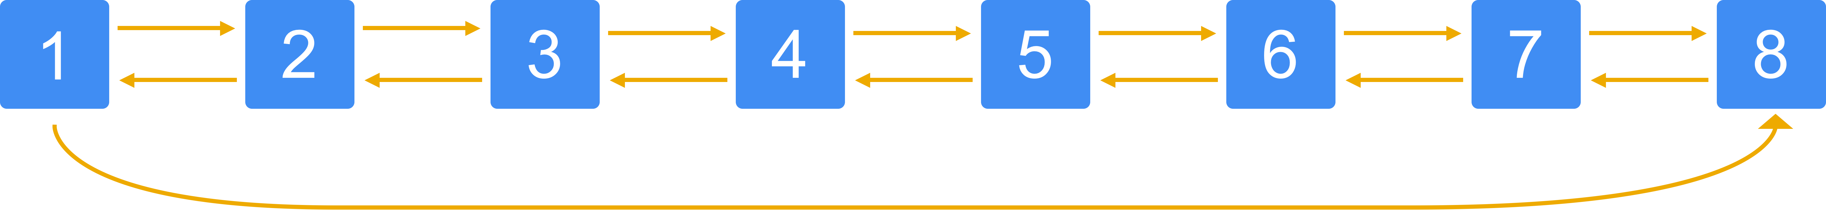
Page Links

Slide 4
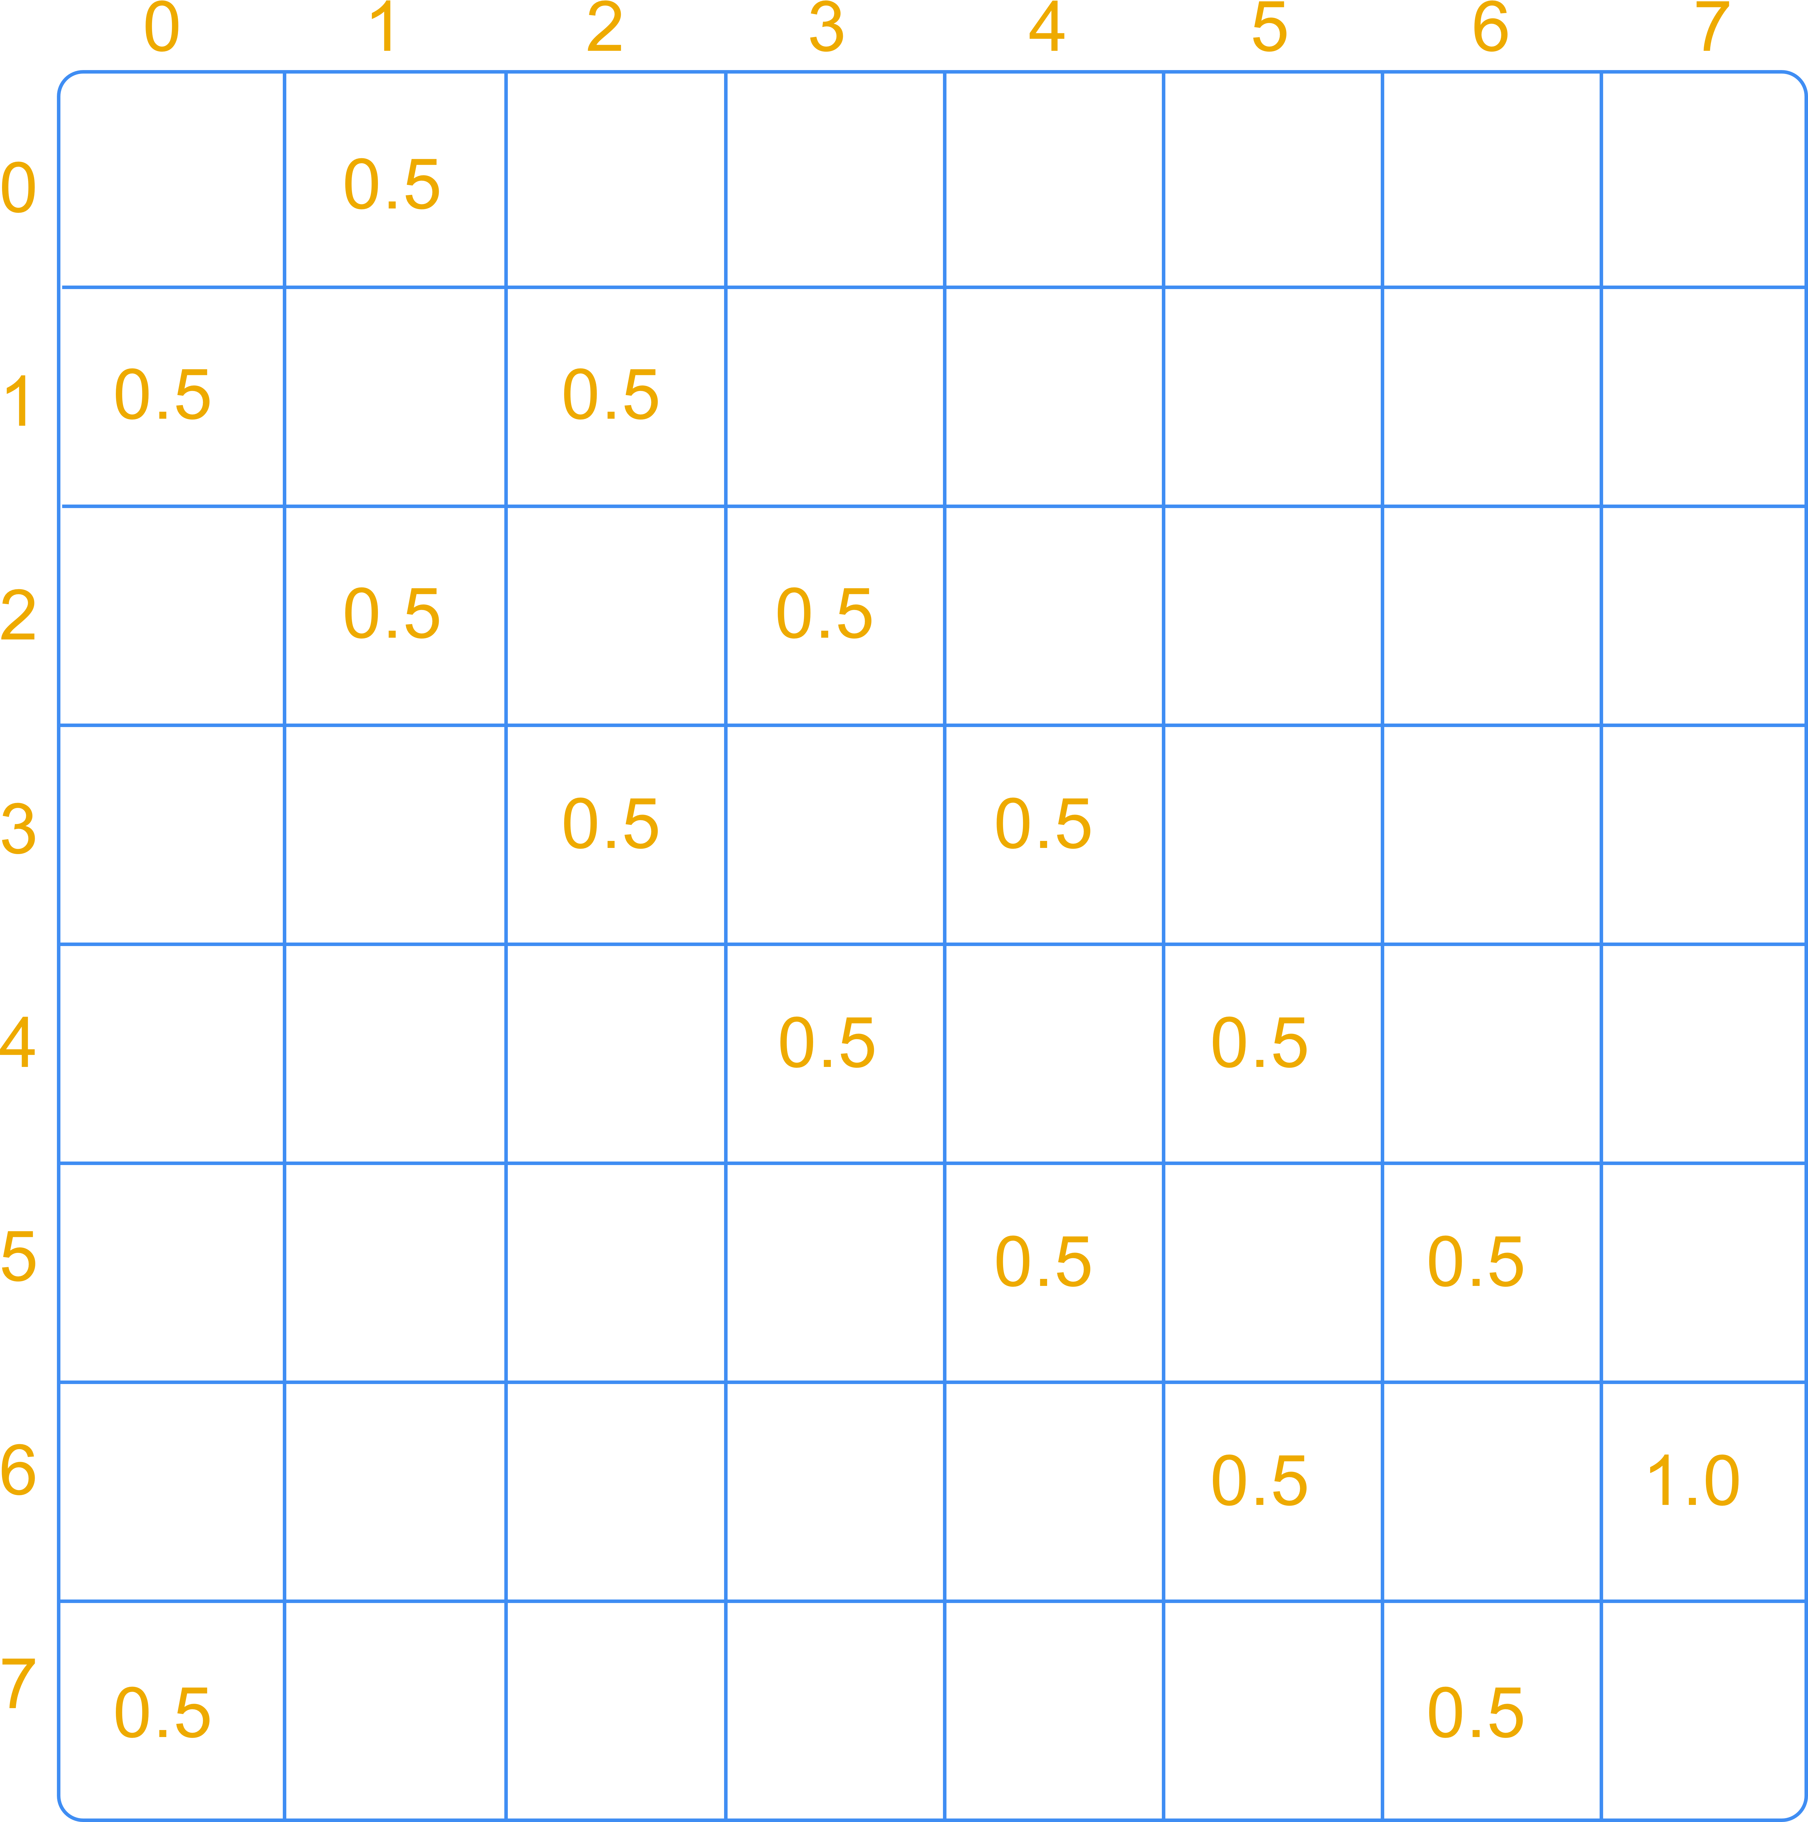
Dense Rank Matrix

Slide 5
Step 1: Split Up The Data

Slide 6
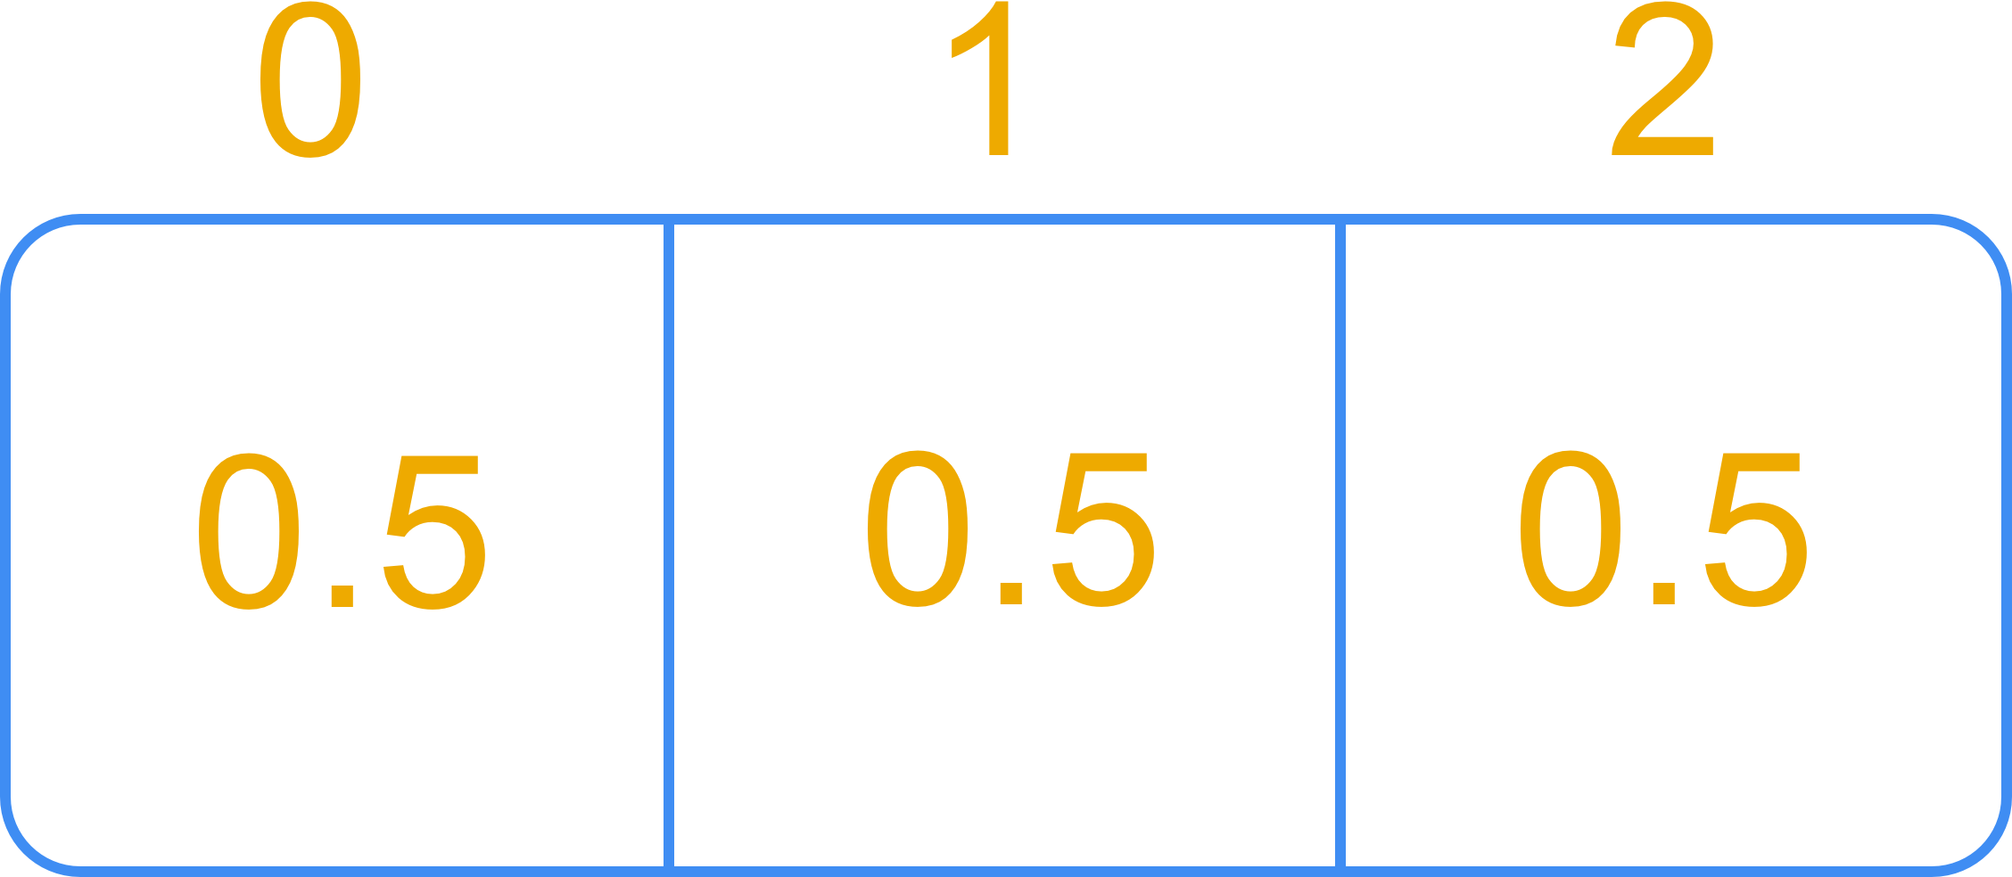
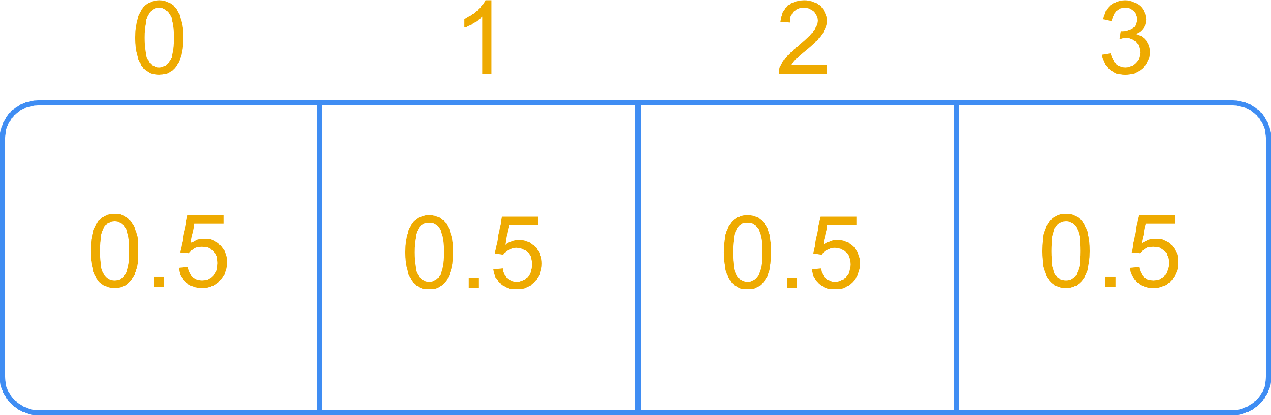
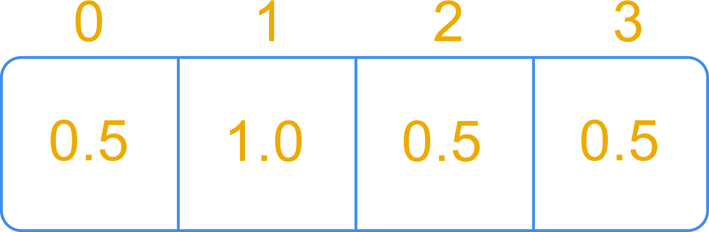
Step 1a: Split Rank Matrix
8 Pages 4 Processes
Sparse Rank Matrix
Process 0
Process 1
Process 2
Process 3

Slide 7
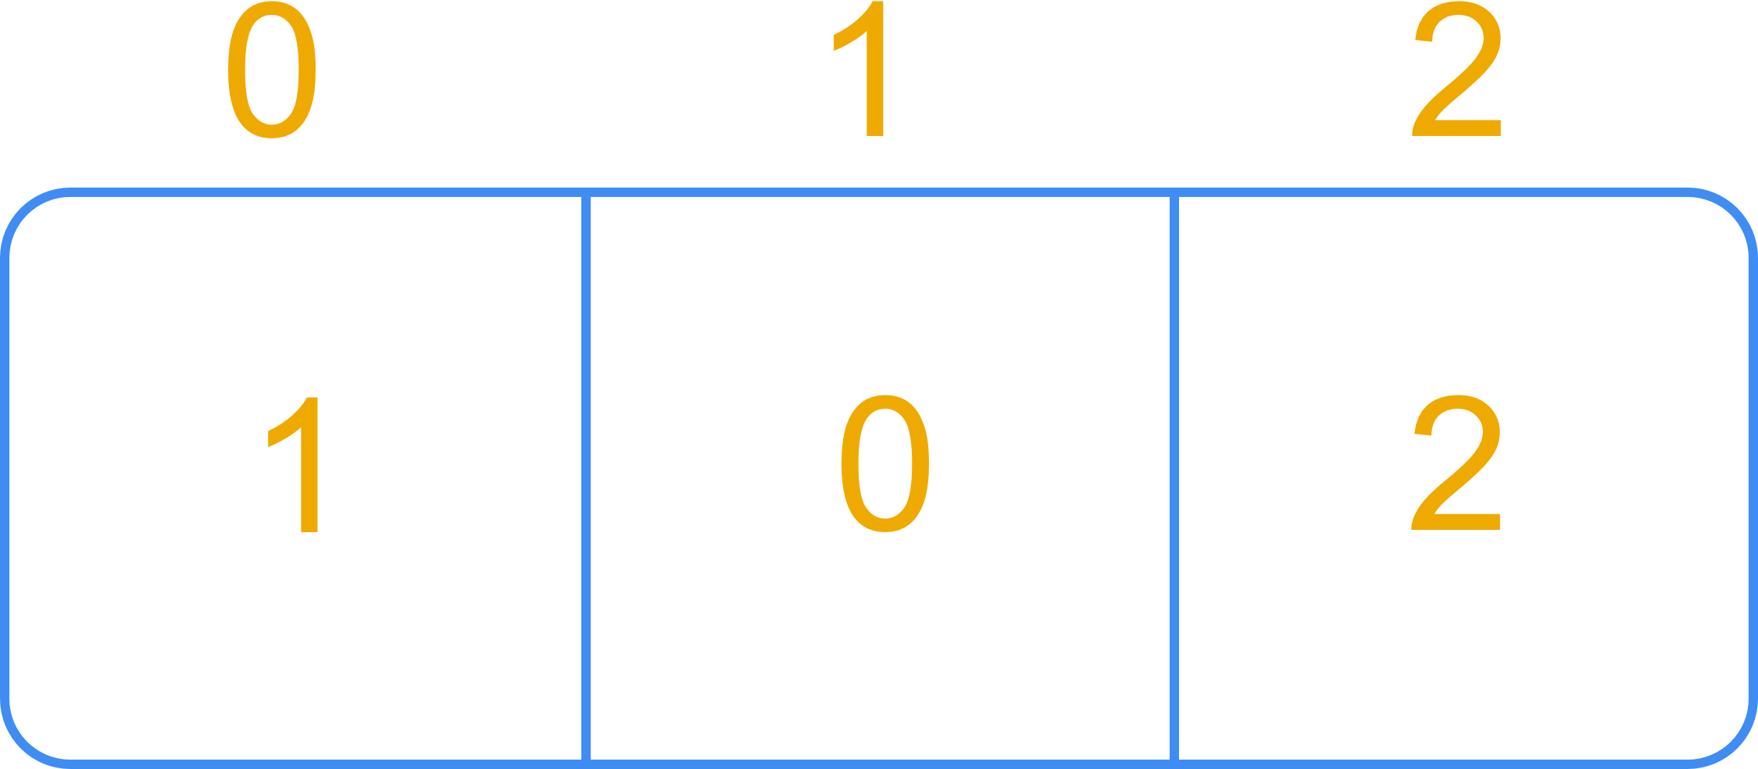
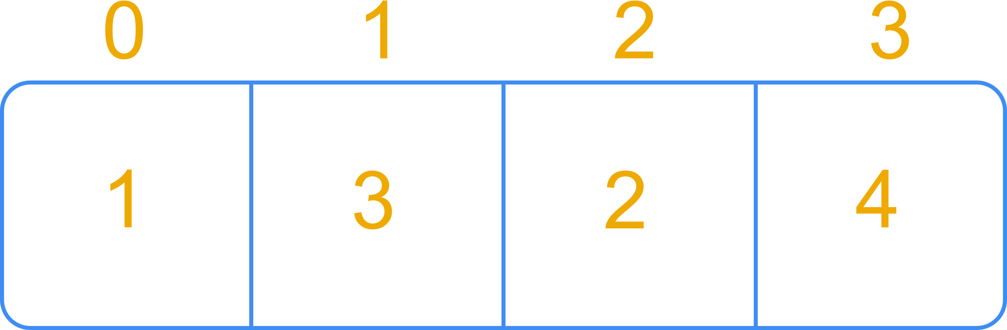
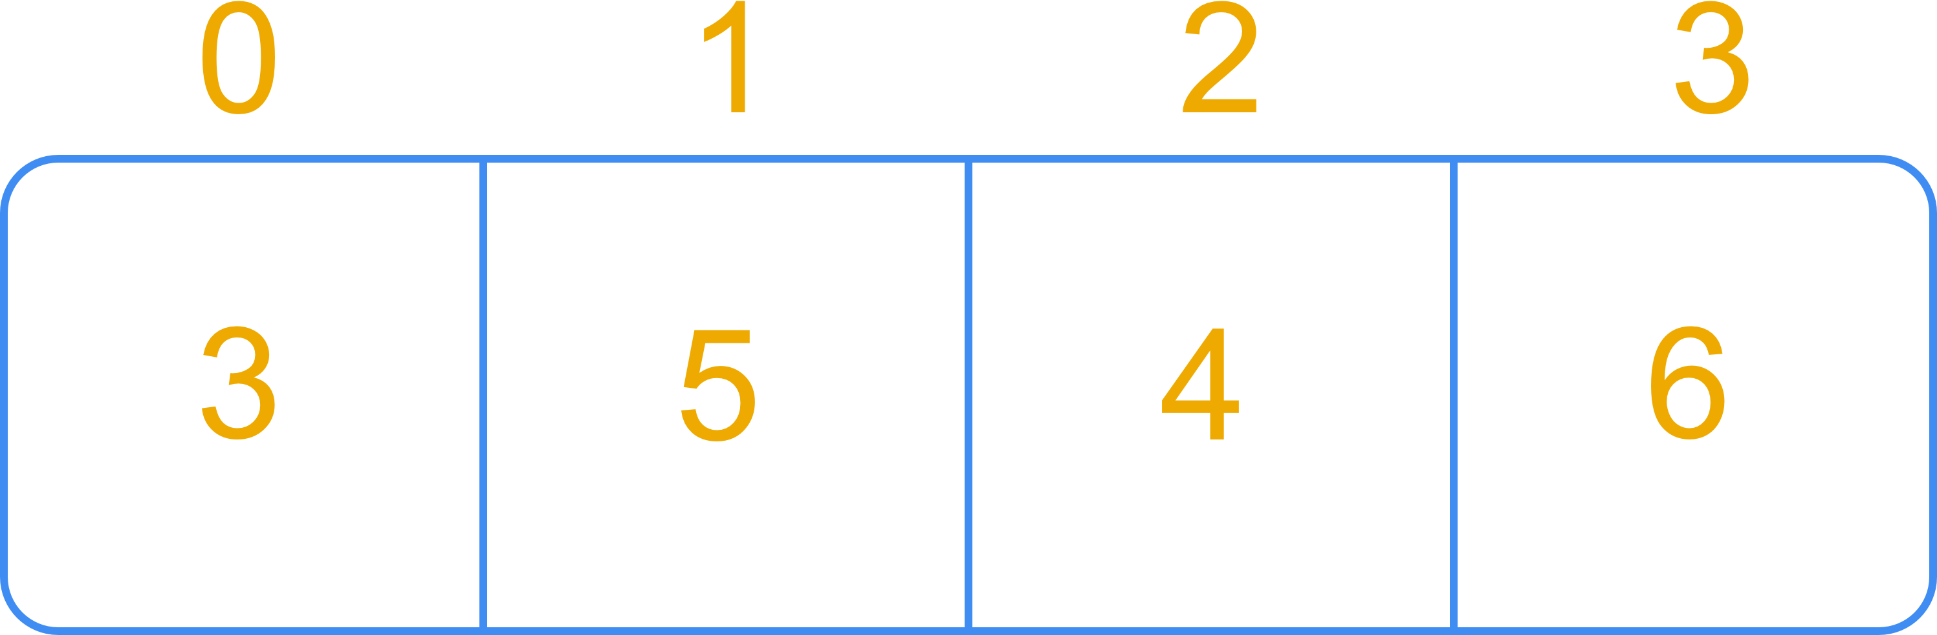
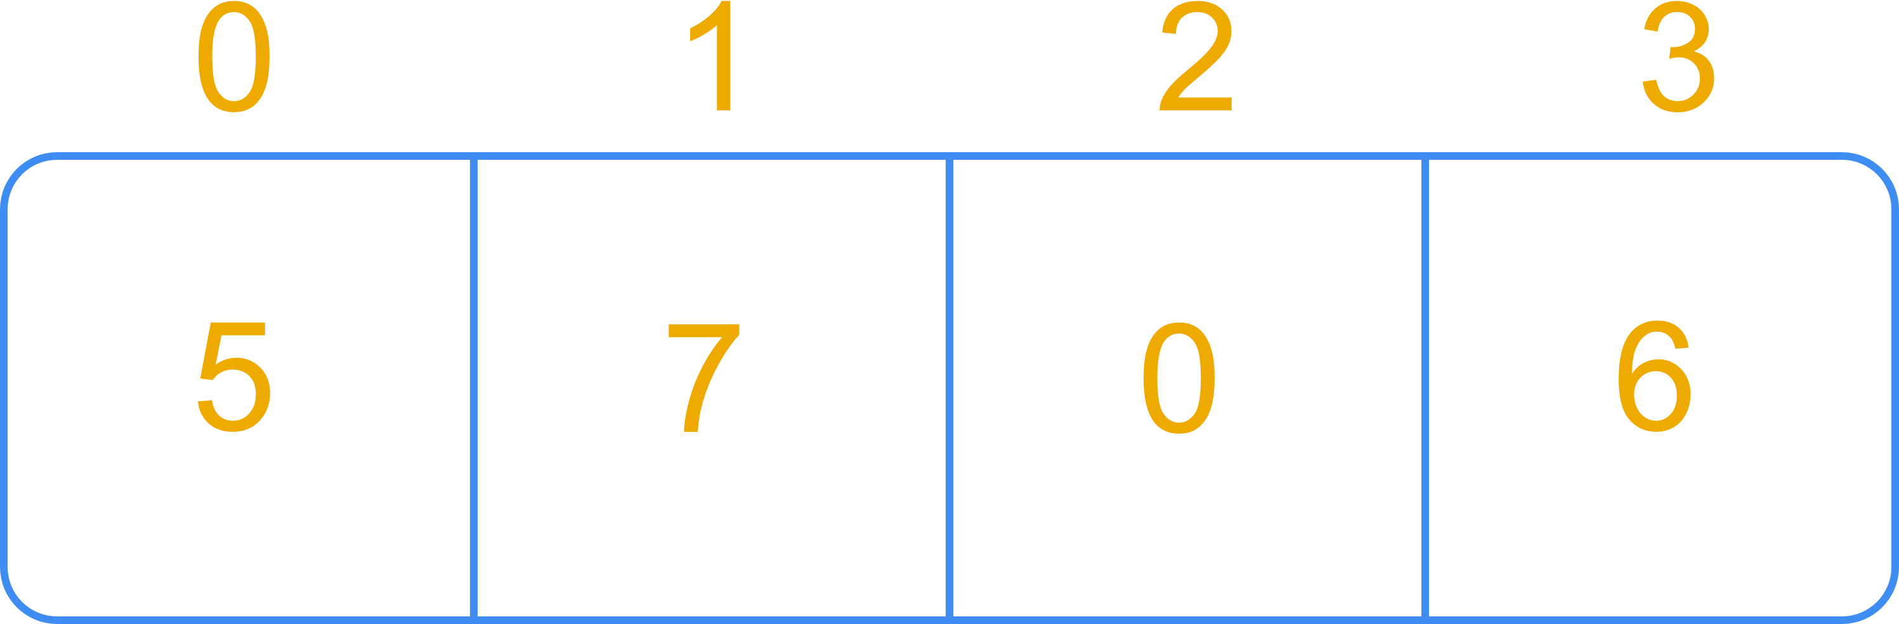
Step 1b: Split Column Vector
8 Pages 4 Processes
Column Index Vector
Process 0
Process 1
Process 2
Process 3

Slide 8
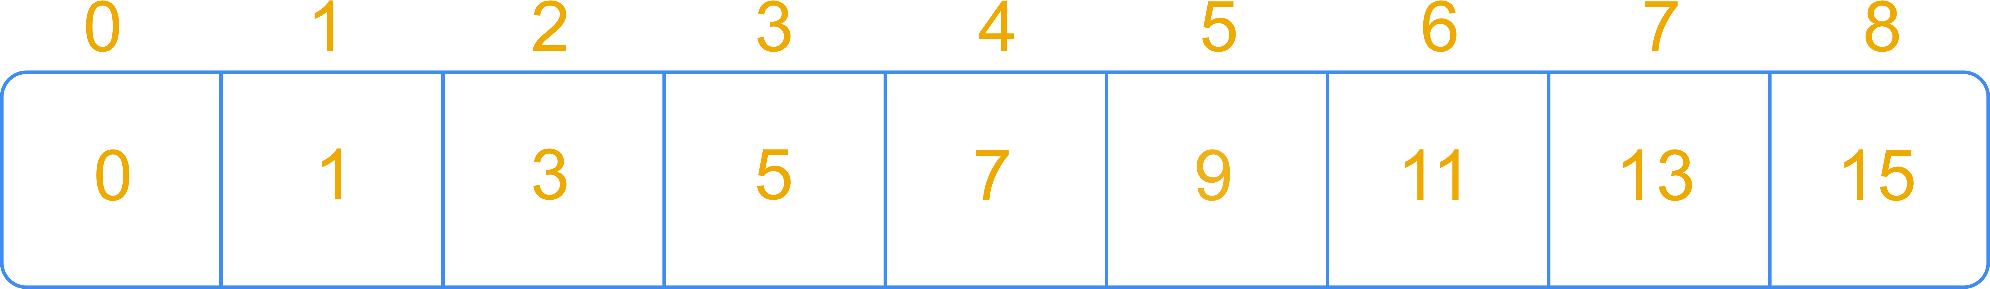
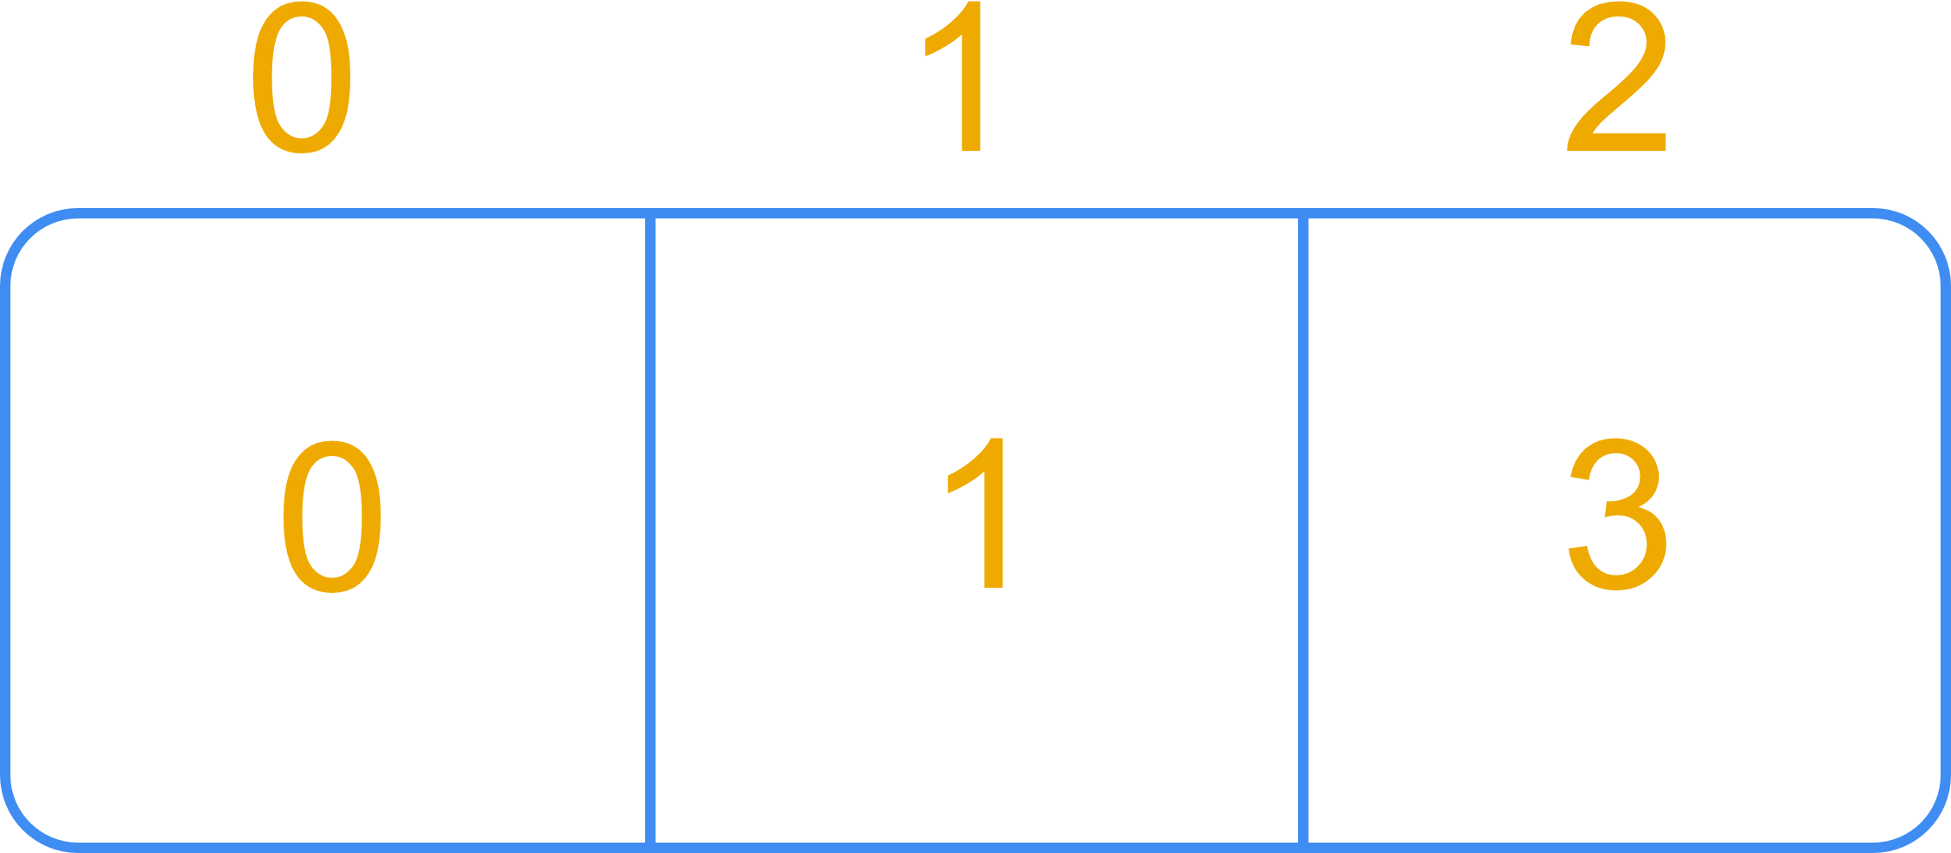
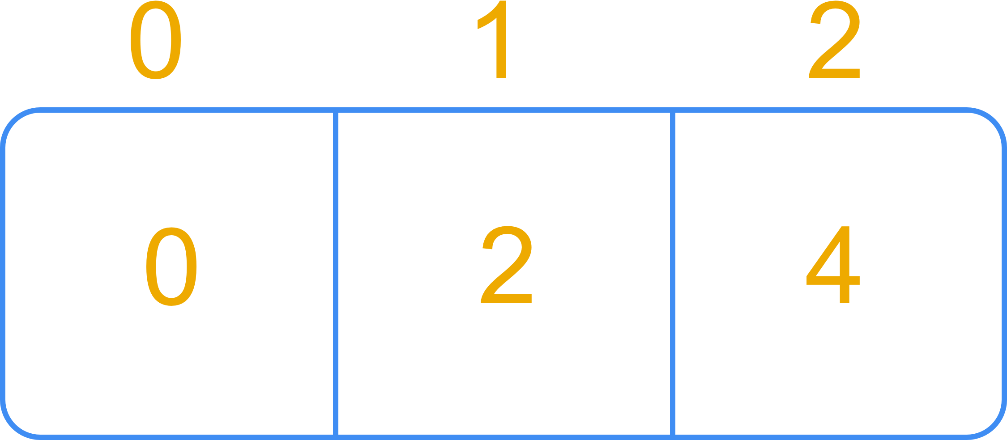
Step 1C: Split Row Vector
8 Pages 4 Processes
Row Index Vector
Process 0
Process 1
Process 2
Process 3

Slide 9
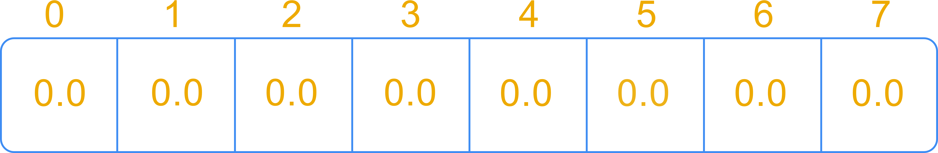
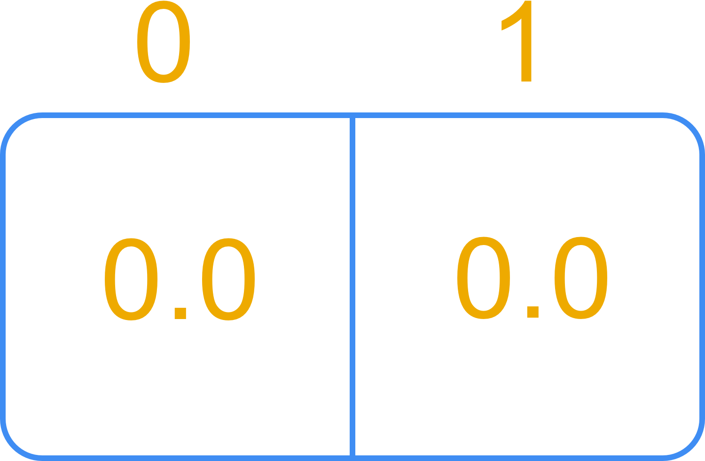
Step 1C: Split Y Vector
8 Pages 4 Processes
Y (Page Rank) Vector
Process 0
Process 1
Process 2
Process 3

Slide 10
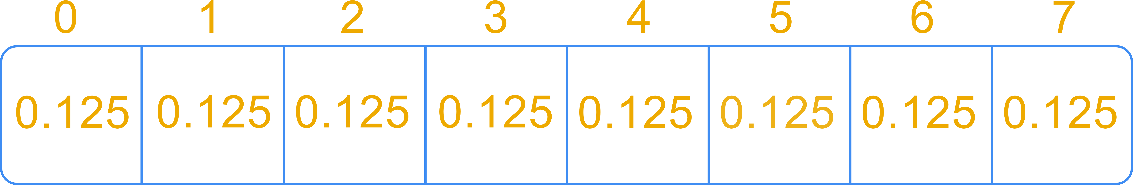
Step 1D: Global X Vector
8 Pages 4 Processes
X (Multiply) Vector

Slide 11
Step 2: Minimize Communication

Slide 12
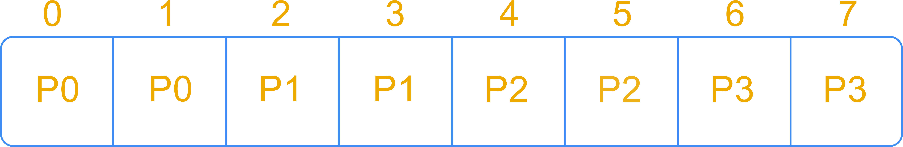
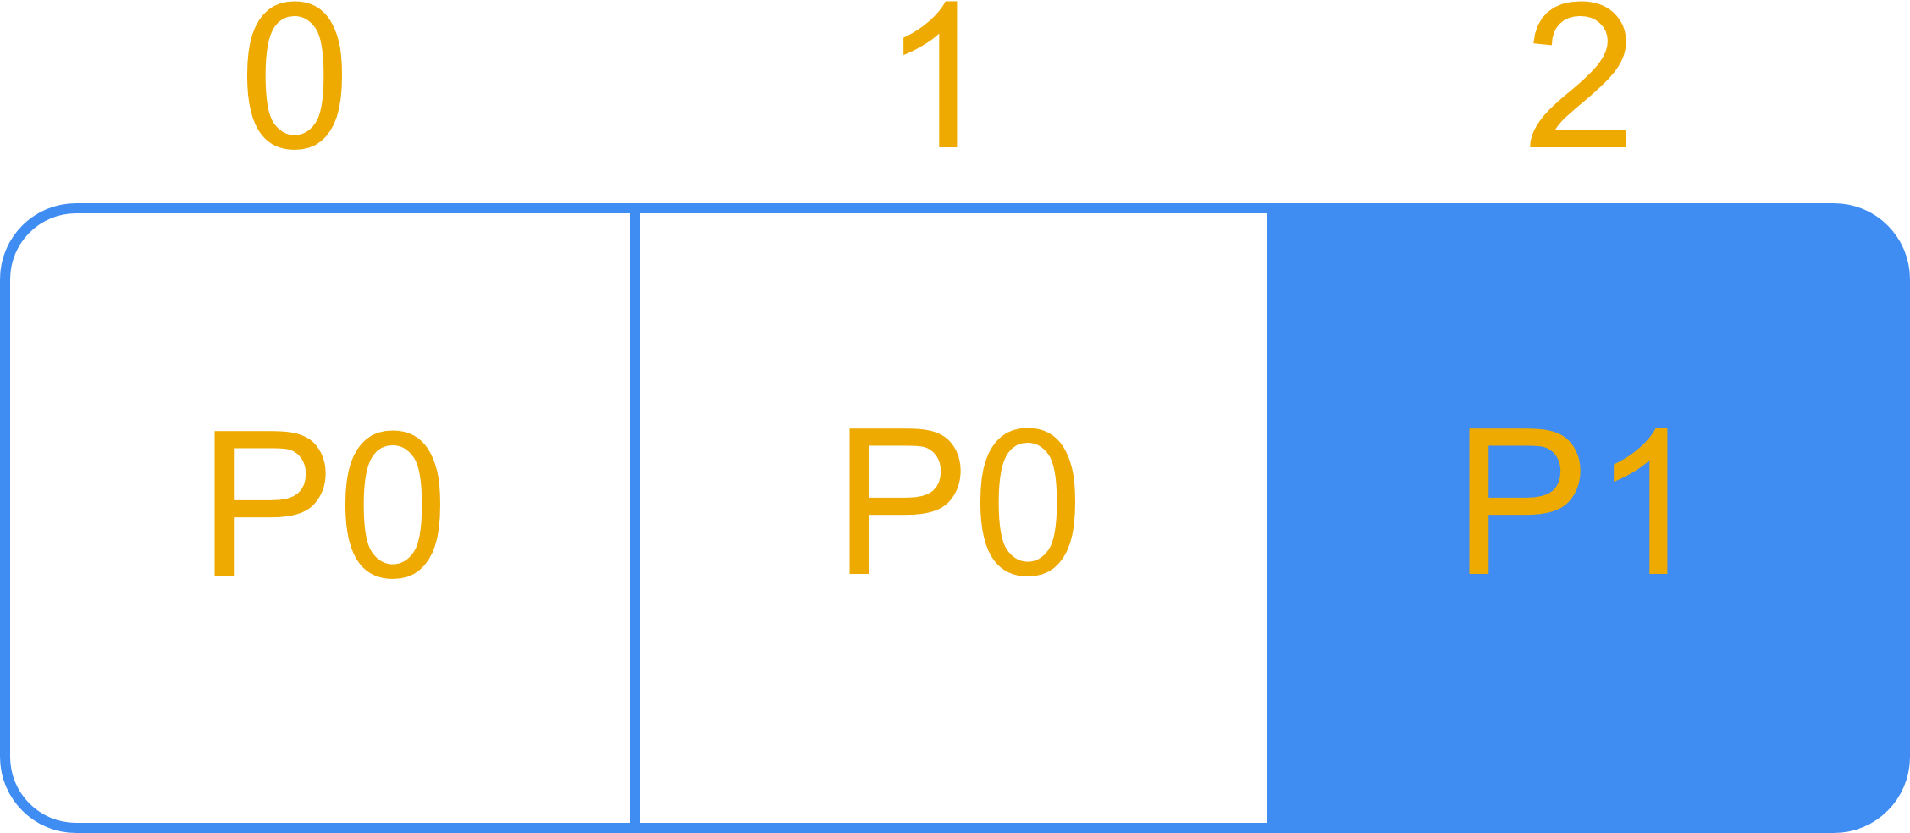
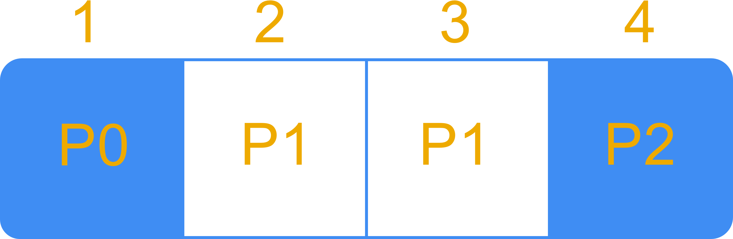
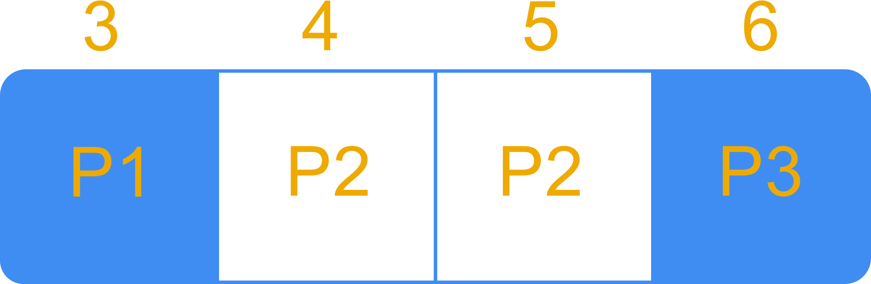
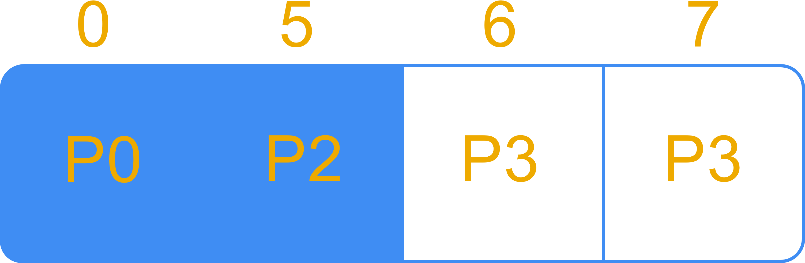
Step 2: X Vector
8 Pages 4 Processes
X Vector Computations
Process 0
Process 1
Process 2
Process 3

Slide 13
Speedup Study
OpenMP Sparse
Procs | Runtime (sec.) | Speedup
1 | 0.001707 | 1.000000
2 | 0.002311 | 0.738641
4 | 0.006632 | 0.257388
8 | 0.081032 | 0.021066
16 | 0.009028 | 0.189078
MPI Allgather Sparse
Procs | Runtime (sec.) | Speedup
1 | 0.001035 | 1.000000
2 | 0.003723 | 0.278002
4 | 0.003423 | 0.302366
8 | 0.015487 | 0.066830
16 | 4.587890 | 0.000226
16 Pages
MPI Send/Recv Sparse
Procs | Runtime (sec.) | Speedup
1 | 0.000898 | 1.000000
2 | 0.002835 | 0.316755
4 | 0.012240 | 0.073366
8 | 0.014347 | 0.062591
16 | 14.734795 | 0.000061

Slide 14
Speedup Study
OpenMP Sparse
Procs | Runtime (sec.) | Speedup
1 | 0.081346 | 1.000000
2 | 0.086240 | 0.943251
4 | 0.145172 | 0.560342
8 | 0.147048 | 0.553194
16 | 0.134218 | 0.606074
MPI Allgather Sparse
Procs | Runtime (sec.) | Speedup
1 | 0.072373 | 1.000000
2 | 0.068496 | 1.056602
4 | 0.061127 | 1.183978
8 | 0.056276 | 1.286037
16 | 31.336738 | 0.002310
1600 Pages
MPI Send/Recv Sparse
Procs | Runtime (sec.) | Speedup
1 | 0.073745 | 1.000000
2 | 0.053150 | 1.387488
4 | 0.036749 | 2.006721
8 | 0.016838 | 4.379677
16 | 2.824470 | 0.026109

Slide 15
Questions?

