Slide 1
Predicting GDP growth using AR models
Dan Lewis

Slide 2
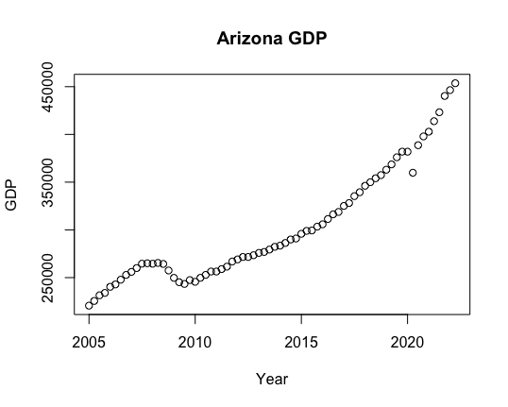
The dataset
Obtained from the Federal Reserve Bank of St. Louis.
Consists of quarterly data on the seasonally adjusted annual rate of the all industry GDP total, measured in millions of dollars, for each of the 50 US states, together with the District of Columbia.
The data stretches from 2005 Q1 to 2022 Q2: 70 quarters in all.

Slide 3
Recall the theory:
An AR(4) model:
$$Y_{t}=α+ρ_{1}Y_{t-1}+ρ_{2}Y_{t-2}+ρ_{3}Y_{t-3}+ρ_{4}Y_{t-4}+ϵ_{t}.$$
The best predictor of economic growth.
Should outperform a model with fewer lags, since it approximates the data generating process (DGP) better.
Should outperform a model with more lags since the coefficients will be estimated with more precision.

Slide 4
Plan of attack
Step one:
Train each model on the first 69 data points.
Compare the predicted GDP figures for 2022 Q2 against the true figures.
Predict ahead to 2022 Q3, Q4 and 2023 Q1. No comparison possible.
Step two:
Train the model on the first 50 datapoints in our sample, and use this to make predictions for the remaining 20 datapoints.
Estimate the MSFE and provide the R squared.

Slide 5
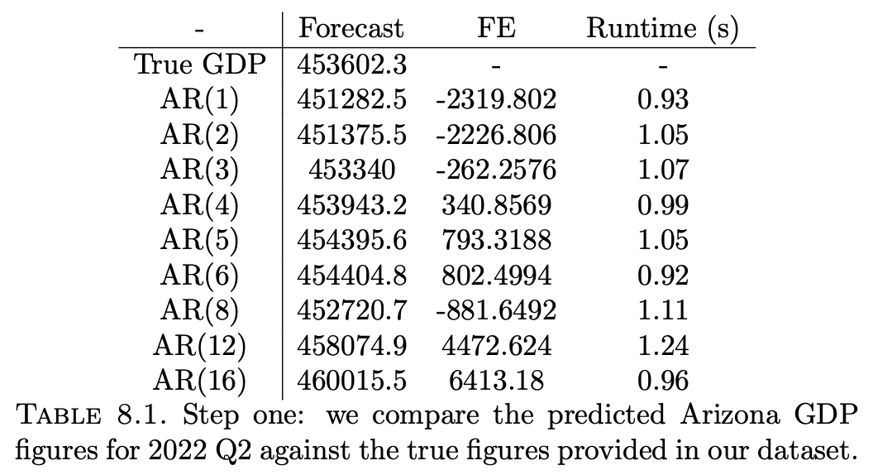
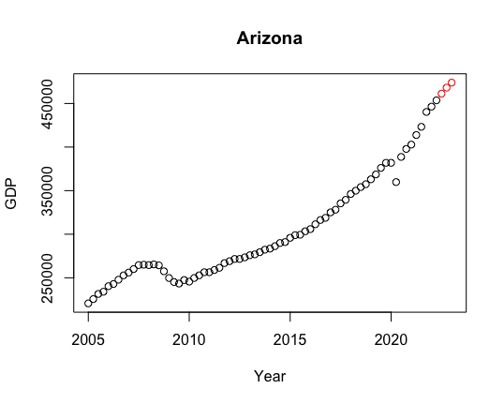
Results
Step one:
AR3 performs better!
BUT: very weak evidence (N = 1)
Caption

Slide 6
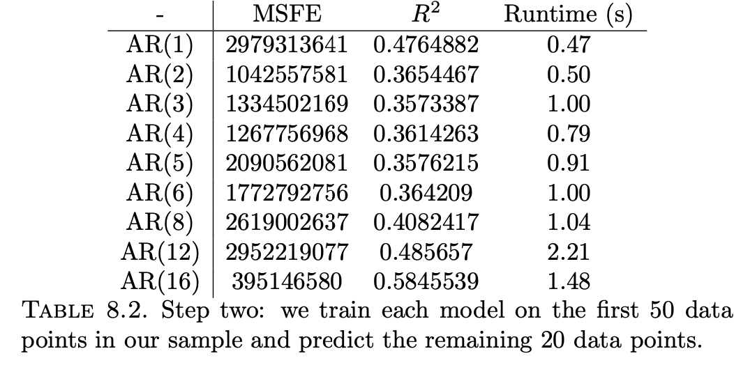
Results
Step two:
AR(2) performs better
BUT AR(16) performs best!
Possible explanation:
Doesn’t suffice to train the model on 50 data points to produce 20 predictions.
A more refined approach, e.g. k-fold cross-validation, may point to the AR(4) model as the best predictor.
Caption

Slide 7
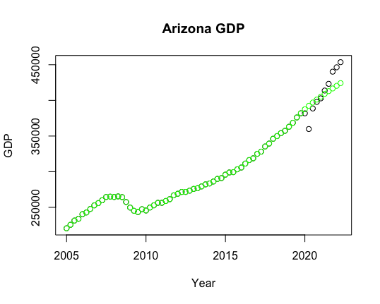
Side quests
What if the Covid-19 Pandemic hadn’t occurred?
Our AR(4) model (green) predicts continued economic growth, without the 2020 slump.
However, by 2021 actual growth catches these predictions, and in 2022 is significantly higher than our model predicts.

Slide 8
Conclusions
We apply autoregressive models to real-world data to predict future economic growth.
Our experimental evidence points to the AR(16) model as the best predictor (lowest MSFE, highest R^2), contrary to theory, which says AR(4) is best.
Why? Likely due to too small a sample size.
Possible remedy: k-fold cross validation.
We have insufficient evidence to reject the hypothesis that AR(4) models provide the best prediction of future economic growth.
The task warrants further investigation.

Slide 9
Reproducibility
Description of computing infrastructure — All computation was run on the author's Macbook Air with a 1.1 GHz Dual-Core Intel Core i3 processor and 8GB memory.
Average runtime for each approach — Included in tables.
Details of train/validation/test splits — Described in ‘Plan of attack’
Corresponding validation performance for each reported test result — There are not separate validation and test sets in this paper.
A link to implemented code — See https://github.com/danlewis92/GDPproject.

Slide 10
Conclusions
We apply autoregressive models to real-world data to predict future economic growth.
Our experimental evidence points to the AR(16) model as the best predictor (lowest MSFE, highest R^2), contrary to theory, which says AR(4) is best.
Why? Likely due to too small a sample size.
Possible remedy: k-fold cross validation.
We have insufficient evidence to reject the hypothesis that AR(4) models provide the best prediction of future economic growth.
The task warrants further investigation.

