Slide 1


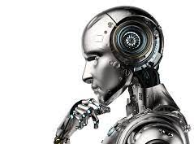
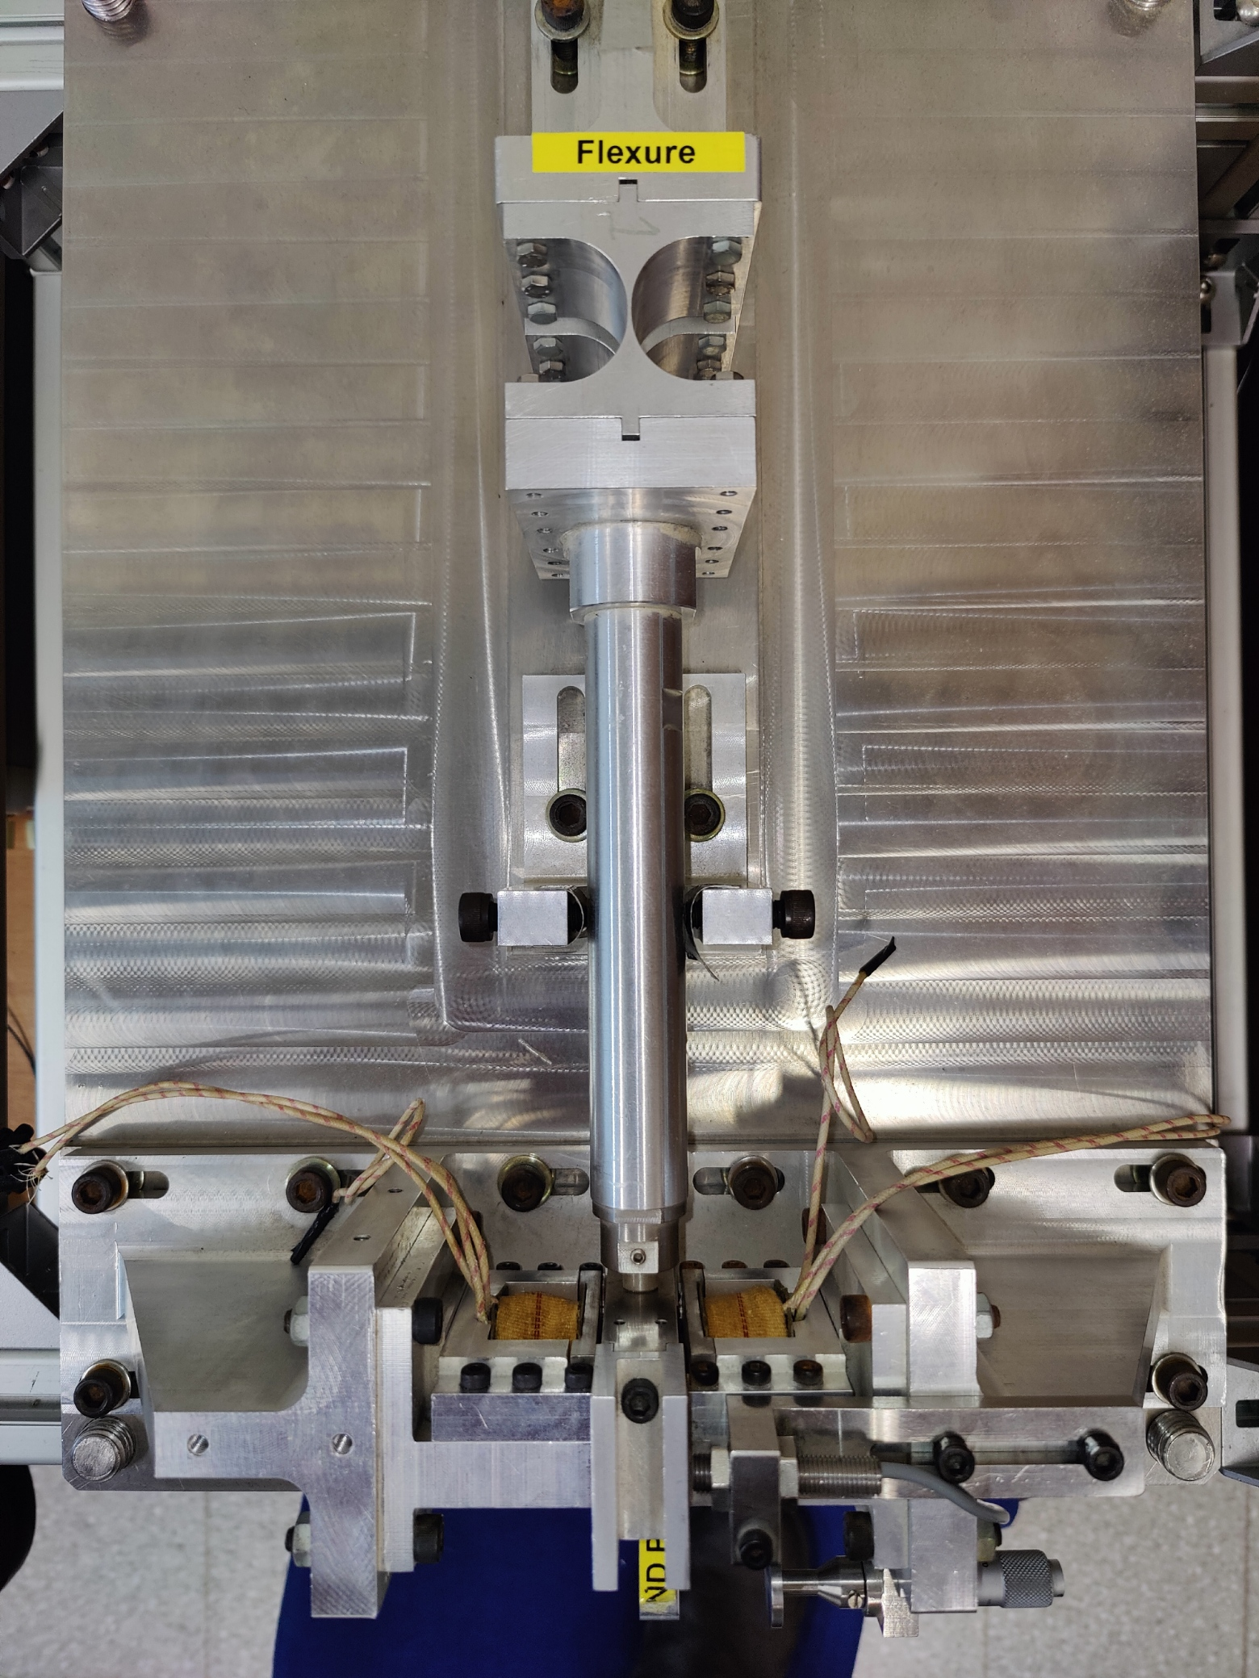
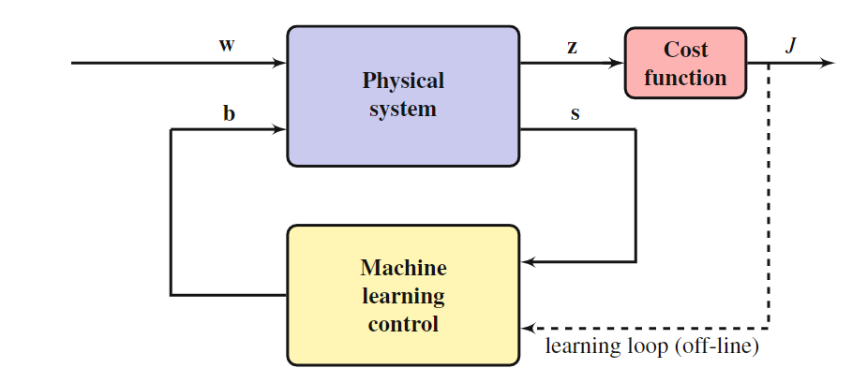
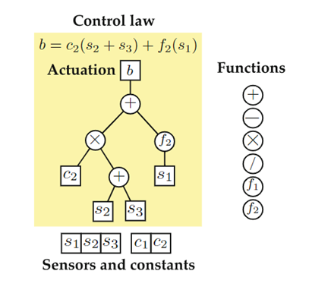
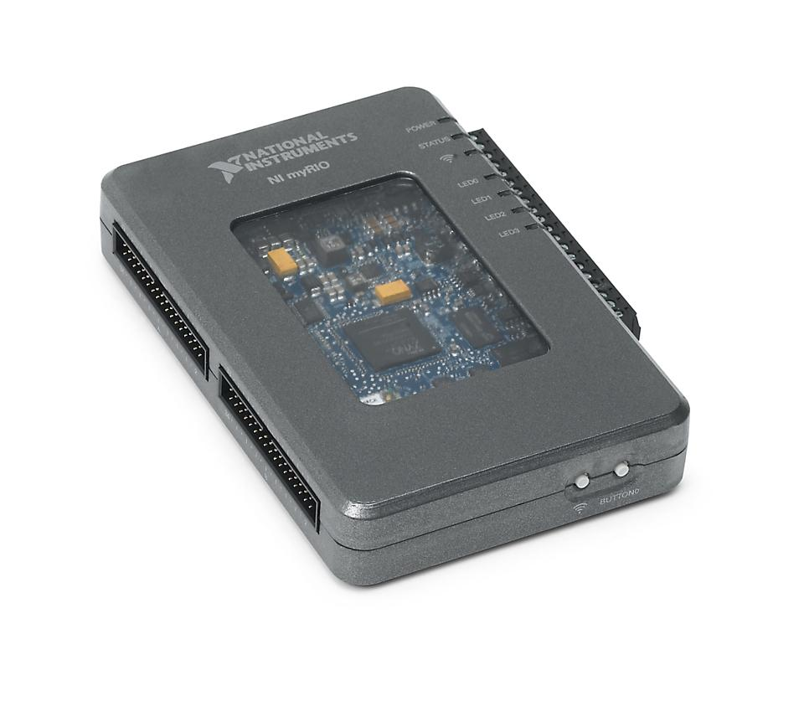
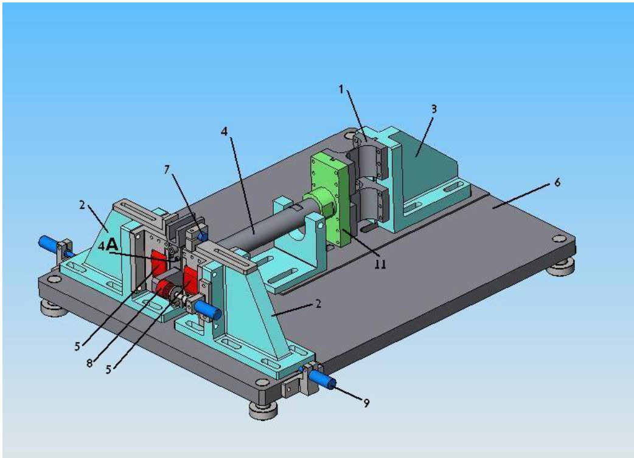
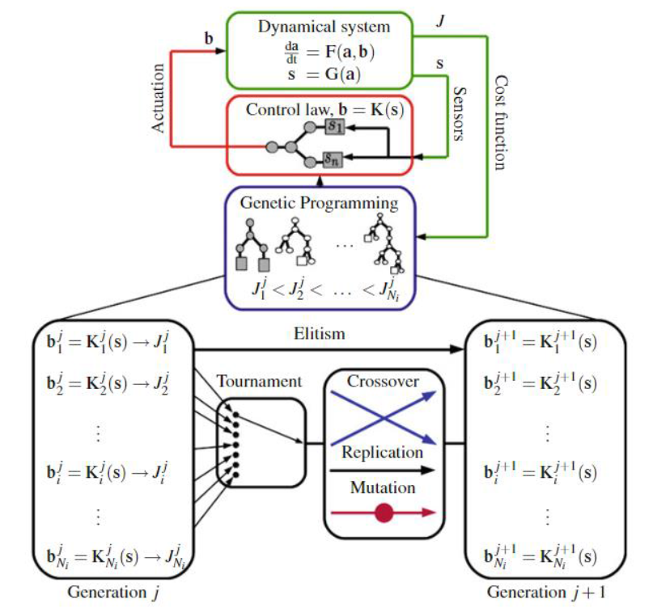

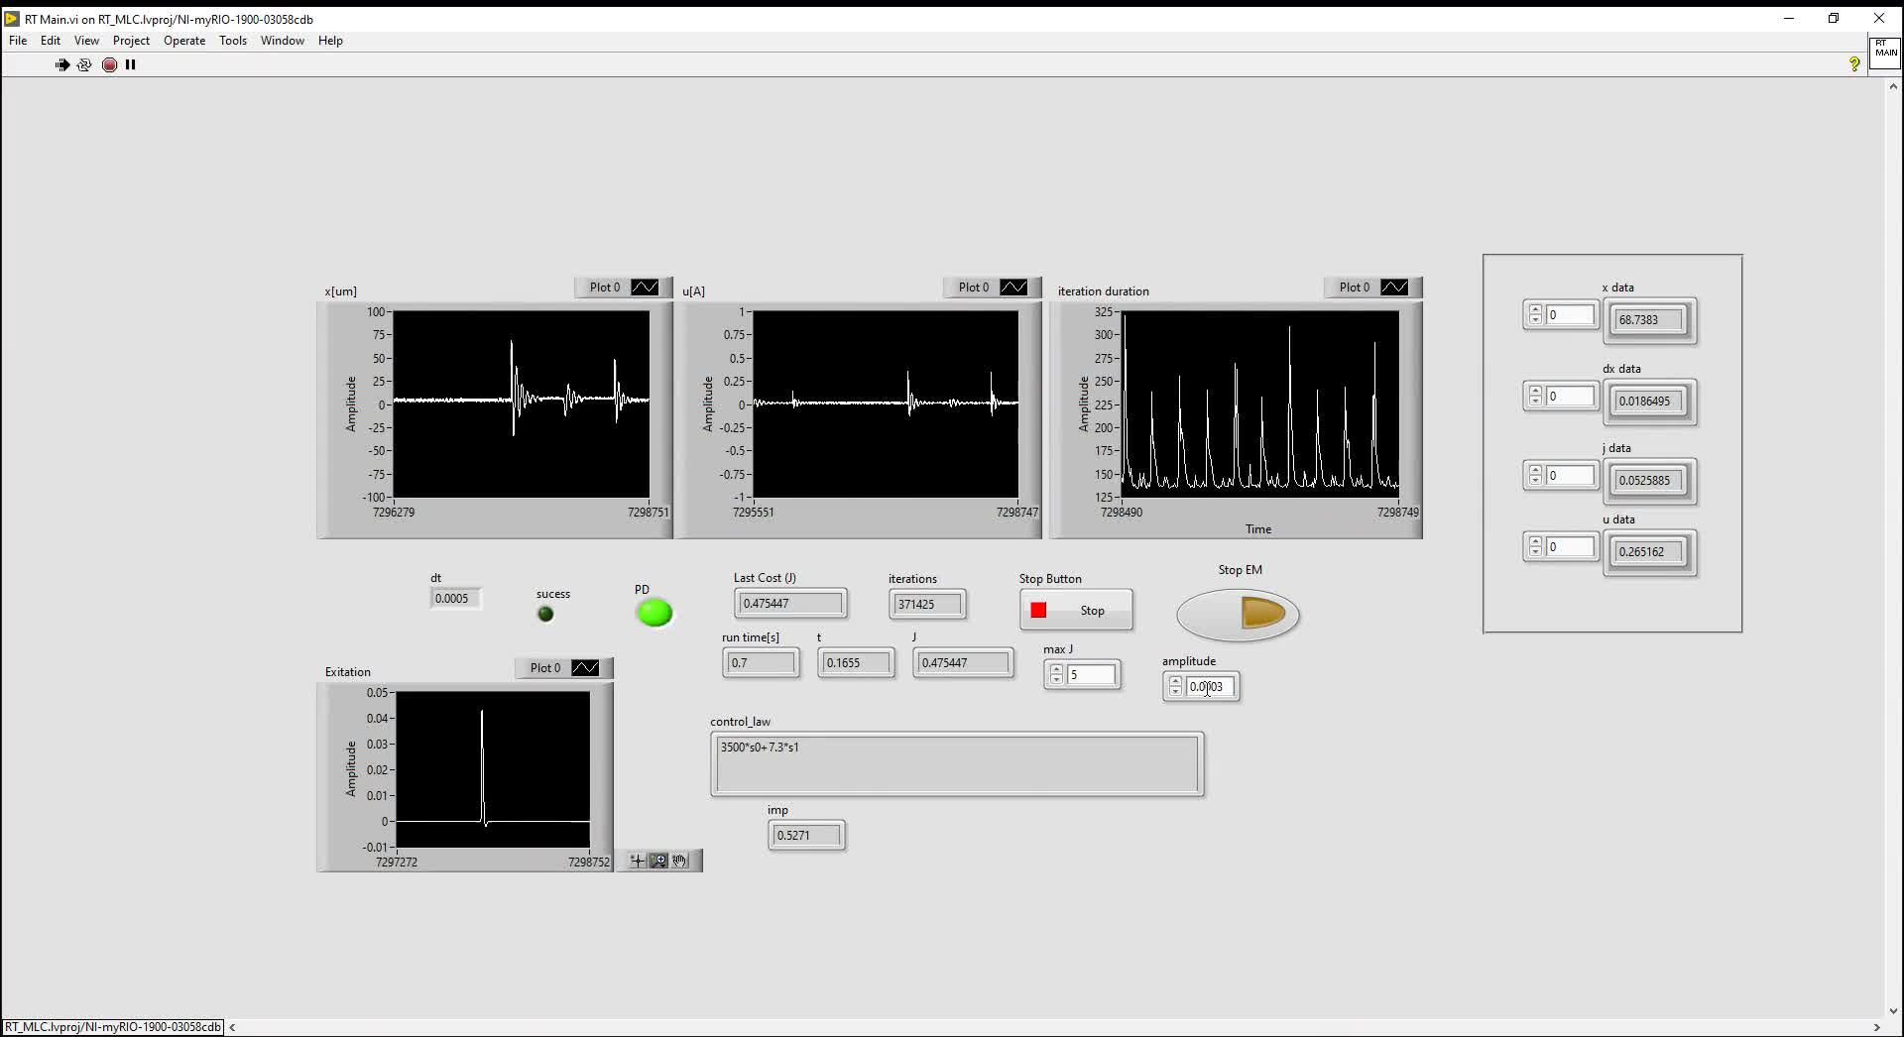


Machine Learning Based Control Algorithm For Active Vibration Suppression of a Mechanical Flexure Hinge
(BS-22-19)
Daniel Lilintal
Advisors: Dr. Ziv Brand, Dr. Eitan fisher
Introduction
Flexible mechanical structures exist in many applications such as aerospace systems, bridges, machining machines and more. In many cases, the structures are under dynamic loads generated by vibrations and mechanical shocks. Dynamic loads can accelerate failure mechanisms, such as fatigue and wear damage alongside damage to system functionality and reliability. Using closed-loop control can reduce vibrations and improve the reliability of systems. Sometimes mechanical systems are complex, and it is not possible to know all the parameters that affect their dynamics or that the systems are not linear. In these cases, using artificial intelligence can help find a controller that performs best.
Goals
Development of an infrastructure based on a genetic algorithm for finding a controller close to optimal
Performing calculations and simulations for the technological demonstrator
Performing test experiments on the physical system
The Experiment
Flexure
Fixing
Electro-Magnets
Distance Sensor
Iron Core
Top View of the Technological Demonstrator
Figure of impulse uncontrolled
Machine-Learning Control Diagram
LabView Control Panel
Results
The results obtained in the experiments show that it is indeed possible to obtain a machine learning-based controller that outperforms an optimal controller after several generations of calculation, since the system is non-linear and there is also parametric uncertainty. If the system was linear, the optimal controller would be the best controller for the system.
Conclusions
Machine-learning control results are near to optimal control method for the given mechanical system.
There is potential for using machine learning control for nonlinear systems with uncertainty based on input/output data measurements.
What Next
Later in the activity, the research will deal with the examination of more efficient convergence algorithms and the development of a dynamic MLC-based comprehension. Implementing MLC algorithm to find a dynamic estimator for a complex system. Implementation of MLC algorithm to preventing chatter in machining.

