Slide 1



Machine Learning Based Control Algorithm for Active Vibration Suppression of a Mechanical Flexure Hinge
Daniel Lilienthal, Ziv Brand, Etan Fisher
Department of Mechanical Engineering
Shamoon College of Engineering (SCE)
Beer Sheva, ISRAEL
The Machine Learning in Engineering (MLE) conference
April 26th , 2022
zivbr@sce.ac.il

Slide 2
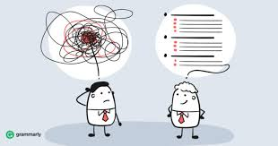
Outline
Background
Our goal
Results
Conclusion
Time for questions

Slide 3
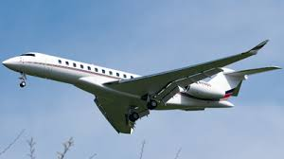
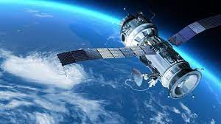
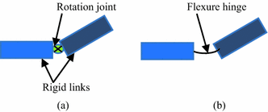
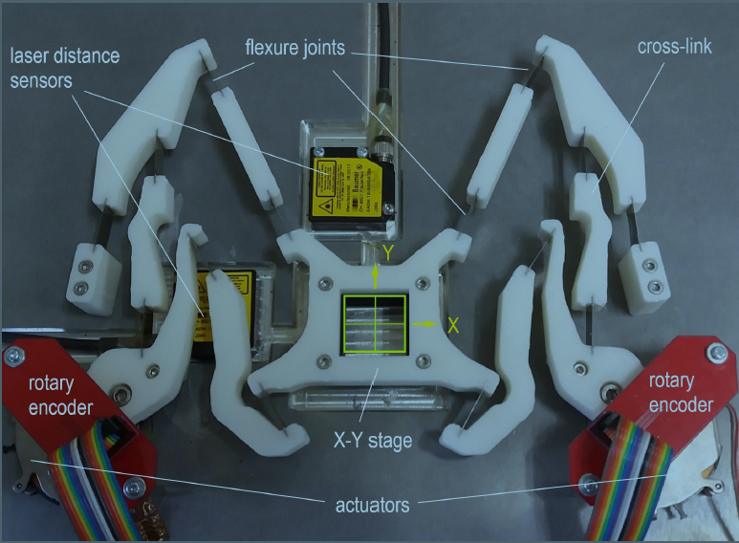
Background – Applications of flexible structure (examples)
Aircraft
Satellite
Manipulator mechanism
X-Y micro-positioning stage
Flexible structures form vital components in a wide range of engineering systems.

Slide 4
Background – Flexible Structure
The mechanical vibration may be a cause of various types of problems, such as
System dynamic instability
Fatigue damage
Fretting fatigue

Slide 5

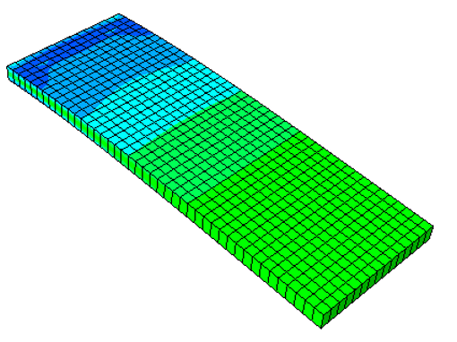
Background – Research issues
Active vibration control of flexible structures has become a popular research interest.
In many vibration control problems, the goal is to suppress the effect of external disturbances while keeping the structure in its equilibrium state.
controller
known model
unknown model
actuator
sensor

Slide 6
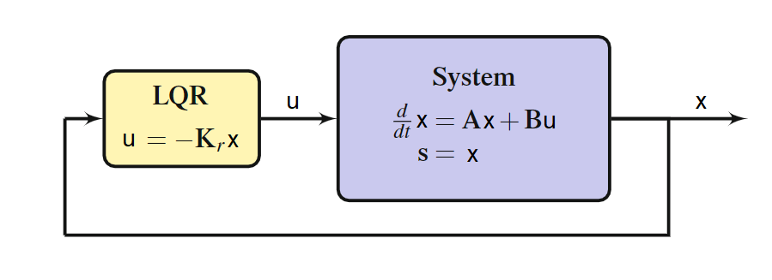




Optimal Control - LQR
$$J\left(u\right)=\int_{0}^{∞}{\left(x^{T}Qx+u^{T}Ru\right)dt}$$
$$u=−Kx$$
the feedback control law that minimizes the value of the cost is:
where $K$ is given by:
$$K=R^{−1}B^{T}P$$
And P is found by solving algebraic Riccati equation:
$$A^{T}P+PA−PBR^{−1}B^{T}P+Q=0$$
Required to know the dynamic model

Slide 7
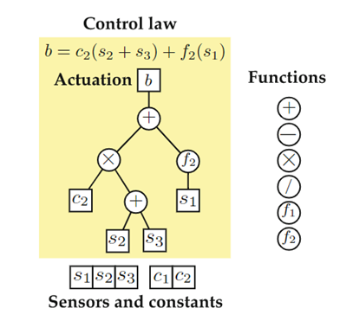
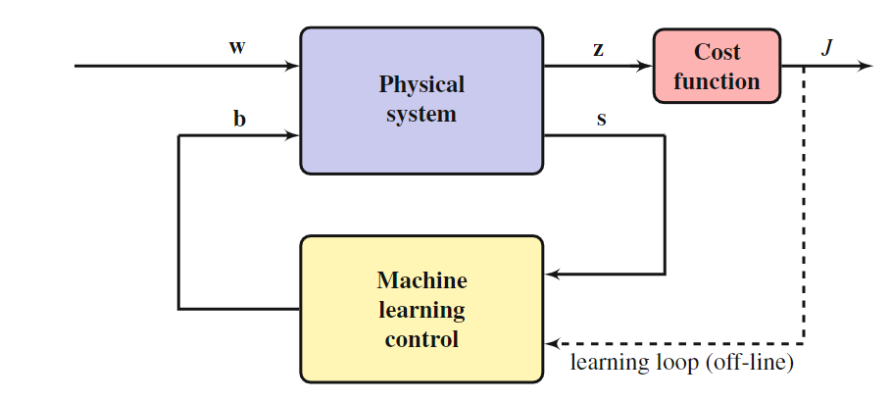
Machine Learning Control Algorithm
Individual function
tree representation used in
genetic programming.
Schematic of machine learning control wrapped around a complex system using noisy sensor-based feedback.
T. Duriez et al., “Machine Learning Control - Taming Nonlinear Dynamics and Turbulence”, Springer, 2017

Slide 8
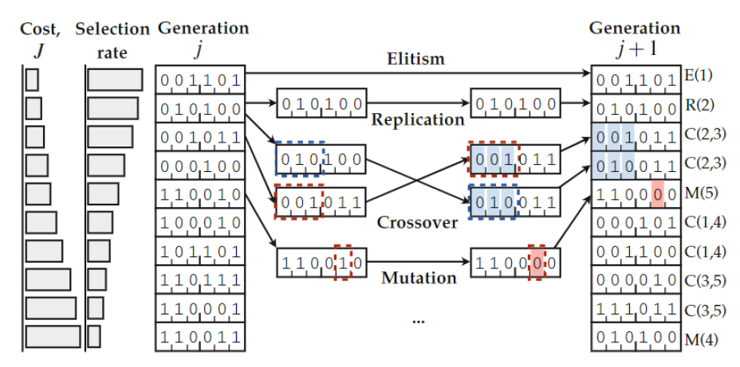
Machine Learning Control Algorithm
Individual function
tree representation used in
genetic programming.
Genetic operations to advance one generation of parameters to the next in a genetic
algorithm.
T. Duriez et al., “Machine Learning Control - Taming Nonlinear Dynamics and Turbulence”, Springer, 2017

Slide 9
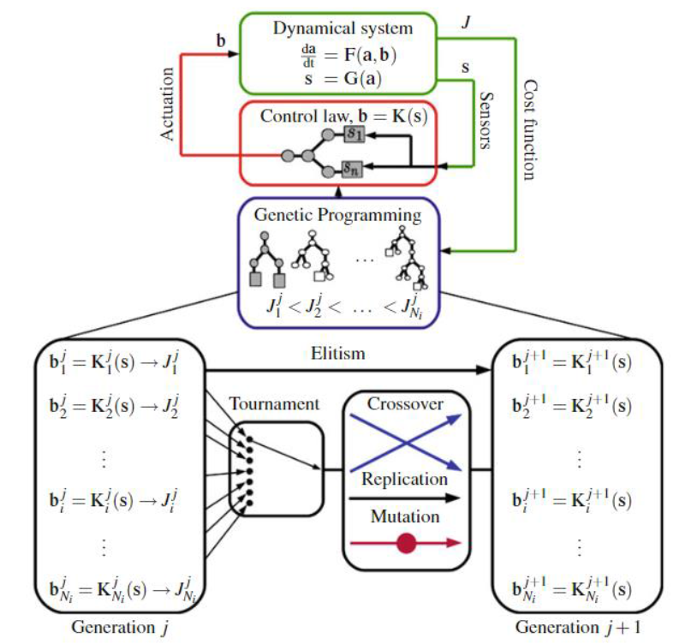
Machine Learning Control Algorithm
Model-free control design using GP for MLC.
T. Duriez et al., “Machine Learning Control - Taming Nonlinear Dynamics and Turbulence”, Springer, 2017

Slide 10
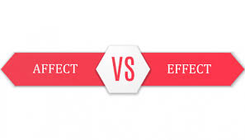
Our goal
The aim of this study is to investigate a machine learning control method for active vibration suppression of a mechanical flexure hinge.
Machine learning control
Optimal control
Simulation
Experiment
(Next Stage)

Slide 11
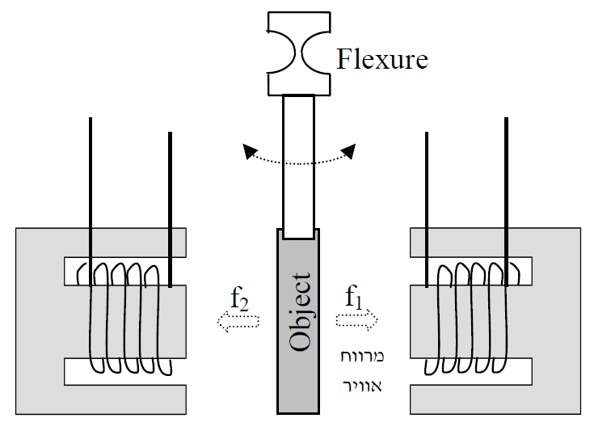
Mechanical Flexure Hinge System Architecture main components
Main components Flexible hinge
Rigid shaft
Displacement sensor
Controller
Current Amplifiers
Electromagnet actuators
Current Amp.
Current Amp.
Controller
displacement sensor

Slide 12
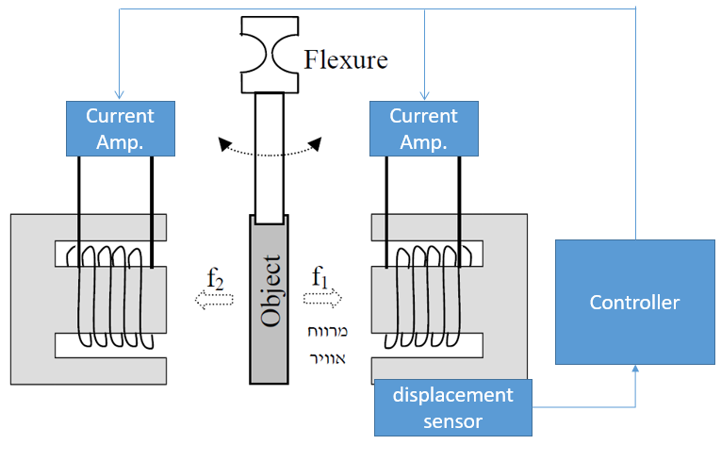
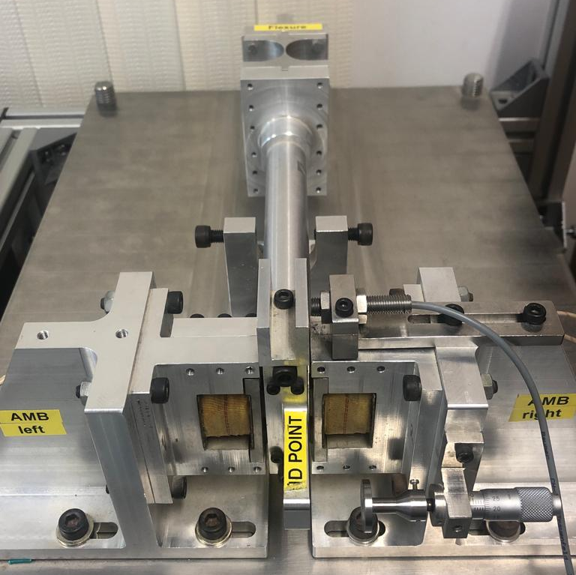
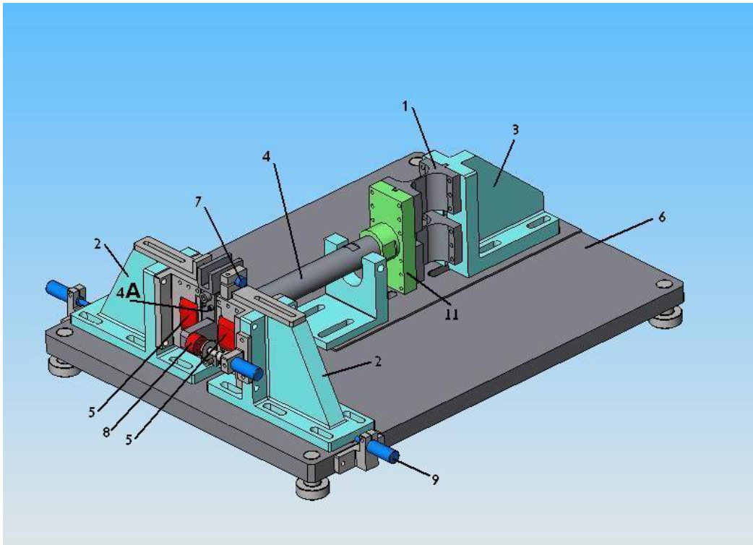
Mechanical Flexure Hinge Test Rig - main components
Main components Flexible hinge
Rigid shaft
Displacement sensor
Electromagnet actuators
S Basovich, S Arogeti, Z Brand, Adaptive output zero-bias tracking control of 1DOF AMB suspension system, 13th International Conference on Control Automation Robotics & Vision , 2014

Slide 13






System Model
Mechanical model
Electromagnet model
Newton's second law
Biot-Savart law and Lorentz force
$$m\ddot{x}=ΣF$$
$$m\ddot{x}\left(t\right)+c\dot{x}\left(t\right)+kx\left(t\right)=f_{2}\left(t\right)−f_{1}\left(t\right)$$
$$\left|f_{1/2}\right|=\left.\frac{μ_{0}A_{s}{\left(Ni\right)}^{2}}{4x^{2}}\right.$$
$$f_{1}$$
N turns
$$x$$
i[A]
x[m]
$$f_{2}$$
$$f_{m}[N]$$

Slide 14








Dynamic Model
$$m\ddot{x}\left(t\right)+c\dot{x}\left(t\right)+kx \left(t\right)=\frac{μ_{0}A_{s}N^{2}}{4}\frac{i_{2}^{2}\left(t\right)}{{\left(x_{eq}−x\left(t\right)\right)}^{2}}−\frac{μ_{0}A_{s}N^{2}}{4}\frac{i_{1}^{2}\left(t\right)}{{\left(x_{eq}+x\left(t\right)\right)}^{2}}$$
$$i_{1}$$
Dynamic system
$$x$$
$$i_{2}$$
$$i_{2}\left(t\right)$$
$$i_{1}\left(t\right)$$
Current Amp.
Current Amp.
Non-linear system
Unstable system
$$x_{eq}$$
Controller
$$x\left(t\right)$$
displacement sensor
$$x\left(t\right)$$

Slide 15
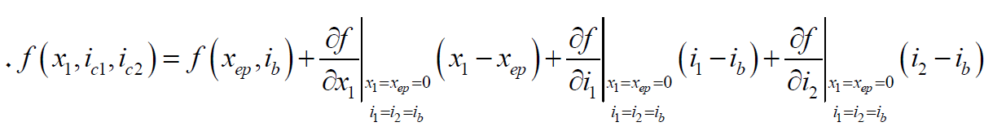
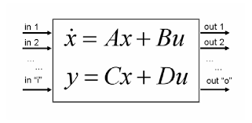
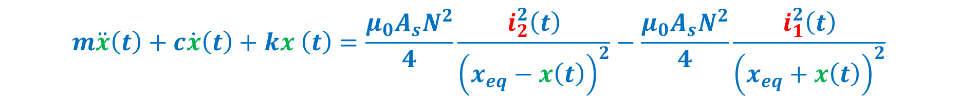

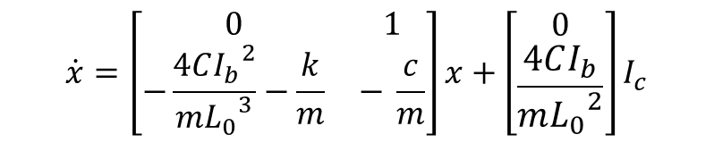
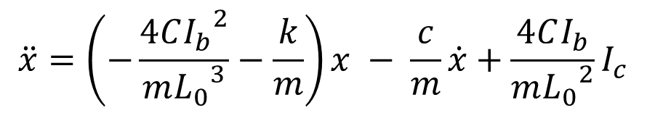
Linearization - Dynamic Model
$$m\ddot{x}\left(t\right)+c\dot{x}\left(t\right)+kx \left(t\right)=\frac{μ_{0}A_{s}N^{2}}{4}\frac{i_{2}^{2}\left(t\right)}{{\left(x_{eq}−x\left(t\right)\right)}^{2}}−\frac{μ_{0}A_{s}N^{2}}{4}\frac{i_{1}^{2}\left(t\right)}{{\left(x_{eq}+x\left(t\right)\right)}^{2}}$$
$$\dot{x}=\left[\begin{matrix}0 & 1 \\ −\frac{4C{I_{b}}^{2}}{m{L_{0}}^{3}}−\frac{k}{m} & − \frac{c}{m}\end{matrix}\right]x+\left[\begin{aligned}0 \\ \frac{4CI_{b}}{m{L_{0}}^{2}}\end{aligned}\right]I_{c}$$
$$\ddot{x}=\left(−\frac{4C{I_{b}}^{2}}{m{L_{0}}^{3}}−\frac{k}{m}\right)x − \frac{c}{m}\dot{x}+\frac{4CI_{b}}{m{L_{0}}^{2}}I_{c}$$
State space
$$y=\left[\begin{matrix}1 & 0\end{matrix}\right]x$$

Slide 16
Simulation Optimal Control VS MLC

Slide 17
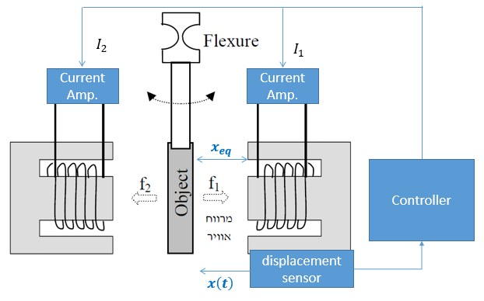
Simulation Results – Unconstrained system

Slide 18
Simulation Results – Closed Loop Linear Model
Mlc main parameters:
Individuals: 1000
Functions: +,x
Max Depth:15
After 20 Generations (about an hour of calculations):
b MLC = - 3864* y(1) - 16.95 * y(2)
b LQR = -3914*y(1) -18.94*y(2)

Slide 19
Simulation Results – Closed Loop Non-Linear Model
Mlc main parameters:
Individuals: 1000
Functions: +,x
Max Depth:15
After 20 Generations (about an hour of calculations):
b MLC = - 4711* y(1) – 21.37 * y(2)
b LQR = -3914*y(1) -18.94*y(2)

Slide 20
Conclusion
Machine-learning control results are similar to the optimal control method for the given mechanical system.
There is potential for using machine learning control for nonlinear systems with uncertainty based on input/output data measurements.

Slide 21
What’s Next
Build a framework for running the algorithm on the physical system.
Run the experiment on the physical system.
Compare the results to the optimal control results.
Dynamic observer based on MLC.

Slide 22


zivbr@sce.ac.il

