Slide 1
Microsoft .NET MVC

Slide 2
What is MVC?
“Model-View-Controller”
Wrong answer
MVC is a Design Pattern for building robust and secure web applications
For .NET, it is:
Web Development Framework
Agile Development
Core part of the .NET platform
Alternative to, or replacement for, ASP.NET WebForms
So, .NET MVC is a framework for building web applications that applies the general Model View Controller design pattern to the .NET platform

Slide 3
A Little Bit of History
2002
ASP.NET 1.0 released
Visual Studio .NET with WebForms
2005
ASP.NET 2.0
Visual Studio 2005
2007
2008
ASP.NET 3.5 with MVC
Visual Studio 2008 SP1 (DynamicData – Generate data-driven apps in minutes)
2010
ASP.NET 4.0
Visual Studio 2010 with MVC 4
ASP.NET 3.0, MS announces MVC
Visual Studio 2008
2012
ASP.NET 4.5 with MVC 4.5
Visual Studio 2012

Slide 4
A Little Bit of History
2013
ASP.NET 4.51 with MVC 5.0
Visual Studio 2013
2014
ASP.NET 4.52 with MVC 5.1
2014
ASP.NET 4.6 with MVC 5.2
2015
ASP.NET 4.6.1
Visual Studio 2015 Community with MVC 5.2
Visual Studio 2013 updates 1, 2
Visual Studio 2013 Community with updates 3, 4
2016*
vNext with MVC 6 (Beta)
open-source, multi-platform, MVC/WebAPI integration

Slide 5
What’s Wrong with WebForms?
Viewstate weight
Page life cycle
False sense of separation of concerns (SOC)
Limited control over HTML
Leaky abstraction
Low testability
MVC solves all of these problems

Slide 6
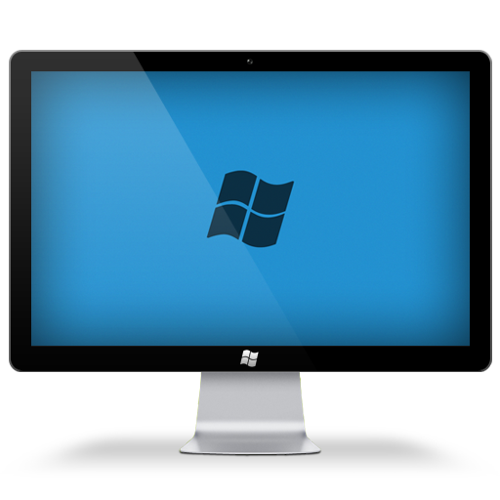
MVC
Model
(Database, etc.)
Demand
Controller
Request
Data
(HTTP, CLI, etc.)
Data
View
(Templates, Layout)
Response
(HTML, XML, JSON, etc.)

Slide 7
ASP.NET Architecture (and where does MVC fit?)
Web API
Services
SignalR
Web Forms
Web Pages
Single Page Apps
MVC
Sites
ASP.NET

Slide 8
What is Razor?
Code-focused templating for HTML generation

Slide 9
Razor - continued
Razor syntax is easy to type, easy to read.
No heavy XML-like syntax (unlike Web Forms)
NOT a new language – simply C# in a Web context
You know HTML, and you know C#, so type your HTML and hit the @ sign whenever you need to write.NET code
Good IntelliSense

Slide 10
MVC 5 Key Features
UI helpers with automatic scaffolding
Bootstrap 3.0 included in the MVC template
Attribute-based model validation on both client and server
Strongly typed HTML helpers
Data Annotations
Use of NuGet to deliver software and manage dependencies
Task support for Asynchronous Controllers
Bundling and Minification
ASP.NET Identity
Filter overrides
Attribute routing

Slide 11
What’s Coming in vNext?
New cloud-optimized versions of MVC, Web API, Web Pages, SignalR, and Entity Framework.
MVC, Web API, and Web Pages are a single framework: MVC 6
MVC 6 has no dependency on System.Web
Uses the Rosyln compiler to compile code dynamically
Open source and cross platform
Host agnostic

Slide 12
Questions?
Let’s build our first MVC app…

