Slide 1

If you build a man a fire, you'll keep him warm for a night.
If you set a man on fire, you'll keep him warm for the rest of his life.
— Terry Pratchett
author of Discworld novels
Notes:
Ok, so for the next section I want to talk about some resources that will help you go from the web-based consumer style resource and bioinformatics tools that we’ve been talking about and into the more powerful and flexible command line tools and techniques that we’re going to talk about later.
So to steal from the late but wonderful Sir Terry Pratchett, here’s the idea -

Slide 2

Lab skills for scientific computing
“We save researchers a day a week for the rest of their careers”
Greg Wilson
Notes:
So I’d like to talk about Software Carpentry, which is an organisation that provides training for trainers, for lab scientists and a core set of resources for scientific computing.
They teach the boring stuff for science computing that actually works – not the stuff that geeks like me like to enthuse about.
Their tagline is that they Save researchers a day a week for rest of careers – and that’s the key thing, they’re not trying to make biologists into computer scientists, rather they’re trying to supercharge and help biologists become better technically.
It’d only take me a couple of minutes to show you what courses they provide so Im going to show you about some lessons they’ve learned about teaching and why this is a good thing for you as learners

Slide 3
A Core Course
Open source lessons in scientific computing
Unix shell
Git / GitHub
Python (or R)
SQL
task automation
tracking and sharing
modularization
structured data
Greg Wilson
Notes:
So Im a SWC trainer, I teach this stuff to the people at TSL and other places.
The hook is that with software carpentry we are teaching our students the Unix shell, the git / github system for versioning. Python or R and SQL.
The truth is we’re teaching them something more fundamental how to automate repetitive tasks, how to track and share code, how to modularise code. The point is to teach them how to write code that is modular, readable and testable and that those are the same thing. We don’t teach them SQL so they will use databases, but so that they will understand and make better use of structured data and know the difference between structured data and unstructured data. Because its things like that that are the real trick – whatever particular tool we teach it’s the general technique of automation, sharing, structure and re-use that is important.
So it’s a kind of bait and switch, if you tell people you're going to talk about concepts you lose them, but if you tell them you’ll teach a tool they’ve heard of they get more excited and turn up.

Slide 4
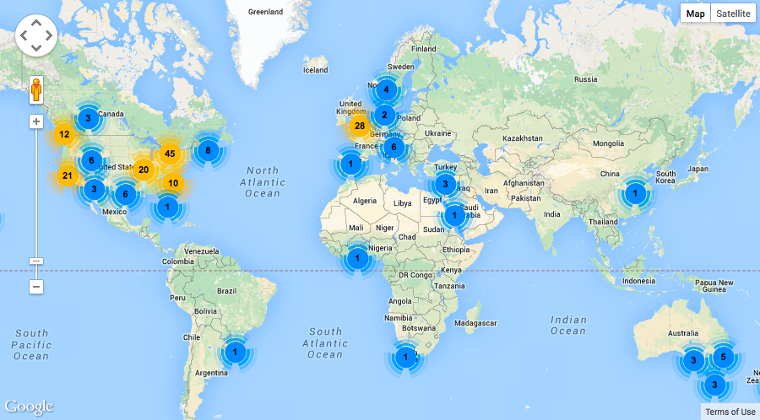
Greg Wilson
Notes:
SWC is becoming a worldwide thing. Since 2012 they’ve run hundreds of 2-day workshops they have a team of hundreds of instructors and reached thousands of learners. Most workshops have been in Europe in the US but they’re spreading.

Slide 5
Lessons Learned
Teaching scientists to compute
Lesson 1:
Most scientists think of programming as a tax they have to pay in order to do science.
Greg Wilson
Notes:
The most important thing these guys have realized, is that most biologists aren’t interested in programming, they aren’t any more excited about programming than they are about statistics. Bioinformaticians and programmers are a bit odd in enjoying it, so geeking out when teaching this stuff and teaching programming for its own sake really loses a general audience. The motivation a biologist has is is that they can do new science with what they learn. Not they become hackers
This is a very important insight. Because if you’re a biologist you’re not going to get a teacher who drags you down into the details and gives you a very pragmatic, results based tutorial

Slide 6
Lessons Learned
Teaching scientists to compute
Lesson 2:
The curriculum is full.
f1000research.com/articles/3-62/v1
Greg Wilson
Notes:
The second inisght is that people are busy, and they don’t know this stuff because they’ve been busy getting an education – it was just a bit different from the one I got.
People tend to agree that computing should be taught as early as possible, in high school or even earlier. But until you can work out what to leave out. Languages? Gym? Maths? Basically, you have a problem, so its probably going to remain a challenge at Undergrad and graduate level for a very long time, and that’s the reality of the situation.
So we know we’re dealing with smart people who just don’t know! Which is important – you’re not going to get a teacher who over-estimates what you should know.
You can see all this in software carpentry’s paper.

Slide 7
Lessons Learned
Teaching scientists to compute
Lesson 3:
We know a lot about how people learn and how to teach them.
Greg Wilson
Notes:
We already know a lot about how people learn and how to teach them.
Most people in science and engineering, tend to dismiss social science research but there is a ton of useful educational stuff that works. And most tertiary education – university level does not take advantage of the things we have learned about teaching.
– its lecture based and biases the success of students who can learn easiest in that particular way. And lectures are entirely predicated on the student having some sort of background in the topic, whether the teacher knows it or not, they’re jargon filled and concept rich so need that to be successful.
Lectures are also definitively non-challenging because they’re one way and when delivered without reinforcement mechanisms, can fail to land as well as you’d hope.
But the truth is, if you’re not confused, you’re not learning much.
Lectures tend to pre-dominate because they’re the easiest for teaching and the least likely to make students feel uncomfortably confused. But we can do better.

Slide 8

Background reading for trainers
Greg Wilson
Notes:
This is a key text for anyone coming from an academic background wanting to start training groups of their peers. Its from a group of workers at Carnegie Mellon university. It’s a key secondary resource: it can help you with things like “do you want to know whether multimedia resources work better than printed ones” Turns out “it depends” this book makes good summaries and leads you back to the primary research on the topic.
If you are teaching this is a really good resource for anyone who wants evidence backed educational decisions. And Its compulsory reading for the software carpentry trainers.

Slide 9
What affects learning?
Effect on teaching/learning speed of classes
http://tinyurl.com/hattie-effect-sizes
Shifting schools: -0.34
Web-based learning: 0.09
Teacher subject matter knowledge: 0.12
Class size: 0.21
Motivation: 0.48
Concept mapping: 0.52
Peer tutoring: 0.55
Formative evaluation for teachers: 0.70
Absence of disruptive students: 0.86
Greg Wilson
Notes:
Here’s a particular highlight,
John Hattie in New Zealand has been doing metastudies of tens of thousands of educational studies over several decades and he looks at effect sizes. Basically a percentage of a standard deviation. And one standard deviation is roughly equivalent to a year grade in North American high schools. Very roughly.
So shifting schools costs about 1/3 of a class year. Web based learning – not worth having. Those of you who have kids in schools that are rushing to buy iPads etc, tell them to stop.
Teacher subject knowledge isn’t so important at school level. Its better to be good at teaching.
Class size in itslef isn’t a much of a problem. Reducing it gets you about a fifth of a year. More important actually is the absence of disruptive students. That includes over eager students who want to get there questions answered. T
More surprisingly important is things like concept mapping, peer tutoring and formative evaluation of teachers. All of which we now absolutely know makes a difference in learning and can put into our training practice. If we want to be effective trainers, we need to really overhaul the lecture/workshop and those dreadful feedback forms we hand out at the end.
And that is what SWC does for your trainers, it helps them to learn to use things like concept mapping, peer tutoring – which uses up the energies of those eager students in a positive way thats beneficial for them, bags of formative evaluation. And this is really important as it energises and engages classes as they learn a brand new practical skill.

Slide 10
Lesson 4:
Most people would rather fail than change.
Greg Wilson
Notes:
Most people would rather ignore what we know than change their working practice or business plan.
Climate change, anyone?
We know all this stuff but its tricky to change institutionally.
We have lots of empirical evidence but we don’t include it often enough. So it can be very hard to make change happen…

Slide 11
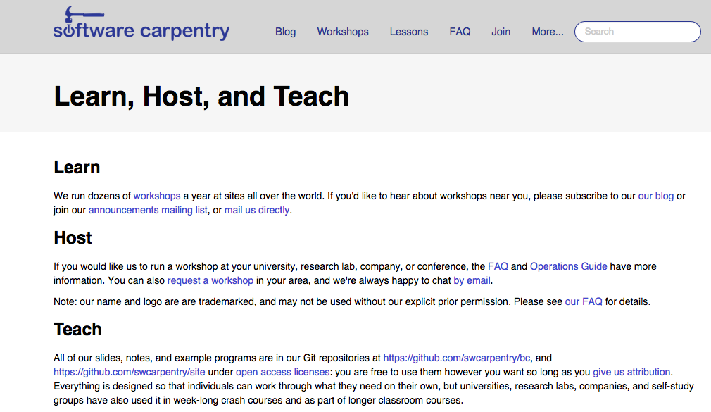
Free and Open Source Learning
http://software-carpentry.org/
Notes:
Software Carpentry really build on these lessons in their workshops and materials. They provide a great deal more interaction and more materials with many useful and motivating examples and ways for the tutor to receive feedback during the lessons and after.
The lessons are live-work, so no lectures up front and very little tedious theory. And work is pair based, so everyone gets a feel for how much everyone else is finding it hard and you can break down the fear of the subject that way
This results in what feels like a very much more successful training exercise.
The best thing about software carpentry is that they are a not for profit organization, you can use and contribute to their materials and lessons. Its Open Source education. They’ll even train you to do training in their way.
You can see lots more on this and get the materials at Software Carpentry’s own site. And you can find a course to go on here too!

