Slide 1

If you build a man a fire, you'll keep him warm for a night.
If you set a man on fire, you'll keep him warm for the rest of his life.
— Terry Pratchett
author of Discworld novels
Notes:
So to steal from the late but wonderful Sir Terry Pratchett, here’s our ethos…

Slide 2

Training
A jump-statrt
Workshops:
Perl, Ruby,
CMD Line,
MySQL,
R + Stats,
Browsers and Desktop tools…
Resource provision:
Workshop notes,
Workshop Podcasts,
Quick ‘How do I’ podcasts
Library
Integration of best practice:
Lab meetings,
Journal Clubs,
Notes:
We set about implementing a training scheme. This was designed to be a jump start into bioinformatics, from the ground up for a novice.
So we built a series of workshops, focusing on introductory topics in the subject, like
Driving the computer through the command line,
Like introductory programming and scripting etc

Slide 3
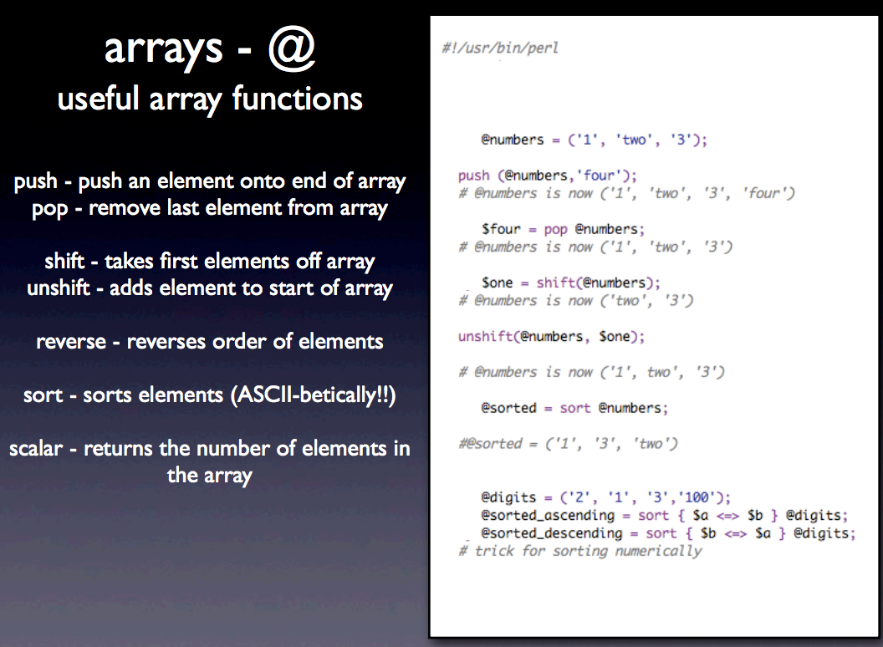
Typical Teaching
Notes:
When we built our training workshops, we took a very naïve approach. We set out and delivered workshops that were essentially lectures, which were supported by slides like this one. It is essentially a list, an instruction manual of commands. And even though our lessons were mixed in with a lot of live practice exercises, the emphasis of the workshop was still very much on the teaching rather than the learning. And that I think was an error we made, I’ll explain more in a few slides.

Slide 4

Lab skills for scientific computing
“We save researchers a day a week for the rest of their careers”
Greg Wilson
Notes:
And it was then that I discovered Software Carpentry. They have the same mission as us, but they go about it in a completely different way than I did instinctively
They teach the boring stuff for science computing that actually works – not the stuff that geeks like me like to enthuse about.
Their tagline is that they Save researchers a day a week for rest of careers
I’d like to tell you a bit about what Software Carpentry have learned about teaching and training and how it helps out with those trying to implement this themselves

Slide 5
A Core Course
Open source lessons in scientific computing
Unix shell
Git / GitHub
Python (or R)
SQL
task automation
tracking and sharing
modularization
structured data
Greg Wilson
Notes:
The hook is that with software carpentry we are teaching the Unix shell, the git / github system for versioning. Python or R and SQL.
The truth is we’re teaching them something more fundamental how to automate repetitive tasks, how to track and share code, how to modularise code. The point is to teach them how to write code that is modular, readable and testable and that those are the same thing. We don’t teach them SQL so they will use databases, but so that they will understand and make better use of structured data and know the difference between structured data and unstructured data .
So it’s a kind of bait and switch, if you tell people you're going to talk about concepts you lose them, but if you tell them you’ll teach a tool they’ve heard of they get more excited and turn up.

Slide 6
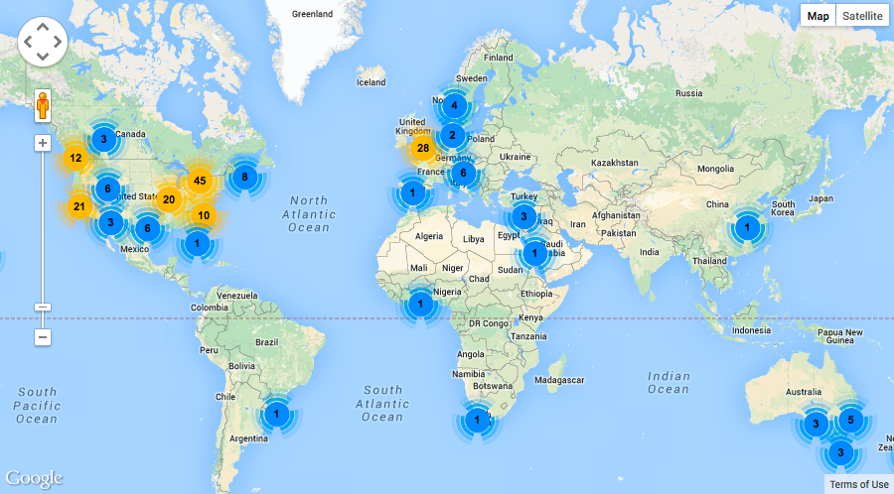
Greg Wilson
Notes:
SWC is becoming a worldwide thing. Since 2012 they’ve run over 200 2-day workshops they have a team of 230 instructors and reached 6800 learners. Most workshops have been in Europe in the US but they’re spreading.

Slide 7
Lessons Learned
Teaching scientists to compute
Lesson 1:
Most scientists think of programming as a tax they have to pay in order to do science.
Greg Wilson
Notes:
The most important thing these guys have realized, is that most biologists aren’t interested in programming, they aren’t any more excited about programming than they are about statistics. Bioinformaticians and programmers are a bit odd in enjoying it, so geeking out when teaching this stuff and teaching programming for its own sake really loses a general audience. The motivation they have is in that they can do new science with what they learn.
This is a very important insight.

Slide 8
Lessons Learned
Teaching scientists to compute
Lesson 2:
The curriculum is full.
f1000research.com/articles/3-62/v1
Greg Wilson
Notes:
People tend to agree that computing should be taught as early as possible, in high school or even earlier. But until you can work out what to leave out. Languages? Gym? Maths? Basically, you have a problem, so its probably going to remain a challenge at Undergrad and graduate level for a very long time, and that’s the reality of the situation.
You can see all this in software carpentry’s paper.

Slide 9
Lessons Learned
Teaching scientists to compute
Lesson 3:
We know a lot about how people learn and how to teach them.
Greg Wilson
Notes:
Humans already know a lot about how people learn and how to teach them.
Most people in science and engineering, tend to dismiss social science research but there is a ton of useful educational stuff that works.

Slide 10

Background reading for trainers
Greg Wilson
Notes:
This is a key text for anyone coming from an academic background wanting to start training groups of their peers. Its from a group of workers at Carnegie Mellon university. It’s a key secondary resource: it can help you with things like “do you want to know whether multimedia resources work better than printed ones” Turns out “it depends” this book makes good summaries and leads you back to the primary research on the topic.
If you are teaching this is a really good resource for anyone who wants evidence backed educational decisions.

Slide 11
What affects learning?
Effect on teaching/learning speed of classes
http://tinyurl.com/hattie-effect-sizes
Shifting schools: - 0.34
Web-based learning: 0.09
Teacher subject matter knowledge: 0.12
Class size: 0.21
Motivation: 0.48
Concept mapping: 0.52
Peer tutoring: 0.55
Formative evaluation for teachers: 0.70
Absence of disruptive students: 0.86
Greg Wilson
Notes:
Here’s a particular highlight,
John Hattie in New Zealand has been doing metastudies of tens of thousands of educational studies over several decades and he looks at effect sizes. Basically a percentage of a standard deviation. And one standard deviation is roughly equivalent to a year grade in North American high schools. Very roughly.
So shifting schools costs about 1/3 of a class year. Web based learning – not worth having. Those of you who have kids in schools that are rushing to buy iPads etc, tell them to stop.
Teacher subject knowledge isn’t so important at school level. Its better to be good at teaching.
Class size in itslef isn’t a much of a problem. Reducing it gets you about a fifth of a year. More important actually is the absence of disruptive students. That includes over eager students who want to get there questions answered.
More surprisingly important is things like concept mapping, peer tutoring and formative evaluation of teachers. All of which we now absolutely know makes a difference in learning and can put into our training practice. If we want to be effective trainers, we need to really overhaul the lecture/workshop and those dreadful feedback forms we hand out at the end.

Slide 12
Lesson 4:
Most people would rather fail than change.
Greg Wilson
Notes:
Most people would rather ignore what we know than change their working practice or business plan.
Climate change, anyone?
We know all this stuff but its tricky to change institutionally.
We have lots of empirical evidence but we don’t include it often enough. So it can be very hard to make change happen…

Slide 13
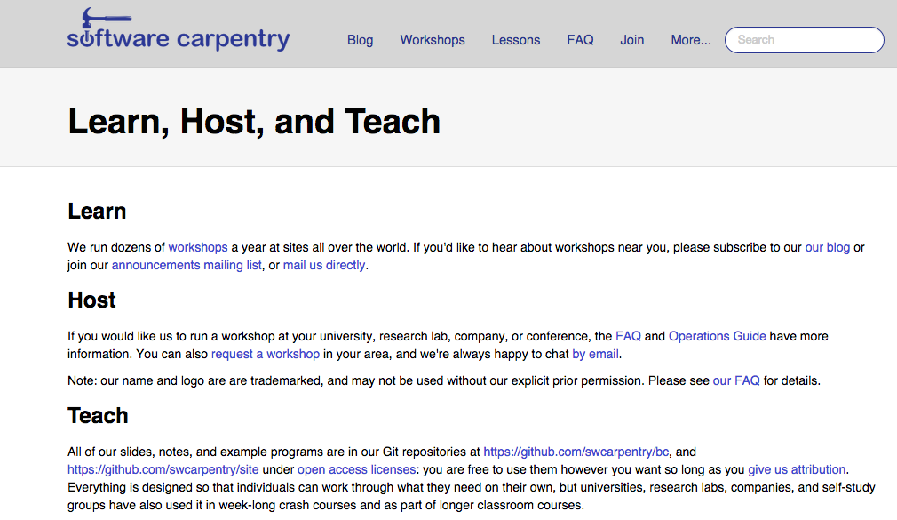
Free and Open Source Learning
http://software-carpentry.org/pages/training.html#teach
Notes:
Software Carpentry really build on these lessons in their workshops and materials. They provide a great deal more interaction and more materials with many useful and motivating examples and ways for the tutor to receive feedback during the lessons and after.
The lessons are live-work, so no lectures up front and very little tedious theory. And work is pair based, so everyone gets a feel for how much everyone else is finding it hard and you can break down the fear of the subject that way
This results in what feels like a very much more successful training exercise.
The best thing about software carpentry is that they are a not for profit organization, you can use and contribute to their materials and lessons. Its Open Source education. They’ll even train you to do training in their way.
You can see lots more on this and get the materials at Software Carpentry’s own site.
So this has become the new basis for our training, we have become qualified Software carpentry instuctors and we do think that it is working and I’d like to show you some of the fringe benefits me and my team and my department have discovered by implementing a supportive training scheme.

