Slide 1
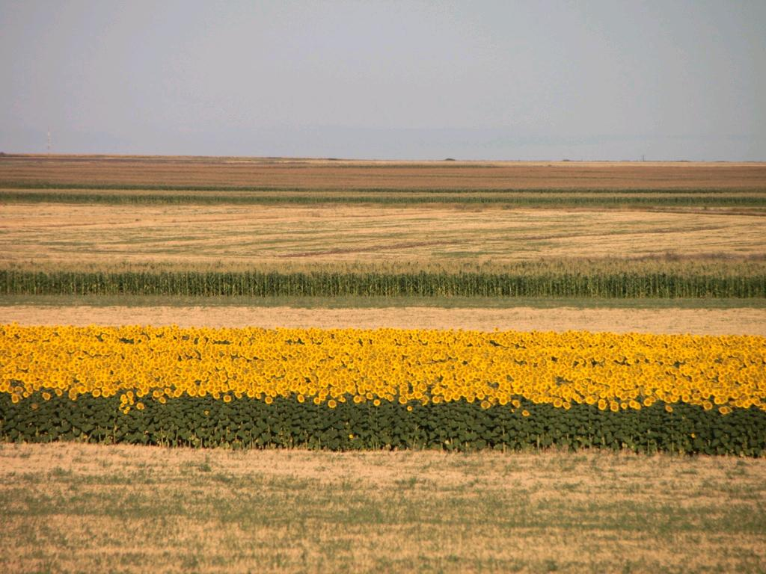
Putting drones to work
What tech can help with plant health now?
dan.maclean@tsl.ac.uk
@danmaclean
cc: Public Domain Photos - https://www.flickr.com/photos/28958738@N06
Notes:
Good morning everyone. So my name is Dan MacLean and I work at The Sainsbury Laboratory (TSL) which is about 200m that way on this site And today, Im going to talk about the off the shelf, consumer level products and options that are available for you to construct and run a useful drone in your particular use case At TSL we work on plant and micro-organism interactions.

Slide 2
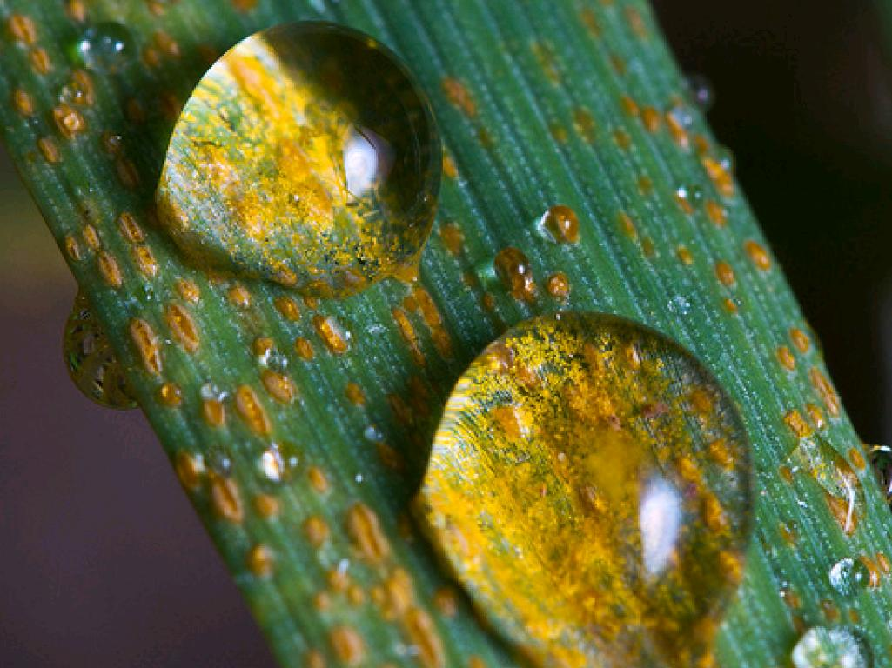
The Sainsbury Laboratory
Plant Microbe Interactions
cc: CIMMYT - https://www.flickr.com/photos/44760652@N05
Notes:
In particular we carry out fundamental research for plant diseases caused by bacteria, fungi and similar micro-organisms. But importantly we're involved in not just understanding what's happening in diseases but in developing new ways of defeating and resisting disease from the plant side of the equation. A lot of the diseases we work on are crop disease - including the stripe rust on wheat you see here, but also potato blight and others.

Slide 3
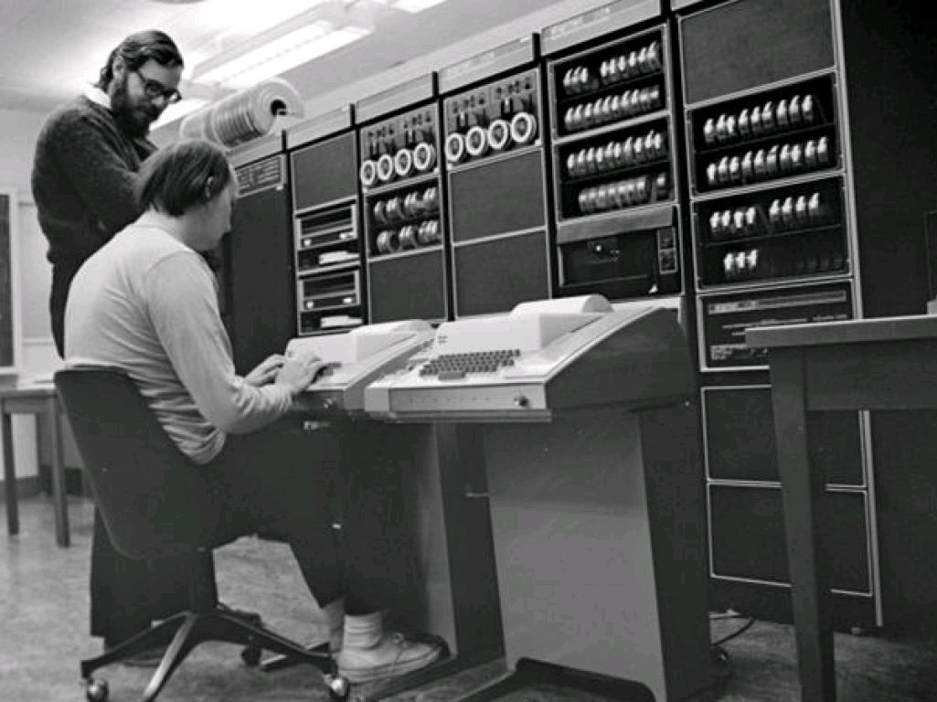
Computational Biology - Genes to Whole Plants
Notes:
And my role at TSL is to run a department called Bioinformatics. Bioinformatics is basically what it sounds like - its the use of computer science and computational techniques to answer biological questions. Often this will be things like using computer power to churn through gene data. Through genetic data that tells us about the tiny differences in the massive genetic code that makes up the instructions for a plant - with the hope that we're going to find the ones that make a plant more resistant than another.

Slide 4
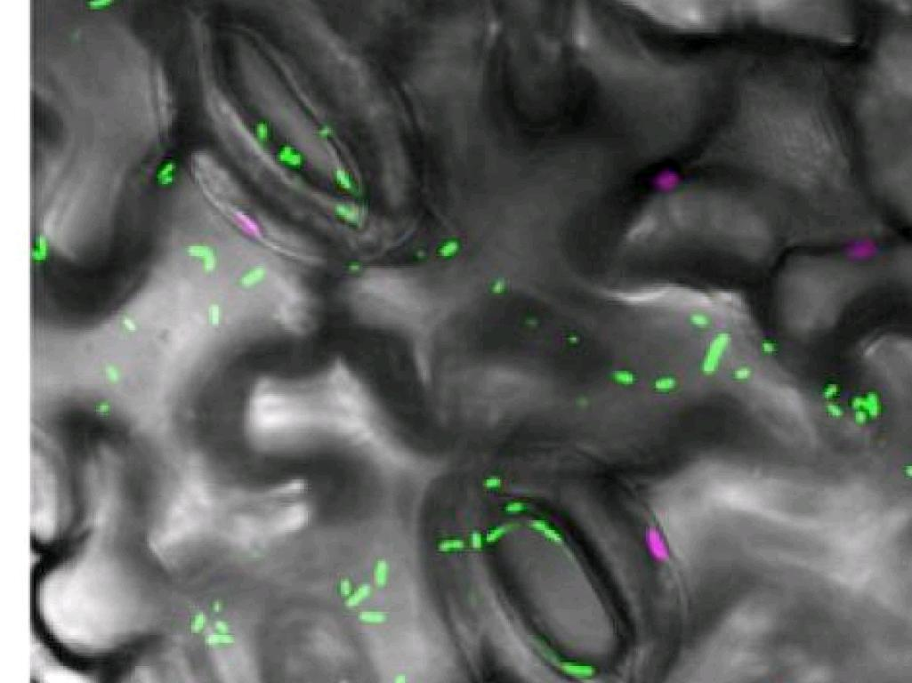
Computational Image Analysis
Image Courtesy of Prof Silke Robatzek, TSL
Notes:
Often though we will study image data - usually this will be images from expensive high power microscopes - like this one, which is showing the leaf cells (the ones that look like jigsaw pieces) and the open pores in the leaf (the rugby ball shaped ones). And we might be trying to watch the entry of disease causing bacteria the bright green blobs and the path they make through the leaf. So we'd need to take thousands of images taken fractions of a second apart and track from the blobs from image to image to work out what’s going on. Now, that's a long and involved process, but I would like to touch on the basics of image analysis because it has some bearing on image acquisition - the two are different sides of the same coin and when I want to talk about the tech in a minute it makes the choices you have a lot more clear.

Slide 5
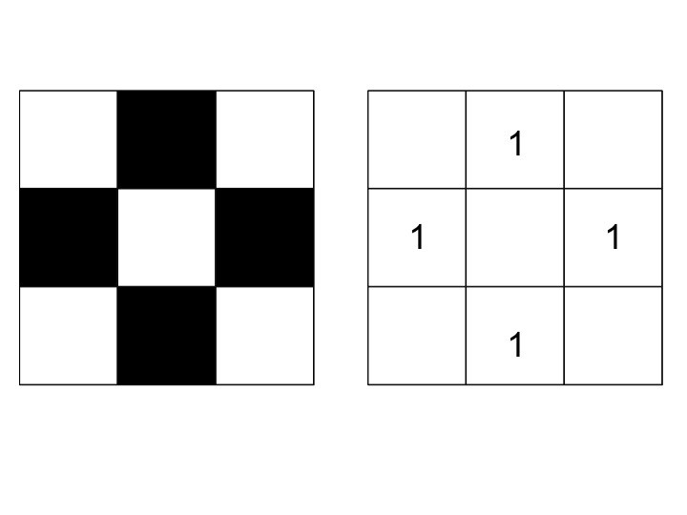
Images are grids of numbers
Notes:
An image on a computer, a digital or a digitized image is basically just a big grid of tiny squares - pixels - you'll have seen this if you've ever zoomed in really far. The encoding of the image, the way it is stored, is basically just as a grid of numbers - with a number for colouring in the square, so here a 1 for on (or colour in) so we can put together a basic black and white picture just from the grid

Slide 6
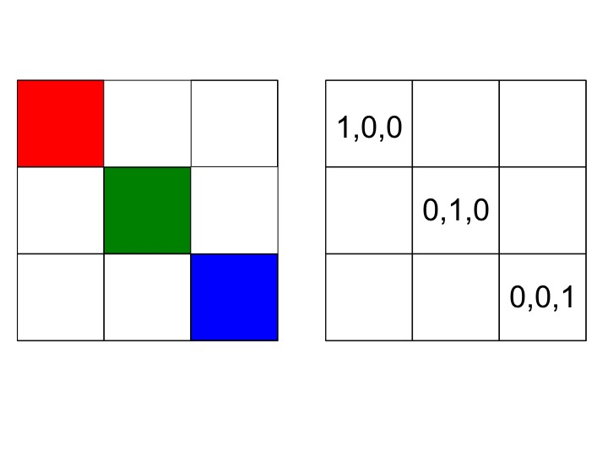
Images are grids of numbers
Notes:
The colour information comes from the way display equipment works. TVs and screens can mix Red, Green and Blue light in each square of the grid, so for each pixel we need three numbers - one for each colour, so here we have a red pixel with the red number set but the others off and so on…

Slide 7
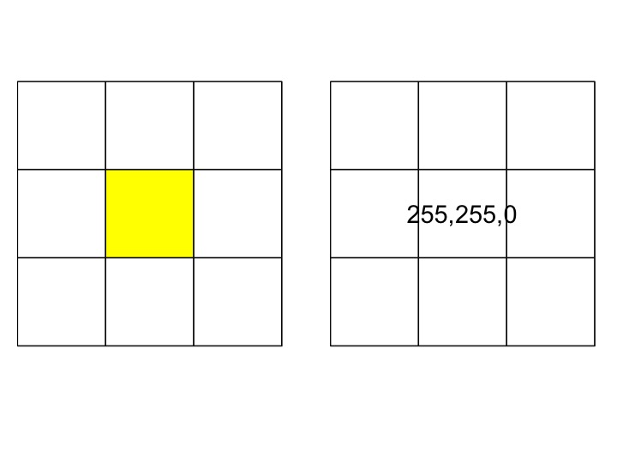
Images are grids of numbers
Notes:
And by going higher than 1 for each colour we can create many gradations and mixings of colours. We use up to 255 for each colour, and for example turning on the Red and Green and turning off the blue gives us yellow.

Slide 8
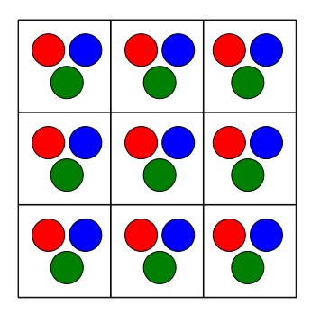
Cameras translate light into grids of numbers
Notes:
And modern digital camera equipment is the exact flipside of this system. The sensor is again a grid of picture elements, but each one has 3 tiny light sensors for Red, green and blue. And each one saves a measure of the strength of light as a number. and the resulting image is therefore actually a readout for different strengths of different wavelengths of light.
And the point of this is that pretty much any digital camera is a light sensor array that works in multiple spectra of light.
Including Infrared. .The sensor of a digital camera by itself can read infrared, though most manufacturers stick in a layer of plastic that deliberately filters infrared out.
And this is really useful for measuring plant health because of a quirk of how healthy plants absorb visible light and even generate some infrared

Slide 9
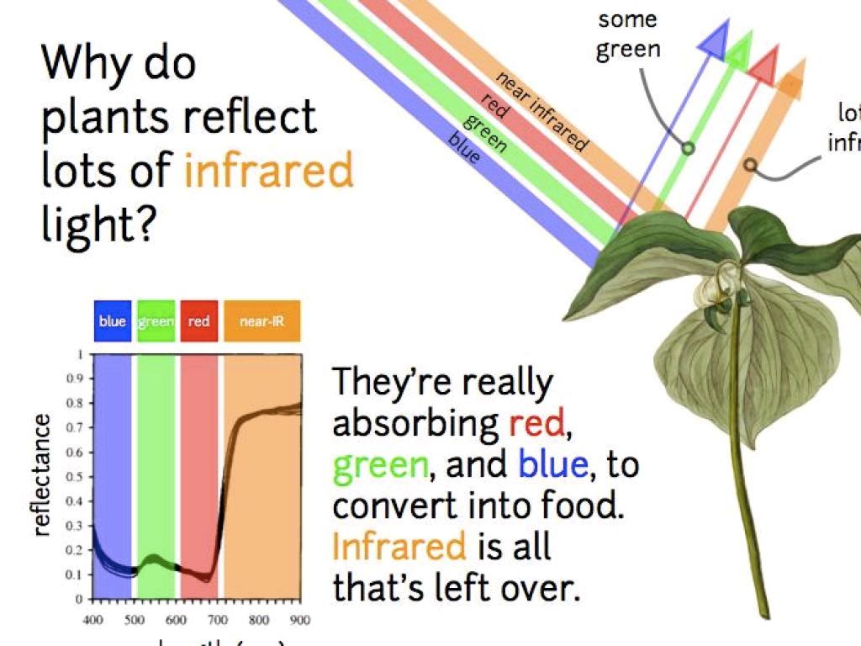
Notes:
Because when the plant is growing well and photosynthesis is going well there is a large absorption of the visible parts of the spectrum. With infrared left over.
Basically we see a green plant because the blue and red – and in fact most of the green is absorbed by photosynthetic light capturing apparatus – the photosystems, and what is reflected is mostly green. And almost all the infrared comes back – though we can’t see that. The amount of infrared that bounces back is also increased when the plant is in high light or doing really well. The plant often cant use all the red green and blue light energy the photosystems have already converted, so photosynthesis has a kind of overflow that lets that energy go as heat and thermal infrared light.
So all this boils down to is that light reflected from a healthy plant has a greater proportion of infrared than that from an unhealthy plant and that’s a difference we can take advantage of

Slide 10
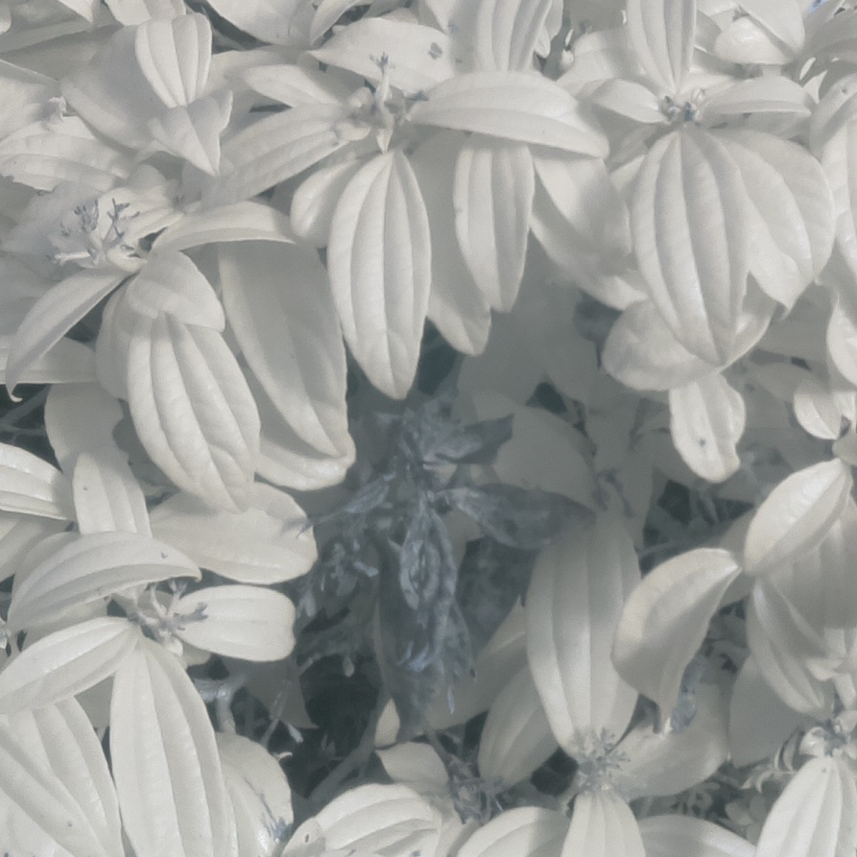
Notes:
This is an infrared image of some plants in just outside my office. Is was a bright day, the plants are growing pretty well and theyre nice and bright in the infrared channel so Its pretty easy to see which is the dead one.
...But don't we need a lot of expensive kit to capture and then analyse that light?

Slide 11
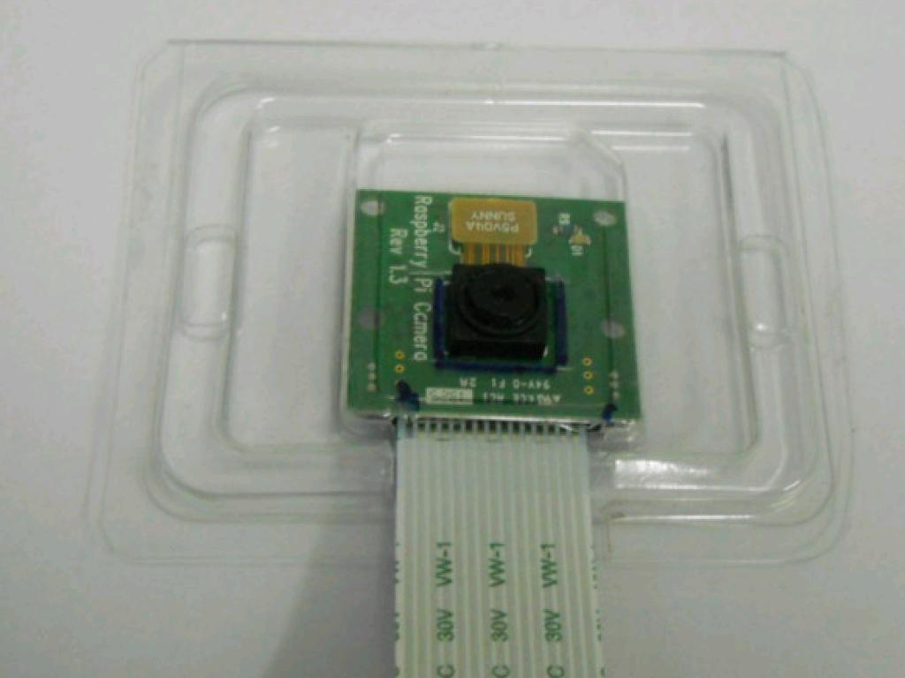
Cheap Available High Street Hardware
cc: xmodulo - https://www.flickr.com/photos/91795203@N02
Notes:
Actually, no! As I said, pretty much any digital camera is capable of capturing light in the useful infrared. Even down to the level of the ones you get in mobile phones. The problem with most consumer cams is the plastic infrared filter that needs removing. But you can get cameras without, one like this is £20. From places like Amazon, or Maplin on the high street.

Slide 12
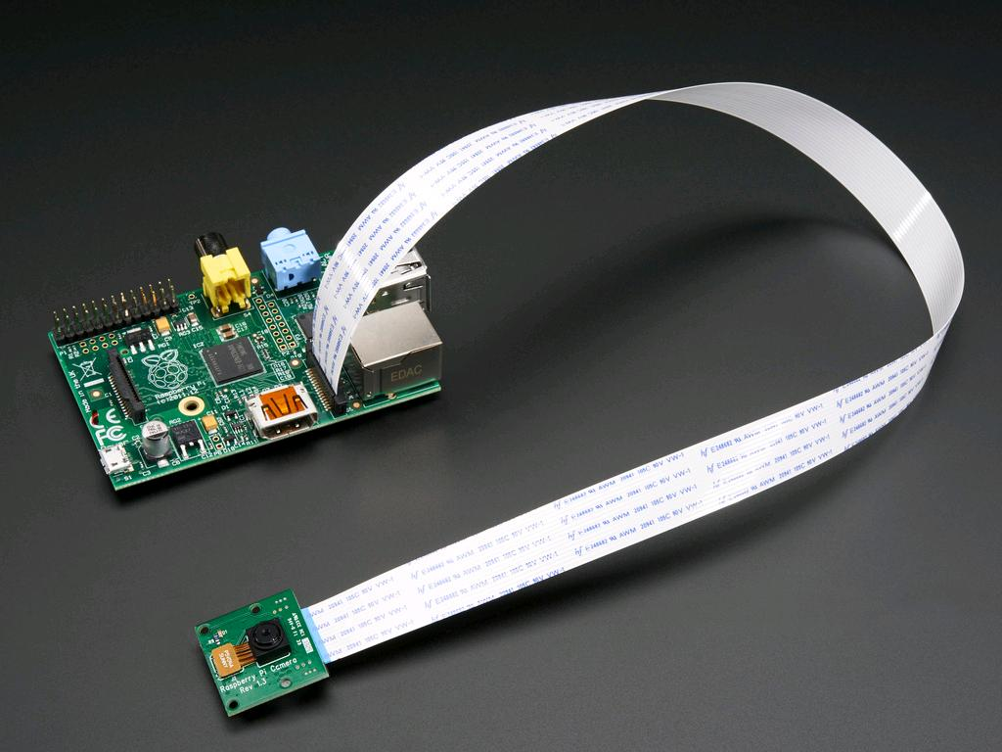
cc: adafruit - https://www.flickr.com/photos/35434449@N08
Notes:
You can connect these cameras up to tiny little computers to control the taking and timing of the pictures.

Slide 13
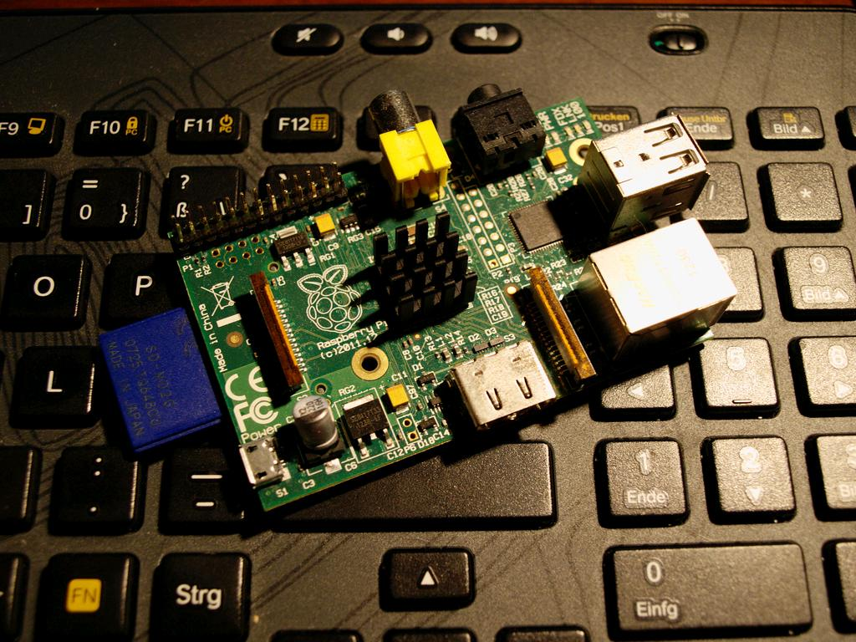
Raspberry Pi
And Arduino and more...
cc: Fabian-Horst.de - https://www.flickr.com/photos/99714066@N05
Notes:
And these computers like the Raspberry Pi are great. They're cheap at about £30. They're fully equipped with ports for USB, HDMI, other video and ethernet, they'll run off batteries or a mobile phone charger, and the hard drive is an SD Memory card. They're pretty powerful too, about as powerful as a 10 year old highend laptop but with massively better graphics capabilities - they have a dedicated graphics unit built in, which takes a lot of work away from the central processor and saves a lot of work

Slide 14
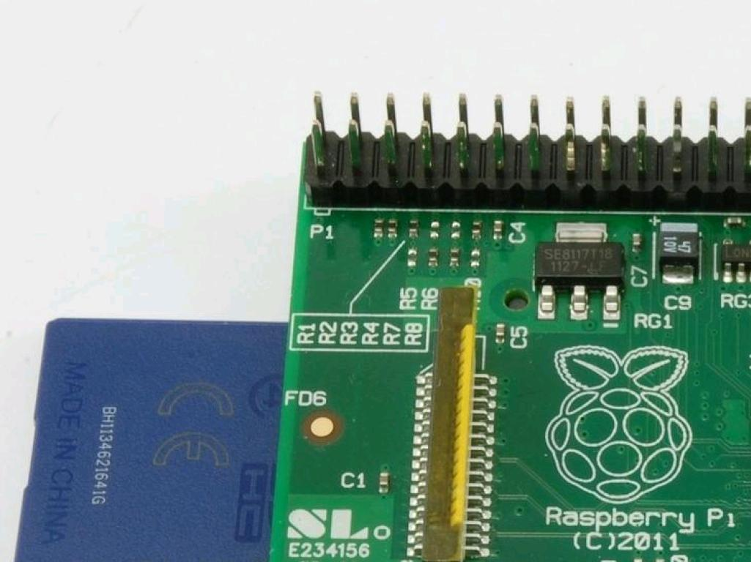
Programmable Pins
Notes:
And every Raspberry Pi has this bank of completely programmable pins. The user can program these things to turn on and off at will, allowing you to develop all sorts of interfaces with external hardware and sensors. You don't need a special plug, you can just wire straight to the pins if you need to, so its a completely extensible platform for cheap tech prototyping and development. And people have gone crazy with these things...

Slide 15
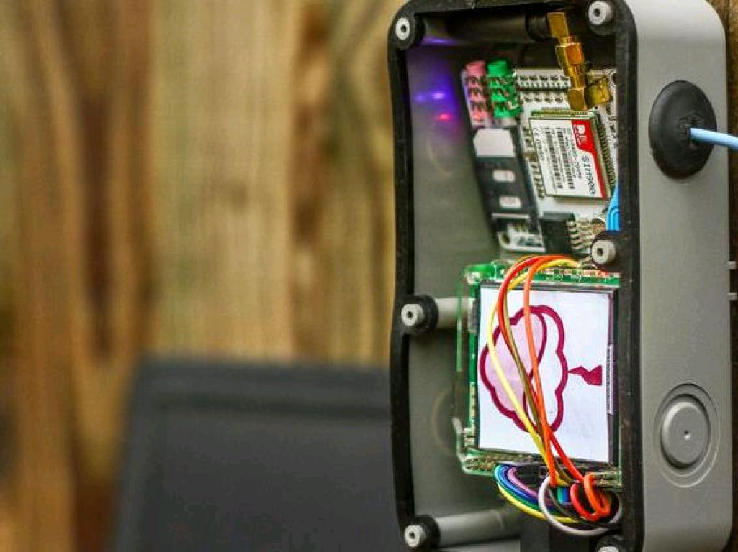
Notes:
This is a Raspberry Pi weather station in someones yard, complete with touch screen interface. They have stuck a range of sensors around the garden and wired them up to the Pi which coordinates the collection of data and produces reports

Slide 16
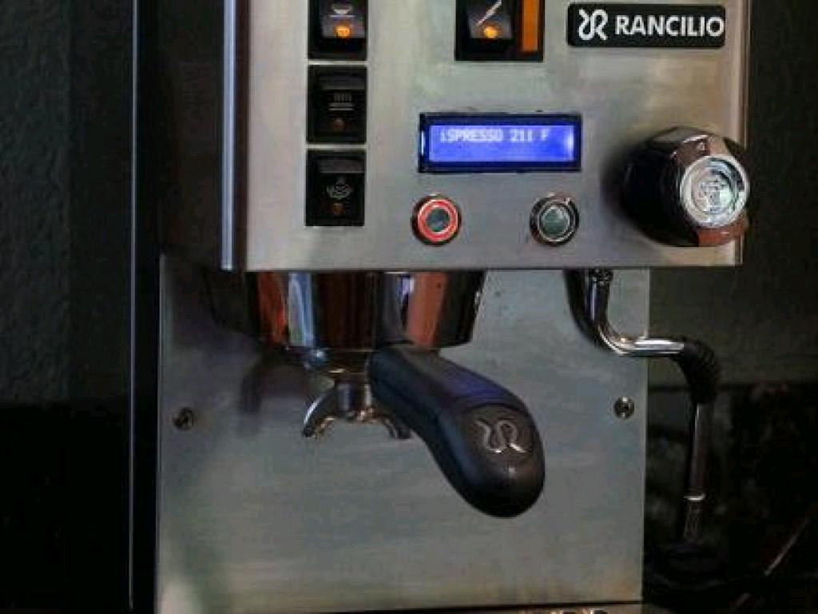
Notes:
This is someone's home built espresso machine, the core computational bit is the Raspberry pi and it controls the water heaters, dispensers and nozzles etc.

Slide 17
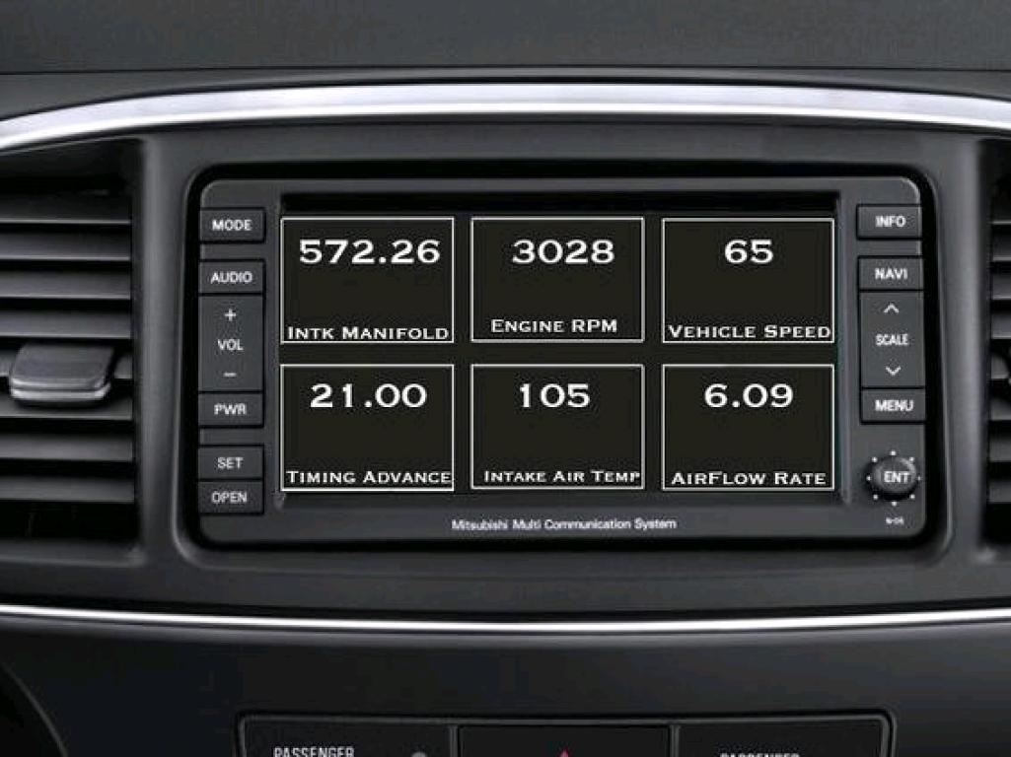
Notes:
Someone else has replaced their in car computer with one they engineered to better monitor engine performance etc.

Slide 18
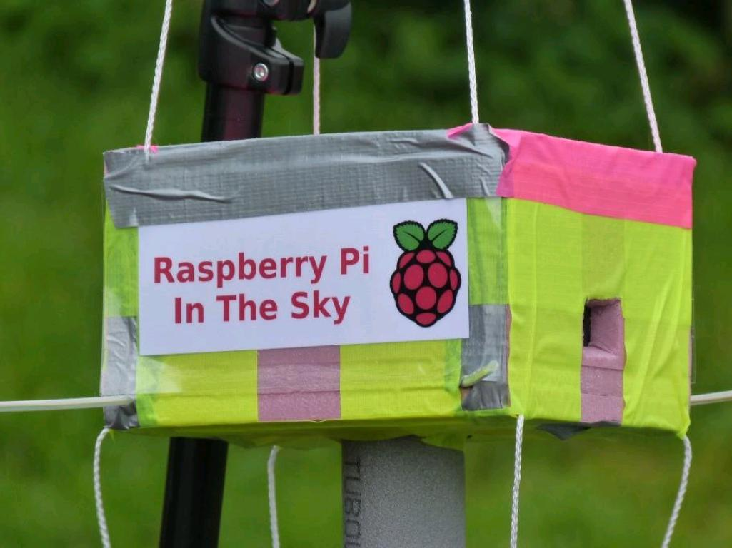
Notes:
My favourite is this one, Its a Raspberry Pi, hooked up to a load of environmental sensors and secured in a big foam box, with a battery.

Slide 19
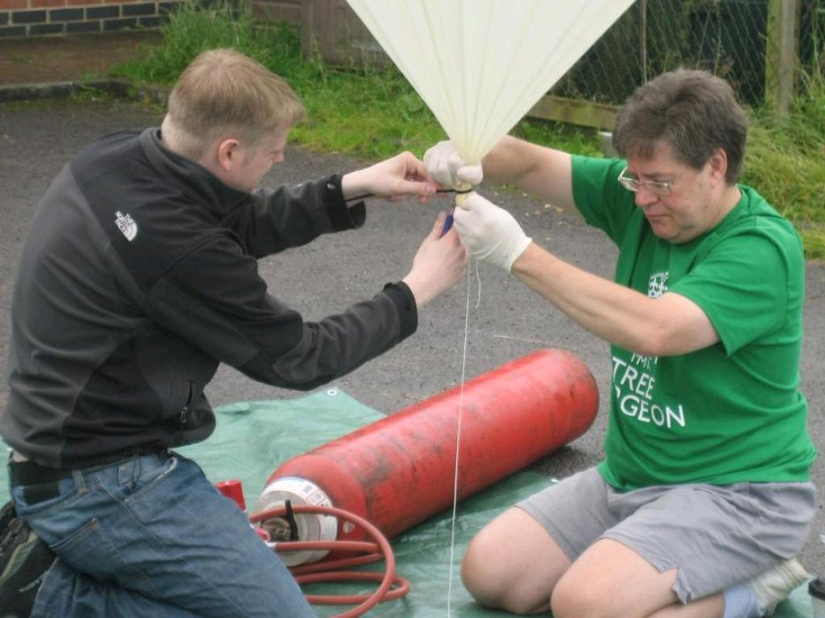
Notes:
Then it was attached to a weather balloon and launched up to the edge of space, taking pictures and readings all the way. And this isn't something you need loads of tech experience to do. You don't need to be an IT person to do this ...

Slide 20
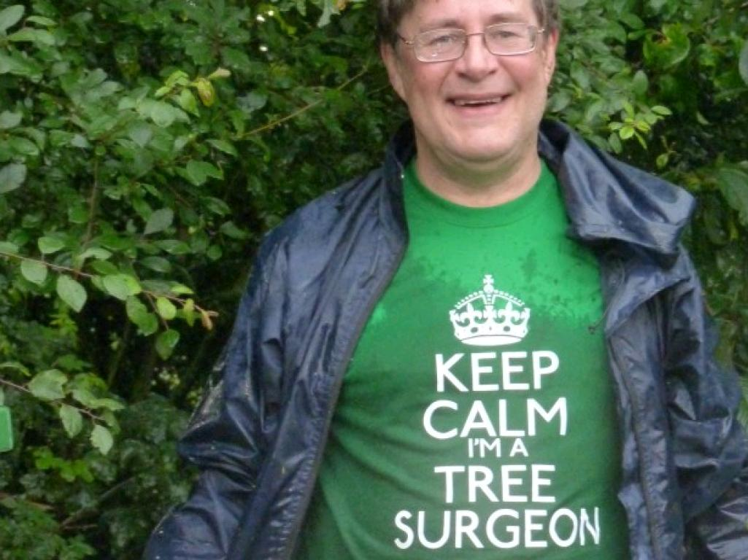
Notes:
The guy with the weather balloon is a tree surgeon and he makes use of this sort of setup and does it himself. The point being that these computers and technology are consumer oriented devices, with the express design of being extended and used by anyone. They were designed as an educational tool so aren’t massively complicated.

Slide 21
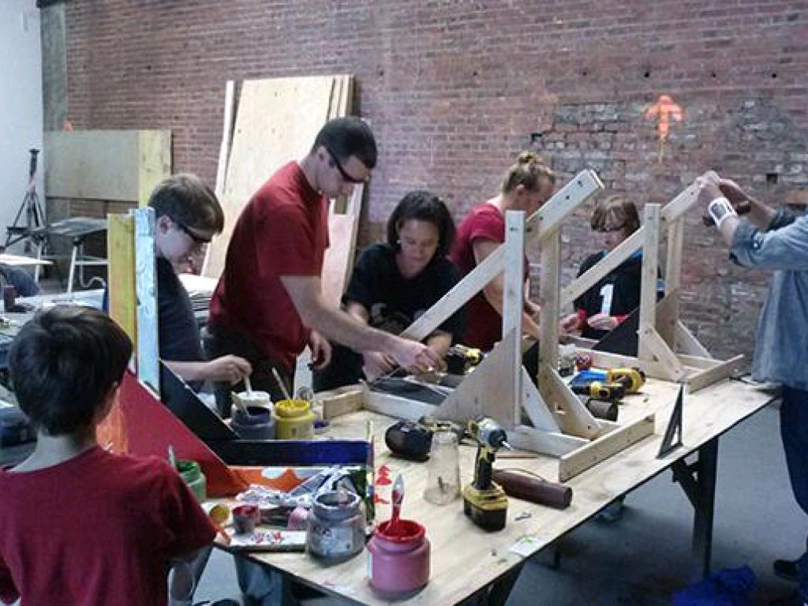
Pop Up Workshops
Maker/Hackspaces
Notes:
And if you're thinking thats all very well but what am I supposed to do - I don't have a tech background or know how to program, then you're not alone. There is a growing group of people who are coming together to share their knowledge and experiences for free, for the love of it all over the world. Including the East of England!
They're calling themselves Makers, and they convene local clubs and work areas called maker spacers or hack spaces. This is one. Typically these will have all sorts of kit to make stuff with, so electronics benches, 3d printers, computerised routers etc. The people are usually really friendly and helpful. They can often have very diverse goals and like a good challenge. The mix of people is usually very broad, you get kids with school projects working with PhD level physicists and in these places or people looking to make their next piece of home art on a 3D printer working with engineers. Its often a very educational mix. There are local ones in Norwich, they meet on Monday and quite a big one in Cambridge.

Slide 22
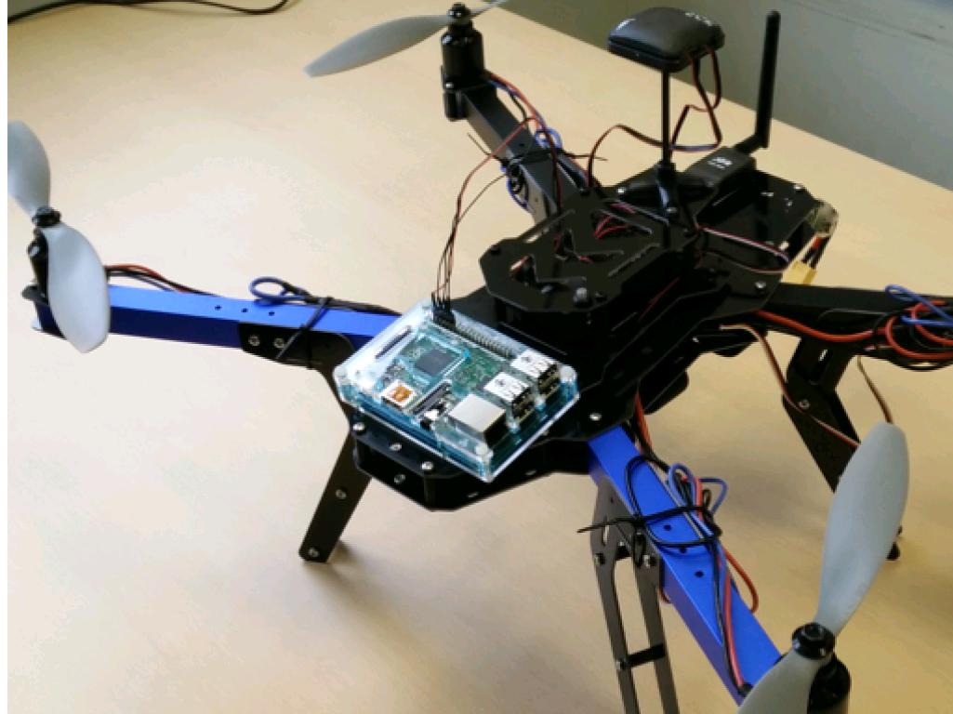
Consumer Quadcopters
Cost Effective and Flexible
Notes:
And its at this sort of level that my work comes in
We've been working on combining these consumer level computer and cameras with an eye on helping our plant disease interaction research. Sometimes this is for lab based stuff, so in controlled growth rooms but also we are trying to push this into the research field plots that we have. And this means having some sort of mobile platform, For us this is consumer quadcopters and GPS systems that we can hack. You can see here a quadcopter from a kit, a 3D Robotics Quad kit - to be precise, which costs about £500. It carries GPS modules, telemetry and here on the front we’ve stuck a Raspberry Pi. The Quad is autonomous, there's laptop software so that you can program the onboard GPS with a flightplan and just let it off. Alternatively you can fly it with a remote.

Slide 23
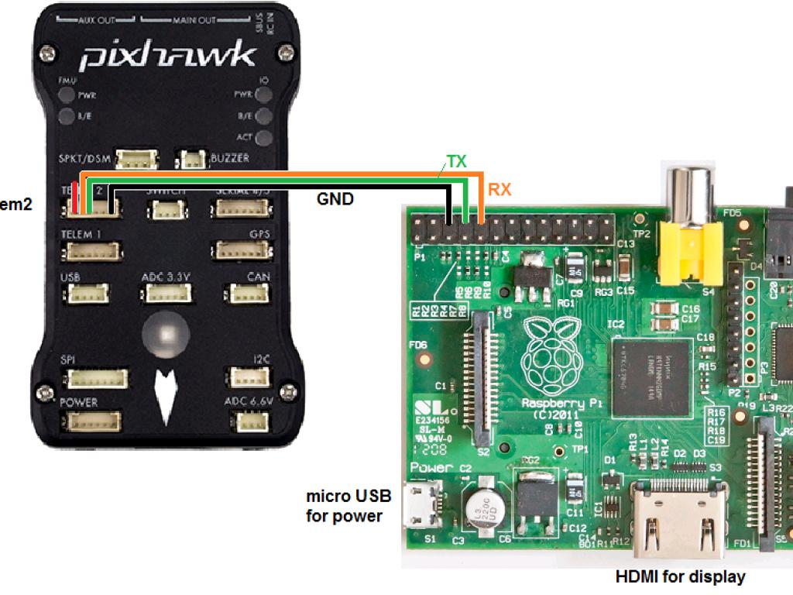
Notes:
And the GPS unit the PixHAwk, which is about £155 can talk directly to the Pi. So the copter can reach a way point and send a signal to the Pi that its time to perform an operation, like taking a picture or a reading or something. So for about £700 or so you can build custom extensible drone solutions that you can tailor to your needs. And that is the basis of a hackable open source remote sensing platform.
Of course, just being able to fly and take some pictures does not lead to added research, or indeed agricultural value. The harder part is the analysis and interpretation of the images.
Sometimes simple visual inspection of the pictures you take can be very informative.

Slide 24
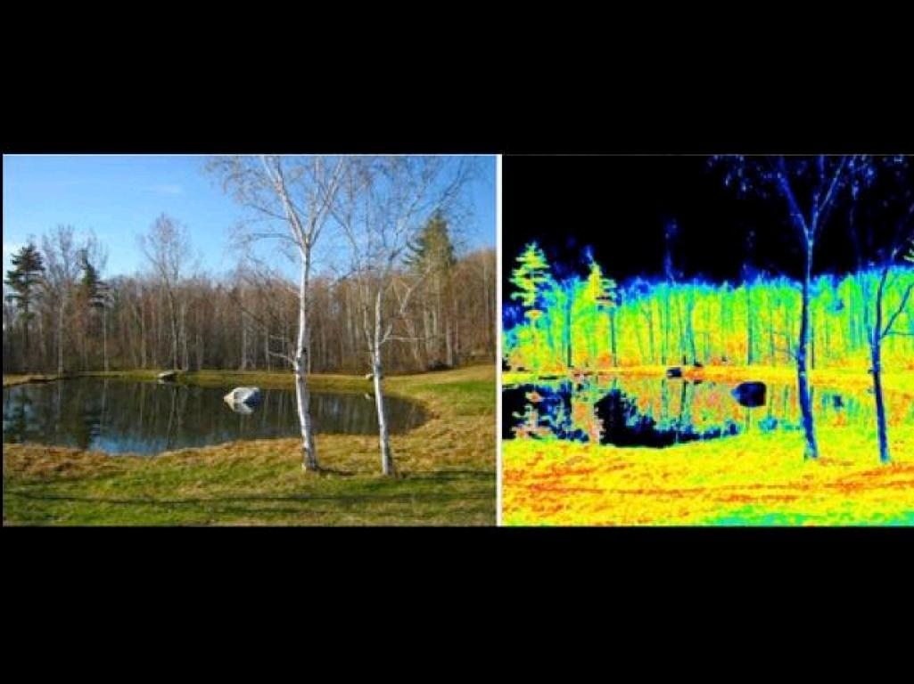
Infragram.org
online image processing
Notes:
Free, open services on the web like Infragram can help you deal with the images you can collect. On this website you can take your infrared image and scale and transform the numbers in it to highlight the photosynthetically active bits, so the healthy plant bits. This lovely scene here pictured in visible light on the left has been taken in infrared and put through infragram. As you can see in this picture any non leafy bits show up dead dark

Slide 25
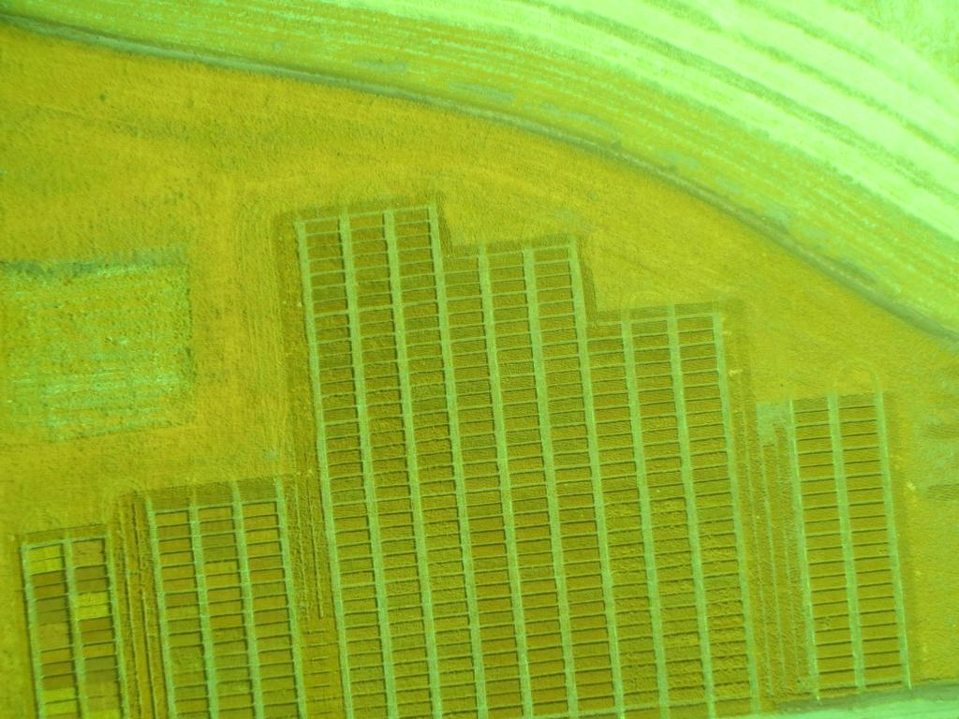
InfraGram.org
Notes:
So you can go from a murky aerial shot of a field like this one

Slide 26
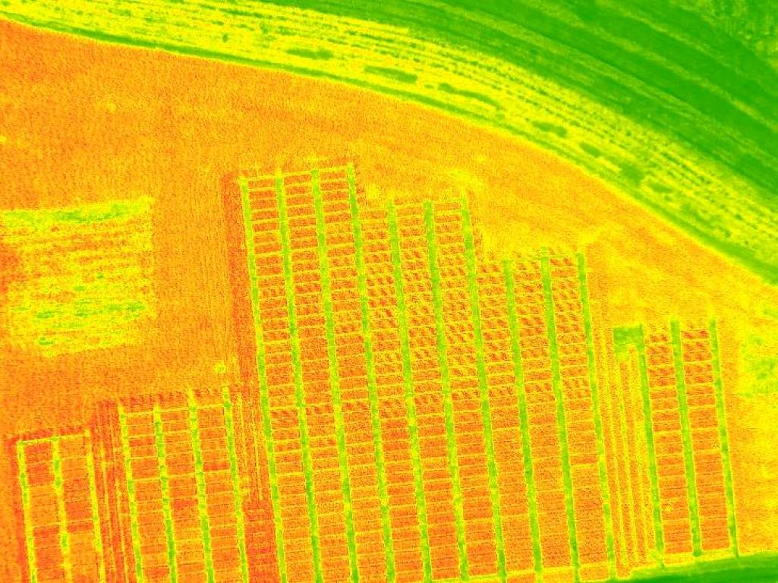
InfraGram.org
Notes:
To a scaled one showing in nice bright colours the healthy bits and the less healthy bits as darker patches, with much better contrast and better discoverability. All this in a few clicks. And infragram is a really brilliant service for light use, for analysing a couple of pictures a week or something.
But for us as researchers, we need something a bit more high throughput and the bulk of my groups work comes into making those high throughput image analysis pipelines.

Slide 27
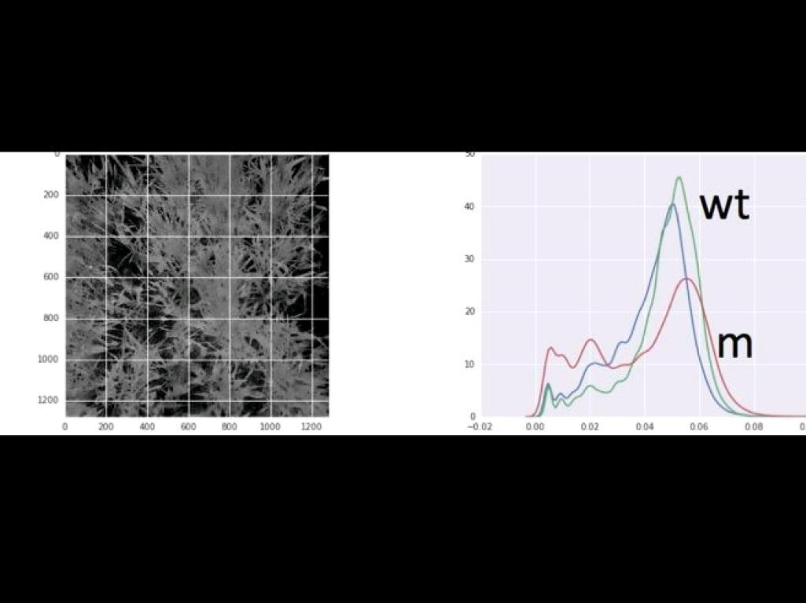
Our Work
Whole/Sub-Field Status Analysis
Notes:
so as an example we've been taking images of wheat lines like this one and using those image methods to quantify photosynthetic capacity well enough to compare within plots. In this image the wheat lines are planted in vertical lines, so we can look at the infrared coming off certain sections of the image corresponding to the lines and make plots like this of infrared enrichment. So in the graph on the right we can see that the plants in the left and centre of the picture have a strong infrared component – the strong blue and green peaks, whereas the plants in the right of the picture shown by the red peak in the graph are reflecting less infrared, so have a weaker peak.
And this sort of analysis over images taken in time courses in a growing season on smallish plantings is the basis of the technology what we try to implement

Slide 28
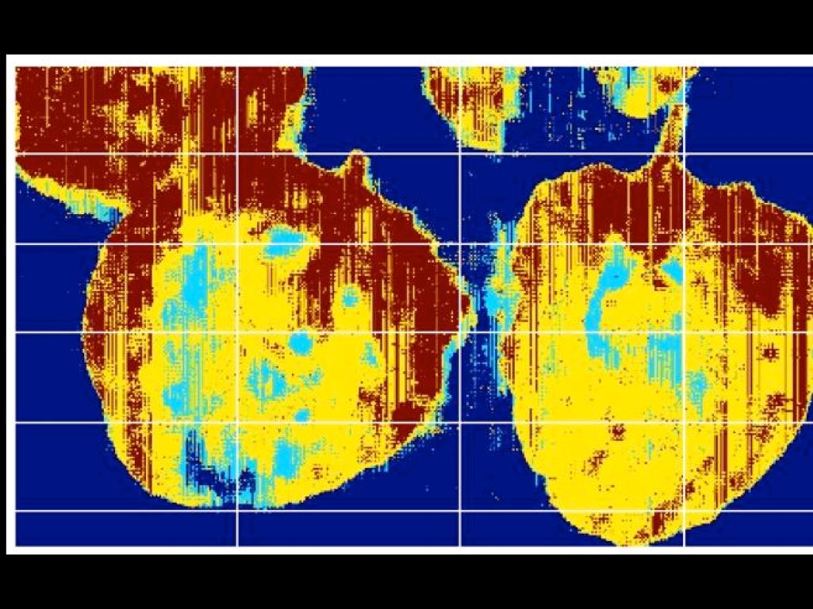
Leaf level disease detection
Notes:
And also we're getting down to the leaf level. This is an in-lab proof of principle shot measuring disease progression in some infected potato leaves. The red bits are the uninfected tissues and the yellow bit and blue bits are dead or dying off – and we hope that we’ll be able to bring together disease lesion detection for monitoring existence and progression of disease in research labs. But there’s also potential in this sort of thing as a disease detector in the field, Consider having the drone and Raspberry Pi combination I’ve shown take off each afternoon and scan a field and highlighting potential disease lesions on crops – then simply emailing you the pictures for a human verification. That sort of thing is doable right now. The overall aim with this project in my group is to try and bring the open source image analysis and hardware options together and develop them into workable open source solutions for common agricultural and research applications. We believe a lot can be accomplished with a little, particularly if you have some niche or developmental requirments.
And that is all I wanted to say.

Slide 29


Acknowledgements
Martin Page
Cristobal Uauy
Phillipa Borrill
Alex Webb
The Sainsbury Laboratory
dan.maclean@tsl.ac.uk
@danmaclean

