Slide 1
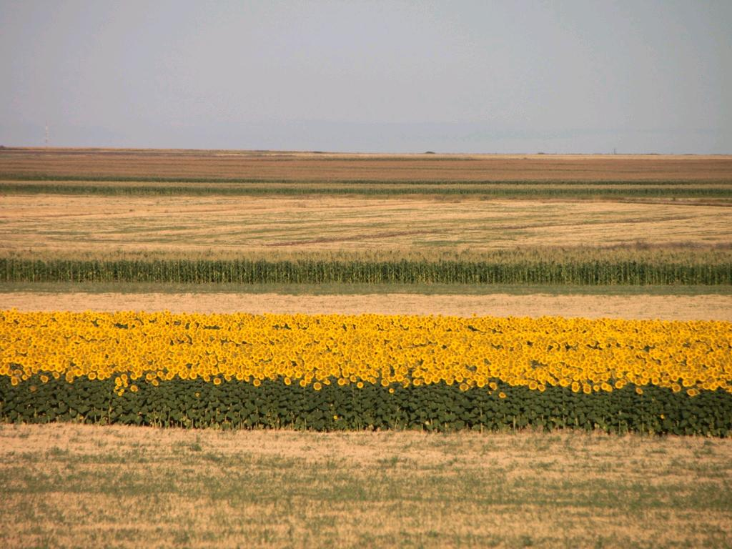
Putting drones to work
What tech can help with plant health now?
dan.maclean@tsl.ac.uk
@danmaclean
cc: Public Domain Photos - https://www.flickr.com/photos/28958738@N06
Notes:
Good morning everyone. So my name is Dan MacLean and I work at The Sainsbury Laboratory (TSL) which is about 200m that way on this site And today, Im going to talk about the off the shelf, consumer level products and options that are available for you to construct and run a useful drone in your particular use case At TSL we work on plant and micro-organism interactions.

Slide 2
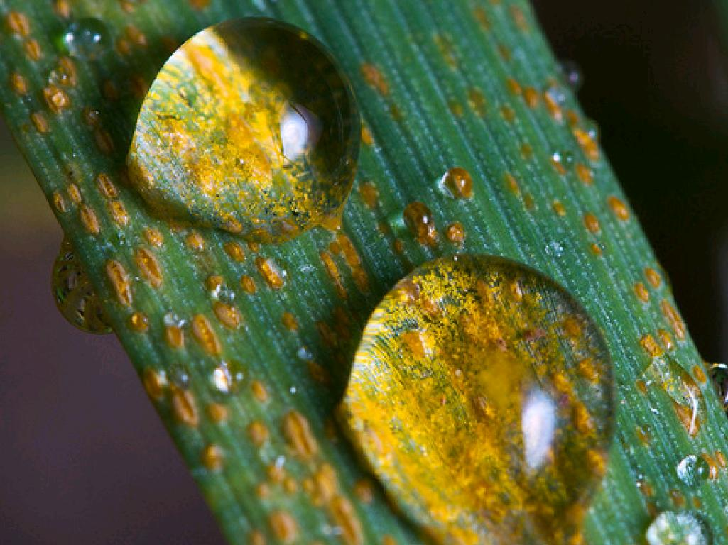
The Sainsbury Laboratory
Plant Microbe Interactions
cc: CIMMYT - https://www.flickr.com/photos/44760652@N05
Notes:
In particular we carry out fundamental research for plant diseases caused by bacteria, fungi and similar micro-organisms. But importantly we're involved in not just understanding what's happening in diseases but in developing new ways of defeating and resisting disease from the plant side of the equation. A lot of the diseases we work on are crop disease - including the stripe rust on wheat you see here, but also potato blight and others.

Slide 3
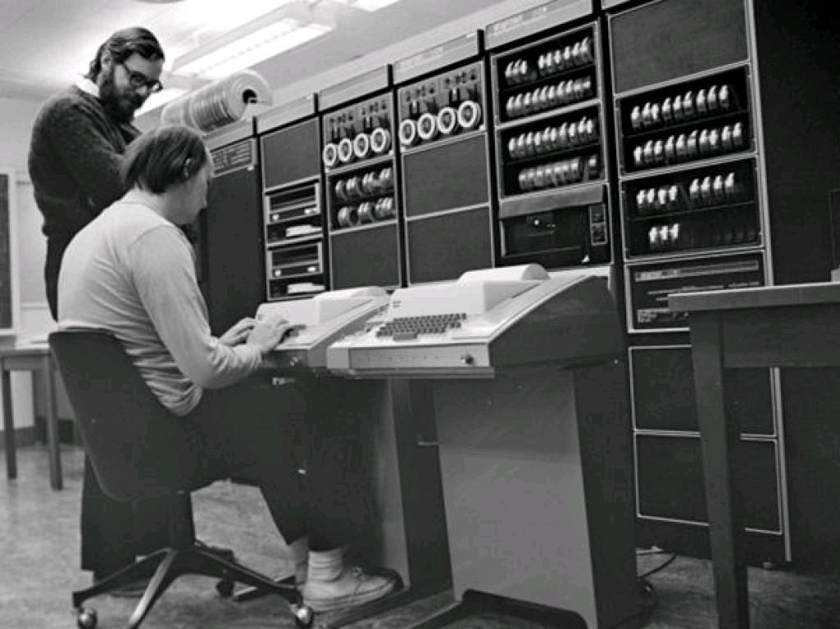
Computational Biology - Genes to Whole Plants
Notes:
And my role at TSL is to run a department called Bioinformatics. Bioinformatics is basically what it sounds like - its the use of computer science and computational techniques to answer biological questions. Often this will be things like using computer power to churn through gene data. Through genetic data that tells us about the tiny differences in the massive genetic code that makes up the instructions for a plant - with the hope that we're going to find the ones that make a plant more resistant than another.

Slide 4
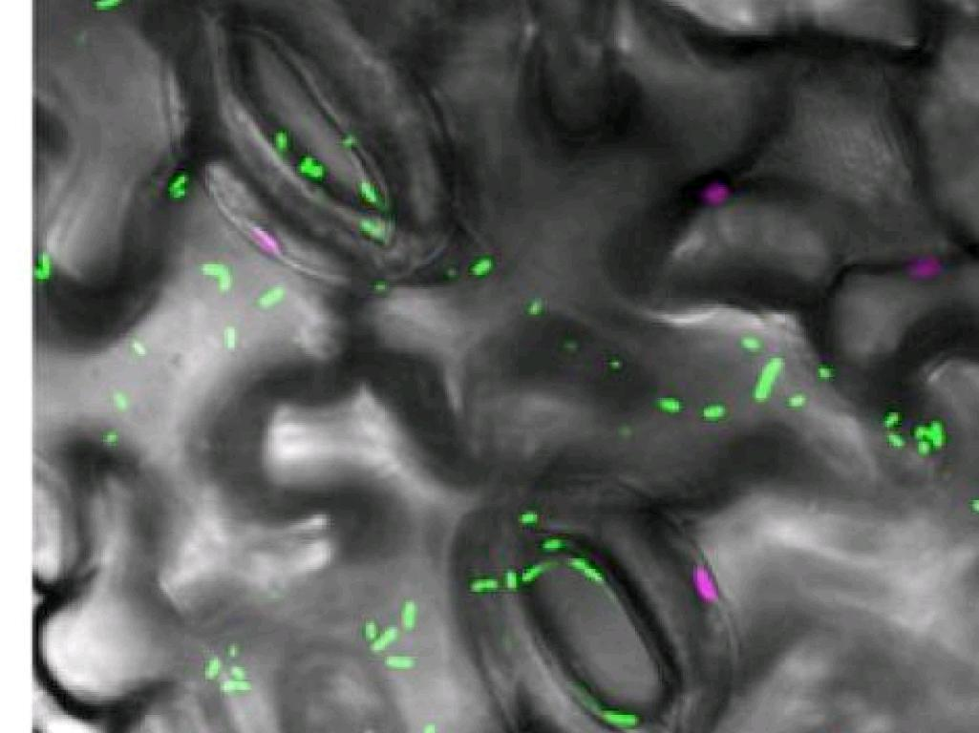
Computational Image Analysis
Image Courtesy of Prof Silke Robatzek, TSL
Notes:
Often though we will study image data - usually this will be images from expensive high power microscopes - like this one, which is showing the leaf cells (the ones that look like jigsaw pieces) and the open pores in the leaf (the rugby ball shaped ones). And we might be trying to watch the entry of the bright green blobs - disease causing bacteria and the path they make through the leaf. So we'd need to take thousands of images taken fractions of a second apart and track from image to image the blobs. Now, thats a long and involved process, but I would like to touch on the basics of image analysis because it has some bearing on image acquisition - the two are different sides of the same coin and when I want to talk about the tech in a minute it makes the choices you have a lot more clear.

Slide 5
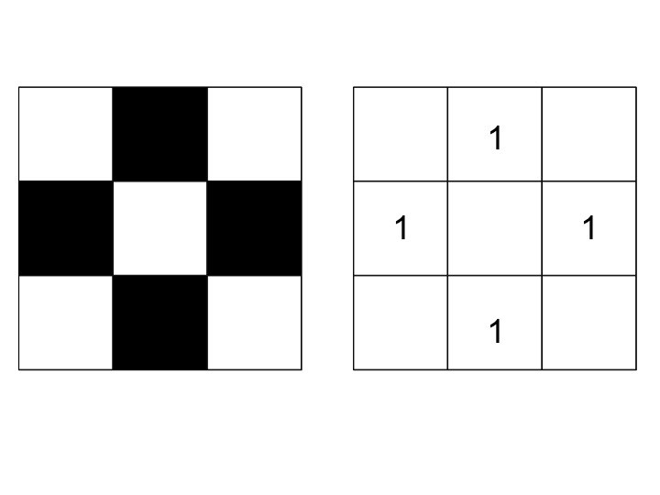
Images are grids of numbers
Notes:
An image on a computer, a digital or a digitised image is basically just a big grid of tiny squares - pixels - , you'll have seen this if you've ever zoomed in really far. The encoding of the image, the way it is stored, is basically just as a grid of numbers - with a number for colouring in the square, so here a 1 for on (or colour in).

Slide 6
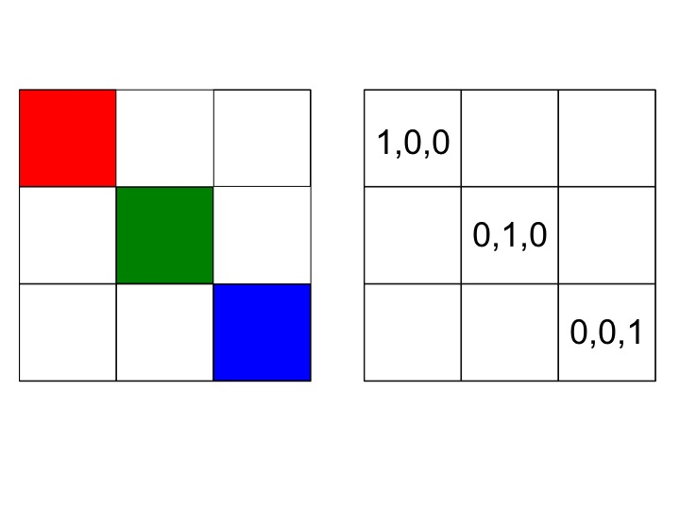
Images are grids of numbers
Notes:
Colour information comes from the way display equipment works. TVs and screens can mix Red, Green and Blue light in each square of the grid, so for each pixel we need three numbers - one for each colour

Slide 7
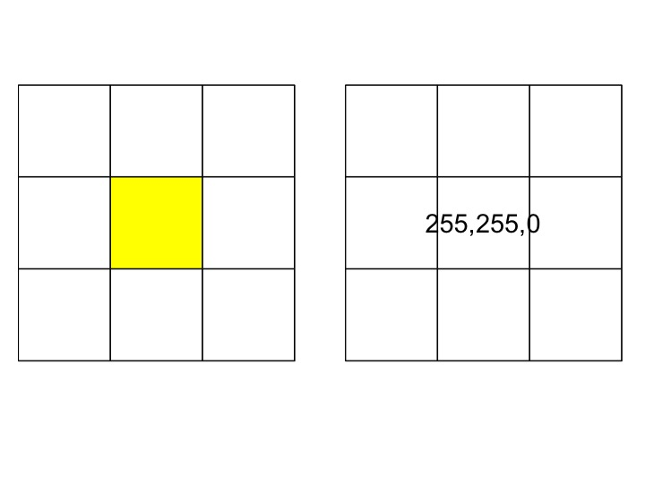
Images are grids of numbers
Notes:
And by going higher than 1 for each colour we can create many gradations and mixings of colours. We use up to 255 for each colour, and for example turning on the Red and Green and turning off the blue gives us yellow.

Slide 8
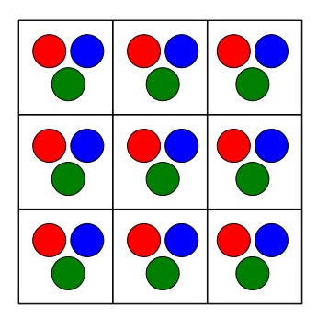
Cameras translate light into grids of numbers
Notes:
And modern digital camera equipment is the exact flipside of this system. The sensor is again a grid of picture elements, but each one has 3 tiny light sensors for Red, green and blue. And each one saves a measure of the strength of light as a number. So the digital camera and the resulting image is actually a readout for different strengths of different wavelengths of light. Including Infrared, digital cameras can read infrared, though most manufacturers stick in a layer of plastic that deliberately filters infrared out. And this is really useful for measuring plant health

Slide 9
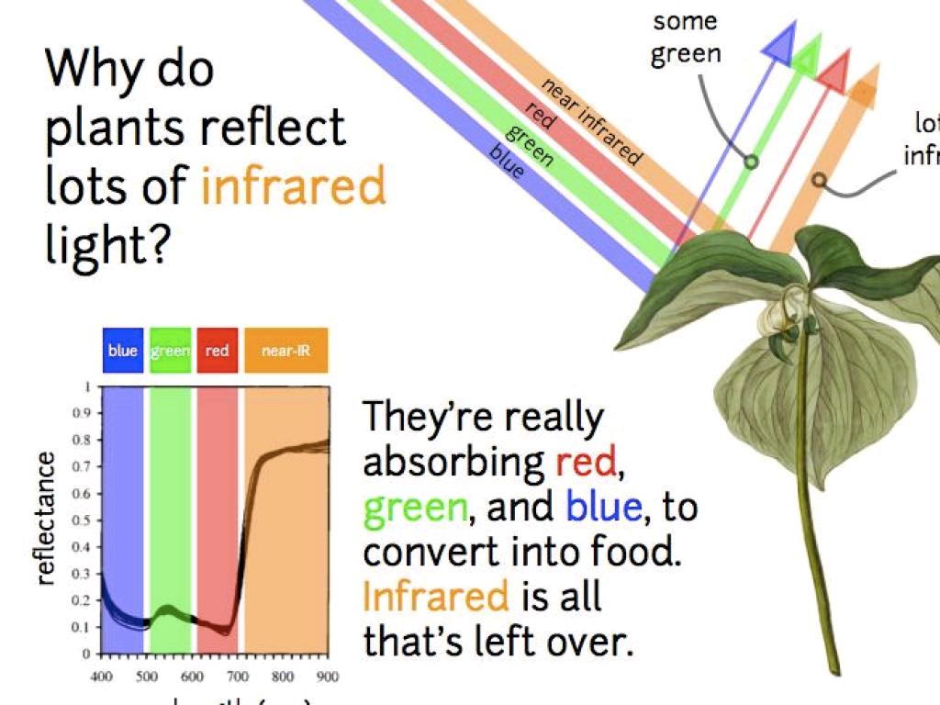
Notes:
Because when the plant is growing well and photosynthesis is going well there is a large absorption of the visible parts of the spectrum. With infrared left over. ...But don't we need a lot of expensive kit to capture and analyse that light?

Slide 10
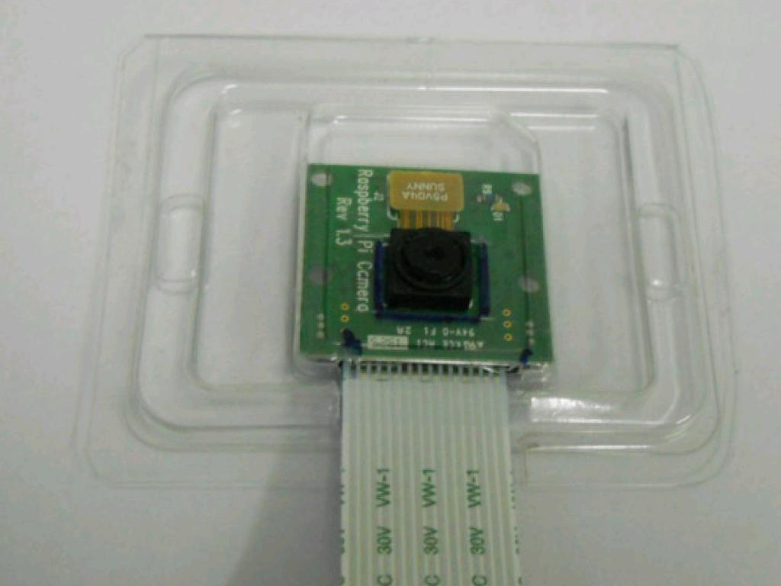
Cheap Available High Street Hardware
cc: xmodulo - https://www.flickr.com/photos/91795203@N02
Notes:
ACtually, no! Pretty much any digital camera is capable of capturing light in that range. Even down to the level of the ones you get in mobile phones. The problem with most consumer cams is the plastic infrared filter that needs removing. But you can get cameras without, one like this is £20. From places like Amazon, or Maplin on the high street.

Slide 11
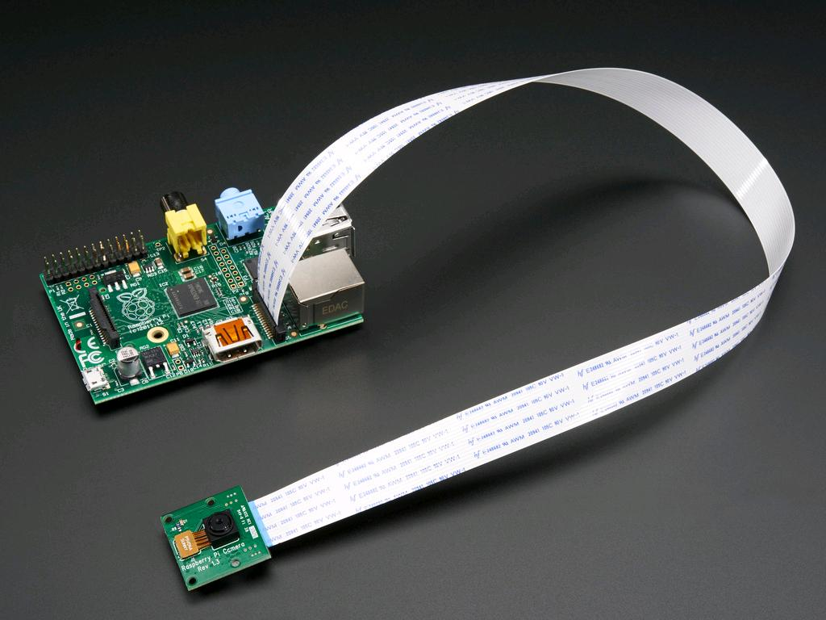
cc: adafruit - https://www.flickr.com/photos/35434449@N08
Notes:
You can connect these cameras up to tiny little computers to control the taking and timing of the pictures.

Slide 12
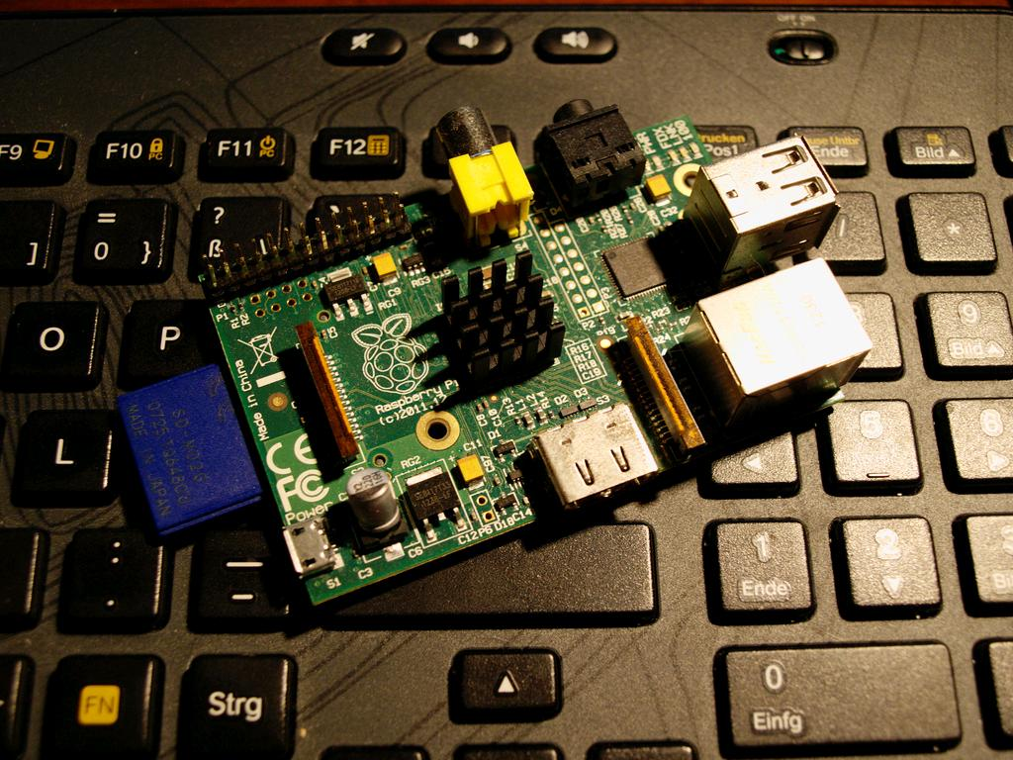
Raspberry Pi
And Arduino and more...
cc: Fabian-Horst.de - https://www.flickr.com/photos/99714066@N05
Notes:
And these computers like the Raspberry Pi are great. They're cheap at about £30. They're fully equipped with ports for USB, HDMI, other video and ethernet, they'll run off batteries or a mobile phone charger, and the hard drive is an SD Memory card. They're pretty powerful too, about as powerful as a 10 year old highend laptop but with massively better graphics capabilities - they have a dedicated graphics unit built in, which takes a lot of work away from the central processor and saves a lot of work

Slide 13
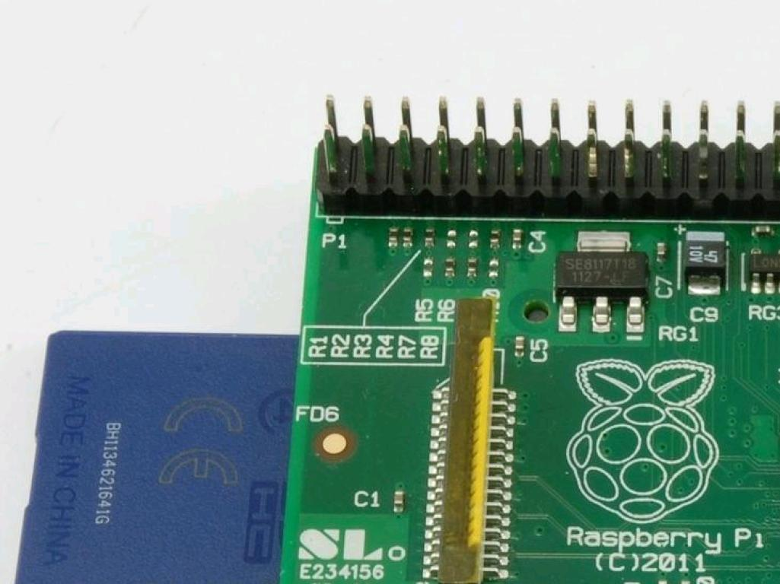
Programmable Pins
Notes:
And every Raspberry Pi has this bank of completely programmable pins. The user can program these things to turn on and off at will, allowing you to develop all sorts of interfaces with external hardware and sensors. You don't need a special plug, you can just wire straight to the pins if you need to, so its a completely extensible platform for cheap tech prototyping and development. And people have gone crazy with these things...

Slide 14
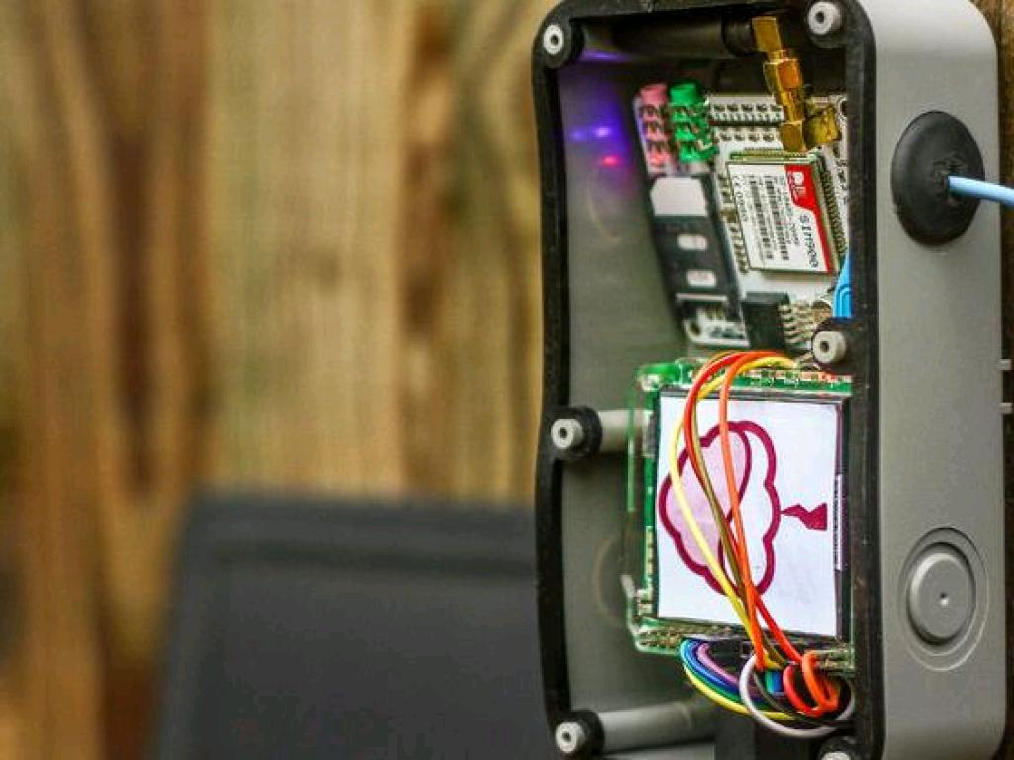
Notes:
This is a Raspberry Pi weather station in someones yard, complete with touch screen interface.

Slide 15
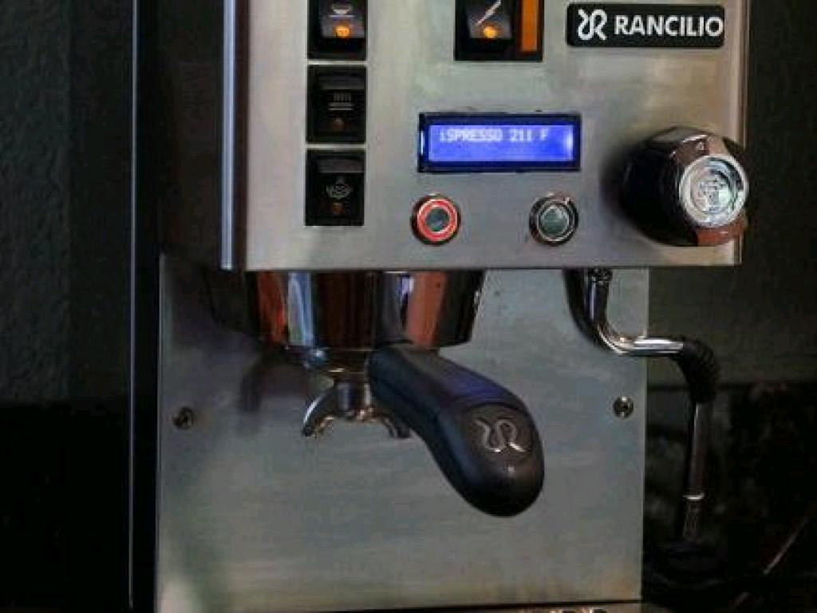
Notes:
This is someone's home built espresso machine, the core computational bit is the Raspberry pi.

Slide 16
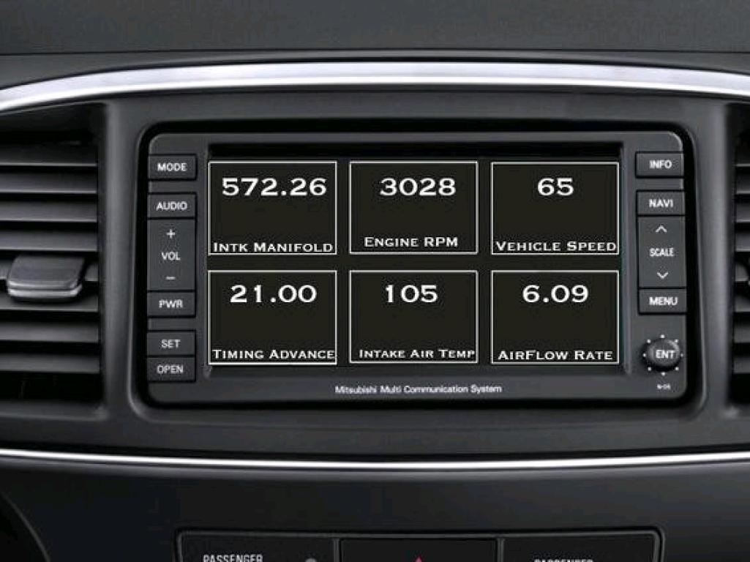
Notes:
Someone else has replaced their in car computer with one they engineered theirselves to better monitor engine performance from one of these things.

Slide 17
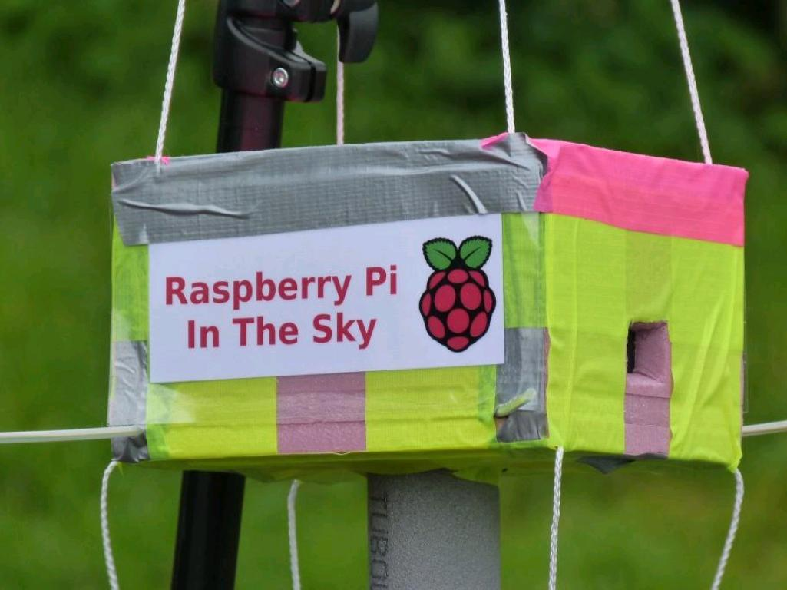
Notes:
My favourite is this one, Its a Raspberry Pi, hooked up to a load of environmental sensors and secured in a big foam box,

Slide 18
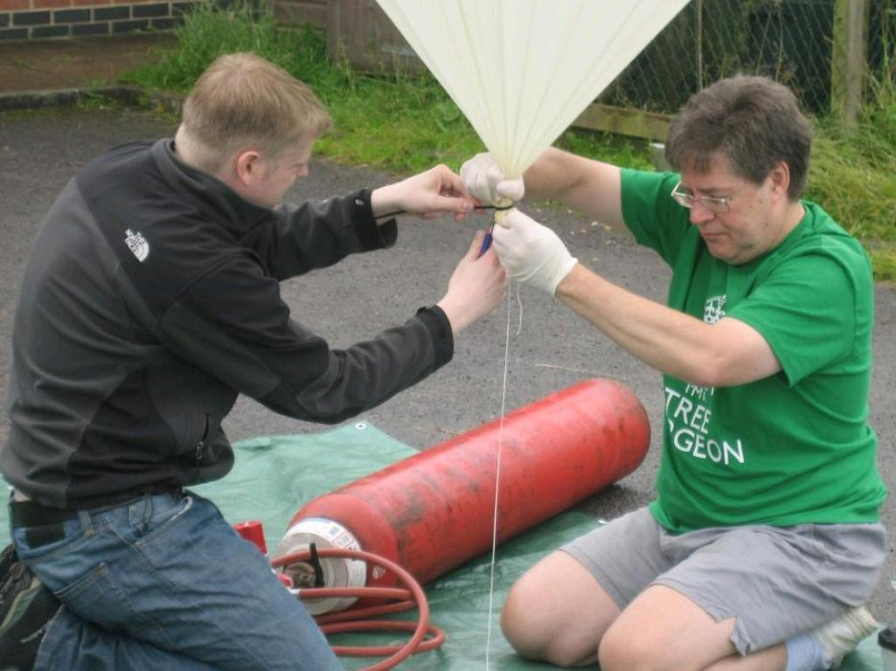
Notes:
Then attached to a weather balloon and launched up to the edge of space, taking pictures and readings all the way. And this isn't something you need loads of tech experience to do. You don't need to be an IT person to do this ...

Slide 19
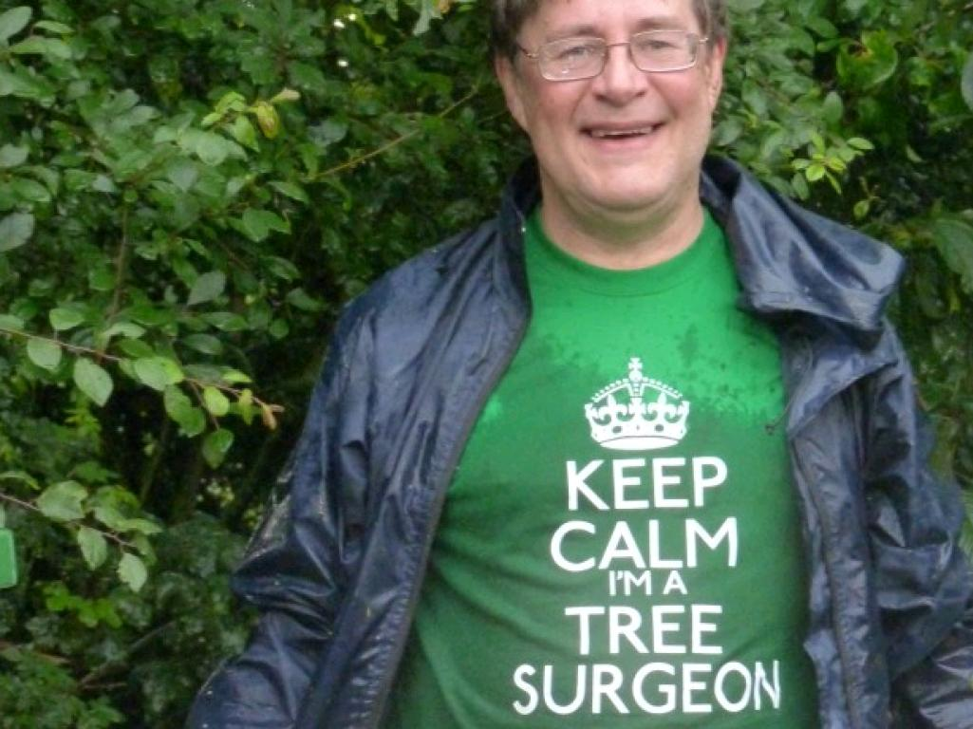
Notes:
The guy with the weather balloon is a tree surgeon and he makes use of this sort of setup and does it himself.

Slide 20
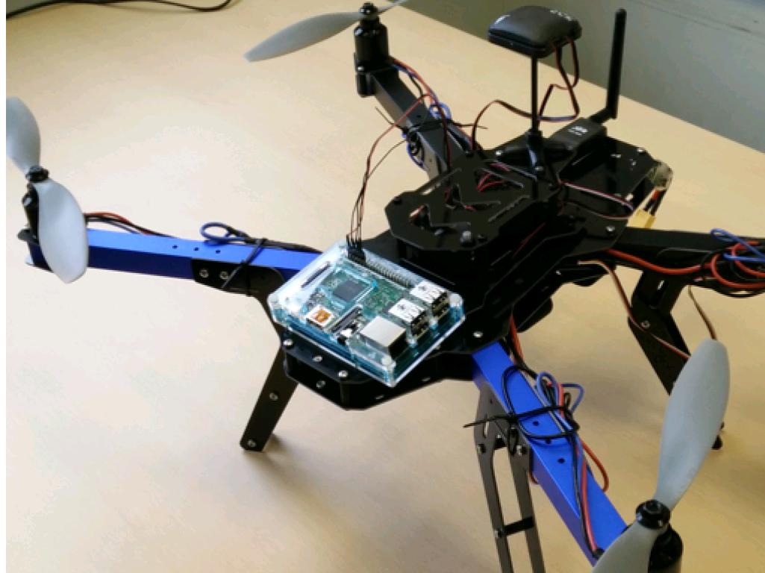
Consumer Quadcopters
Cost Effective and Flexible
Notes:
And we've been working on combining these consumer level flexible compute and image systems with equally consumer quadcopters and GPS systems. You can see here a quadcopter from a kit, a 3DR robotics Quad kit - to be precise, which costs about £500. It carries GPS modules, telemetry and here on the front a Raspberry Pi. The Quad is autonomous, there's laptop software so that you can program the onboard GPS with a flightplan and just let it off. Alternatively you can fly it with a remote.

Slide 21
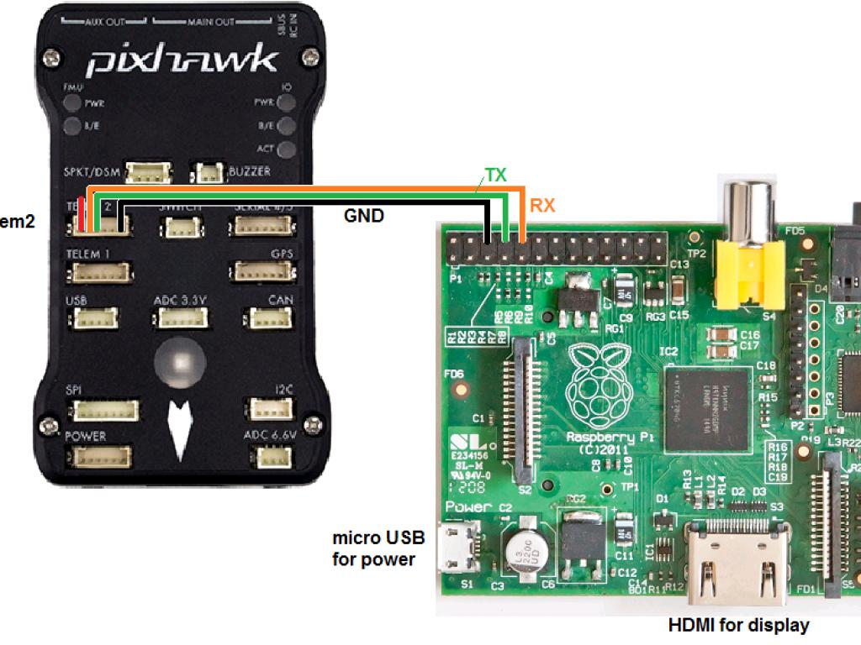
Notes:
And the GPS unit the PixHAwk, which is about £155 can talk directly to the Pi. So the copter can reach a way point and send a signal to the Pi that its time to perform an operation, like taking a picture or a reading or something. So for about £700 or so you can build custom extensible drone solutions that you can tailor to your needs.

Slide 22
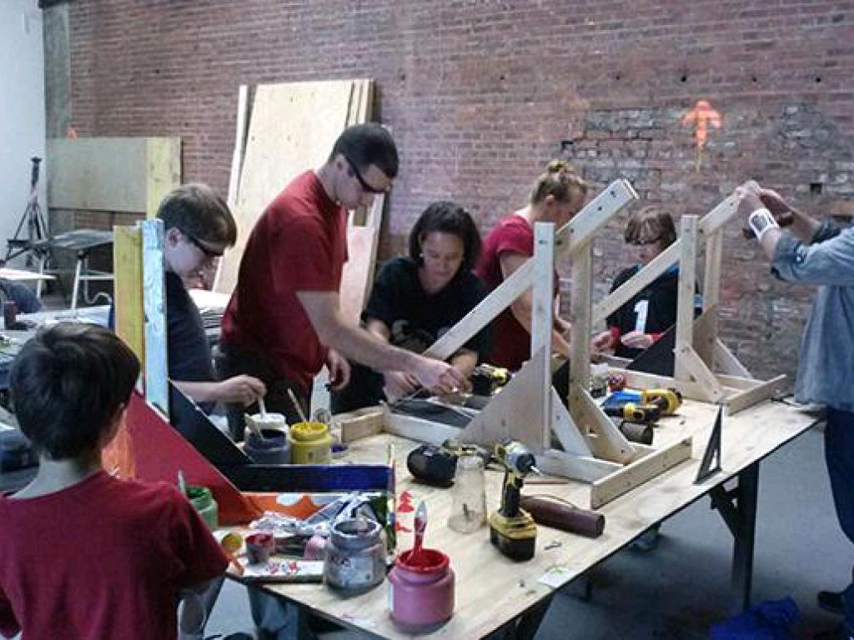
Pop Up Workshops
Maker/Hackspaces
Notes:
And if you're thinking thats all very well but what am I supposed to do - I don't have a tech background or know how to program, then you're not alone. There is a growing group of people who are coming together to share their knowledge and experiences for free, for the love of it all over the world. Including the East of England! Motorway out of the region or not. They're calling themselves Makers, and they convene local clubs and workareas called maker spacers or hack spaces. This is one. Typically these will have all sorts of kit to make stuff with, so electronics benches, 3d printers, computerised routers etc. The people are usually really friendly and helpful. They can often have very diverse goals and like a good challenge, this is an arts and crafts makerspace in New York. There are local ones in Norwich and quite a big one in Cambridge.

Slide 23
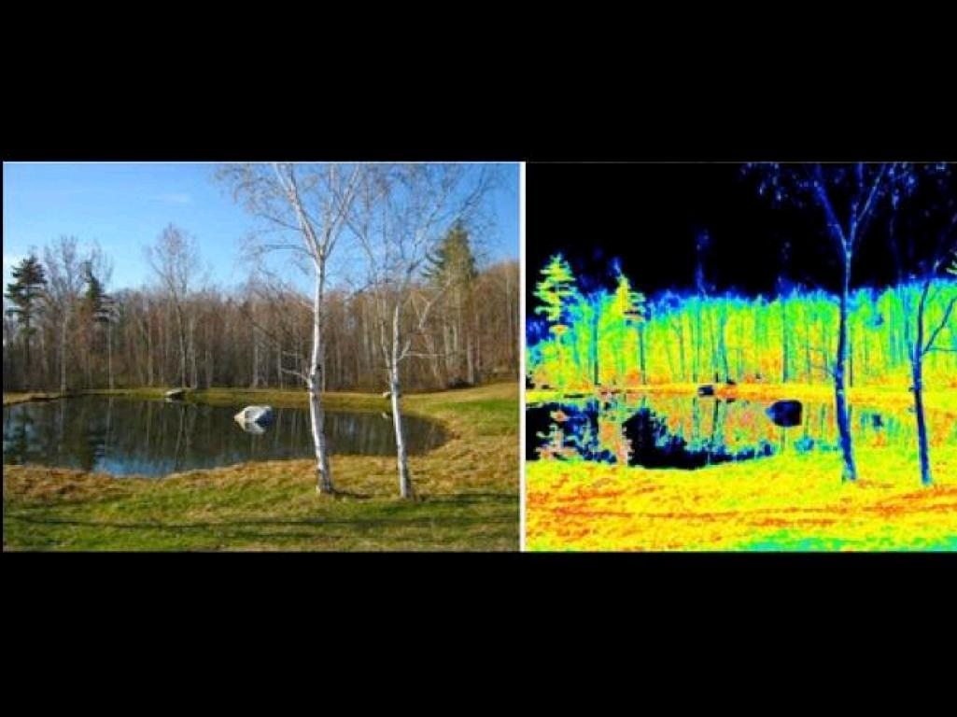
Infragram.org
online image processing
Notes:
And when you've got the hardware sorted, there are free and open source web tools for dealing with any images you can collect. A free web service like infragram can take your infrared image and scale and transform the numbers in it to highlight the photosynthetically active bits, so the healthy plant bits. As you can see in this picture any non leafy bits show up dead dark

Slide 24
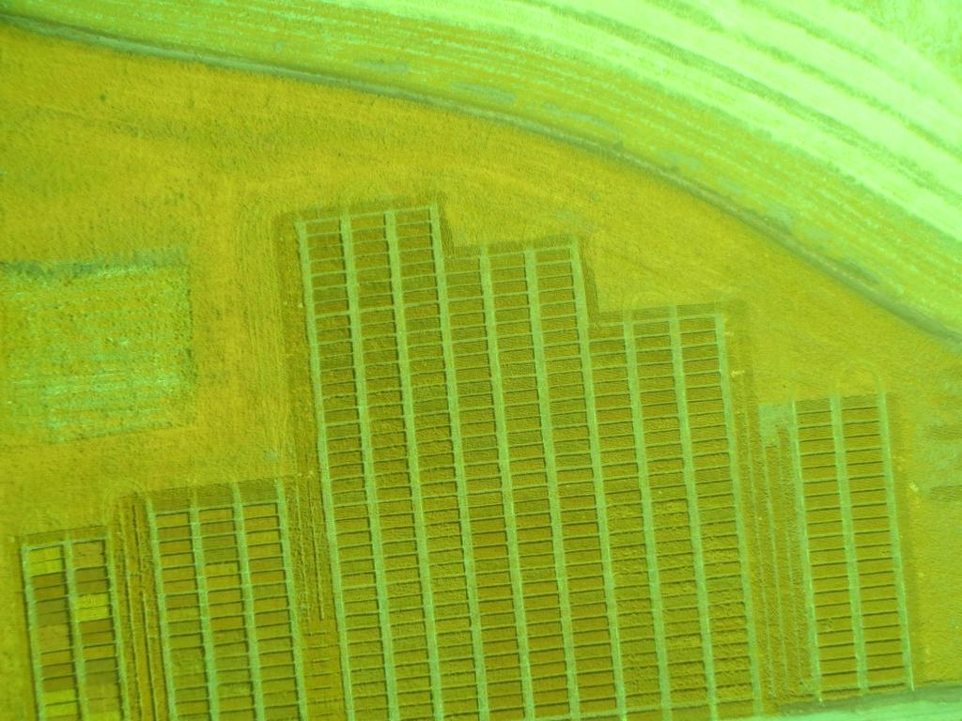
InfraGram.org
Notes:
So you can go from a murky aerial shot of a field like this one

Slide 25
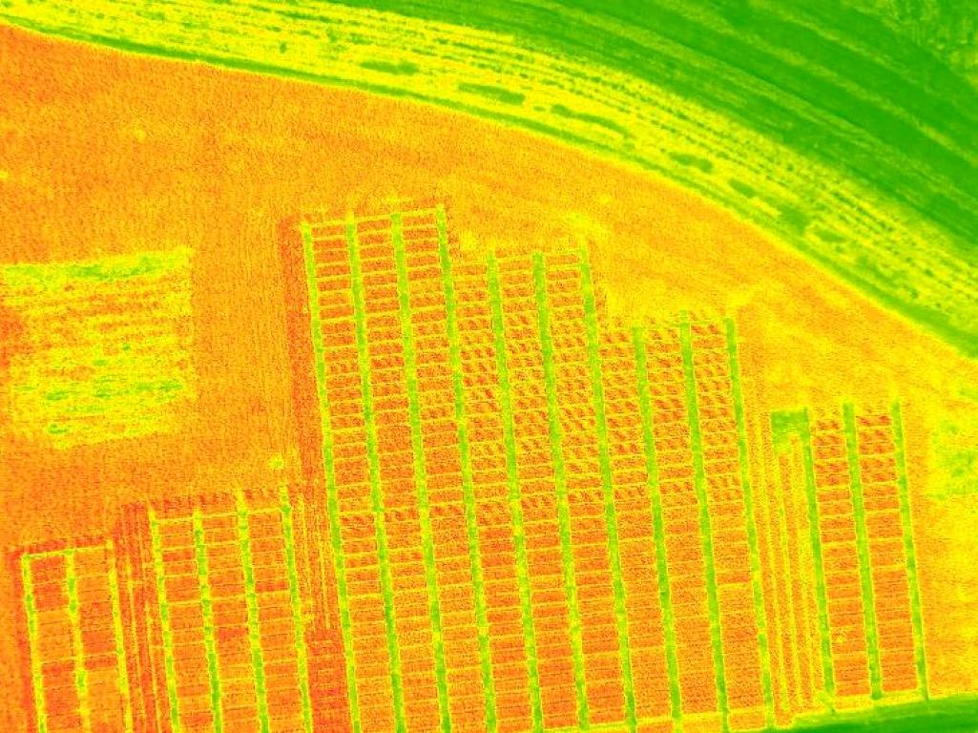
InfraGram.org
Notes:
To a scaled one showing in nice bright colours the healthy bits and the less healthy bits as darker patches. All this in a few clicks.

Slide 26
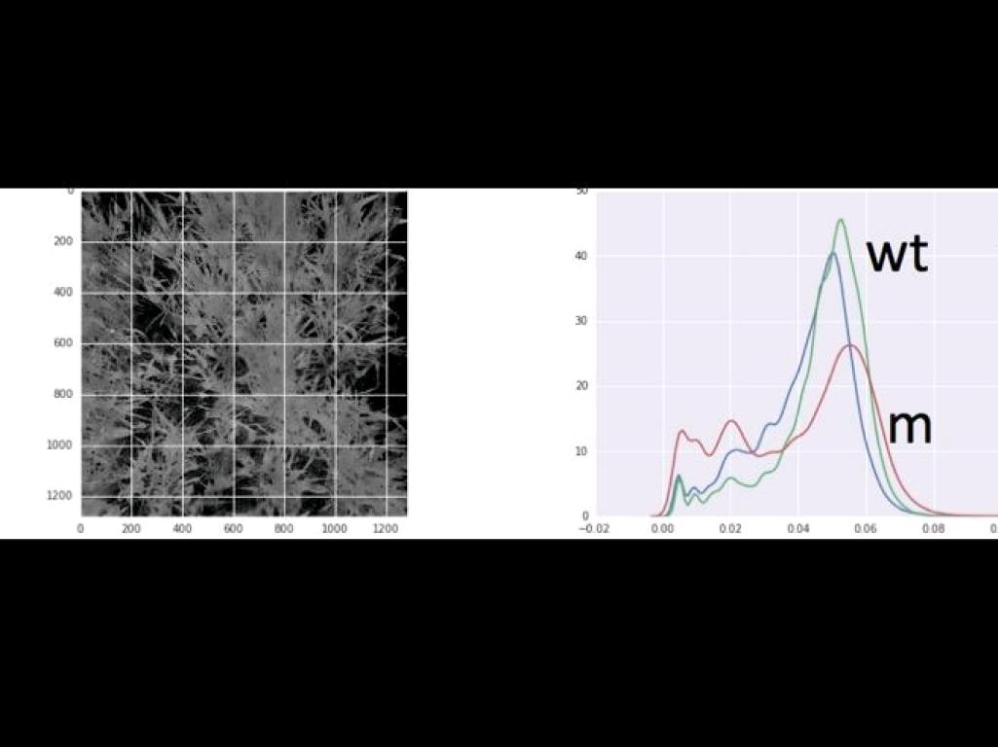
Our Work
Whole/Sub-Field Status Analysis
Notes:
And we've been developing these ideas into working tools at TSL, so we've been taking images of wheat lines like this one and using those image methods to quantify photosynthetic capacity well enough to compare within plots

Slide 27
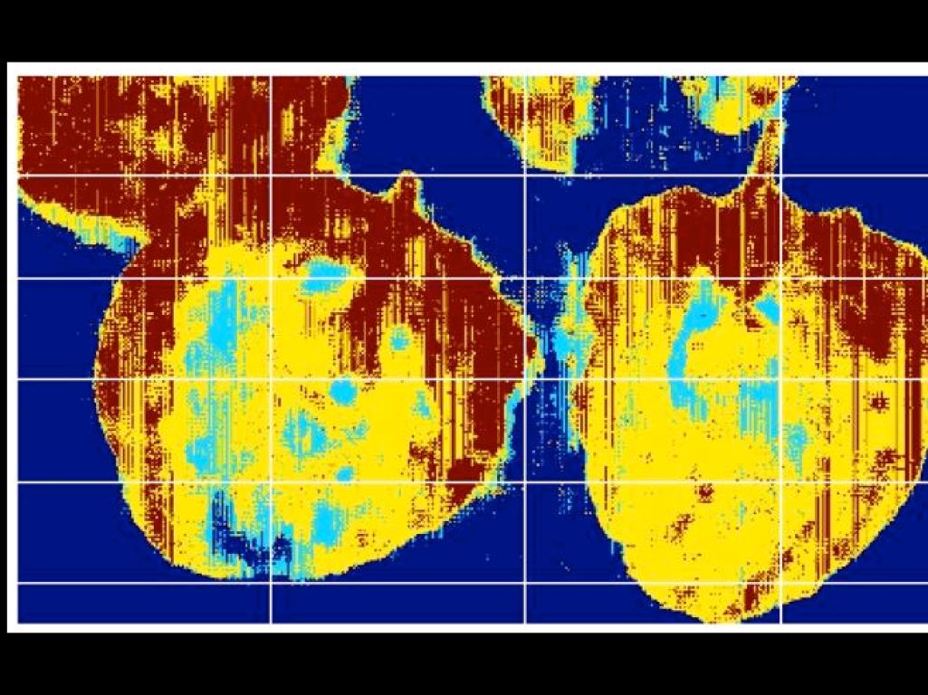
Leaf level disease detection
Notes:
And also we're getting down to the leaf level. This is an in-lab proof of principle shot measuring disease progression in some infected potato leaves. The red bits are the uninfected tissues and the yellow bit and blue bits are dead or dying off. So our overall aim is to try and bring this together and develop these tools into workable open source solutions for common agricultural and research applications.

Slide 28


Acknowledgements
Martin Page
Cristobal Uauy
Phillipa Borrill
Alex Webb
The Sainsbury Laboratory
dan.maclean@tsl.ac.uk
@danmaclean

