Slide 1
Mercenary Robotics 4-H Charter Club -
Parent’s Night Out – September 29th and 30th Classes
By Daniel Margavio
Date: 09/16/2023

Slide 2
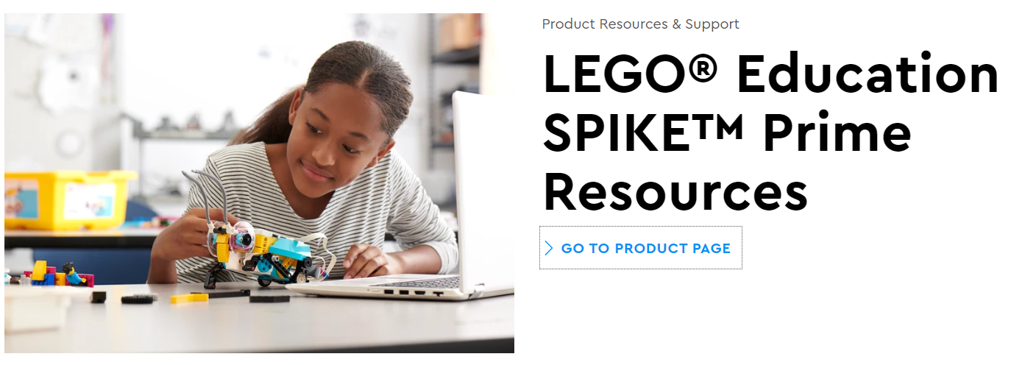
Agenda
Introductions and Instructions
Demonstration of the Robot Capabilities
Lego Spike Prime Software Development
Python Programming Crash Course
Start with basics and work up to full robot
Robot Challenges!

Slide 3
Introductions
We welcome you to XXXXXXXXX, home of Mercenary Robotics!
Your leadership team for Parent’s Night Out are
  Instructors:
  Student Mentors:
For the next few hours, you are gonna learn Python programming and use it to guide a robot through challenges
    Don’t worry if you have never programmed before (we will help you) or if you are already a programming expert (we will give you harder challenges)
https://spike.legoeducation.com/#/

Slide 4
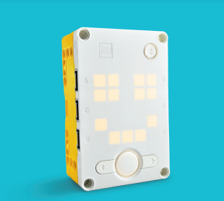
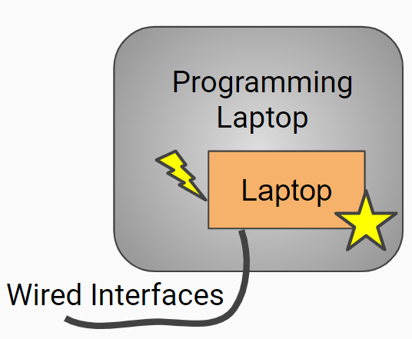
Instructions
A few basic rules before we begin
  Listen to the leadership team; they want to keep you safe and make sure everyone has fun
  If you have a computer problem or just need help, SPEAK UP!
  Unless directed, DO NOT browse the internet using the provided laptops
  Be nice and respectful to one another
Programming this robot is pretty simple
Lego Spike Prime Hub
Development environment is accessed using website
https://spike.legoeducation.com/prime/project
3 programming language options are available:
Icon Blocks, Icon Words, Python
Robot connection can be over USB or Bluetooth, but we will be using USB here
Bluetooth

Slide 5
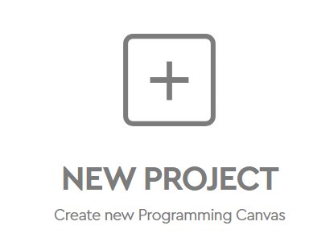
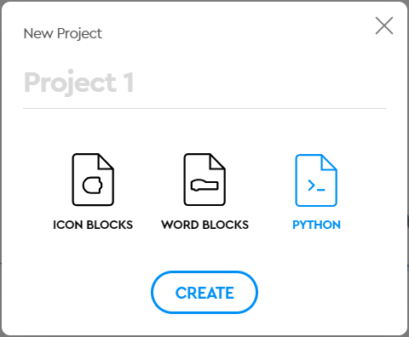
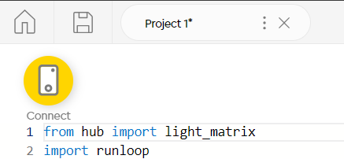
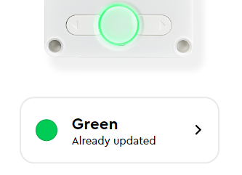

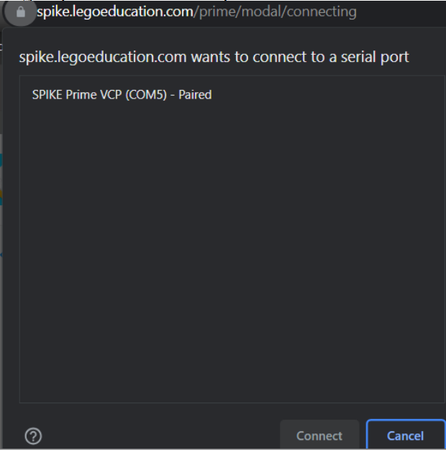
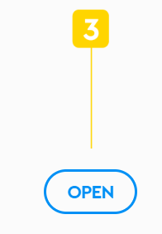
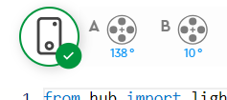
Lego Spike Prime Development Environment Basics
Start up and connect to the Hub
  Click the desktop shortcut or type https://spike.legoeducation.com/prime/project in browser
  Click on the “NEW PROJECT” button
  Click “PYTHON” and then click “CREATE”
  Click “Connect” if the Hub Image doesn’t already have a green check
  Connect the Hub to the laptop using the USB cable
  Press and hold Hub power button for at least a second
  Click on the “Green: Already Updated” button
  Click on the “Connect with the USB cable” text on screen
  Click the “OPEN” button on screen
  Click on the “SPIKE Prime…” text in the box and “Connect”
  Hub image should now have a green check; you’re ready!
You can turn off the Hub by holding the Hub power button for at least 3 seconds

Slide 6
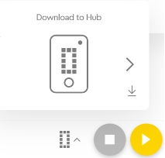
Lego Spike Prime Development Environment Basics (continued)
You can rename and save your program using the buttons at the top of the screen
  We will email you your programs after the class, if you want them
All of the exercises are located on the laptop
  Desktop folder “PNO Examples” contains text files that you can copy (control + c key) and paste (control + p key) directly into the too
Hub has 20 “save slots” you can use to store and recall programs without having to reprogram it each time
  Use the download button to save the current program to the selected slot
  Then you can use the Hub arrow keys and single green button click to run the selected program

Slide 7
Lego Spike Prime Development Environment Basics (continued)
You can rename and save your program
  Click the desktop shortcut or type
Observe the basic structure of the default program
Lets review some of the key words that we see
  from and import – used to declare usage of existing libraries and packages
  async – used to control whether multiple code lines can run at once or not
  def – used to declare the definition of a method or class (a callable section of code)
  await – used to control whether the processor should wait for a line of code to complete

Slide 8
Quick Robot Demo
Let’s take a quick look through the capabilities of this robot

Slide 9
Lego Spike Prime Python Basics
Select a very basic example program
  Start → 1 → The Light Matrix
Observe the basic structure of the default program
Lets review some of the key words that we see
  from and import – used to declare usage of existing libraries and packages
  async – used to control whether multiple code lines can run at once or not
  def – used to declare the definition of a method or class (a callable section of code)
  await – used to control whether the processor should wait for a line of code to complete

Slide 10
Python Crash Course
Now we are going to learn Python and robot basics

Slide 11
Closing
Thank you all for attending!
  Hope you had fun; hope you learned something new and stay interested in programming and robotics
  If you enjoyed it, consider joining a FIRST Lego League team or other FIRST program
  Please provide feedback and let us know if you want your source code emailed to you

