Slide 1
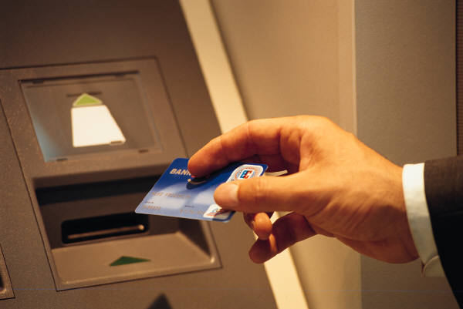

Financial Banking TERMS

Slide 2
FINANCIAL BANKING TERMS
The most important bank in a country is the central bank. It stands at the top of all other banks.
The main aim of a central bank is to maintain monetary and economic stability of a country.
It enjoys the monopoly of note issue. Every country has a central bank of its own with different names.

Slide 3

FINANCIAL TERMS
Co-signer
This refers to someone who agrees to take responsibility for another person’s debt in the event payments aren’t made. Lenders may require a co signer/co maker on a loan for a high-risk borrower with poor credit or a scanty credit history.
Parents sometimes co-sign a child’s car or student loans. Such debts are reflected on both co-signers’ credit reports, and a default will affect each one.

Slide 4
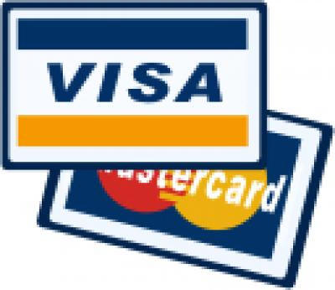
FINANCIAL TERMS
Cash advance
Credit card holders get one of these when they receive cash directly from the account, often through an ATM or by using a check issued by the card provider. While an advance can deliver fast cash, it typically comes with a fee of 3% to 5% of the amount, which may be capped at several hundred dollars. It’s best to reserve cash advances for emergencies

Slide 5
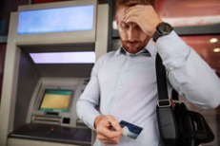
FINANCIAL TERMS
Overdraft
This happens when money is withdrawn from a bank account and more than exhausts the available funds, often resulting in an overdraft fee as the financial institution covers the difference.
These often costly charges can be avoided by keeping extra money in the account as a buffer.

Slide 6

FINANCIAL TERMS
Collateral
This is typically an asset used to secure a loan. If you fail to make payments on the debt, the lender may be able to seize the property used as collateral, such as a residence financed with a mortgage or a car purchased with an auto loan.IT Server or an Oculus gadget.

Slide 7
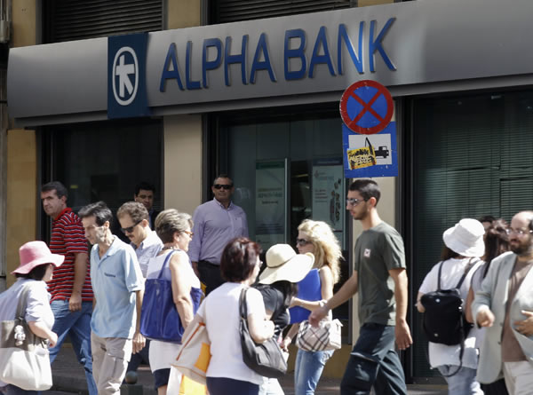
FINANCIAL TERMS
BANK RUN
A bank run is a situation that occurs when a large number of bank or other financial institution's customers withdraw their deposits simultaneously due to concerns about the bank's solvency. ( RCBC,BPI}
As to deposits, people withdraw their funds, the probability of default increases, thereby prompting more people to withdraw their deposits

Slide 8

FINANCIAL TERMS
Escrow
This describes money or a financial instrument held by a third party on behalf of two others engaged in a transaction. The most common example is during the purchase of a home: Escrow is used when a buyer and seller sign a purchase agreement, and the money involved is held in escrow to be delivered when certain conditions are fulfilled.

Slide 9

FINANCIAL TERMS
CEO- favorite financial term
EBITDA — earnings before interest, taxes, depreciation and amortization — is an important standard measure of profitability.

Slide 10
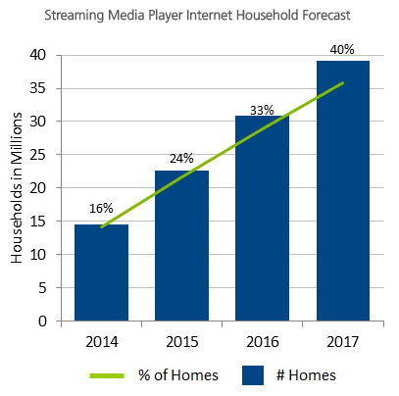
FINANCIAL TERMS
EBITDA factors in other expenses, like taxes and interest. EBITDA allows analysts to generate useful comparisons between companies, and to project long-term profitability and the ability to pay off future financing.

Slide 11
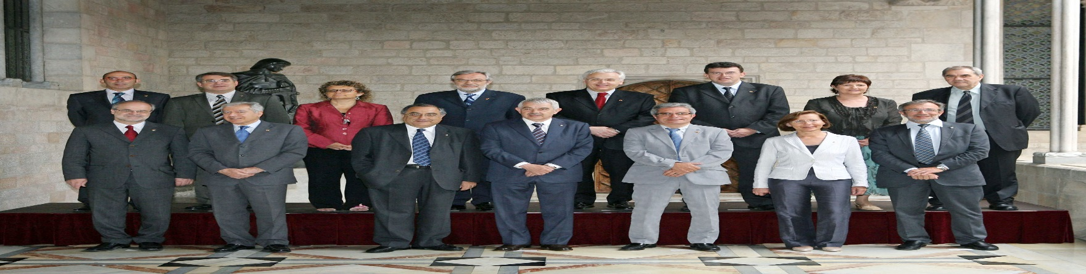
FINANCIAL TERMS
AMLAC
The Anti-Money Laundering Council is an executive council mandated to protect and preserve the integrity and confidentiality of bank accounts and to ensure that the Phils. shall not be used as a Money Laundering site for the proceeds of any unlawful activity.

