Slide 1
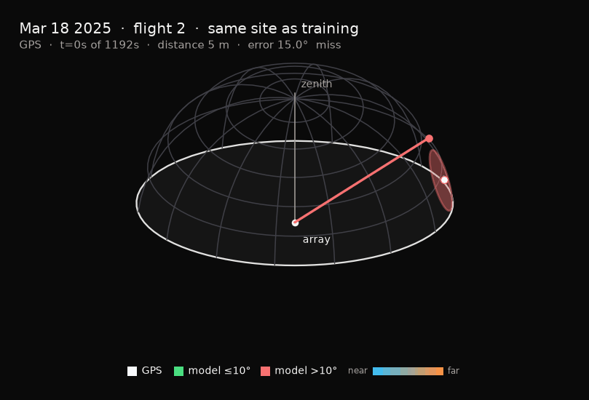
APPLIED DEEP LEARNING · AUDIO
Hearing drones
in 3D
Six microphones on one recorder match the full array. Extra frames help only where microphones are scarce.
Shai Livshits · Dan Masad
5 October 2026

Slide 2
01 · THE PROBLEM
A direction, ten times a second
● Drones are small, and they often fly with no radio link. That defeats a camera in poor visibility, and a radio detector outright.
● Sound is the cheap fallback. Rotors are loud, and the sound is harmonically distinctive.
● From a ground array we want a report, ten times a second: is a drone audible, and in which direction.
● Published systems use 24 or more synchronized microphones. Six in one off-the-shelf recorder would cost about four times less.
THE QUESTION
Rodríguez et al. (2026) leave temporal context as untested future work. Can a few frames of history let six microphones match twenty-four?
WHAT WE FOUND
They can, and the history is not why. Six on one recorder match the full array on every drone frame. Extra frames help only where microphones are scarce.
Their dataset and their splits. One DJI Air 3, four recorders of six, 48 kHz, GPS at 10 Hz. Training is 52 minutes at site 1. Test 2 is 20 minutes at the same site. Test 1 is 3 minutes at another site and stayed sealed through development. Targets are 10° discs.
Hearing drones in 3D · Livshits & Masad
2 / 8

Slide 3
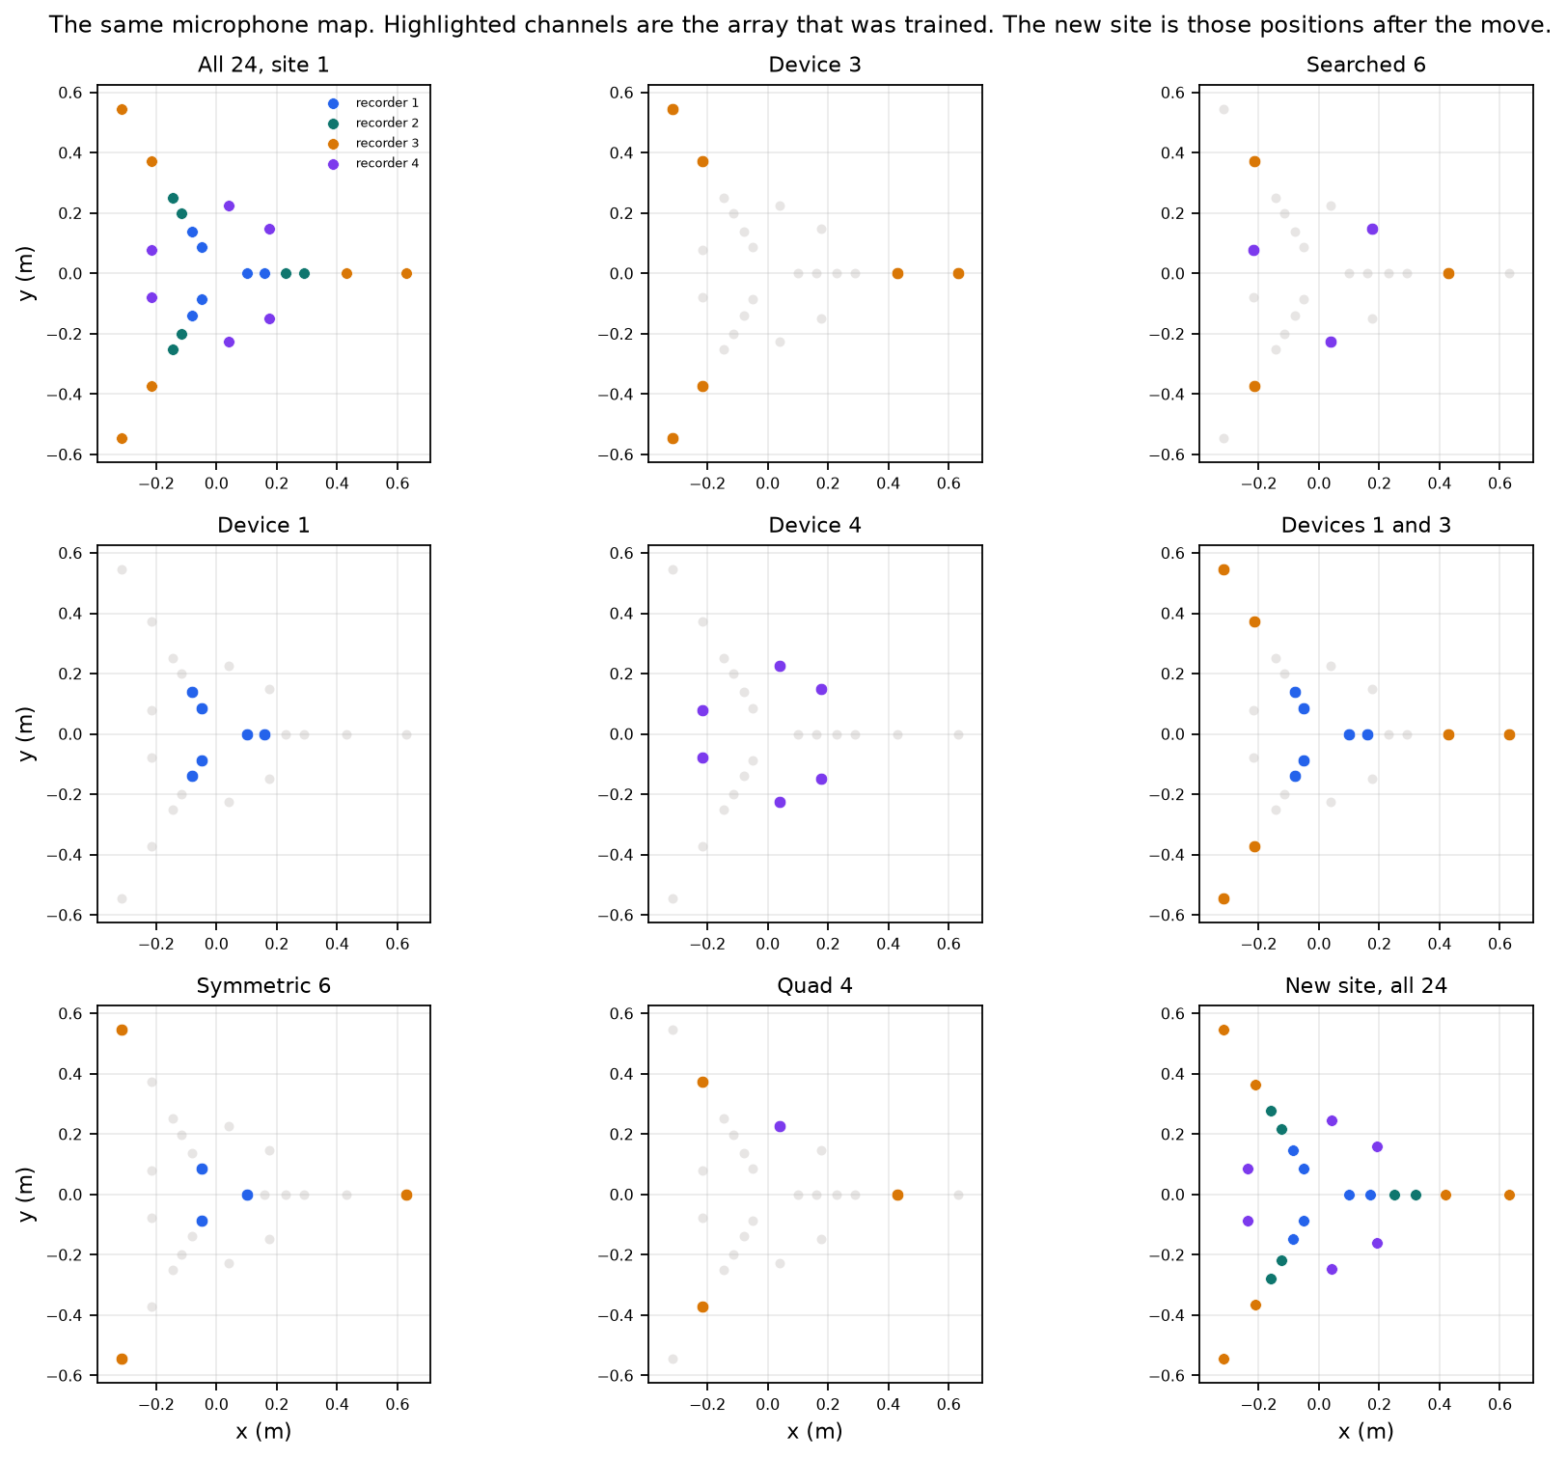
02 · THE ARRAY
Unambiguous only below 1.47 kHz
1.47 kHz
2.2 kHz
3.6 dB
Unambiguous only below this.
The maps run to here, past that band.
The phantom all 24 microphones still leave.
Sixteen sub-bands on a 23 by 91 grid at 4°. A sidelobe can line up almost as well as the source. All 24 has a coplanar recorder and a pair 0.17 m apart, so eighteen further microphones buy nothing.
Every panel is the same map. Highlighted channels are the array that was trained. The new site is those microphones after they were moved. Lobe hops are what the filter removes. The smooth miss inside 30 m is the near field, and the filter does not fix it.
Hearing drones in 3D · Livshits & Masad
3 / 8

Slide 4
03 · THE MODEL
A U-Net on the map, with two measured changes
Architecture
Causal history
A depth-3 U-Net, 3×3 convolutions, circular padding on azimuth. A per-pixel mask, and a presence head pooled from the middle. It reads the 23 by 91 map.
Temporal context is K frames stacked on the channel axis, newest last, so the stack is causal. The runs use K = 1, 5, and 9.
Training
The baseline
Adam at 5×10⁻³, class-weighted cross-entropy, early stopping on the test-2 hit rate, patience 10. 32 base filters rather than 64: faster, and 72% against 63% of frames within 10°. A leaky presence head, after a plain ReLU died in one seed.
Brightest-pixel delay-and-sum, on the same frames. A separate 1-D CNN, 86k parameters, detects from one microphone, so it can be tested on audio we did not render as a map.
Hearing drones in 3D · Livshits & Masad
4 / 8

Slide 5
04 · THE KINEMATIC FILTER
After the mask, not inside the network
21 m/s
2.1 m
+ 4°
0.5 s
A DJI Air 3 in sport mode, the published speed.
How far that allows in one 0.1 s frame.
One grid cell, on top of the sky-angle cap.
Five frames outside the cap before a jump is kept.
When the stored direction moves
What the history was doing
● It runs after the mask, on the decoded direction. It is not an input channel, and not a reason to retrain.
● Inside the cap the stored direction updates at once. The cap is the sky angle of 2.1 m at the GPS range, plus one 4° cell.
● A hard hold with no second chance wrecks the score. Some large jumps are the model correcting itself.
● A fixed 16° cap, with no range, landed within about a point of this rule on the same-site 24-microphone run.
Hit rate, on weights already trained. Not the paper’s mean angle.
● Corrupting the past of the K = 5 models costs 4.3 points. The climb ends near 0.8 s.
● Deleting history from the K = 9 weights costs 5.1 points, block-resampled, Holm-adjusted p = 0.0007.
● About +0.5 inside 30 m, +8.7 at 60–90 m, and +21.8 at 90–120 m. Order does not matter. The cue is persistence.
Hearing drones in 3D · Livshits & Masad
5 / 8

Slide 6
05 · AGAINST THE PAPER
Mean angular error, on their terms
Their metric only. U-Net rows are stable frames: the last three directions within 10°. Delay-and-sum is every frame. The lower block is the new site, a second look. Matched-site U-Net cells are the range over three seeds.
mean angular error
site
0–50 m
50–100 m
100–200 m
Paper, delay-and-sum
matched
38°
75°
33°
Ours, delay-and-sum, 24
matched
40°
72°
31°
Paper, U-Net, stable
matched
10°
13°
14°
Ours, U-Net 24, stable
matched
7–10°
9–12°
31–74°
Paper, delay-and-sum
new, second look
8°
29°
92°
Ours, delay-and-sum, 24
new, second look
9°
23°
83°
Paper, U-Net, stable
new, second look
12°
24°
54°
Ours, 24 mics, K = 1, stable
new, second look
16±4°
10±3°
20±9°
Ours, device 3, K = 1, stable
new, second look
14°
12±3°
11±2°
On the matched site, under 100 m, we are level and slightly ahead on the frames they keep: 7–10° and 9–12° against 10° and 13°. Past 100 m their 14° still beats our stable-frame mean, 31–74°. The filter is not this cut. On the new site, a second look, they lead under 50 m and we lead from 50 m out — device 3 is 12±3° and 11±2° against their 24° and 54°, on 1,592 frames, 238 past 100 m.
Delay-and-sum reproduces their bars within a few degrees. Their rule calls 67.0% of no-drone frames detections; ours calls 68.6%.
Hearing drones in 3D · Livshits & Masad
6 / 8

Slide 7
06 · AGAINST OURSELVES
Every drone frame, raw then filtered
Matched site. Not their bins and not their mean. Share of drone frames inside 10°, our 30 m bins. Each cell is raw, then filtered. ± is the seed spread, omitted under 2. Pooled spread here is ±1.2 points.
inside 10°
raw → filtered
0–30 m
30–60 m
60–90 m
90–120 m
120–180 m
all
Delay-and-sum, 24
50→52
33→36
18→21
3→0
2→0
33→35
24 mics, K = 1
66±5→66±5
79→83±3
73→82±6
57±3→74±12
27±11→55±13
70±2→76
24 mics, K = 5
63→62
79±3→81±2
75→77±3
60±2→64±6
27±6→34±12
70→72
Device 3, K = 1
69±3→70±2
75→81±2
68→77
56→64±20
25±4→65±11
69→75±2
Device 3, K = 9
72±2→72±2
78±3→78±4
73±3→74±4
71±12→74±12
24±6→22±4
73→73±2
Not a comparison with the paper. Delay-and-sum, matched site, our reading of the sideways miss, range × sin(angle): about 3 m under 30 m, and about 64 m in the far bin. That far-bin entry is the bin’s 32° mean. A 10° error is about 5 m at 30 m and 17 m at 100 m.
Six microphones match twenty-four. At one frame, 69.3% ± 0.7 against 70.5% ± 1.5, inside seed noise, and at five frames still inside it. At nine frames, 0.9 s, device 3 reaches 73.2% ± 1.4 and all 24 stays at 70.1% ± 2.7. Depth pays only on the small array. The searched six, out of 106,183, score 52.1% ± 0.8.
The filter, on this reading. One frame takes 24 microphones from 70% to 76% and device 3 from 69% to 75%. The gain is in the far bins; inside 30 m the cells do not move. Once five or nine frames are stacked it adds about a point, and device 3 at K = 9 stays at 73%. New site, a second look: 52% to 61% and 54% to 61%; device 3 at K = 9 stays at 52%. Where the raw track is stably wrong, the filter holds the error.
Hearing drones in 3D · Livshits & Masad
7 / 8

Slide 8
07 · LIMITS
What these numbers cannot support
Past about 90 m
Inside 30 m
Set aside
The labelled drone is often quieter than ambient in the beamformed map, and two thirds of labelled positives there are quieter than typical ambient. Early stopping on a pooled hit rate never selected for that bin. On the matched site, their stable-frame 14° remains ahead of us there.
The learned cells sit below the next bin, and the filter leaves them there. On the new site, a second look, the closest 30 m stay near 30% inside 10°. A source metres from a 2 m array is not a plane wave. Untested.
Polar discs, Tversky loss, and the rest of the array list were measured. None changes the claim above. Sub-band count moves the hit rate by about half a point.
Detection fails across scenes
One drone, one dataset, two sites
Held out one scene at a time, the per-channel detector scores 0.488 ± 0.056 AUROC. The 0.662 was two halves of one afternoon. On the sealed new site the presence score reads 0.639 AUROC. Training negatives grew from 4.8 to 8.2 minutes and from one scene to three. That is still not enough to learn a detector.
The sealed new-site score, once, already said device 3 is not worse than all 24: 54.4% ± 4.6 against 52.2% ± 5.5 at one frame. The seed spread widens to ±5–8 points, and delay-and-sum wins the pool, because most of that flight is inside 90 m. The paper bins and the filter on that flight are a second look at those dumps.
Hearing drones in 3D · Livshits & Masad
8 / 8

