Slide 1

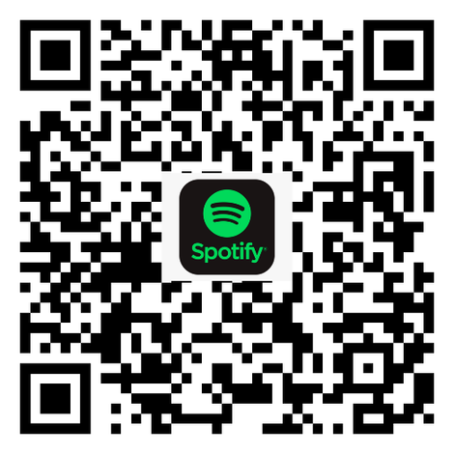
Shabbat Shalom!
שַׁבָּת שָׁלוֹם!
Learn the Davis Academy Shabbat prayers and songs!

Slide 2
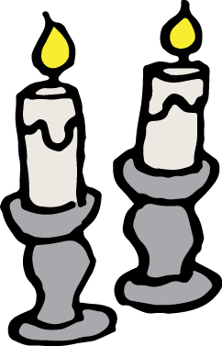



Bim Bam
בִּים בַּם
Bim bam, bim bim bim bam,
bim bim bim bim bim bam.
Shabbat shalom!
Shabbat, Shabbat, Shabbat,
Shabbat shalom!
בִּים בַּם, בִּים בִּים בִּים בַּם,
בִּים בִּים בִּים בִּים בִּים בַּם.
שַׁבָּת שָׁלוֹם!
שַׁבָּת, שַׁבָּת, שַׁבָּת,
שַׁבָּת שָׁלוֹם!
Bim Bam
Video
Last Word
Candles
Kiddush
Hamotzi
Oseh Shalom
Priestly Blessing
Rocks
May you have a peaceful Shabbat.
Notes:
Intro - Bim Bam. Leader: Micah. Opening niggun welcoming Shabbat. Music: Nurit Hirsh.

Slide 3

Video
Bim Bam
Video
Last Word
Candles
Kiddush
Hamotzi
Oseh Shalom
Priestly Blessing
Rocks
Notes:
Video. Leader: Cristy.

Slide 4
Last Word
הַמִּלָּה הָאַחֲרוֹנָה
Bim Bam
Video
Last Word
Candles
Kiddush
Hamotzi
Oseh Shalom
Priestly Blessing
Rocks
Notes:
Last Word sharing, round 1. Micah facilitates.

Slide 5
Candle Blessing
הַדְלָקַת נֵרוֹת
Baruch atah Adonai,
Eloheinu Melech ha'olam,
asher kid'shanu b'mitzvotav
v'tzivanu l'hadlik
ner shel Shabbat.
בָּרוּךְ אַתָּה יְיָ,
אֱלֹהֵינוּ מֶלֶךְ הָעוֹלָם,
אֲשֶׁר קִדְּשָׁנוּ בְּמִצְוֹתָיו
וְצִוָּנוּ לְהַדְלִיק
נֵר שֶׁל שַׁבָּת.
Bim Bam
Video
Last Word
Candles
Kiddush
Hamotzi
Oseh Shalom
Priestly Blessing
Rocks
Blessed are You, Adonai our God, Sovereign of all, who makes us holy with mitzvot and calls us to kindle the lights of Shabbat.
Notes:
Candle blessing. Amy lights.

Slide 6
Last Word
הַמִּלָּה הָאַחֲרוֹנָה
Bim Bam
Video
Last Word
Candles
Kiddush
Hamotzi
Oseh Shalom
Priestly Blessing
Rocks
Notes:
Last Word sharing, round 2. Micah facilitates.

Slide 7
Kiddush
● ○ ○
קִדּוּשׁ
Baruch atah Adonai,
Eloheinu Melech ha'olam,
borei p'ri hagafen.
בָּרוּךְ אַתָּה יְיָ,
אֱלֹהֵינוּ מֶלֶךְ הָעוֹלָם,
בּוֹרֵא פְּרִי הַגָּפֶן.
Bim Bam
Video
Last Word
Candles
Kiddush
Hamotzi
Oseh Shalom
Priestly Blessing
Rocks
Blessed are You, Adonai our God, Sovereign of all, Creator of the fruit of the vine.
Notes:
Kiddush, short form over wine. Leader: Dan Medwin. The Davis template also carries the full Kiddush if a longer version is wanted.

Slide 8
Kiddush
○ ● ○
קִדּוּשׁ
Baruch atah, Adonai
Eloheinu, Melech haolam,
asher kid’shanu b’mitzvotav
v’ratzah vanu, v’Shabbat kodsho
b’ahavah uv’ratzon hinchilanu,
zikaron l’maaseih v’reishit.
בָּרוּךְ אַתָּה, יְיָ,
אֱלֹהֵינוּ, מֶלֶךְ הָעוֹלָם,
אֲשֶׁר קִדְּשָׁנוּ בְּמִצְוֹתָיו
וְרָצָה בָנוּ, וְשַׁבַּת קָדְשׁוֹ
בְּאַהֲבָה וּבְרָצוֹן הִנְחִילָנוּ,
זִכָּרוֹן לְמַעֲשֵׂה בְרֵאשִׁית.
Bim Bam
Video
Last Word
Candles
Kiddush
Hamotzi
Oseh Shalom
Priestly Blessing
Rocks
Praise to You, Adonai our God, Sovereign of the universe who finding favor with us, sanctified us with mitzvot. In love and favor, You made the holy Shabbat our heritage as a reminder of the work of Creation.
Notes:
Last Word sharing, round 3. Micah facilitates. DRAFT PROMPTS - replace with the prompts from the printed outline.

Slide 9
Kiddush
○ ○ ●
קִדּוּשׁ
Ki hu yom t’chilah
l’mikra-ei kodesh,
zecher litziat Mitzrayim.
Ki vanu vachar’ta v’otanu
kidash’ta mikol haamim,
v’Shabbat kodshecha
b’ahavah uv’ratzon hinchaltanu.
כִּי הוּא יוֹם תְּחִלָּה
לְמִקְרָאֵי קֹדֶשׁ,
זֵכֶר לִיצִיאַת מִצְרָיִם.
כִּי בָנוּ בָחַרְתָּ וְאוֹתָנוּ
קִדַּשְׁתָּ מִכָּל הָעַמִּים,
וְשַׁבַּת קָדְשְׁךָ
בְּאַהֲבָה וּבְרָצוֹן הִנְחַלְתָּנוּ.
Bim Bam
Video
Last Word
Candles
Kiddush
Hamotzi
Oseh Shalom
Priestly Blessing
Rocks
בָּרוּךְ אַתָּה, יְיָ, מְקַדֵּשׁ הַשַּׁבָּת.
Baruch atah, Adonai, m’kadeish HaShabbat.
As first among our sacred days, it recalls the Exodus from Egypt. You chose us and set us apart from the peoples. In love and favor You have given us Your holy Shabbat as an inheritance. Praise to You, Adonai, who sanctifies Shabbat.
Notes:
Last Word sharing, round 3. Micah facilitates. DRAFT PROMPTS - replace with the prompts from the printed outline.

Slide 10
Last Word
הַמִּלָּה הָאַחֲרוֹנָה
Bim Bam
Video
Last Word
Candles
Kiddush
Hamotzi
Oseh Shalom
Priestly Blessing
Rocks
Notes:
Last Word sharing, round 2. Micah facilitates.

Slide 11
Hamotzi
הַמּוֹצִיא
Baruch atah Adonai,
Eloheinu Melech ha'olam,
hamotzi lechem min ha'aretz.
בָּרוּךְ אַתָּה יְיָ,
אֱלֹהֵינוּ מֶלֶךְ הָעוֹלָם,
הַמּוֹצִיא לֶחֶם מִן הָאָרֶץ.
Bim Bam
Video
Last Word
Candles
Kiddush
Hamotzi
Oseh Shalom
Priestly Blessing
Rocks
Blessed are You, Adonai our God, Sovereign of all, who brings forth bread from the earth.
Notes:
Hamotzi, blessing over bread. Leader: Micah.

Slide 12
Oseh Shalom
עֹשֶׂה שָׁלוֹם
Oseh shalom bimromav,
hu ya'aseh shalom aleinu,
v'al kol Yisrael,
v'al kol yosh'vei teiveil,
v'imru: Amen.
עֹשֶׂה שָׁלוֹם בִּמְרוֹמָיו,
הוּא יַעֲשֶׂה שָׁלוֹם עָלֵינוּ,
וְעַל כָּל יִשְׂרָאֵל,
וְעַל כָּל יוֹשְׁבֵי תֵבֵל,
וְאִמְרוּ: אָמֵן.
Bim Bam
Video
Last Word
Candles
Kiddush
Hamotzi
Oseh Shalom
Priestly Blessing
Rocks
May the One who makes peace in the high heavens make peace for us, for all Israel, and for all who dwell on earth. And let us say: Amen.
Notes:
Oseh Shalom. Leader: Micah.

Slide 13

Priestly Blessing
בִּרְכַּת כֹּהֲנִים
Y'varech'cha Adonai v'yishm'recha.
Ya'er Adonai panav eilecha vichuneka.
Yisa Adonai panav eilecha
v'yasem l'cha shalom.
יְבָרֶכְךָ יְיָ וְיִשְׁמְרֶךָ.
יָאֵר יְיָ פָּנָיו אֵלֶיךָ וִיחֻנֶּךָּ.
יִשָּׂא יְיָ פָּנָיו אֵלֶיךָ
וְיָשֵׂם לְךָ שָׁלוֹם.
Bim Bam
Video
Last Word
Candles
Kiddush
Hamotzi
Oseh Shalom
Priestly Blessing
Rocks
May God bless you and keep you.
May God’s face shine upon you and be gracious to you.
May God’s face shine upon you and bless you with peace.
Notes:
Priestly Blessing, Numbers 6:24-26. Leaders: Micah, Javier, Michelle, and Emilie, one verse each with Micah leading.

Slide 14
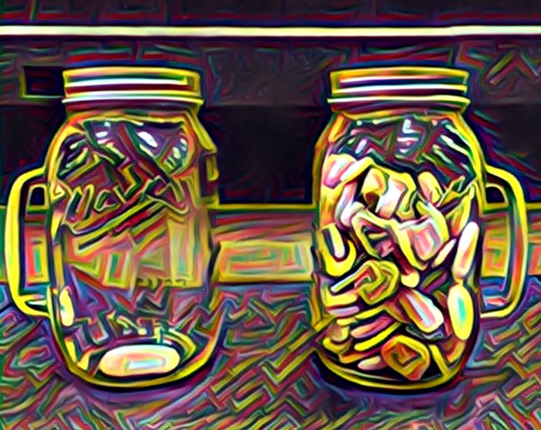
Rocks
אֲבָנִים
“Teach us to count our days,
so that we may acquire a wise and loving heart.”
- Psalm 90:12
Bim Bam
Video
Last Word
Candles
Kiddush
Hamotzi
Oseh Shalom
Priestly Blessing
Rocks
לִמְנוֹת יָמֵינוּ, כֵּן הוֹדַע וְנָבִא, לְבַב חָכְמָה
Notes:
Rocks slide. Leader: Micah. Content area left open - drop in the rocks image or text here.

