Slide 1
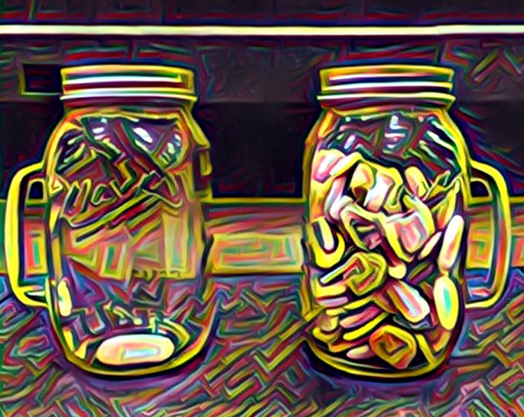

Rocks
אֲבָנִים
“Teach us to count our days,
so that we may acquire a wise and loving heart.”
- Psalm 90:12
Bim Bam
Video
Last Word
Candles
Kiddush
Hamotzi
Oseh Shalom
Priestly Blessing
Rocks
לִמְנוֹת יָמֵינוּ, כֵּן הוֹדַע וְנָבִא, לְבַב חָכְמָה
Notes:
Rocks slide. Leader: Micah. Content area left open - drop in the rocks image or text here.

