Slide 1

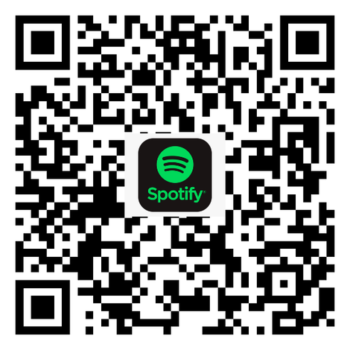
Shabbat
Shalom!
Living
Our
Values
Everyday
Learn our Shabbat prayers and songs!
The Davis Academy Shabbat and Jewish Music Playlist!

Slide 2
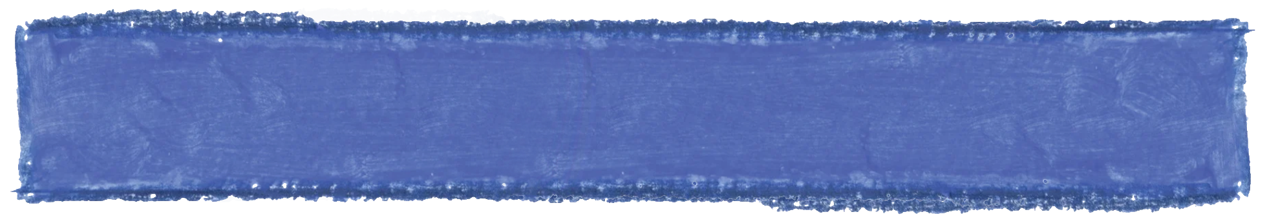
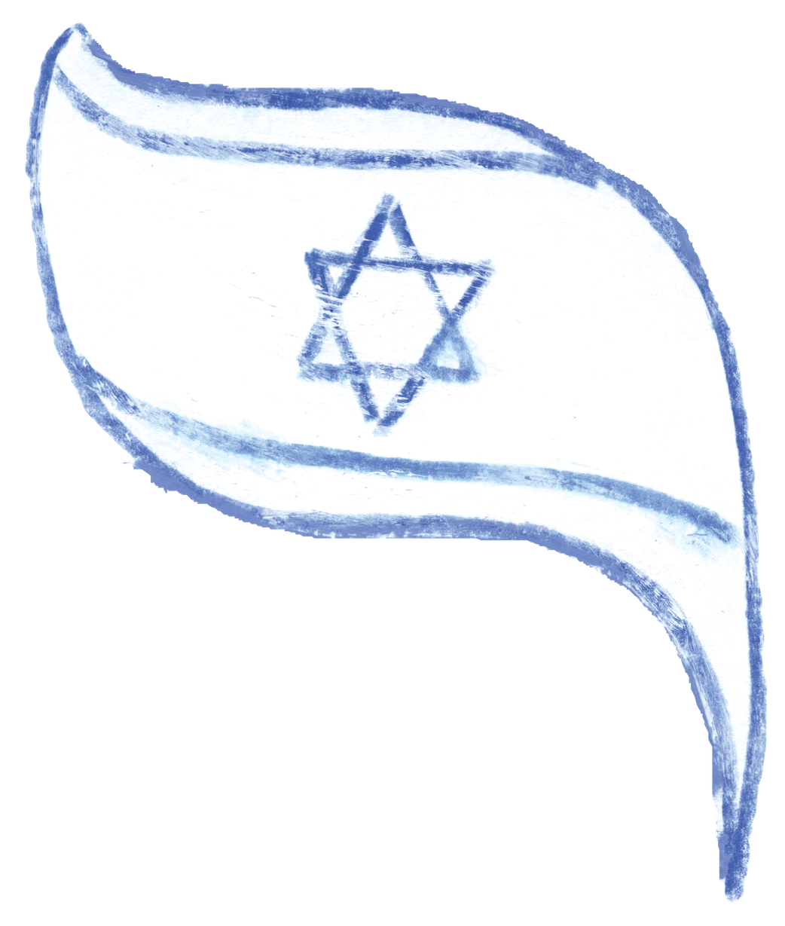
הַתִּקְוָה
Hatikvah
Kol od baleivav p’nimah
nefesh Y’hudi homiyah
ul’faatei mizrach kadimah
ayin l’Tziyon tzofiyah.
Od lo av’dah tikvateinu
hatikvah bat sh’not alpayim
lih’yot am chofshi b’artzeinu
eretz Tziyon virushalayim.
כֹּל עוֹד בַּלֵּבָב פְּנִימָה
נֶפֶשׁ יְהוּדִי הוֹמִיָּה,
וּלְפַאֲתֵי מִזְרָח, קָדִימָה,
עַיִן לְצִיּוֹן צוֹפִיָּה,
עוֹד לֹא אָבְדָה תִּקְוָתֵנוּ,
הַתִּקְוָה בַּת שְׁנוֹת אַלְפַּיִם,
לִהְיוֹת עַם חָפְשִׁי בְּאַרְצֵנוּ,
אֶרֶץ צִיּוֹן וִירוּשָׁלַיִם.
So long as within the inmost heart a Jewish spirit sings,
so long as the eye looks eastward, gazing toward Zion, our hope is not lost—the hope of two thousand years: to be free people in our land, the land of Zion and Jerusalem.

Slide 3

Hinei Mah Tov
הִנֵּה מַה טּוֹב
Hineih mah tov u'mah na-im
shevet achim gam yachad.
הִנֵּה מַה־טּוֹב וּמַה־נָּעִים
שֶׁבֶת אַחִים גַּם־יָחַד.
▾ Opening
• Pledge / HaTikvah
• Hinei Mah Tov
• Living Our Values
• Modeh Ani
• Ozi V'zimrat Yah
‣ Sh'ma and Its Blessings
‣ Amidah
‣ The Blessings of Our Lives
‣ Prayers of Welcome
‣ Conclusion
How good and how pleasant it is that brothers and sisters dwell together. (Psalm 133:1)

Slide 4

Living Our Values Everyday
צֶדֶק
Righteousness
קְהִילָּה
Community
כָּבוֹד
Respect
רוּחַ
Spirit
חָכְמָה
Wisdom

Slide 5


MORNING BLESSINGS | BIRCHOT HASHACHAR
Modah ani l’fanecha,
Melech chai v’kayam,
she-hechezarta bi nishmati b’chemlah, rabbah emunatecha.
מוֹדֶה אֲנִי לְפָנֶֽיךָ,
מֶֽלֶךְ חַי וְקַיָּם,
שֶׁהֶחֱזַֽרְתָּ בִּי נִשְׁמָתִי
בְּחֶמְלָה רַבָּה אֱמוּנָתֶֽךָ.
I offer thanks to You,
ever-living Sovereign,
that You have restored my soul to me. How great is Your trust.

Slide 6
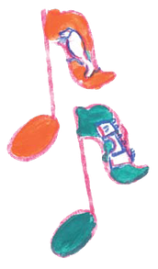
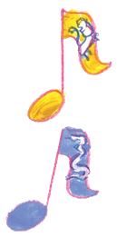
Ozi V’zimrat Yah
עׇזִּי וְזִמְרָת יָהּ
עׇזִּי וְזִמְרָת יָהּ וַיְהִי־לִי לִישׁוּעָה
Ozi v’zimrat yah,
vayehi li vayehi li
lishua, lishua, lishua
My strength and the song of God will be my salvation

Slide 7
Bar'chu
בָּרְכוּ
Bar'chu et Adonai ham'vorach!
Baruch Adonai ham'vorach l'olam va-ed!
בָּרְכוּ אֶת יְיָ הַמְבֹרָךְ!
בָּרוּךְ יְיָ הַמְבֹרָךְ לְעוֹלָם וָעֶד!
‣ Opening
▾ Sh'ma and Its Blessings
• Bar'chu
• Sh'ma
• V'ahavta
• Mi Chamochah
‣ Amidah
‣ The Blessings of Our Lives
‣ Prayers of Welcome
‣ Conclusion
Praise Adonai, to whom praise is due! Praise Adonai, to whom praise is due, now and forever!

Slide 8
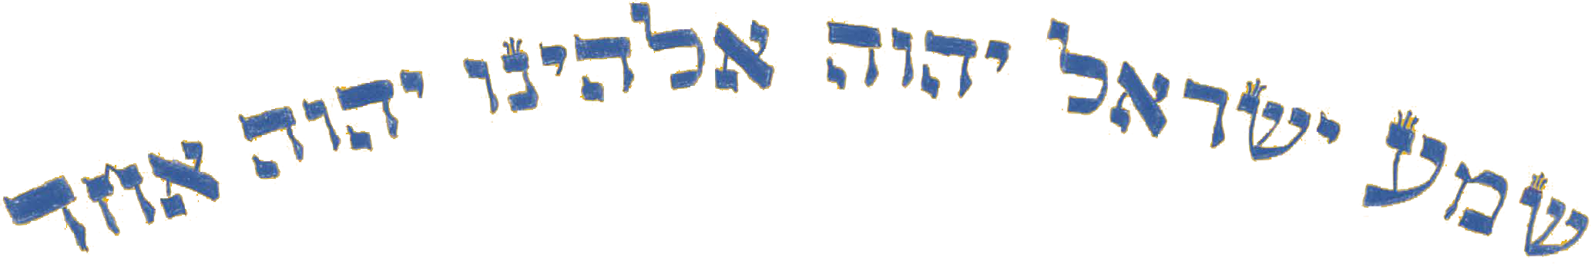
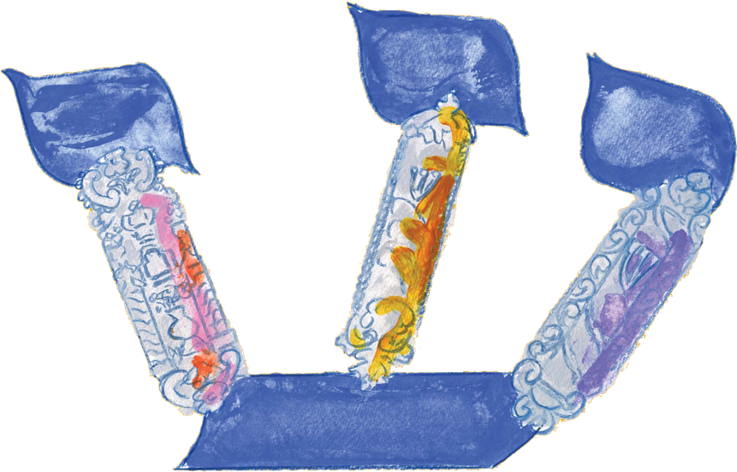
Sh'ma Yisrael,
Adonai Eloheinu, Adonai Echad!
Baruch shem k'vod malchuto
l'olam va-ed.
שְׁמַע יִשְׂרָאֵל,
יְהֹוָה אֱלֹהֵֽינוּ, יְהֹוָה אֶחָד!
בָּרוּךְ שֵׁם כְּבוֹד מַלְכוּתוֹ
לְעוֹלָם וָעֶד!

Slide 9

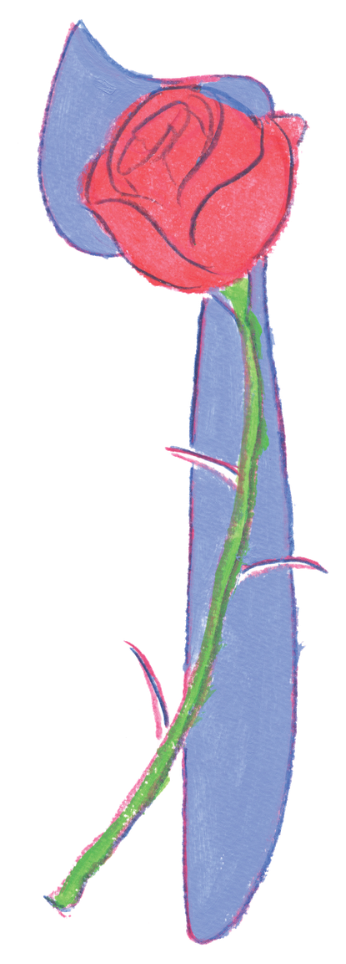
SH'MA AND ITS BLESSING | SH'MA UVIRCHOTEHA
You shall love Adonai your God
with all your heart,
with all your soul,
and with all your might.
Place the words
I command you today
on your heart.
…
וְאָהַבְתָּ אֵת יְהֹוָה אֱלֹהֶֽיךָ בְּכָל֯־לְ֯בָבְ֒ךָ
וּבְכָל־נַפְשְׁ֒ךָ
וּבְכָל־מְאֹדֶֽךָ:
וְהָיוּ הַדְּ֒בָרִים הָאֵֽלֶּה
אֲשֶׁר֯ אָ֯נֹכִי מְצַוְּ֒ךָ
הַיּוֹם עַל֯־לְ֯בָבֶֽךָ:
...
‣ Opening
▾ Sh'ma and Its Blessings
• Bar'chu
• Sh'ma
• V'ahavta
● ○ ○
• Mi Chamochah
‣ Amidah
‣ The Blessings of Our Lives
‣ Prayers of Welcome
‣ Conclusion

Slide 10
SH'MA AND ITS BLESSING | SH'MA UVIRCHOTEHA
Repeat them to your children
and speak them
when you sit at home
and when you walk on the street,
when you lie down
and when you get up.
Tie them as a sign on your hand,
and let them be a symbol
between your eyes.
Write them on the doorposts
of your house and on your gates.
…
וְשִׁנַּנְתָּם לְבָנֶֽיךָ
וְדִבַּרְתָּ בָּם
בְּשִׁבְתְּ֒ךָ בְּבֵיתֶֽךָ
וּבְלֶכְתְּ֒ךָ בַדֶּֽרֶךְ
וּבְשָׁכְבְּ֒ךָ וּבְקוּמֶֽךָ.
וּקְשַׁרְתָּם לְאוֹת עַל֯־יָ֯דֶֽךָ
וְהָיוּ לְטֹטָפֹת בֵּין עֵינֶֽיךָ.
וּכְתַבְתָּם עַל־מְזֻזוֹת
בֵּיתֶֽךָ וּבִשְׁעָרֶֽיךָ.
...

Slide 11
SH'MA AND ITS BLESSING | SH'MA UVIRCHOTEHA
In this way, you will remember
and do all My mitzvot,
and you will be holy
to your God.
I am Adonai your God
who brought you out of
the land of Egypt
to be your God.
I am Adonai your God.
לְמַֽעַן תִּזְכְּ֒רוּ
וַעֲשִׂיתֶם֯ אֶ֯ת־כָּל־מִצְוֹתָי
וִהְיִיתֶם קְדשִׁים
לֵאלֹהֵיכֶם.
אֲנִי יְהֹוָה אֱלֹהֵיכֶם֯
אֲ֯שֶׁר הוֹצֵֽאתִי אֶתְכֶם֯
מֵ֯אֶֽרֶץ מִצְרַֽיִם
לִהְיוֹת לָכֶם לֵאלֹהִים֯
אֲ֯נִי יְהֹוָה אֱלֹהֵיכֶם֯.

Slide 12
Mi Chamochah
מִי כָמֹכָה
Mi chamochah ba-eilim, Adonai!
Mi kamochah nedar bakodesh,
nora t'hilot, oseih fele!
מִי כָמֹכָה בָּאֵלִם יְיָ,
מִי כָּמֹכָה נֶאְדָּר בַּקֹּדֶשׁ,
נוֹרָא תְהִלֹּת עֹשֵׂה פֶלֶא.
‣ Opening
▾ Sh'ma and Its Blessings
• Bar'chu
• Sh'ma
• V'ahavta
• Mi Chamochah
‣ Amidah
‣ The Blessings of Our Lives
‣ Prayers of Welcome
‣ Conclusion
Who is like You, Adonai, among the gods that are worshipped? Who is like You, majestic in holiness, awesome in splendor, working wonders!

Slide 13
Amidah
עֲמִידָה
Please RISE and open your siddur to the following page
Adonai S’fatai 124 or 98
Avot 126 or 100
G’vurot 128 or 102
Kedushah 130 or 104
Student siddur on the following page:
10

Slide 14
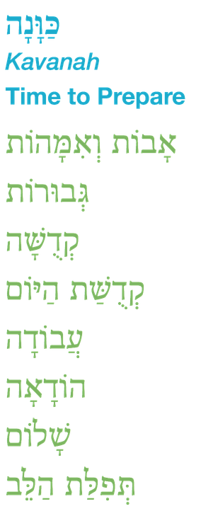
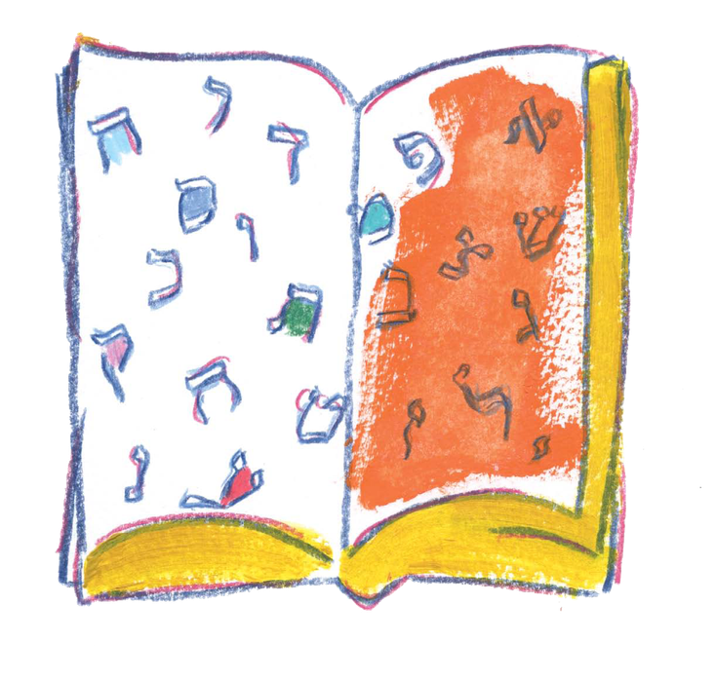
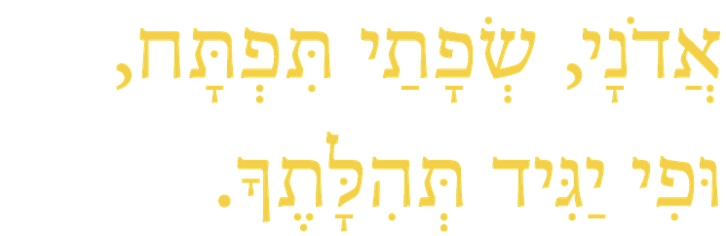
Eternity Utters a Day
Dan Nichols
A thought has blown the market place away
There is a song on the wind and joy in the trees
Shabbat has arrived in the world
Scattering a song in the silence of the night
And eternity utters a day (2x)
‣ Opening
‣ Sh'ma and Its Blessings
▾ Amidah
• Amidah
○ ●
• Mi Shebeirach
• Oseh Shalom
‣ The Blessings of Our Lives
‣ Prayers of Welcome
‣ Conclusion
Adonai, s'fatai tiftach, ufi yagid t'hilatecha.

Slide 15
Mi Shebeirach
מִי שֶׁבֵּרַךְ
Mi shebeirach avoteinu,
m'kor hab'rachah l'imoteinu.
Mi shebeirach imoteinu,
m'kor hab'rachah la'avoteinu.
מִי שֶׁבֵּרַךְ אֲבוֹתֵינוּ,
מְקוֹר הַבְּרָכָה לְאִמּוֹתֵינוּ.
מִי שֶׁבֵּרַךְ אִמּוֹתֵינוּ,
מְקוֹר הַבְּרָכָה לַאֲבוֹתֵינוּ.
‣ Opening
‣ Sh'ma and Its Blessings
▾ Amidah
• Amidah
• Mi Shebeirach
● ○
• Oseh Shalom
‣ The Blessings of Our Lives
‣ Prayers of Welcome
‣ Conclusion
May the One who blessed our fathers be the source of blessing for our mothers; may the One who blessed our mothers be the source of blessing for our fathers.

Slide 16
Mi Shebeirach
מִי שֶׁבֵּרַךְ
[ English refrain — Debbie Friedman ]
‣ Opening
‣ Sh'ma and Its Blessings
▾ Amidah
• Amidah
• Mi Shebeirach
○ ●
• Oseh Shalom
‣ The Blessings of Our Lives
‣ Prayers of Welcome
‣ Conclusion
Friedman's English refrain is her own copyrighted lyric, so it is not reproduced here. Paste in the school's existing slide.

Slide 17
Oseh Shalom
עֹשֶׂה שָׁלוֹם
Oseh shalom bimromav,
hu yaaseh shalom aleinu,
v’al kol Yisrael,
v’al kol yosh’vei teiveil,
v’imru: Amen.
עֹשֶׂה שָׁלוֹם בִּמְרוֹמָיו,
הוּא יַעֲשֶׂה שָׁלוֹם עָלֵינוּ,
וְעַל כָּל יִשְׂרָאֵל,
וְעַל כָּל יוֹשְׁבֵי תֵבֵל,
וְאִמְרוּ: אָמֵן.
‣ Opening
‣ Sh'ma and Its Blessings
▾ Amidah
• Amidah
• Mi Shebeirach
• Oseh Shalom
‣ The Blessings of Our Lives
‣ Prayers of Welcome
‣ Conclusion
May the One who makes peace in the high heavens make peace for us, for all Israel, and for all who dwell on earth. And let us say: Amen.

Slide 18
Class Song
שִׁיר הַכִּתָּה
[ Class Song ]
‣ Opening
‣ Sh'ma and Its Blessings
‣ Amidah
▾ The Blessings of Our Lives
• Class Song
• Birthday Blessings
• Rock Counting
‣ Prayers of Welcome
‣ Conclusion
Changes weekly. Drop this week's song in — same frame, same type sizes.

Slide 19

יוֹם הוּלֶדֶת שָׂמֵחַ
Happy Birthday
בָּרוּךְ אַתָּה יְיָ אֱלֹהֵינוּ מֶלֶךְ הָעוֹלָם שֶׁהֶחֱיָנוּ וְקִיְּמָנוּ וְהִגִּיעָנוּ לַזְּמַן הַזֶּה׃
Shehechiyanu v’kiyamanu v’higiyanu lazman hazeh

Slide 20
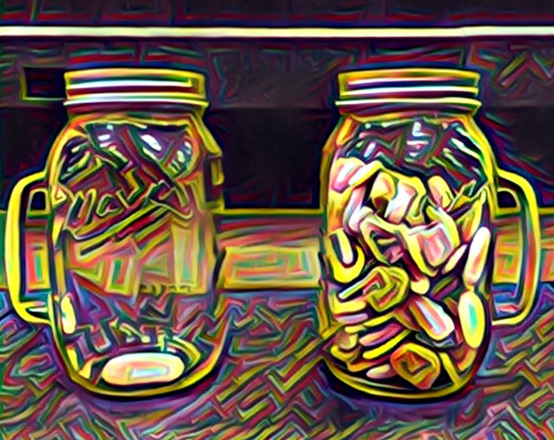
Rocks
אֲבָנִים
“Teach us to count our days,
so that we may acquire a wise and loving heart.”
- Psalm 90:12
‣ Opening
‣ Sh'ma and Its Blessings
‣ Amidah
▾ The Blessings of Our Lives
• Class Song
• Birthday Blessings
• Rock Counting
‣ Prayers of Welcome
‣ Conclusion
לִמְנוֹת יָמֵינוּ, כֵּן הוֹדַע וְנָבִא, לְבַב חָכְמָה

Slide 21
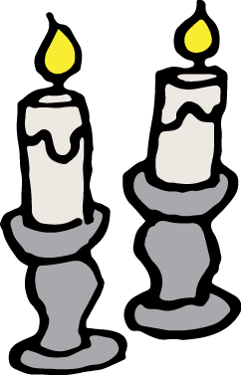
Candle Blessing
הַדְלָקַת נֵרוֹת
Baruch atah, Adonai,
Eloheinu Melech haolam,
asher kid’shanu b’mitzvotav
v’tzivanu l’hadlik
ner shel Shabbat.
בָּרוּךְ אַתָּה יְיָ,
אֱלֹהֵינוּ מֶלֶךְ הָעוֹלָם,
אֲשֶׁר קִדְּשָׁנוּ בְּמִצְוֹתָיו
וְצִוָּנוּ לְהַדְלִיק
נֵר שֶׁל שַׁבָּת.
‣ Opening
‣ Sh'ma and Its Blessings
‣ Amidah
‣ The Blessings of Our Lives
▾ Prayers of Welcome
• Candles
• Kiddush
• Motzi
‣ Conclusion
Blessed are You, Adonai our God, Sovereign of all, who makes us holy with mitzvot and calls us to kindle the lights of Shabbat.

Slide 22

Kiddush
קִדּוּשׁ
Baruch atah, Adonai,
Eloheinu Melech haolam,
borei p’ri hagafen.
בָּרוּךְ אַתָּה יְיָ,
אֱלֹהֵינוּ מֶלֶךְ הָעוֹלָם,
בּוֹרֵא פְּרִי הַגָּפֶן.
‣ Opening
‣ Sh'ma and Its Blessings
‣ Amidah
‣ The Blessings of Our Lives
▾ Prayers of Welcome
• Candles
• Kiddush
● ○ ○
• Motzi
‣ Conclusion
Blessed are You, Adonai our God, Sovereign of all, Creator of the fruit of the vine.

Slide 23
Kiddush
קִדּוּשׁ
Baruch atah, Adonai,
Eloheinu Melech haolam,
asher kid’shanu b’mitzvotav
v’ratzah vanu, v’Shabbat kodsho
b’ahavah uv’ratzon hinchilanu,
zikaron l’maaseih v’reishit.
בָּרוּךְ אַתָּה, יְיָ,
אֱלֹהֵינוּ, מֶלֶךְ הָעוֹלָם,
אֲשֶׁר קִדְּשָׁנוּ בְּמִצְוֹתָיו
וְרָצָה בָנוּ, וְשַׁבַּת קָדְשׁוֹ
בְּאַהֲבָה וּבְרָצוֹן הִנְחִילָנוּ,
זִכָּרוֹן לְמַעֲשֵׂה בְרֵאשִׁית.
‣ Opening
‣ Sh'ma and Its Blessings
‣ Amidah
‣ The Blessings of Our Lives
▾ Prayers of Welcome
• Candles
• Kiddush
○ ● ○
• Motzi
‣ Conclusion
Praise to You, Adonai our God, Sovereign of the universe who, finding favor with us, sanctified us with mitzvot. In love and favor, You made the holy Shabbat our heritage as a reminder of the work of Creation.

Slide 24
Kiddush
קִדּוּשׁ
Ki hu yom t’chilah
l’mikra-ei kodesh,
zeicher litziat Mitzrayim.
Ki vanu vacharta v’otanu
kidashta mikol haamim,
v’Shabbat kodsh’cha
b’ahavah uv’ratzon hinchaltanu.
כִּי הוּא יוֹם תְּחִלָּה
לְמִקְרָאֵי קֹדֶשׁ,
זֵכֶר לִיצִיאַת מִצְרָיִם.
כִּי בָנוּ בָחַרְתָּ וְאוֹתָנוּ
קִדַּשְׁתָּ מִכָּל הָעַמִּים,
וְשַׁבַּת קָדְשְׁךָ
בְּאַהֲבָה וּבְרָצוֹן הִנְחַלְתָּנוּ.
‣ Opening
‣ Sh'ma and Its Blessings
‣ Amidah
‣ The Blessings of Our Lives
▾ Prayers of Welcome
• Candles
• Kiddush
○ ○ ●
• Motzi
‣ Conclusion
בָּרוּךְ אַתָּה, יְיָ, מְקַדֵּשׁ הַשַּׁבָּת.
Baruch atah, Adonai, m’kadeish haShabbat.
As first among our sacred days, it recalls the Exodus from Egypt. You chose us and set us apart from the peoples. In love and favor You have given us Your holy Shabbat as an inheritance. Praise to You, Adonai, who sanctifies Shabbat.

Slide 25
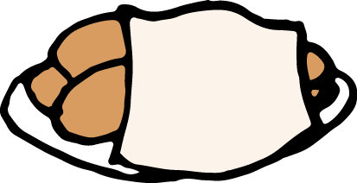
Hamotzi
הַמּוֹצִיא
Baruch atah, Adonai,
Eloheinu Melech haolam,
hamotzi lechem min haaretz.
בָּרוּךְ אַתָּה יְיָ,
אֱלֹהֵינוּ מֶלֶךְ הָעוֹלָם,
הַמּוֹצִיא לֶחֶם מִן הָאָרֶץ.
‣ Opening
‣ Sh'ma and Its Blessings
‣ Amidah
‣ The Blessings of Our Lives
▾ Prayers of Welcome
• Candles
• Kiddush
• Motzi
‣ Conclusion
Blessed are You, Adonai our God, Sovereign of all, who brings forth bread from the earth.

Slide 26

Priestly Blessing
בִּרְכַּת כֹּהֲנִים
Y’varech’cha Adonai v’yishm’recha.
Ya’eir Adonai panav eilecha vichuneka.
Yisa Adonai panav eilecha
v’yasem l’cha shalom.
יְבָרֶכְךָ יְיָ וְיִשְׁמְרֶךָ.
יָאֵר יְיָ פָּנָיו אֵלֶיךָ וִיחֻנֶּךָּ.
יִשָּׂא יְיָ פָּנָיו אֵלֶיךָ
וְיָשֵׂם לְךָ שָׁלוֹם.
‣ Opening
‣ Sh'ma and Its Blessings
‣ Amidah
‣ The Blessings of Our Lives
‣ Prayers of Welcome
▾ Conclusion
• Priestly Blessing
• Shofar Blessing
• Turn the World Around
May God bless you and keep you.
May God’s face shine upon you and be gracious to you.
May God’s face shine upon you and bless you with peace.

Slide 27
Shofar Blessing
תְּקִיעַת שׁוֹפָר
Baruch atah, Adonai,
Eloheinu Melech haolam,
asher kid'shanu b'mitzvotav
v'tzivanu lishmoa kol shofar.
בָּרוּךְ אַתָּה יְיָ,
אֱלֹהֵינוּ מֶלֶךְ הָעוֹלָם,
אֲשֶׁר קִדְּשָׁנוּ בְּמִצְוֹתָיו
וְצִוָּנוּ לִשְׁמֹעַ קוֹל שׁוֹפָר.
‣ Opening
‣ Sh'ma and Its Blessings
‣ Amidah
‣ The Blessings of Our Lives
‣ Prayers of Welcome
▾ Conclusion
• Priestly Blessing
• Shofar Blessing
• Turn the World Around
Blessed are You, Adonai our God, Sovereign of the universe, who makes us holy with mitzvot and calls us to hear the sound of the shofar.

Slide 28
Turn the World Around
[ Turn the World Around — Harry Belafonte ]
‣ Opening
‣ Sh'ma and Its Blessings
‣ Amidah
‣ The Blessings of Our Lives
‣ Prayers of Welcome
▾ Conclusion
• Priestly Blessing
• Shofar Blessing
• Turn the World Around
Belafonte's lyric is copyrighted, so it is not reproduced here. Paste in the school's existing slide.

Slide 29
Living
Our
Values
Everyday
Shabbat Shalom!
Want to learn more of our Shabbat prayers and songs? Scan this QR code for The Davis Academy Shabbat and Jewish Music Playlist!

