Slide 1

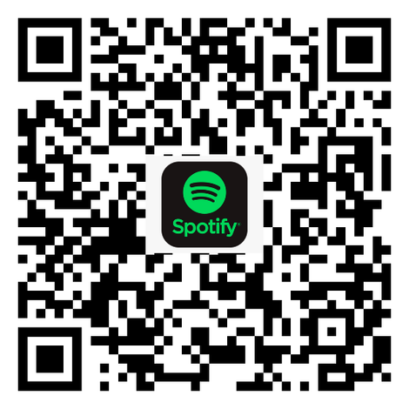
Shabbat Shalom!
שַׁבָּת שָׁלוֹם!
Learn the Davis Academy Shabbat prayers and songs!

Slide 2

HaTikvah
הַתִּקְוָה
▾ Opening
• Pledge / HaTikvah
• Hinei Mah Tov
• Living Our Values
• Modeh Ani
• Ozi V’zimrat Yah
‣ Sh’ma and Its Blessings
‣ Amidah
‣ The Blessings of Our Lives
‣ Prayers of Welcome
‣ Conclusion
Kol od baleivav p’nimah
nefesh Y’hudi homiyah
ul’faatei mizrach kadimah
ayin l’Tziyon tzofiyah.
Od lo av’dah tikvateinu
hatikvah bat sh’not alpayim
lih’yot am chofshi b’artzeinu
eretz Tziyon virushalayim.
כֹּל עוֹד בַּלֵּבָב פְּנִימָה
נֶפֶשׁ יְהוּדִי הוֹמִיָּה,
וּלְפַאֲתֵי מִזְרָח קָדִימָה,
עַיִן לְצִיּוֹן צוֹפִיָּה,
עוֹד לֹא אָבְדָה תִּקְוָתֵנוּ,
הַתִּקְוָה בַּת שְׁנוֹת אַלְפַּיִם,
לִהְיוֹת עַם חָפְשִׁי בְּאַרְצֵנוּ,
אֶרֶץ צִיּוֹן וִירוּשָׁלַיִם.
So long as within the inmost heart a Jewish spirit sings, and the eye looks eastward gazing toward Zion, our hope is not lost — the hope of two thousand years: to be a free people in our land, the land of Zion and Jerusalem.

Slide 3
Hinei Mah Tov
הִנֵּה מַה טּוֹב
▾ Opening
• Pledge / HaTikvah
• Hinei Mah Tov
• Living Our Values
• Modeh Ani
• Ozi V’zimrat Yah
‣ Sh’ma and Its Blessings
‣ Amidah
‣ The Blessings of Our Lives
‣ Prayers of Welcome
‣ Conclusion
Hineih mah tov u’mah na-im
shevet achim gam yachad.
הִנֵּה מַה־טּוֹב וּמַה־נָּעִים
שֶׁבֶת אַחִים גַּם־יָחַד.
How good and how pleasant it is that brothers and sisters dwell together. (Psalm 133:1)

Slide 4

Living Our Values Everyday
▾ Opening
• Pledge / HaTikvah
• Hinei Mah Tov
• Living Our Values
• Modeh Ani
• Ozi V’zimrat Yah
‣ Sh’ma and Its Blessings
‣ Amidah
‣ The Blessings of Our Lives
‣ Prayers of Welcome
‣ Conclusion
צֶדֶק
Righteousness
קְהִילָּה
Community
כָּבוֹד
Respect
רוּחַ
Spirit
חָכְמָה
Wisdom

Slide 5
Modeh Ani
מוֹדֶה אֲנִי
▾ Opening
• Pledge / HaTikvah
• Hinei Mah Tov
• Living Our Values
• Modeh Ani
• Ozi V’zimrat Yah
‣ Sh’ma and Its Blessings
‣ Amidah
‣ The Blessings of Our Lives
‣ Prayers of Welcome
‣ Conclusion
Modeh ani l’fanecha,
Melech chai v’kayam,
shehechezarta bi nishmati
b’chemlah, rabbah emunatecha.
מוֹדֶה אֲנִי לְפָנֶֽיךָ,
מֶֽלֶךְ חַי וְקַיָּם,
שֶׁהֶחֱזַֽרְתָּ בִּי נִשְׁמָתִי
בְּחֶמְלָה רַבָּה אֱמוּנָתֶֽךָ.
I offer thanks to You, ever-living Sovereign, that You have restored my soul to me. How great is Your trust.

Slide 6
Ozi V’zimrat Yah
עׇזִּי וְזִמְרָת יָהּ
▾ Opening
• Pledge / HaTikvah
• Hinei Mah Tov
• Living Our Values
• Modeh Ani
• Ozi V’zimrat Yah
‣ Sh’ma and Its Blessings
‣ Amidah
‣ The Blessings of Our Lives
‣ Prayers of Welcome
‣ Conclusion
Ozi v’zimrat Yah,
vay’hi li vay’hi li
lishuah, lishuah, lishuah.
עׇזִּי וְזִמְרָת יָהּ,
וַיְהִי־לִי וַיְהִי־לִי
לִישׁוּעָה, לִישׁוּעָה, לִישׁוּעָה.
My strength and the song of God will be my salvation.

Slide 7
Bar’chu
בָּרְכוּ
‣ Opening
▾ Sh’ma and Its Blessings
• Bar’chu
• Sh’ma
• V’ahavta
• Mi Chamochah
‣ Amidah
‣ The Blessings of Our Lives
‣ Prayers of Welcome
‣ Conclusion
Bar’chu et Adonai ham’vorach!
Baruch Adonai ham’vorach l’olam va-ed!
בָּרְכוּ אֶת יְיָ הַמְבֹרָךְ!
בָּרוּךְ יְיָ הַמְבֹרָךְ לְעוֹלָם וָעֶד!
Praise Adonai, to whom praise is due! Praise Adonai, to whom praise is due, now and forever!

Slide 8
Sh’ma
שְׁמַע
‣ Opening
▾ Sh’ma and Its Blessings
• Bar’chu
• Sh’ma
• V’ahavta
• Mi Chamochah
‣ Amidah
‣ The Blessings of Our Lives
‣ Prayers of Welcome
‣ Conclusion
Sh’ma Yisrael,
Adonai Eloheinu, Adonai Echad!
Baruch shem k’vod malchuto
l’olam va-ed.
שְׁמַע יִשְׂרָאֵל,
יְיָ אֱלֹהֵֽינוּ, יְיָ אֶחָד!
בָּרוּךְ שֵׁם כְּבוֹד מַלְכוּתוֹ
לְעוֹלָם וָעֶד!
Hear O Israel: Adonai is our God, Adonai is One! Blessed is God’s glorious majesty for ever and ever.

Slide 9

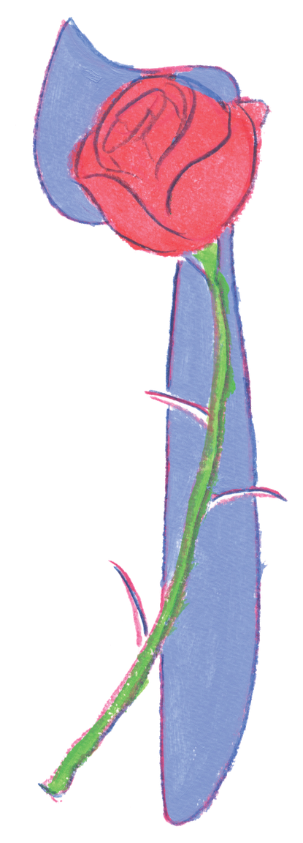
SH’MA AND ITS BLESSING | SH’MA UVIRCHOTEHA
‣ Opening
▾ Sh’ma and Its Blessings
• Bar’chu
• Sh’ma
• V’ahavta
● ○ ○
• Mi Chamochah
‣ Amidah
‣ The Blessings of Our Lives
‣ Prayers of Welcome
‣ Conclusion
You shall love Adonai your God
with all your heart,
with all your soul,
and with all your might.
Place the words
I command you today
on your heart.
…
וְאָהַבְתָּ אֵת יְהֹוָה אֱלֹהֶֽיךָ בְּכָל֯־לְ֯בָבְ֒ךָ
וּבְכָל־נַפְשְׁ֒ךָ
וּבְכָל־מְאֹדֶֽךָ:
וְהָיוּ הַדְּ֒בָרִים הָאֵֽלֶּה
אֲשֶׁר֯ אָ֯נֹכִי מְצַוְּ֒ךָ
הַיּוֹם עַל֯־לְ֯בָבֶֽךָ:
...

Slide 10
V’ahavta
וְאָהַבְתָּ
‣ Opening
▾ Sh’ma and Its Blessings
• Bar’chu
• Sh’ma
• V’ahavta
○ ● ○
• Mi Chamochah
‣ Amidah
‣ The Blessings of Our Lives
‣ Prayers of Welcome
‣ Conclusion
Repeat them to your children
and speak them
when you sit at home
and when you walk on the street,
when you lie down and when you get up.
Tie them as a sign on your hand,
and let them be a symbol between your eyes.
Write them on the doorposts
of your house and on your gates.
וְשִׁנַּנְתָּם לְבָנֶֽיךָ
וְדִבַּרְתָּ בָּם
בְּשִׁבְתְּךָ בְּבֵיתֶֽךָ
וּבְלֶכְתְּךָ בַדֶּֽרֶךְ
וּבְשָׁכְבְּךָ וּבְקוּמֶֽךָ.
וּקְשַׁרְתָּם לְאוֹת עַל־יָדֶֽךָ
וְהָיוּ לְטֹטָפֹת בֵּין עֵינֶֽיךָ.
וּכְתַבְתָּם עַל־מְזֻזוֹת
בֵּיתֶֽךָ וּבִשְׁעָרֶֽיךָ.

Slide 11
V’ahavta
וְאָהַבְתָּ
‣ Opening
▾ Sh’ma and Its Blessings
• Bar’chu
• Sh’ma
• V’ahavta
○ ○ ●
• Mi Chamochah
‣ Amidah
‣ The Blessings of Our Lives
‣ Prayers of Welcome
‣ Conclusion
In this way, you will remember
and do all My mitzvot,
and you will be holy
to your God.
I am Adonai your God
who brought you out of
the land of Egypt
to be your God.
I am Adonai your God.
לְמַֽעַן תִּזְכְּרוּ
וַעֲשִׂיתֶם אֶת־כָּל־מִצְוֹתָי
וִהְיִיתֶם קְדֹשִׁים
לֵאלֹהֵיכֶם.
אֲנִי יְיָ אֱלֹהֵיכֶם
אֲשֶׁר הוֹצֵֽאתִי אֶתְכֶם
מֵאֶֽרֶץ מִצְרַֽיִם
לִהְיוֹת לָכֶם לֵאלֹהִים
אֲנִי יְיָ אֱלֹהֵיכֶם.

Slide 12
Mi Chamochah
מִי כָמֹכָה
‣ Opening
▾ Sh’ma and Its Blessings
• Bar’chu
• Sh’ma
• V’ahavta
• Mi Chamochah
‣ Amidah
‣ The Blessings of Our Lives
‣ Prayers of Welcome
‣ Conclusion
Mi chamochah ba-eilim, Adonai!
Mi kamochah nedar bakodesh,
nora t’hilot, oseih fele!
מִי כָמֹכָה בָּאֵלִם יְיָ,
מִי כָּמֹכָה נֶאְדָּר בַּקֹּדֶשׁ,
נוֹרָא תְהִלֹּת עֹשֵׂה פֶלֶא.
Who is like You, Adonai, among the gods that are worshipped? Who is like You, majestic in holiness, awesome in splendor, working wonders!

Slide 13
Amidah
עֲמִידָה
‣ Opening
‣ Sh’ma and Its Blessings
▾ Amidah
• Amidah
● ○
• Mi Shebeirach
• Oseh Shalom
‣ The Blessings of Our Lives
‣ Prayers of Welcome
‣ Conclusion
Please rise and open your siddur:
Adonai S’fatai — 124 or 98
Avot v’Imahot — 126 or 100
G’vurot — 128 or 102
K’dushah — 130 or 104
Student siddur: page 10.

Slide 14
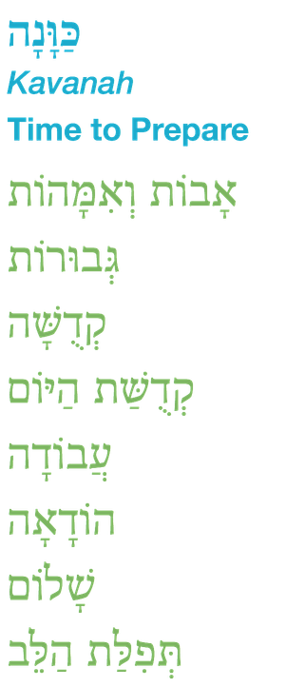
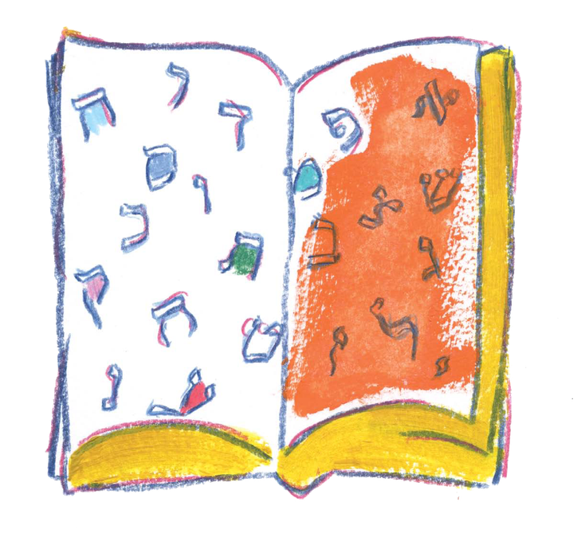
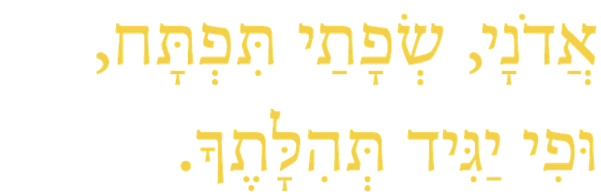
Eternity Utters a Day
Dan Nichols
A thought has blown the market place away
There is a song on the wind and joy in the trees
Shabbat has arrived in the world
Scattering a song in the silence of the night
And eternity utters a day (2x)
‣ Opening
‣ Sh’ma and Its Blessings
▾ Amidah
• Amidah
○ ●
• Mi Shebeirach
• Oseh Shalom
‣ The Blessings of Our Lives
‣ Prayers of Welcome
‣ Conclusion
Adonai, s’fatai tiftach, ufi yagid t’hilatecha.

Slide 15
Mi Shebeirach
מִי שֶׁבֵּרַךְ
‣ Opening
‣ Sh’ma and Its Blessings
▾ Amidah
• Amidah
• Mi Shebeirach
● ○
• Oseh Shalom
‣ The Blessings of Our Lives
‣ Prayers of Welcome
‣ Conclusion
Mi shebeirach avoteinu,
m’kor hab’rachah l’imoteinu.
Mi shebeirach imoteinu,
m’kor hab’rachah la’avoteinu.
מִי שֶׁבֵּרַךְ אֲבוֹתֵינוּ,
מְקוֹר הַבְּרָכָה לְאִמּוֹתֵינוּ.
מִי שֶׁבֵּרַךְ אִמּוֹתֵינוּ,
מְקוֹר הַבְּרָכָה לַאֲבוֹתֵינוּ.
May the One who blessed our fathers be the source of blessing for our mothers; may the One who blessed our mothers be the source of blessing for our fathers.

Slide 16
Mi Shebeirach
מִי שֶׁבֵּרַךְ
‣ Opening
‣ Sh’ma and Its Blessings
▾ Amidah
• Amidah
• Mi Shebeirach
○ ●
• Oseh Shalom
‣ The Blessings of Our Lives
‣ Prayers of Welcome
‣ Conclusion
[ English refrain — Debbie Friedman ]
Friedman’s English refrain is her own copyrighted lyric, so it is not reproduced here. Paste in the school’s existing slide.

Slide 17
Oseh Shalom
עֹשֶׂה שָׁלוֹם
‣ Opening
‣ Sh’ma and Its Blessings
▾ Amidah
• Amidah
• Mi Shebeirach
• Oseh Shalom
‣ The Blessings of Our Lives
‣ Prayers of Welcome
‣ Conclusion
Oseh shalom bimromav,
hu yaaseh shalom aleinu,
v’al kol Yisrael,
v’al kol yosh’vei teiveil,
v’imru: Amen.
עֹשֶׂה שָׁלוֹם בִּמְרוֹמָיו,
הוּא יַעֲשֶׂה שָׁלוֹם עָלֵינוּ,
וְעַל כָּל יִשְׂרָאֵל,
וְעַל כָּל יוֹשְׁבֵי תֵבֵל,
וְאִמְרוּ: אָמֵן.
May the One who makes peace in the high heavens make peace for us, for all Israel, and for all who dwell on earth. And let us say: Amen.

Slide 18
Class Song
שִׁיר הַכִּתָּה
‣ Opening
‣ Sh’ma and Its Blessings
‣ Amidah
▾ The Blessings of Our Lives
• Class Song
• Birthday Blessings
• Rock Counting
‣ Prayers of Welcome
‣ Conclusion
[ Class Song ]
Changes weekly. Drop this week’s song in — same frame, same type sizes.

Slide 19
Birthday Blessings
יוֹם הֻלֶּדֶת שָׂמֵחַ
‣ Opening
‣ Sh’ma and Its Blessings
‣ Amidah
▾ The Blessings of Our Lives
• Class Song
• Birthday Blessings
• Rock Counting
‣ Prayers of Welcome
‣ Conclusion
Baruch atah, Adonai,
Eloheinu Melech haolam,
shehecheyanu v’kiy’manu
v’higianu lazman hazeh.
בָּרוּךְ אַתָּה יְיָ,
אֱלֹהֵינוּ מֶלֶךְ הָעוֹלָם,
שֶׁהֶחֱיָנוּ וְקִיְּמָנוּ
וְהִגִּיעָנוּ לַזְּמַן הַזֶּה.
Blessed are You, Adonai our God, Sovereign of the universe, who has kept us alive, sustained us, and brought us to this season.

Slide 20
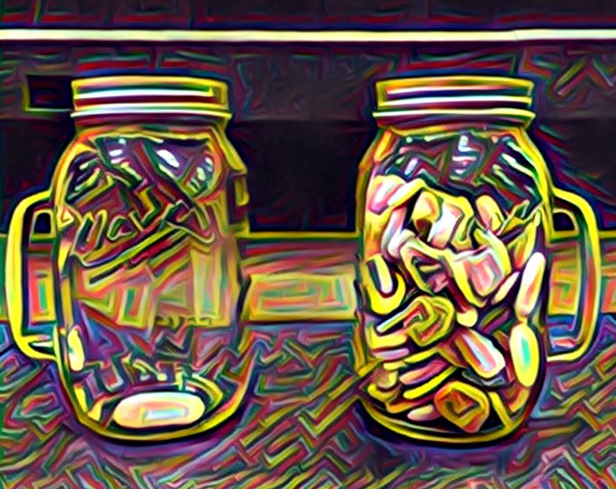
Rocks
אֲבָנִים
“Teach us to count our days,
so that we may acquire a wise and loving heart.”
- Psalm 90:12
‣ Opening
‣ Sh’ma and Its Blessings
‣ Amidah
▾ The Blessings of Our Lives
• Class Song
• Birthday Blessings
• Rock Counting
‣ Prayers of Welcome
‣ Conclusion
לִמְנוֹת יָמֵינוּ, כֵּן הוֹדַע וְנָבִא, לְבַב חָכְמָה

Slide 21

Candle Blessing
הַדְלָקַת נֵרוֹת
‣ Opening
‣ Sh’ma and Its Blessings
‣ Amidah
‣ The Blessings of Our Lives
▾ Prayers of Welcome
• Candles
• Kiddush
• Motzi
‣ Conclusion
Baruch atah, Adonai,
Eloheinu Melech haolam,
asher kid’shanu b’mitzvotav
v’tzivanu l’hadlik
ner shel Shabbat.
בָּרוּךְ אַתָּה יְיָ,
אֱלֹהֵינוּ מֶלֶךְ הָעוֹלָם,
אֲשֶׁר קִדְּשָׁנוּ בְּמִצְוֹתָיו
וְצִוָּנוּ לְהַדְלִיק
נֵר שֶׁל שַׁבָּת.
Blessed are You, Adonai our God, Sovereign of all, who makes us holy with mitzvot and calls us to kindle the lights of Shabbat.

Slide 22

Kiddush
קִדּוּשׁ
‣ Opening
‣ Sh’ma and Its Blessings
‣ Amidah
‣ The Blessings of Our Lives
▾ Prayers of Welcome
• Candles
• Kiddush
● ○ ○
• Motzi
‣ Conclusion
Baruch atah, Adonai,
Eloheinu Melech haolam,
borei p’ri hagafen.
בָּרוּךְ אַתָּה יְיָ,
אֱלֹהֵינוּ מֶלֶךְ הָעוֹלָם,
בּוֹרֵא פְּרִי הַגָּפֶן.
Blessed are You, Adonai our God, Sovereign of all, Creator of the fruit of the vine.

Slide 23
Kiddush
קִדּוּשׁ
‣ Opening
‣ Sh’ma and Its Blessings
‣ Amidah
‣ The Blessings of Our Lives
▾ Prayers of Welcome
• Candles
• Kiddush
○ ● ○
• Motzi
‣ Conclusion
Baruch atah, Adonai,
Eloheinu Melech haolam,
asher kid’shanu b’mitzvotav
v’ratzah vanu, v’Shabbat kodsho
b’ahavah uv’ratzon hinchilanu,
zikaron l’maaseih v’reishit.
בָּרוּךְ אַתָּה, יְיָ,
אֱלֹהֵינוּ, מֶלֶךְ הָעוֹלָם,
אֲשֶׁר קִדְּשָׁנוּ בְּמִצְוֹתָיו
וְרָצָה בָנוּ, וְשַׁבַּת קָדְשׁוֹ
בְּאַהֲבָה וּבְרָצוֹן הִנְחִילָנוּ,
זִכָּרוֹן לְמַעֲשֵׂה בְרֵאשִׁית.
Praise to You, Adonai our God, Sovereign of the universe who, finding favor with us, sanctified us with mitzvot. In love and favor, You made the holy Shabbat our heritage as a reminder of the work of Creation.

Slide 24
Kiddush
קִדּוּשׁ
‣ Opening
‣ Sh’ma and Its Blessings
‣ Amidah
‣ The Blessings of Our Lives
▾ Prayers of Welcome
• Candles
• Kiddush
○ ○ ●
• Motzi
‣ Conclusion
Ki hu yom t’chilah
l’mikra-ei kodesh,
zeicher litziat Mitzrayim.
Ki vanu vacharta v’otanu
kidashta mikol haamim,
v’Shabbat kodsh’cha
b’ahavah uv’ratzon hinchaltanu.
כִּי הוּא יוֹם תְּחִלָּה
לְמִקְרָאֵי קֹדֶשׁ,
זֵכֶר לִיצִיאַת מִצְרָיִם.
כִּי בָנוּ בָחַרְתָּ וְאוֹתָנוּ
קִדַּשְׁתָּ מִכָּל הָעַמִּים,
וְשַׁבַּת קָדְשְׁךָ
בְּאַהֲבָה וּבְרָצוֹן הִנְחַלְתָּנוּ.
בָּרוּךְ אַתָּה, יְיָ, מְקַדֵּשׁ הַשַּׁבָּת.
Baruch atah, Adonai, m’kadeish haShabbat.
As first among our sacred days, it recalls the Exodus from Egypt. You chose us and set us apart from the peoples. In love and favor You have given us Your holy Shabbat as an inheritance. Praise to You, Adonai, who sanctifies Shabbat.

Slide 25
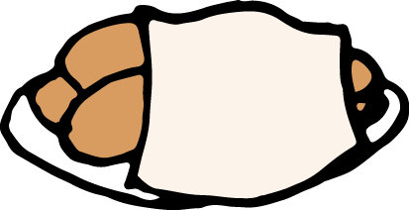
Hamotzi
הַמּוֹצִיא
‣ Opening
‣ Sh’ma and Its Blessings
‣ Amidah
‣ The Blessings of Our Lives
▾ Prayers of Welcome
• Candles
• Kiddush
• Motzi
‣ Conclusion
Baruch atah, Adonai,
Eloheinu Melech haolam,
hamotzi lechem min haaretz.
בָּרוּךְ אַתָּה יְיָ,
אֱלֹהֵינוּ מֶלֶךְ הָעוֹלָם,
הַמּוֹצִיא לֶחֶם מִן הָאָרֶץ.
Blessed are You, Adonai our God, Sovereign of all, who brings forth bread from the earth.

Slide 26

Priestly Blessing
בִּרְכַּת כֹּהֲנִים
‣ Opening
‣ Sh’ma and Its Blessings
‣ Amidah
‣ The Blessings of Our Lives
‣ Prayers of Welcome
▾ Conclusion
• Priestly Blessing
• Shofar Blessing
• Turn the World Around
Y’varech’cha Adonai v’yishm’recha.
Ya’eir Adonai panav eilecha vichuneka.
Yisa Adonai panav eilecha
v’yasem l’cha shalom.
יְבָרֶכְךָ יְיָ וְיִשְׁמְרֶךָ.
יָאֵריְיָ פָּנָיו אֵלֶיךָ וִיחֻנֶּךָּ.
יִשָּׂאיְיָ פָּנָיו אֵלֶיךָ
וְיָשֵׂם לְךָ שָׁלוֹם.
May God bless you and keep you.
May God’s face shine upon you and be gracious to you.
May God’s face shine upon you and bless you with peace.

Slide 27

Shofar Blessing
תְּקִיעַת שׁוֹפָר
‣ Opening
‣ Sh’ma and Its Blessings
‣ Amidah
‣ The Blessings of Our Lives
‣ Prayers of Welcome
▾ Conclusion
• Priestly Blessing
• Shofar Blessing
• Turn the World Around
Baruch atah, Adonai,
Eloheinu Melech haolam,
asher kid’shanu b’mitzvotav
v’tzivanu lishmoa kol shofar.
בָּרוּךְ אַתָּה יְיָ,
אֱלֹהֵינוּ מֶלֶךְ הָעוֹלָם,
אֲשֶׁר קִדְּשָׁנוּ בְּמִצְוֹתָיו
וְצִוָּנוּ לִשְׁמֹעַ קוֹל שׁוֹפָר.
Blessed are You, Adonai our God, Sovereign of the universe, who makes us holy with mitzvot and calls us to hear the sound of the shofar.

Slide 28
Turn the World Around
‣ Opening
‣ Sh’ma and Its Blessings
‣ Amidah
‣ The Blessings of Our Lives
‣ Prayers of Welcome
▾ Conclusion
• Priestly Blessing
• Shofar Blessing
• Turn the World Around
[ Turn the World Around — Harry Belafonte ]
Belafonte’s lyric is copyrighted, so it is not reproduced here. Paste in the school’s existing slide.

Slide 29
Shabbat Shalom!
שַׁבָּת שָׁלוֹם!
Learn the Davis Academy Shabbat prayers and songs!

