Slide 1

git
Or how I learned to stop worrying and love version control
Mike Glazer

Slide 2
How often has this happened to you?
Gee, I sure wish I could version control this project
Find server to host subversion repository
If server doesn’t already have subversion installed, go and install it (along with Apache if required)
Configure subversion repository
svn admin create /path/to/repos
Configure server to export repository (if desired)
Import base directory structure into repository
Checkout trunk from repository
So where do I start?
Yikes!

Slide 3
How about this?
Gee, I sure wish I could backup before I make this big change
But I’m on a plane (or on a bus, or in the woods)
cp current_file.txt current_file.txt.bak1

Slide 4
What is this tutorial?
A brief introduction to git
Everything should work for git 1.6.6
Usage of various commonly used commands
A “fun” case study at the end!

Slide 5
What this tutorial is not
In depth
Think 5km wide, 5m deep
Talk to me afterwards if you’re interested in a more in depth talk
References at the end of the slides

Slide 6
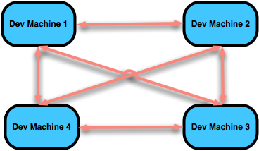
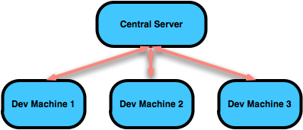
Version Control Types
Centralized
(subversion, CVS)
Decentralized
(git, darcs, mercurial)

Slide 7
Advantages of Decentralized
Anybody can pull or push changes to anybody else
I don’t need to be connected to a network to save my changes
If the central server goes down, nothing is lost, all of the individual nodes can still construct the most recent copy

Slide 8
Creating a new repository
% mkdir GitPresentation
% cd GitPresentation
% git init
% ls -a
.git

Slide 9
Adding files
% edit presentation.markdown
% git add presentation.markdown
% git commit -m “Added presentation”

Slide 10
Moving files
% mv presentation.markdown presentation.mkd
% git commit -am “mv Presentation”
git tracks file contents, subversion does something else
I always forget about ‘svn mv’ and end up regretting it later

Slide 11
Working with remote repositories
% git remote add origin git@github.com/mglazer/GitPresentation.git
% git push origin master
% git remote –v
origin git@github.com:mglazer/GitPresentation.git (fetch) origin git@github.com:mglazer/GitPresentation.git (push)
Logical name of destination
repository
The name of the branch to push
and update on the remote side*
* It’s slightly more complicated than this, refer to manpage for full explanation.

Slide 12
Cloning a remote repository
% git clone git://github.com/mglazer/GitPresentation.git
% ls
GitPresentation/
% cd GitPresentation
% git remote -v
origin git://github.com/mglazer/GitPresentation.git (fetch) origin git://github.com/mglazer/GitPresentation.git (push)
% edit presentation.markdown
% git commit -am “Made changes”
% git push origin master

Slide 13
Pulling in changes
% git commit -am “Committing before pull”
% git pull origin master
Note the same syntax as ‘git push’
At this point there may be merge conflicts, this is outside of the scope of this tutorial
See: http://gitguru.com/2009/02/22/integrating-git-with-a-visual-merge-tool/ for more info

Slide 14

Working with branches
Confession: branches in subversion scare me
When I think of branches in subversion I think of:
code that diverges so far from trunk, that you might as well just call it a separate project
everything that could possibly go wrong
that painful merge back to trunk
baby angels losing their wings

Slide 15
Working with branches
Creating a new branch
% git branch master 1234-spelling-mistake
% git checkout 1234-spelling-mistake
% edit presentation.markdown
% git commit -am “Fixed mistake”
or
% git checkout –b 1234-spelling-mistake
% edit presentation.markdown
% git commit -am “Fixed mistake”

Slide 16
Working with branches
Merging back to master
% git checkout 1234-spelling-mistake
% git fetch origin master
% git rebase origin/master
% git checkout master
% git merge 1234-spelling-mistake
% git push origin master
Notice the slight syntax differences between the fetch and the rebase
The fetch command says: “Get the latest copy of the master branch, from origin”
The rebase command says: “Fast forward our current working branch to the upstream master”
Note that this is my typical workflow.

Slide 17
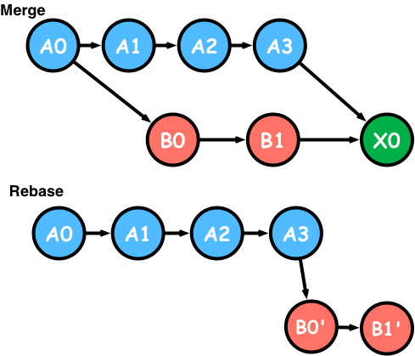
Differences between rebase and merge
Merge
Take changes from two branches and create a new commit point
Rebase
Take changes from a branch, and rewrite history in that branch
Tip: Use rebase when you pull in changes from master,
use merge when you will apply changes from your branch
onto master.
Don’t rebase with collaborated remote branches

Slide 18
Working with branches
Interactive Rebase
Say you’ve made a lot of small commits to your local copy and you’d like to merge those changes upstream
You probably don’t want all of those commit messages to appear in your merge patch
Use interactive rebase to solve this

Slide 19
Working with branches
Interactive Rebase
% git rebase –i HEAD~3
An $EDITOR window will appear:
pick 341e027 Added a new bullet point
pick 12fd986 Added an important bullet point
pick ae29d44 Done adding bullet points
Change ‘pick’ to ‘squash’ for commits you don’t want to see
pick 341e027 Added a new bullet point
squash 12fd986 Added an important bullet point
squash ae29d44 Done adding bullet points

Slide 20
Working with branches
Interactive Rebase
Save and quit, a new editor will appear enter your actual commit message
[#1234] Fixed spelling mistakes
* Added a few bullet points
* Fixed a few spelling mistakes
Save and quit
% git checkout master
% git merge 1234-spelling-mistake
% git push origin master

Slide 21
Tagging
Creating
% git tag v1.0
% git tag
v1.0
Switching to
% git checkout v1.0

Slide 22
Time Travelling
Viewing the log
% git log
commit 3f486fc820cfe6af52717dccc8ba1e4f33fa4258
Author: mglazer <mglazer@mglazer-08161100707.jpl.nasa.gov>
Date: Tue Jan 12 16:33:23 2010 -0800
Added prelim information stating git version number used
commit e2e38ef3fa2e7a18f141bcd5074feea0d374fffd
Author: mglazer <mglazer@mglazer-08161100707.jpl.nasa.gov>
Date: Tue Jan 12 16:31:14 2010 -0800
Updated presentation.
commit 3f7c1604b0e082532ead23992b5617d4abcb2a69
Author: mglazer <mglazer@mglazer-08161100707.jpl.nasa.gov>
Date: Tue Jan 12 11:02:47 2010 -0800
Added pptx presentation.

Slide 23
Time Travelling
Going back in time
% # go back in time to a previous version
% git checkout –f d4103cbce4020a1c5a27201e943e4699d6583cff
% # switch back to the master branch
% git checkout master
% # only go back in time for a specific file
% git checkout master presentation.markdown
% git checkout –f d4103cbce4020a1c5a27201e943e4699d6583cff file

Slide 24
Git Workflows
Git does not impose a workflow on you!
Central repository (à la subversion)
Central
Developer 1
Developer 2
Developer 3

Slide 25
Git Workflows
Integration Manager
Blessed
Developer Public
Developer Public
Developer Public
Integration Manager
Developer Private
Developer Private
Developer Private

Slide 26
Gotchas
git works based on the theory of patches
When you merge with the main repository, patches from all commits are applied
Subversion just diffs your version against the latest one in the repository
git != subversion

Slide 27
Example
Master
First the common ancestor is found, this is ‘ab’.
Subversion can’t figure this out, git does
Apply patches from test branch on top of master branch
For every patch that there is a conflict, you will have to resolve it.
With subversion you would only have to resolve once
Moral: Merge with tracking branches often or you will spend a morning applying patches
Don’t rebase with remote branches (screws over developers tracking that branch)
ab
abc
adc
ddc
git merge test
dbc
dbd
dbd
test

Slide 28
Real live case study
Working on this project called eFGDMS
electronic Flight Ground Dictionary Management System
Supposed to revolutionize the dictionary management process
Managed with git from the start
#developers = 1-2 at any given time

Slide 29
The eFGDMS Story
A0
A1
A2
A3
Master
Then along comes MSL…
Progression of time

Slide 30
MSL says:
We need dynamic schema updates
Because we may have sort of deviated from MSAP
We don’t really know what we need
Authentication
Workflow patterns
Validations
Need it all by tomorrow
And it can’t cost anything

Slide 31


Slide 32

Our solution
Master
A0
A1
A2
B0
B1
B2
adaptations
The adaptations branch was supposed
to use an “experimental” document oriented
database called CouchDB

Slide 33
Our problem
But then we ran into a problem…
CouchDB didn’t support a necessary feature
Regular expression based searching
But we had already done so much work…

Slide 34

Enter MongoDB
Similar concept to CouchDB
But it supports regular expression based searching
Other nice features
Great! Let’s create a new topic branch

Slide 35
git checkout –b mongo_adaptations
Master
A0
A1
A2
adaptations
B0
B1
B2
mongo_adaptations
C0
C1
Notice that development on the adaptations
branch can still continue, and that we branched off
a branch…try doing that in subversion

Slide 36
Incorporating upstream changes
Master
A0
A1
A2
adaptations
B0
B1
B2
mongo_adaptations
C0
C1
C1 +B`
% git rebase adaptations
% # followed by many:
% git mergetool
% git rebase --continue
B` is all the changes between B1 and B2, and then played on top of C1

Slide 37
Now merge back to adaptations
Master
A0
A1
A2
adaptations
B0
B1
B2
B2+C`
C0
C1
C1 +B`
% git checkout adaptations
% git merge mongo_adaptations
# Run unit tests
% rake spec
# Delete mongo branch
% git branch –d mongo_adaptations
% git push origin adaptations
mongo_adaptations

Slide 38
Next will be merge to master
I had never done a “complicated” merge like this before
The histories from the two branches were inconsistent and hadn’t been synced in a while
The whole merge process was done before I finished my morning coffee
Tests passed (unit tests do matter)

Slide 39
Don’t rebase with remote branches
adaptations is a remote branch
My life sucks when someone modifies master and then rebases adaptations
Don’t do this
Remember, rebasing rewrites history
It’s the same reason why they say never to interact with yourself when you go back in time

Slide 40

Don’t rebase with remote branches

Slide 41
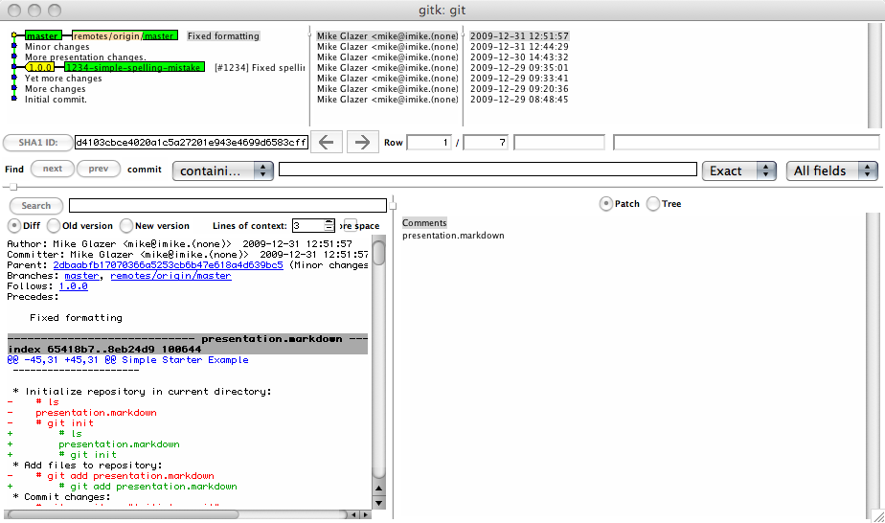
GUIs
gitk
Provides visual of repository history
Comes with git
Can’t edit, not pretty

Slide 42
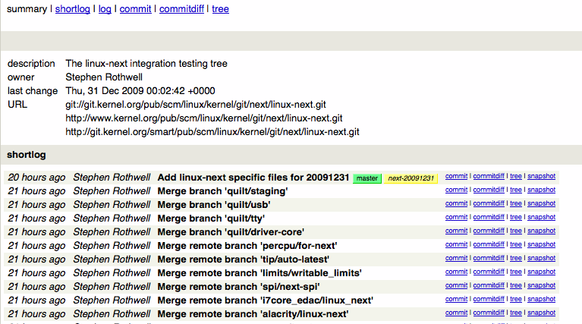
GUIs
gitweb
Nice web interface for git
Comes with distribution

Slide 43
GUIs
Others do exist, but they’re still kinda flakey
Nothing quite beats the command line
Check out zsh with vcs_info:
http://kriener.org/articles/2009/06/04/zsh-prompt-magic
[adaptationsFGDMS (rebase)//: I ]% (mglazer$:..tana Studio/FGDMS/)
Branch
Git Path
Activity
vi mode
CWD

Slide 44
Servers – Share your work!
gitosis
Easy to setup, limited access control
http://scie.nti.st/2007/11/14/hosting-git-repositories-the-easy-and-secure-way
gitolite
Rewrite of gitosis
Access control down to the branch level
http://github.com/sitaramc/gitolite

Slide 45
But I’m forced to use subversion
Check out svk: http://svk.bestpractical.com/view/HomePage
Distributed version control built on subversion
Really just a bunch of perl scripts
git svn provides upstream and downstream interaction with a subversion repository
I’ve never used it
I don’t plan on using it

Slide 46
Other neat git features
Look in the .git directory, it has a lot of handy files
.git/config: Holds configuration data
.git/description: Read by gitweb to provide repository description
.git/hooks: Same concept as subversion hooks

Slide 47

What next?
Download:
http://git-scm.com
Learn:
http://progit.org

