Slide 1
Sberbank Kaggle Project
Author: Dvir Rehavi, Daniel Mizrachi, Lidor Erez

Slide 2
Data Integrity & Cleaning
„Data Integrity of interior features such as full square meter, kitchen square meter etc.
Removed columns with at least 30% missing values and a correlation lower than 0.3 in abs value.
Separated features into groups according to the data dictionary.
Modeling missingness of Interior features
Missing Values in Full sq and Life sq:
Avg ratio fullsq/lifesq for each sub area
Filling missing values using the ratio.

Slide 3
Feature Engineering
Seasonality Features: Year, Month, Quarter etc.
Discrete features to Continuous features:
Population to Density
Education features to Education per capita
We’ve also calculated ratios and differences between features.
Among the features we’ve added full sq – kitch sq has a huge influence on our model.

Slide 4
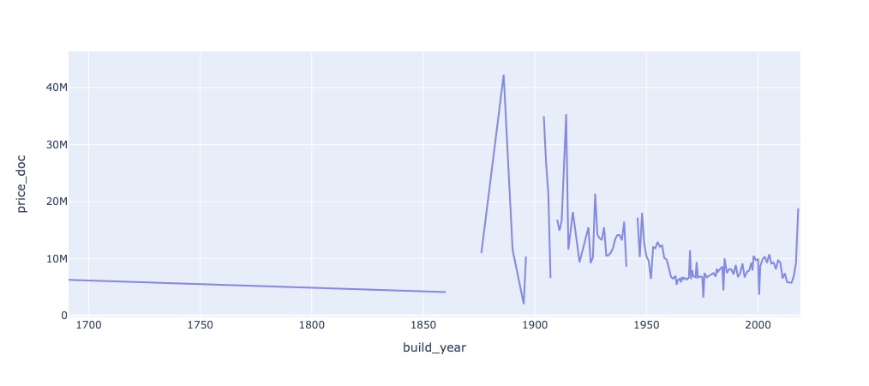
EDA
Price distribution (Log price, Price)
Price Distribution by product type
Prices behavior by build year (Is Vintage)

Slide 5
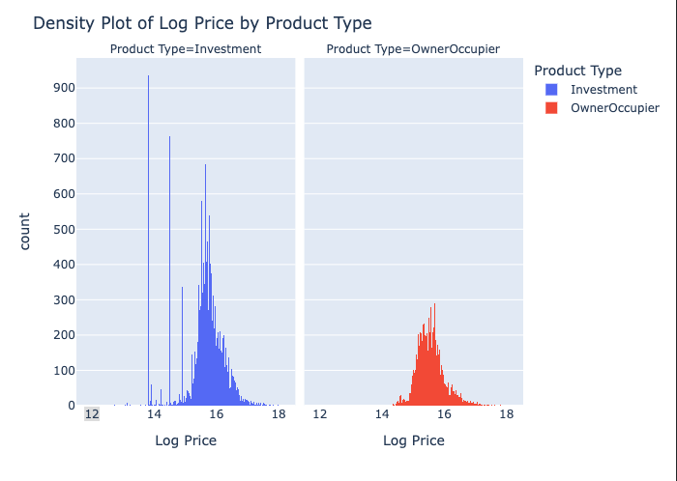
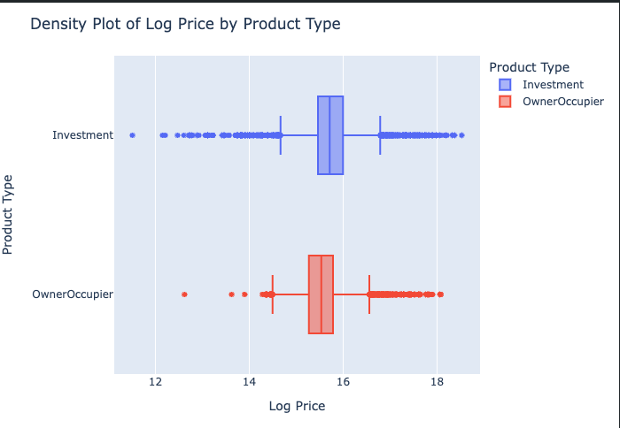
EDA
Distribution of prices

Slide 6
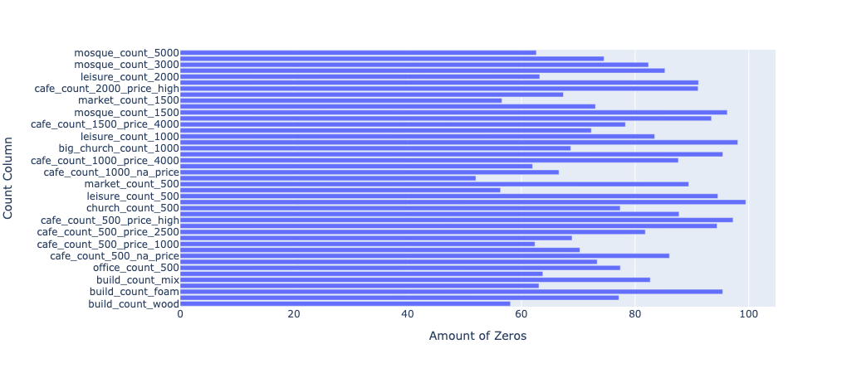
EDA
Sparsity analysis for the discrete features (Count columns)
Sparse columns were changed to binary columns.

Slide 7
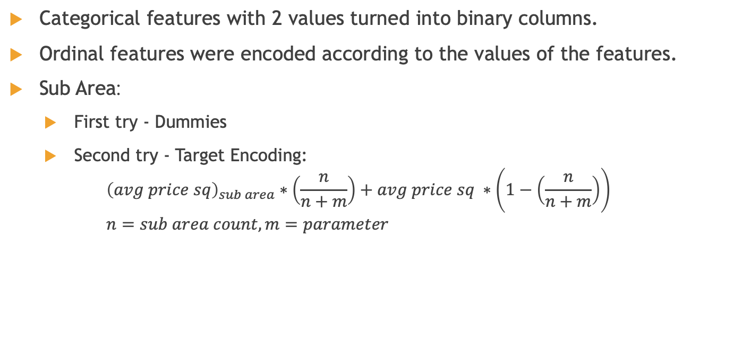
Categorical Features
Categorical features with 2 values turned into binary columns.
Ordinal features were encoded according to the values of the features.
Sub Area:
First try - Dummies
Second try - Target Encoding: ${\left(avg price sq\right)}_{sub area}∗\left(\frac{n}{n+m}\right)+avg price sq ∗\left(1−\left(\frac{n}{n+m}\right)\right)$ $n=sub area count, m=parameter$

Slide 8
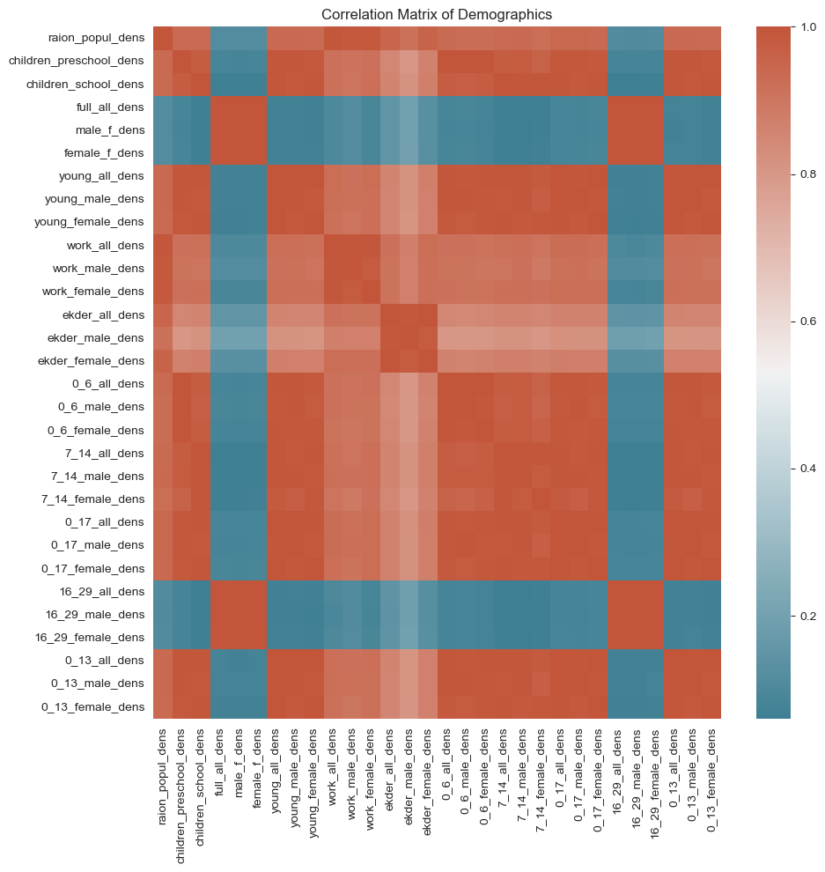
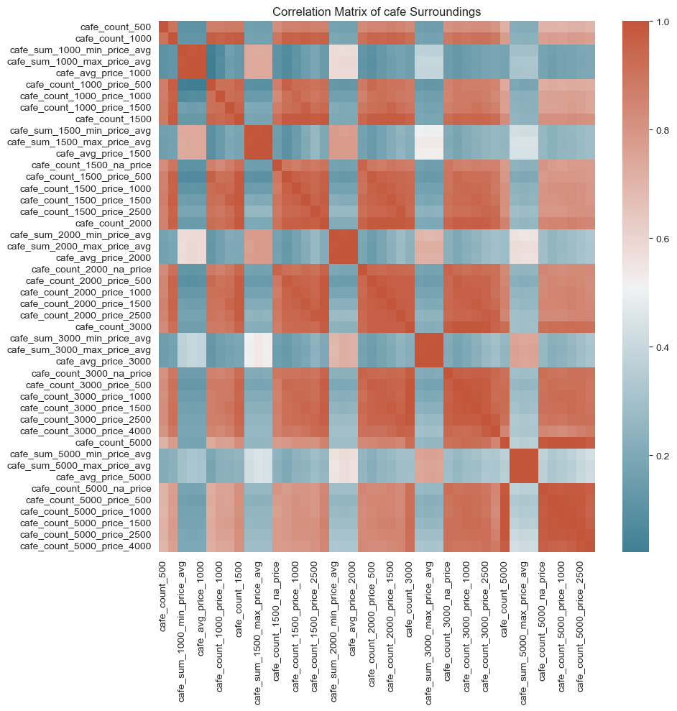
Correlation Analysis
Correlation within each group.

Slide 9
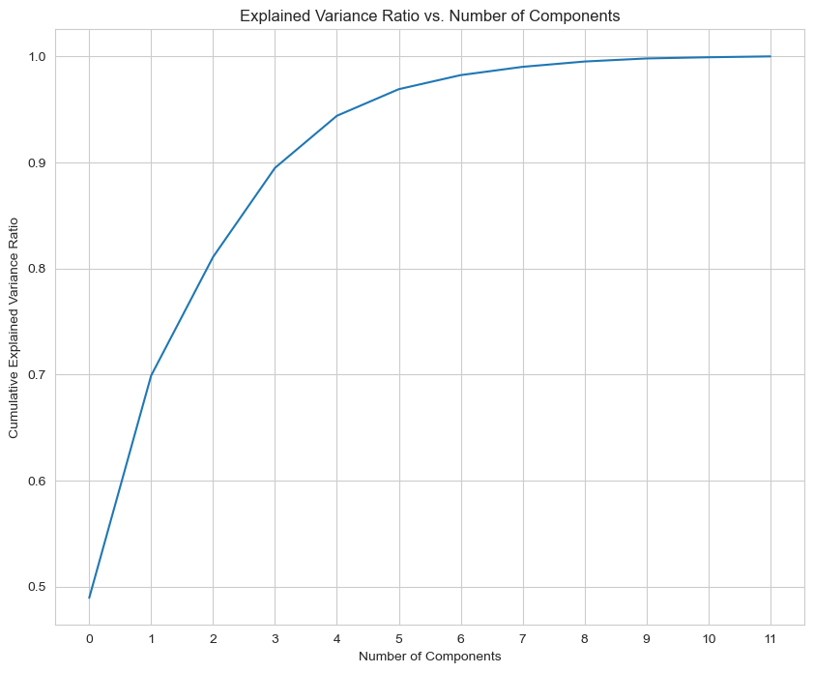
Principal Component Analysis
We used to PCA to reduce the number of features and correlation.
PCA is a method that finds linear combination of the given features while also preserving an amount of variance.
Goal: reduce the number of features and correlation while preserving 95% of the variance.

Slide 10
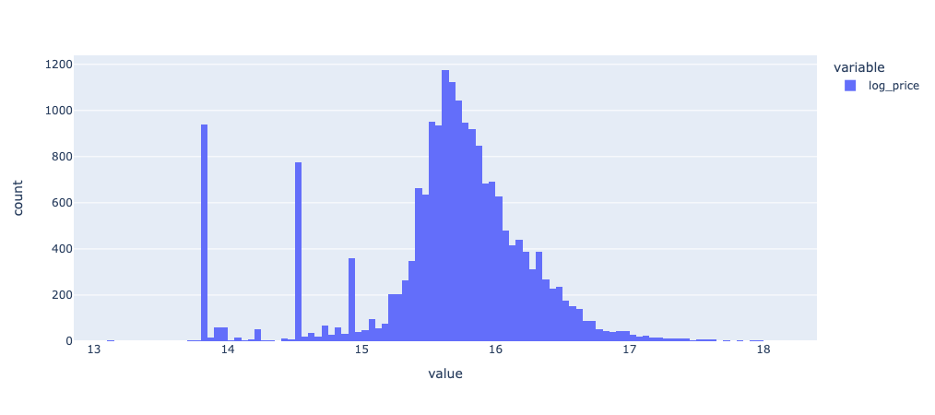
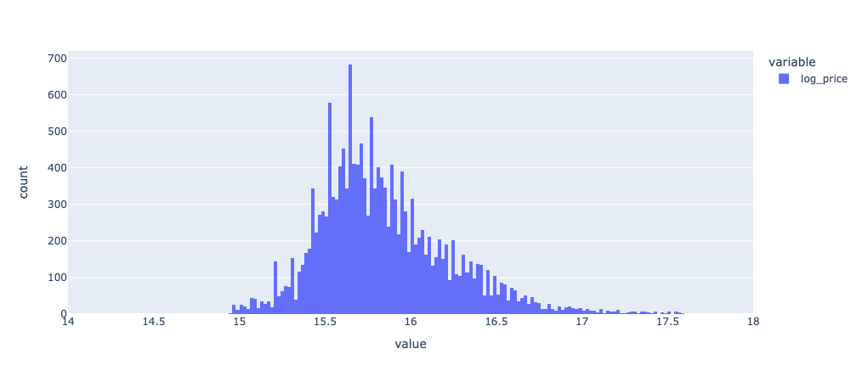
Preparing Data For Model
We removed rows that the price for square meter was lower than 10000 and higher than 600000
We also “fixed” the distribution of the prices of apartments for investment.

Slide 11
Model Building Hyperparameter Tuning
XGBoost, Random Forest
Log Price as a dependent variable.
Bayesian Optimization:
Great method for finding the right hyper parameters.
The method give you trained models.
Can be useful for ensemble.
Was used for each product type.

Slide 12
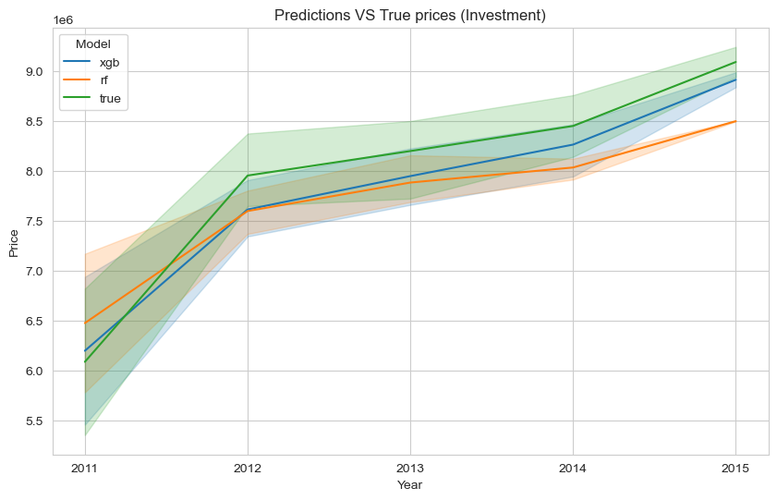
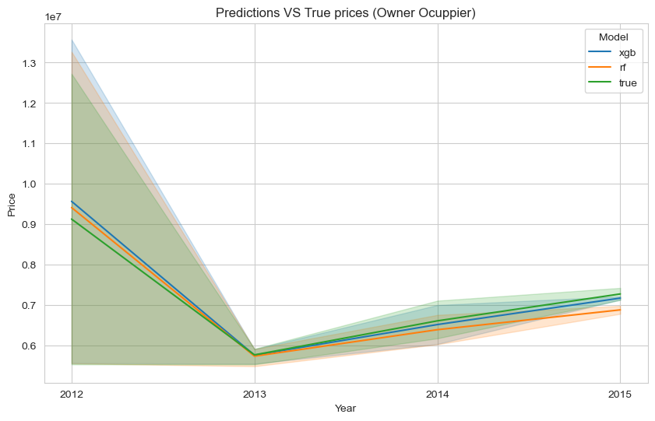
Model Building Hyperparameter Tuning
Results
OwnerOcuppier: Both XGBOOST and RF were good.
Investment: XGBoost was better than RF.

Slide 13
Feature Importance
Target Encoded sub area was an important feature for our model.
The feature Full sq – Kitch sq was an important feature for our model.
Full sq was an important in general and for some models it was the most important.

Slide 14
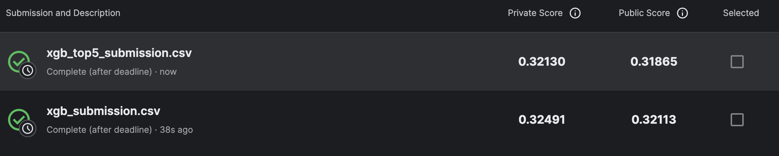
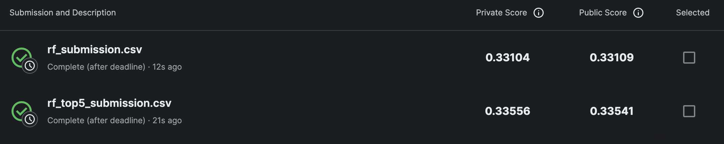
Kaggle Submissions

Slide 15
Model Improvement
We figured that conventional cross validation method won’t be representative enough so we instead analyzed the predictions of our xgboost models to figure out the right hyperparameter.
Owner Ocuppier was easier to model.
Investment was harder to model.
We decided to predict Log Price, Price, Price sq
Price sq gave us the best result.
We ended up having 3 XGB for OwnerOcuppier, and 5 XGB for Investment

Slide 16
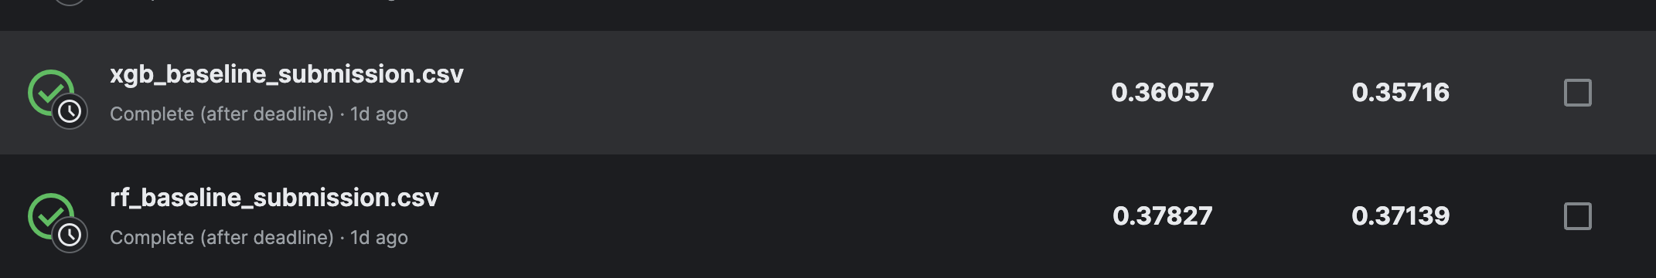
Process Summary
Baseline Model
Integrity and cleaning
Feature Engineering and Transformation
Data Analysis (EDA)
Correlation Analysis
PCA
Predicting Log Price using Bayesian Optimization
XGB and RF prediction analysis
Improving XGB and Predicting price per square meter.

