Slide 1
NCAA Basketball Attendance
Daniel Moeller

Slide 2
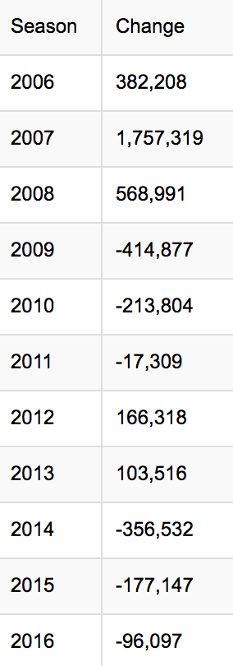
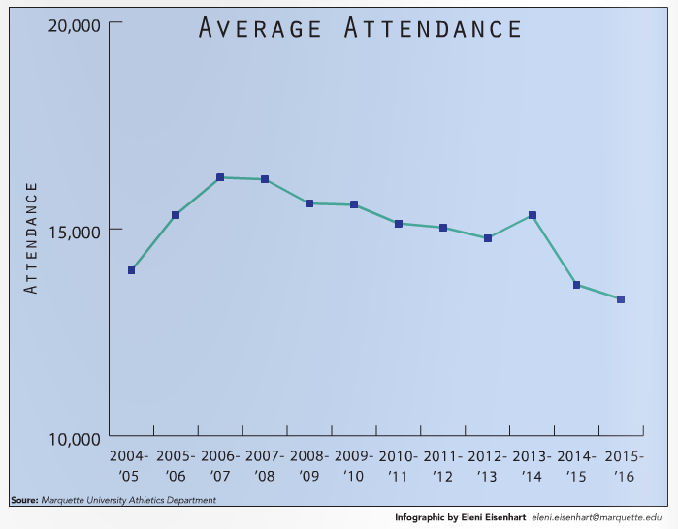
Overview of NCAA Basketball
Six billion dollar earning from tickets and merchandise alone.
Marquette basketball is evaluated at $11.4 million.
Ticket sales on the decline nationally
Marquette ties

Slide 3
Available Data
Possible Future Data
ESPN (‘01-16’)
Game-by-game information
NCAA(‘80-16’)
Full attendance
Sportsbook Review (‘05-’16’)
Betting lines
World Weather Online (‘08-`16)
TV Ratings/Availability
Enrollment Numbers
Population Demographics
Distance between teams
State popularity rank
Rivalry games

Slide 4
Research Questions
Uncertainty of Outcome Hypothesis
Do teams within the same conference or same geographic area have similar attendance models?
How does weather and time of day/week impact attendance numbers?
How important is winning to attendance?
Stretch:
Investigate the relationship between ticket sales and television ratings.

Slide 5
Assumptions & Potential Pitfalls
Attendance based on tickets sold
Ignoring other high profile events in the area
March Madness attendance will not be considered
Ignoring promotional events (lack of data)
Team matching
Data volume
Data quality and verification concern

Slide 6
Resources
https://marquettewire.org/3950304/sports/mu-basketball-attendance-team-value-drops/
http://moneynation.com/how-much-money-does-the-ncaa-make/
http://buildingthepride.com/jobie/uploads/JOBIEV19B31.pdf
http://epublications.marquette.edu/cgi/viewcontent.cgi?article=1052&context=cps_professional

