Slide 1
Introduction to Open Research
Unit Coordinator: Dr Danna R. Gifford (danna.gifford@manchester.ac.uk)
Original author: Prof Andrew J. Stewart (drandrewjstewart@gmail.com)

Slide 2
Let’s travel in my time machine...

Slide 3

Back to 2011...
‘Proof’ of Extrasensory Perception

Slide 4
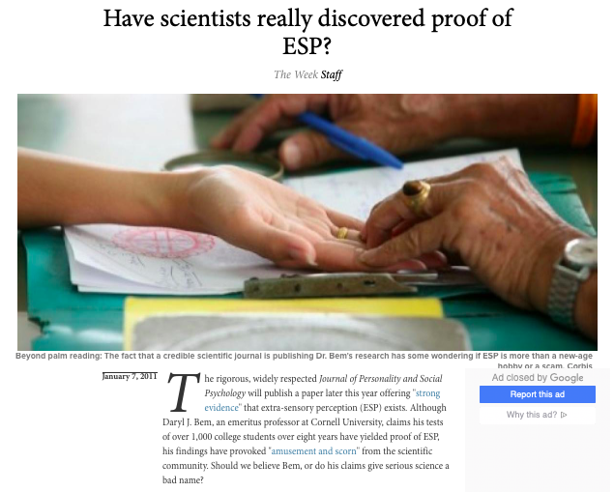

Slide 5
Bem (2011)
The Journal of Personality and Social Psychology published a paper by Daryl Bem showing that the future can influence the present - in one study, using a standard priming paradigm participants responded faster to targets that were then followed by a prime word, than to targets that weren’t.
Bem had a distinguished track record, the paper came out in a top tier journal, went through rigorous peer review, and used standard statistical and scientific methods.

Slide 6
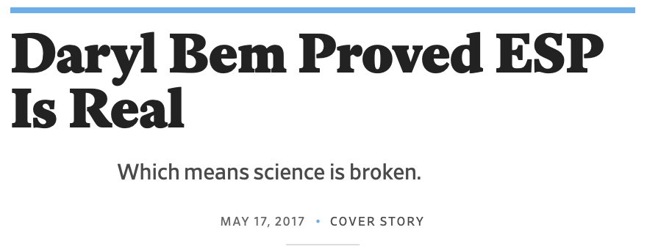
https://slate.com/health-and-science/2017/06/daryl-bem-proved-esp-is-real-showed-science-is-broken.html

Slide 7
Simmons, Nelson, and Simonsohn (2011)
“False-Positive Psychology: Undisclosed Flexibility in Data Collection and Analysis Allows Presenting Anything as Significant” published in Psychological Science.
Simmons et al. (2011) show that selectively reporting data (e.g., dropping participants, ‘problematic’ trials) and selectively reporting analyses (e.g., only reporting comparisons that are significant) results in vastly inflated false positives.
Later termed p-hacking.

Slide 8
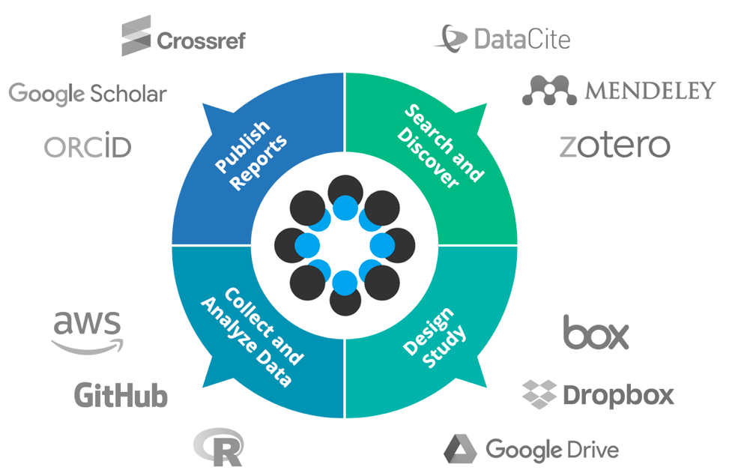

Open Science Framework (OSF)
Brian Nosek set up a series of replication studies to try to determine how big a replication issue psychology might be facing. This resulted in the establishment of the Centre for Open Science (CoS) in 2013.

Slide 9
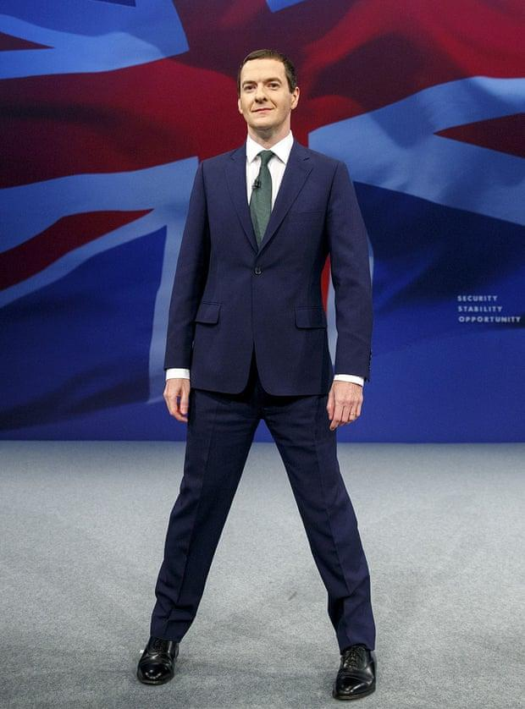
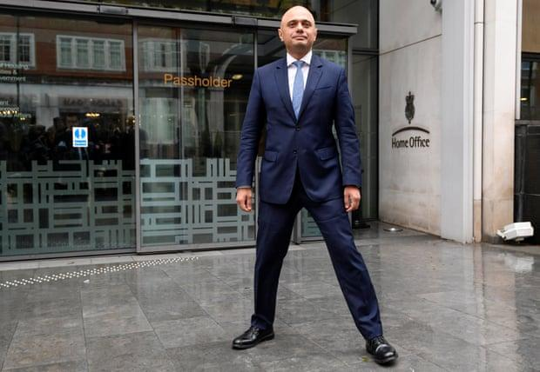
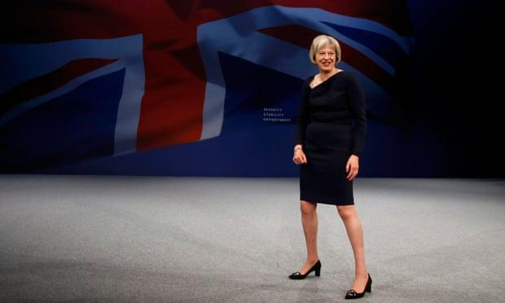

Slide 10
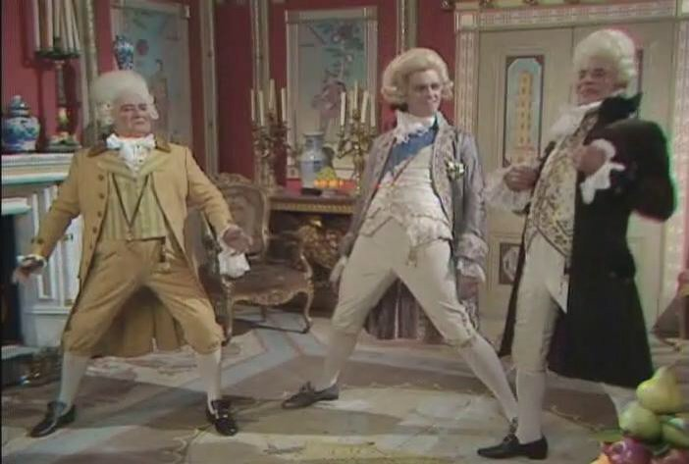

Slide 11
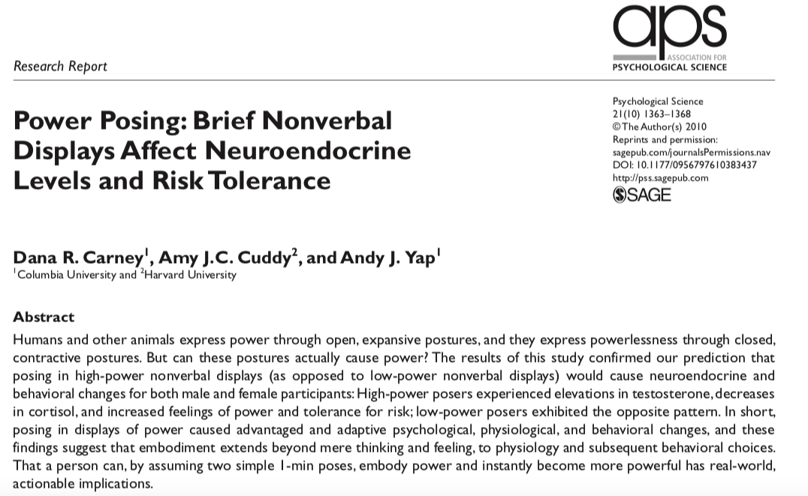

Slide 12
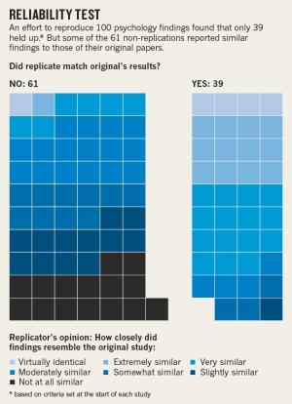
Estimating the reproducibility of psychological science (Nosek et al., 2015)
270 authors tried to replicate 100 experiments drawn from high profile Psychology journals - Psychological Science, Journal of Personality and Social Psychology, and Journal of Experimental Psychology: Learning, Memory, and Cognition.

Slide 13
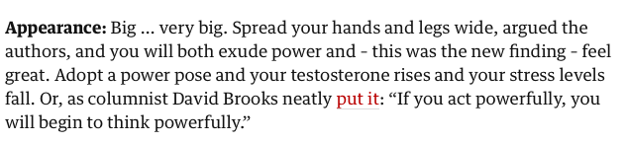
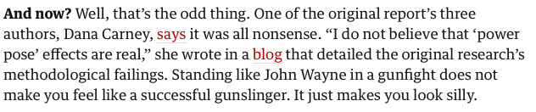
Power Posing - 2010 vs. 2016
https://www.theguardian.com/politics/shortcuts/2016/sep/28/george-osbornes-power-pose-the-science-proves-feeble

Slide 14
Many replications failed or reported effect sizes much smaller than in the original…
Power posing
Ego depletion
Social priming
Learning styles
Stanford prison experiment
Growth mindset
and many more...

Slide 15
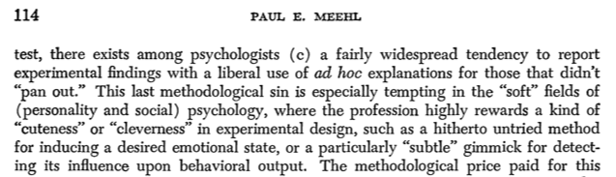
We’ve known about the problems for a while...
Paul Meehl,1967

Slide 16
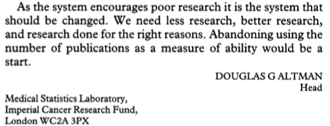
We’ve known about the problems for a while...
Doug Altman,1994

Slide 17
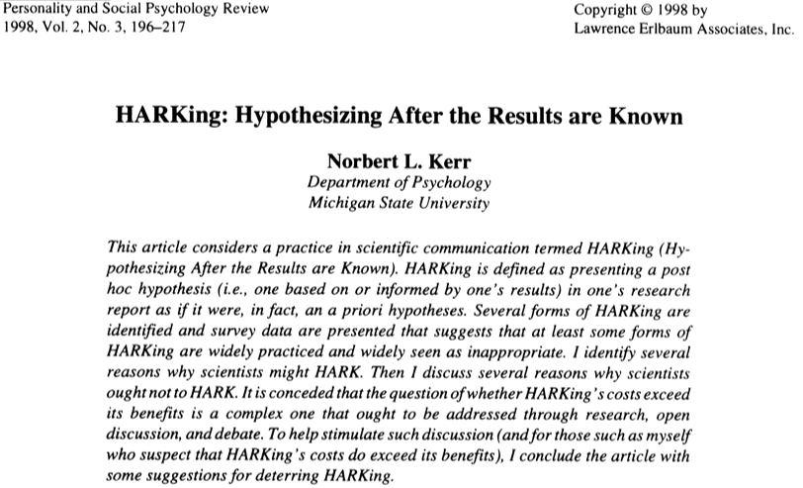
We’ve known about the problems for a while...

Slide 18
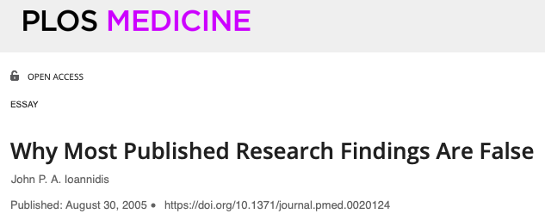
We’ve known about the problems for a while...

Slide 19
Is there not just “good science” and “bad science”?
Without realising it, good scientists have been engaging in questionable research practices (QRPs) partly driven by an incentive structure that doesn’t incentivise good scientific practice…

Slide 20
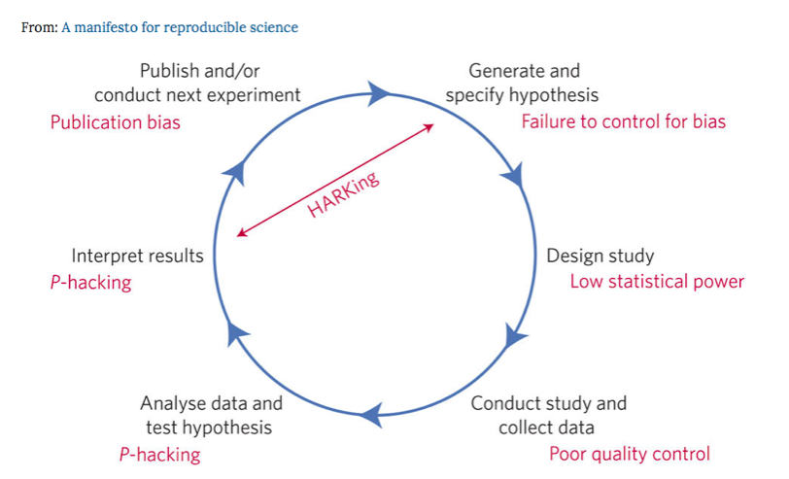
Problems include p-hacking, lack of power, HARKing, failing (refusal) to share data and code, too many researcher degrees of freedom…
Munafo et al. (2017), Nature Human Behaviour

Slide 21
Why do so many studies not replicate?
There are too many studies with experimental power too low to detect the effect size of interest.
One of the consequences of a low powered study is that when real effects are detected their magnitude is likely to be over-estimated.
Studies which find the effect are published and studies that don’t are not published - due to a bias to publish positive results.
Future work may use the published effect size during a priori power analysis (and then fail to find the effect as the new study is effectively under-powered for what it’s looking for).

Slide 22
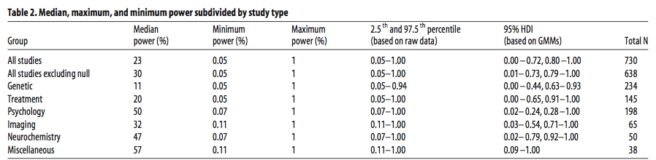
Low Statistical Power
Button et al. (2013), Nature Reviews Neuroscience, small sample size undermines the reliability of neuroscience. Nord et al., (2017), Journal of Neuroscience, highlight wide heterogeneity in power in neuroscience studies.

Slide 23
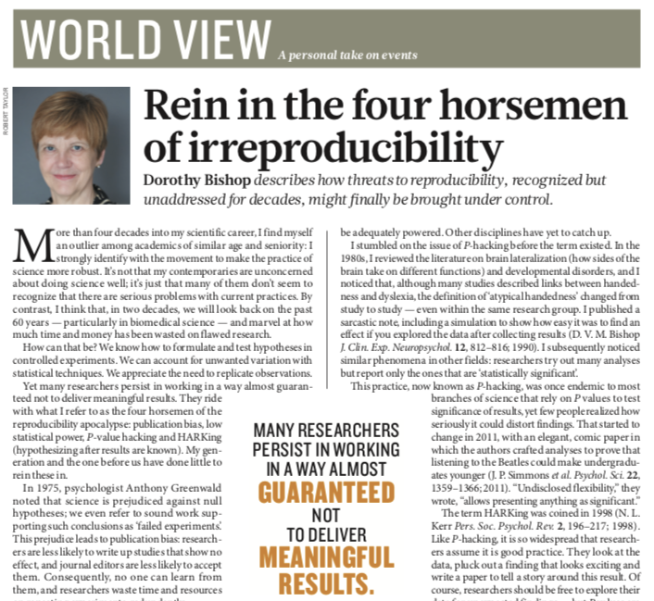
https://www.nature.com/articles/d41586-019-01307-2

Slide 24
How do we make our science more reproducible?

Slide 25
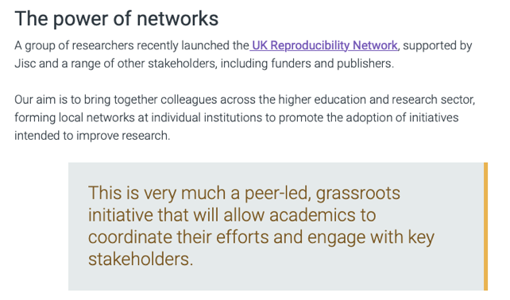
The UKRN

Slide 26
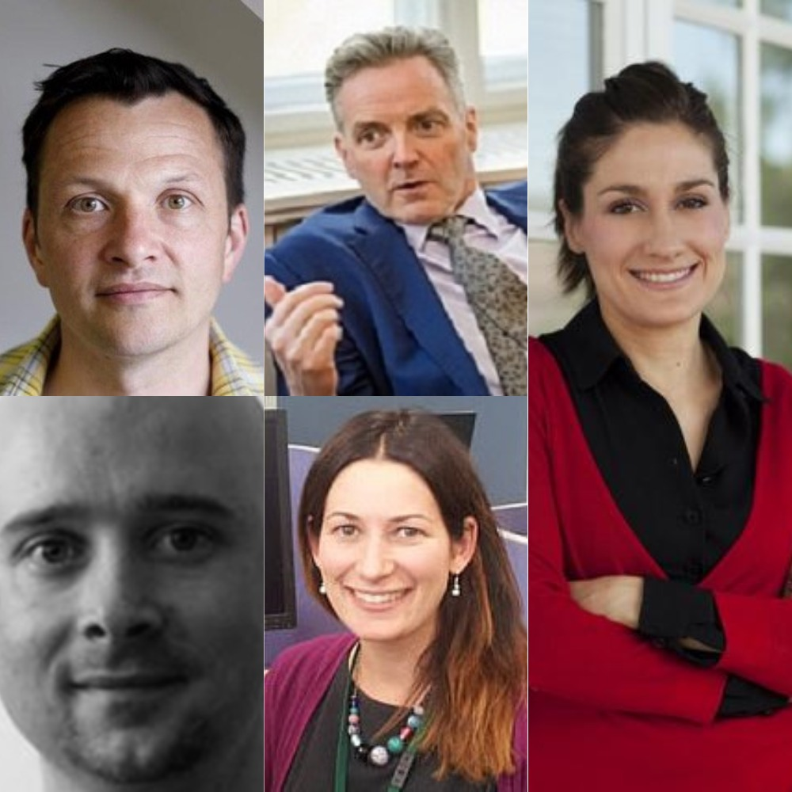
The UKRN
The UK Reproducibility Network (UKRN) is a peer-led consortium that aims to ensure the UK retains its place as a centre for world-leading research.
This will be done by investigating the factors that contribute to robust research, providing training and disseminating best practice, and working with stakeholders to ensure coordination of efforts across the sector.
It is led by Marcus Munafò (Bristol), Chris Chambers (Cardiff), Laura Fortunato (Oxford), Alexandra Collins (Imperial), and Malcolm Macleod (Edinburgh).

Slide 27
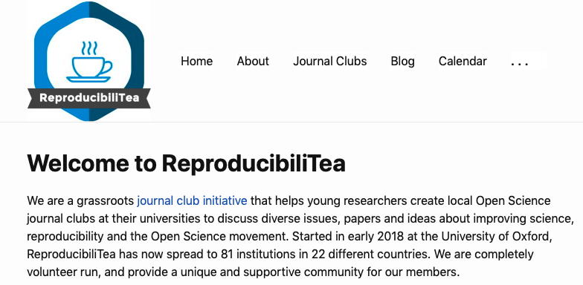
ReproducibiliTea

Slide 28
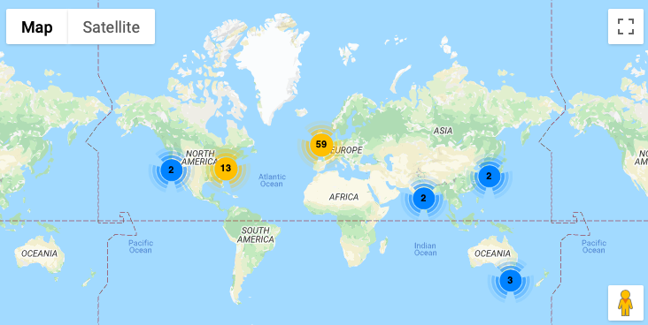
ReproducibiliTea

Slide 29
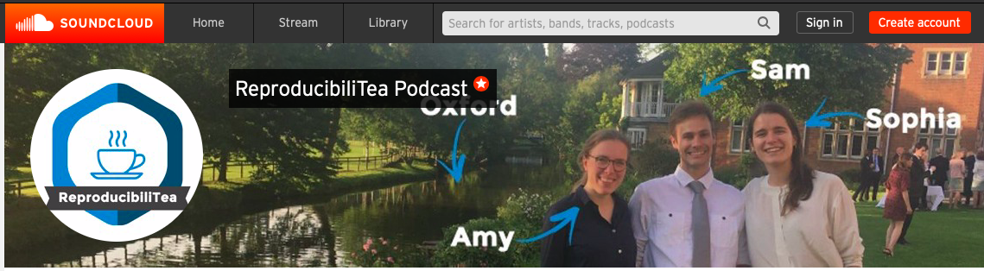
ReproducibiliTea
The ReproducibiliTea parent organisation is run by a group of ECR volunteers:
Amy Orben @OrbenAmy: high-level organisation and UKRN liaising
Sam Parsons @Sam_D_Parsons: podcast production
Sophia Crüwell @cruwelli: podcast scheduling and webinars
Matt Jaquiery @MJaquiery: website design and maintenance
Katie Drax @katiedrax: external communications
Jade Pickering @Jade_Pickering: community building and merchandising
They even have a podcast!

Slide 30
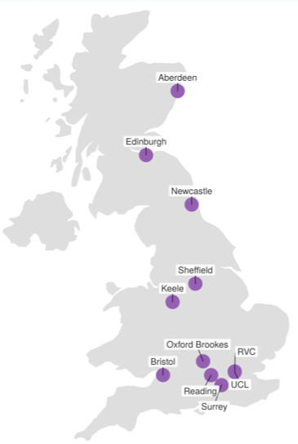
Institutional Academic Leads for Research Improvement and Integrity
Institutional academic leads should be independent of the grassroots Open Research Working Groups.
Ensure training around research improvement and research culture, including promoting the adoption of open research practices and other relevant initiatives, and embedding this into the institutional culture.
https://www.bristol.ac.uk/psychology/research/ukrn/about/tor/
Data Viz: Laura Fortunato

Slide 31
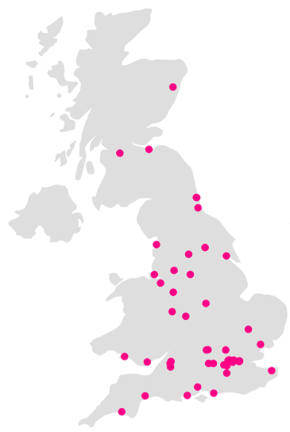
Open Research Working Groups
Currently ~57 institutions with a UKRN local lead - many have set up Open Research Working Groups (ORWGs).
The ORWGs are grassroots led and should cross academic disciplines - not always easy - many traditional teaching-focused institutions also have ORWGs - important that everyone (regardless of research/balance) is part of the conversation.
It’s not just about how we do better research, it’s also about how we teach our students how to do better research.
Data Viz: Laura Fortunato

Slide 32
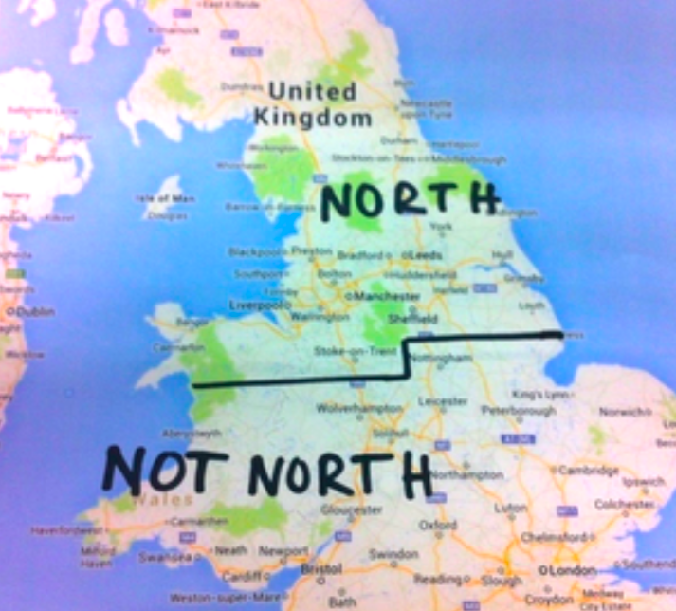
Building A Regional Network
Recent NW Open Research Hub Events - Lancaster, Keele, Chester…
Such hubs may be involved in a Research England Development Fund bid - will be led by institutions with academic UKRN leads.
Image courtesy of Dermot Lynott (Lancaster UKRN lead).

Slide 33
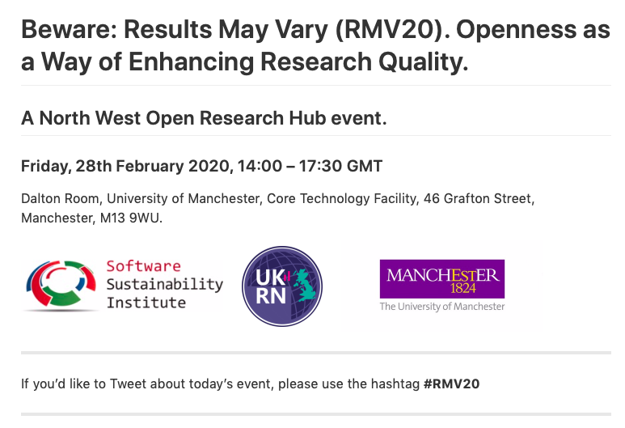
https://hackmd.io/@ajstewartlang/r1ec-g5l8

Slide 34
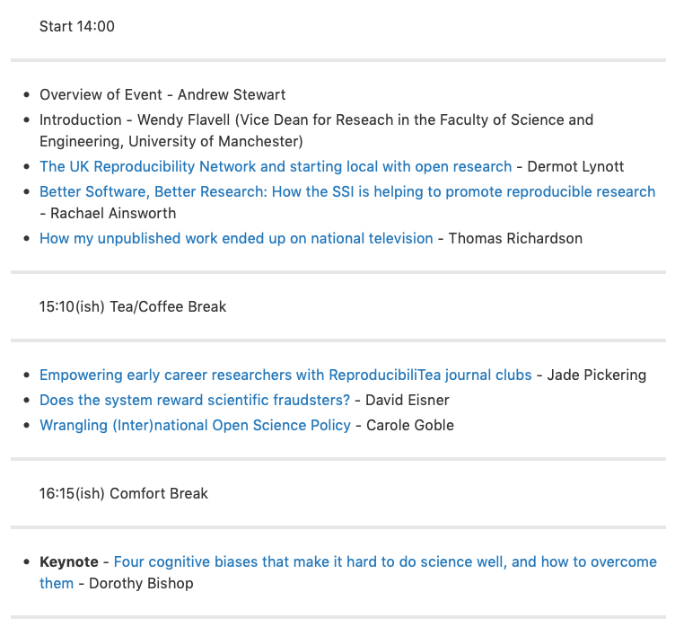
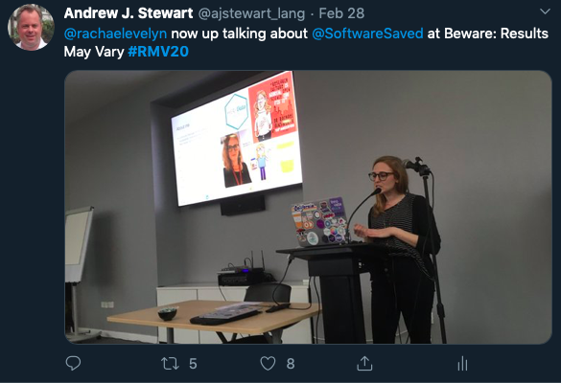
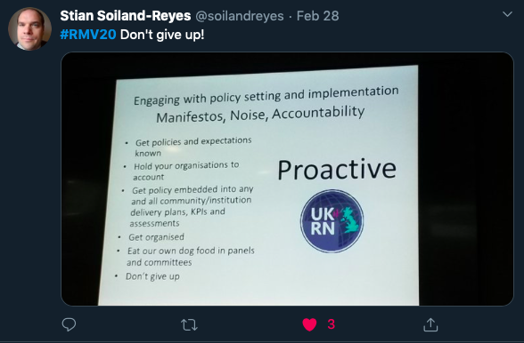
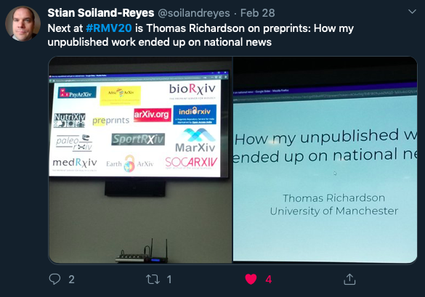
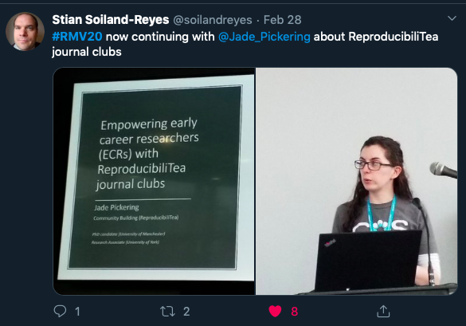
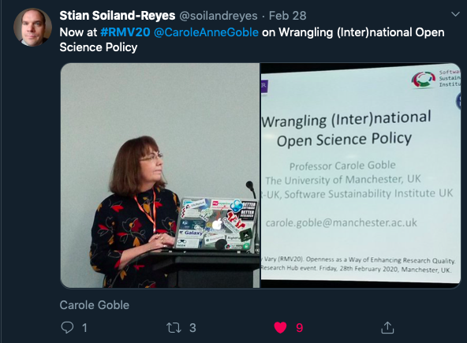
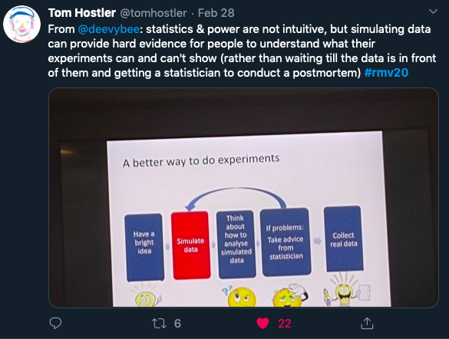
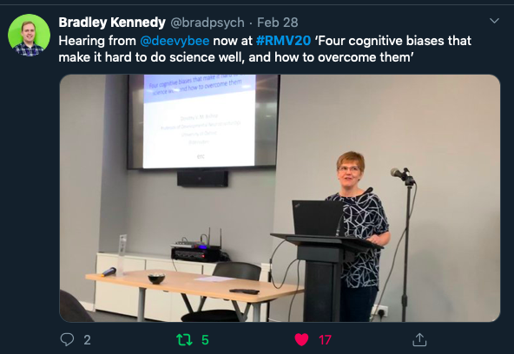

Slide 35








Connecting Communities

Slide 36
Institutions Need to Support/Train/Incentivise Researchers to Adopt Open Research Practices
The academic incentive structure has to change.
There should be less focus/reward for people who are doing expensive science, and more focus/reward for people who are doing better science. REF could play a role in this.
Across disciplines and institutions, there can be a surprising lack of understanding about what open research is (and what it isn’t).

Slide 37
The Biggest Challenge: Education and Training
We need to be teaching open research practices to our students (the next generation of researchers).
There is a huge computational skills gap amongst PhD students, postdoc, and teaching/research academics - without these skills, people simply cannot adopt open and reproducible research practices.

