Slide 1
Getting Started with R and RStudio Desktop
Unit Coordinator: Dr Danna R. Gifford (danna.gifford@manchester.ac.uk)
Original author: Prof Andrew J. Stewart (drandrewjstewart@gmail.com)

Slide 2
Downloading R
We need to start by first download R. R is open source and free to use.
You can download it from one of the CRAN (The Comprehensive R Archive Network) mirrors via this link.
R is available for Mac OS, Windows, and Unix. I run R and RStudio on Mac OS and Ubuntu 20.04 so I can help best with any operating system/installation issues you might have with either of those.
R updates regularly (you need to update manually). I usually stay one release or so behind the current version (just in case there are any issues).

Slide 3
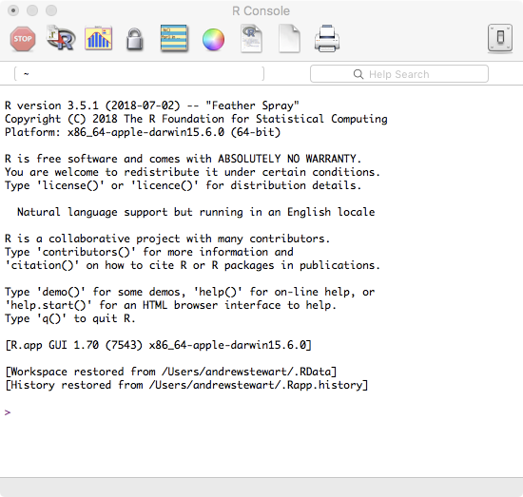
If you just ran the R language...
You’d get a flashing cursor and not much else. For a long time, this is how most people used R...

Slide 4
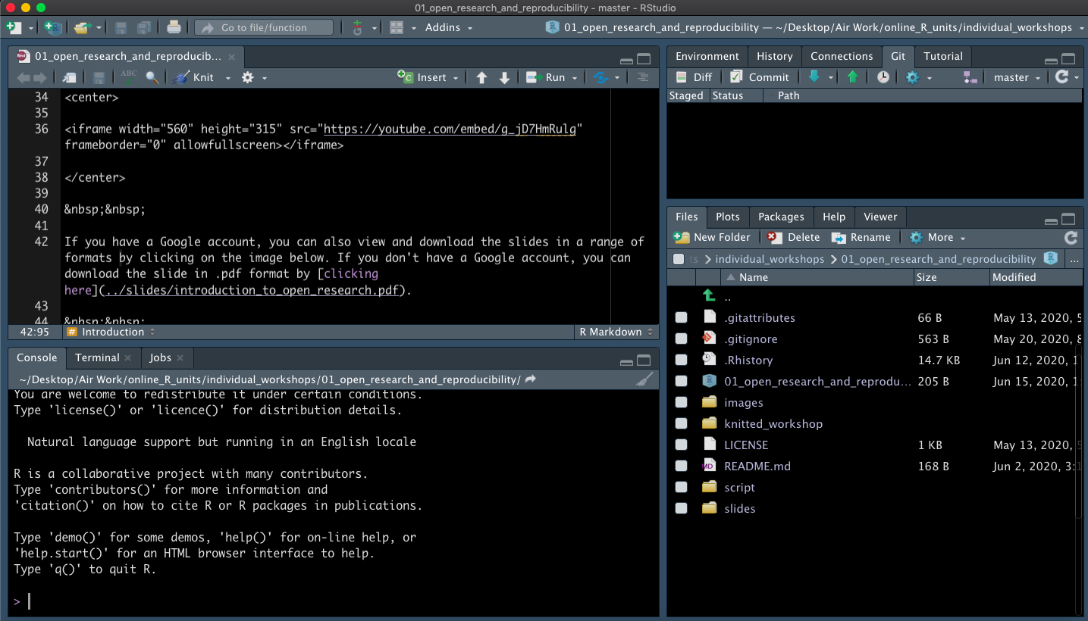
But then came RStudio Desktop (which you can personalise)

Slide 5
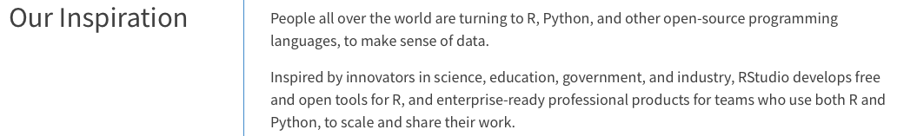
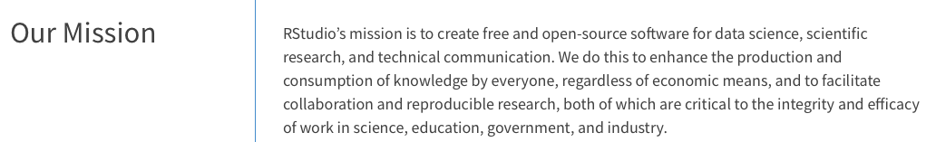

RStudio
https://rstudio.com/about/

Slide 6
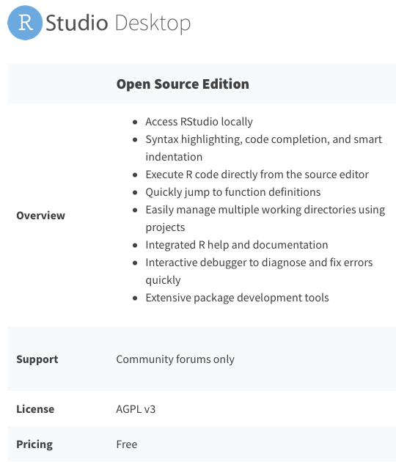
Downloading RStudio Desktop
Go to https://rstudio.com/products/rstudio/ and download the free RStudio Desktop for whatever operating system you’re using...

Slide 7
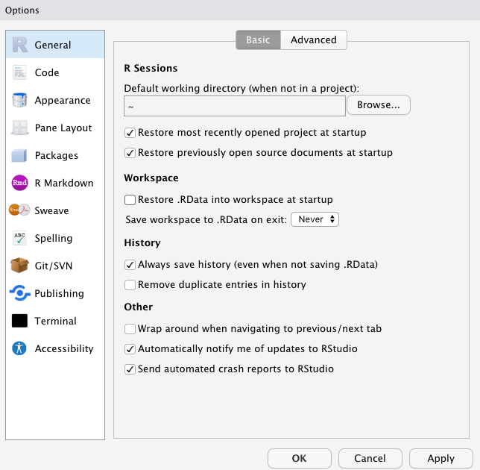
When you first start RStudio Desktop
Under Preferences, make sure you uncheck the “Restore .RData into workspace at startup” option and select “Never” for “Save workspace to .RData on exit” option…

Slide 8
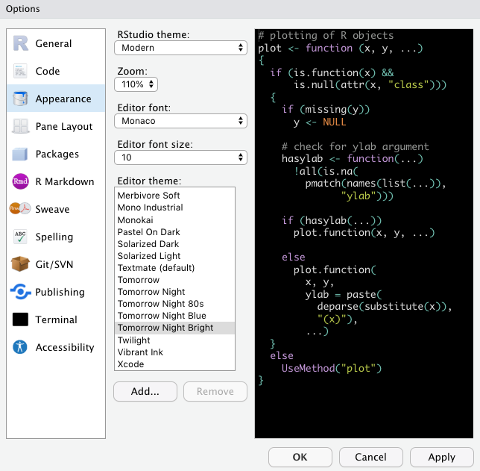
Customising RStudio Desktop
You can move around the 4 panes in the RStudio interface, and change aspects of the display including the appearance (I’m using the Tomorrow Night Bright Dark Mode), the size of the text etc. You can manually zoom in and out using keyboard controls too. Find out how to make the RStudio interface work for you!

Slide 9
Let’s look at how we can customise the look of RStudio Desktop...

Slide 10

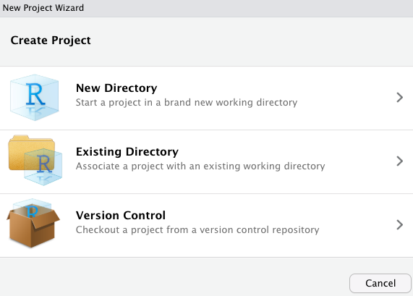
Using .Rproj files
You don’t want to end up with a situation where your data files, your analysis script, your report etc. for a particular project are spread across different folders. You’ll find it hard to keep track of which folders contain which files, you won’t be able to share your analysis with others (or even yourself if you run it on a different computer) and you won’t be able to easily do reproducible research.
Luckily, RStudio allows you to do all these things by creating a link to your project folder - within which you’ll place all the files you’re using in your current research project.

Slide 11
Organise your folders and files
Andrew_project/
|--Andrew_project.Rproj
|--raw_data/
|--data.csv
|--tidied_data/
|--tidy_data.csv
|--R_scripts/
|--data_tidy.R
|--data_vis.R
|--analysis.R
|--markdown_scripts/
|--analysis.Rmd
|--output_reports/
|--analysis.html
|--analysis.pdf
Here’s an example of a folder called “Andrew_project”.
Within this folder there is a file called “Andrew_project.Rproj” and 5 folders called “raw_data”, “tidied_data”, “R_scripts”, “markdown_scripts”, and “output_reports”.
Some of these folders have a number of files inside - for example, the folder entitled “R_scripts” contains three files, namely “data_tidy.R”, “data_vis.R”, and “analysis.R”.

