Slide 1
Why R?
Unit Coordinator: Dr Danna R. Gifford (danna.gifford@manchester.ac.uk)
Original author: Prof Andrew J. Stewart (drandrewjstewart@gmail.com)

Slide 2
Why R?
R allows you to engage in reproducible research and in building reproducible workflows.
Statistical packages in R reflect the latest advances in the fields of Statistics and Data Science.
There are lots of amazing data visualisation packages available.
In many institutions, the next generation of academics (M-level and PhD students, post-docs etc.) are learning R skills as part of their training.
R coding skills are highly sought after in Industry/ONS/NHS/Civil Service...

Slide 3
Open Source Software
Open Source Software is free and built/maintained/modified/improved by the community (which you are part of!) - check what license it is under for full details.
You can use Open Source Software after you graduate - so no more being tied to proprietary software (e.g., SPSS) that needs to be paid for.
Open Source Software is supported by large corporations - for example, Linux is supported by the Linux Foundation which includes Google, Microsoft, Intel, Samsung etc.
Open Source is widely used across the public and private sectors and has had a huge impact on computing over the last couple of decades.
https://opensource.org/history

Slide 4
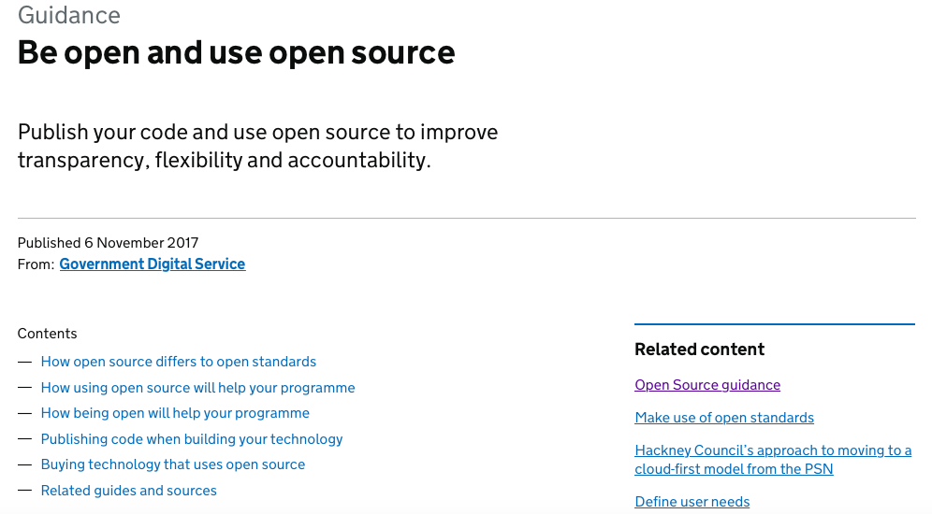
Open Source Software - UK Government
https://www.gov.uk/guidance/be-open-and-use-open-source

Slide 5
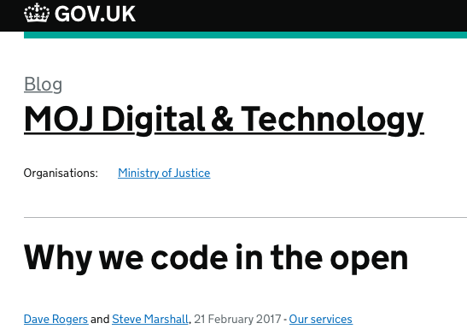
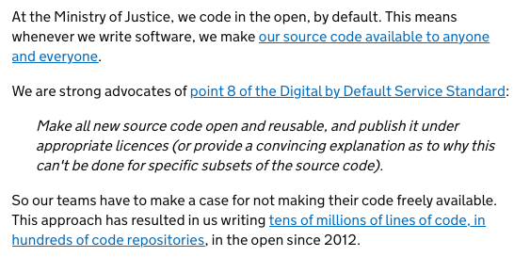
https://mojdigital.blog.gov.uk/2017/02/21/why-we-code-in-the-open/

Slide 6
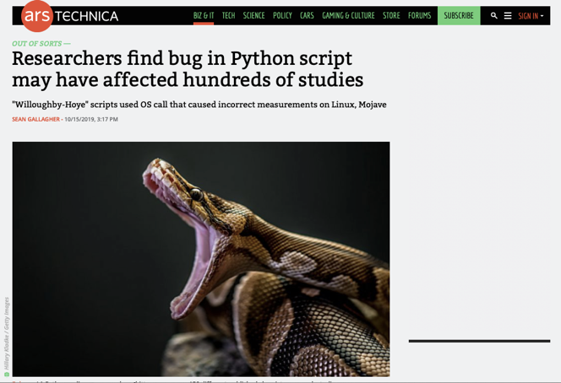
The Advantages of Open Source Software
Open software allows for transparency and reproducibility in your data processing, wrangling, visualisation modelling etc.
It allows others to spot and correct errors...
https://arstechnica.com/information-technology/2019/10/chemists-discover-cross-platform-python-scripts-not-so-cross-platform/

Slide 7
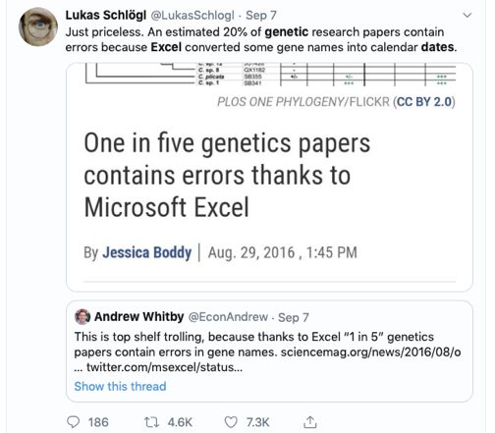
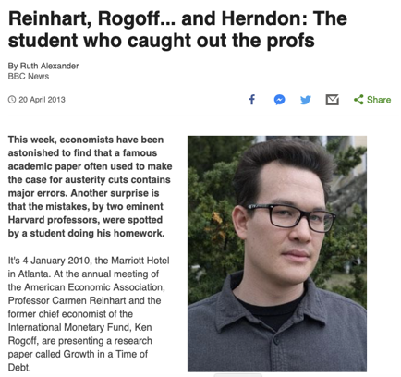
The Risks of Closed Source Software

Slide 8
R vs. SPSS
“SPSS is like a bus - easy to use for the standard things, but very frustrating if you want to do something that is not already pre-programmed.
R is a 4-wheel drive off-roader, with a bike on the back, a kayak on top, good walking and running shoes in the passenger seat, and mountain climbing and spelunking gear in the back.
R can take you anywhere you want to go if you take time to learn how to use the equipment, but that is going to take longer than learning where the bus stops are in SPSS.”
Greg Snow, 2010, stackoverflow.com

Slide 9
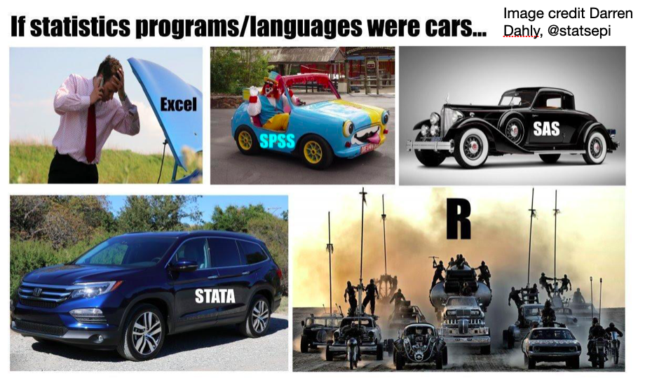
In meme form...

Slide 10
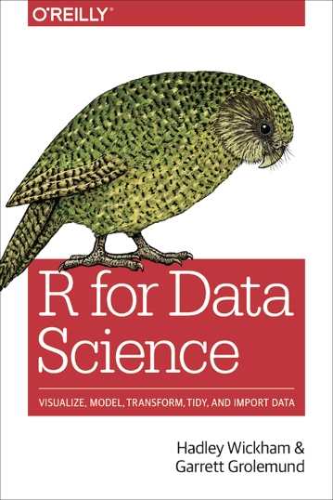
There are great R books to read...
Available electronically at:
http://r4ds.had.co.nz

Slide 11
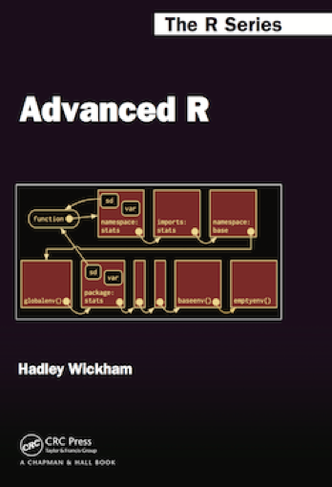
There are great R books to read...
Available electronically at:
https://adv-r.hadley.nz

Slide 12
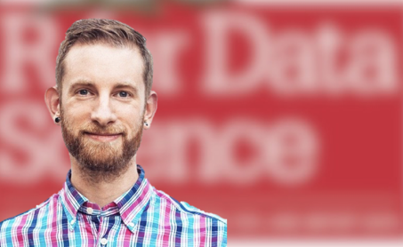
Hadley Wickham
“The Man Who Revolutionized R”
Chief Scientist at RStudio, (lead) author of key R packages incl. ggplot2, tidyr, dplyr - all components of the tidyverse.
https://priceonomics.com/hadley-wickham-the-man-who-revolutionized-r/

Slide 13
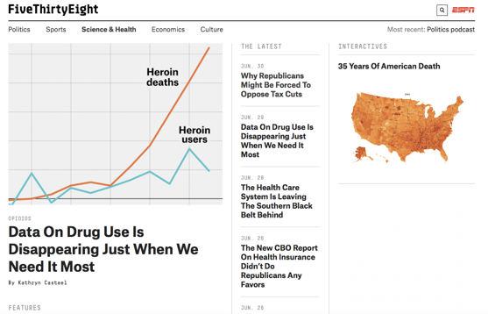
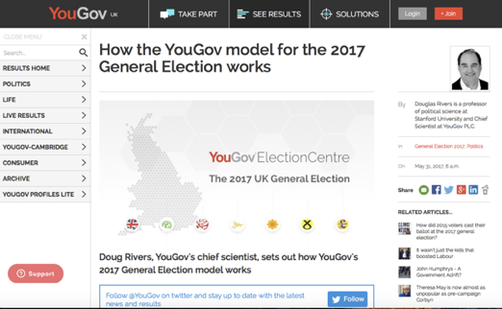
R is widely used by a number of organisations

Slide 14
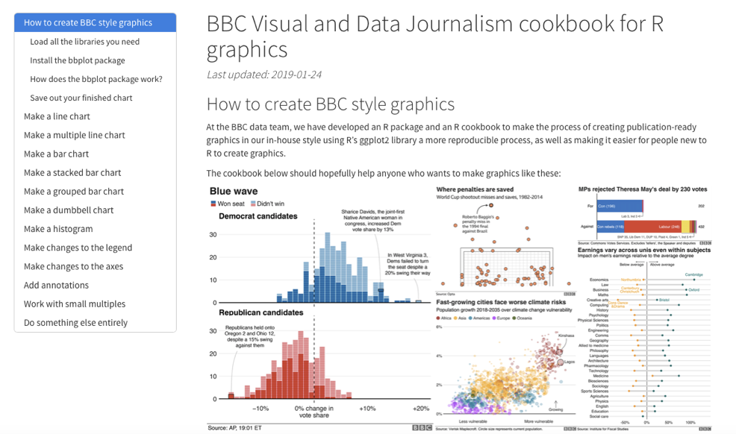
https://medium.com/bbc-visual-and-data-journalism/how-the-bbc-visual-and-data-journalism-team-works-with-graphics-in-r-ed0b35693535

Slide 15
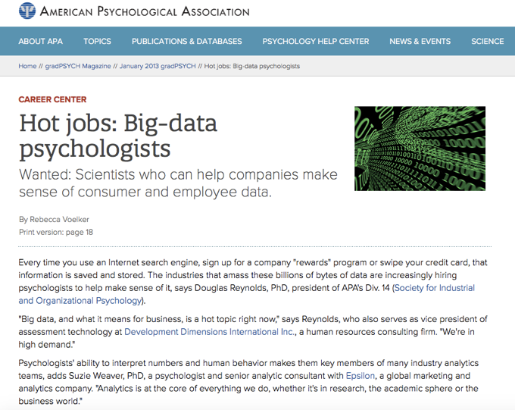
And Data Science is a growing employment destination for Psychologists

Slide 16
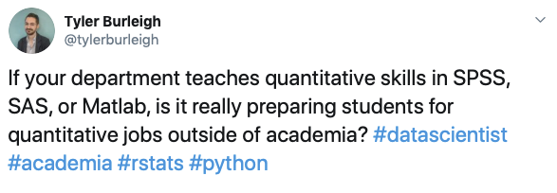
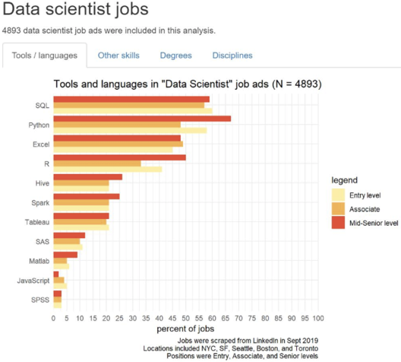

Slide 17
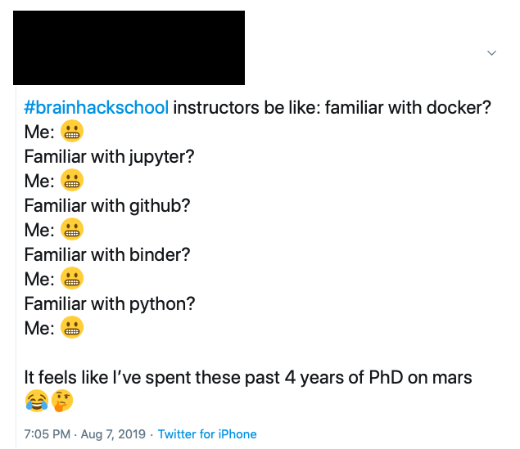

Slide 18
There will be coding...

Slide 19
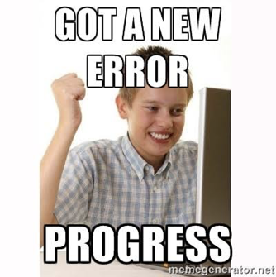
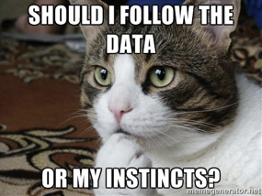
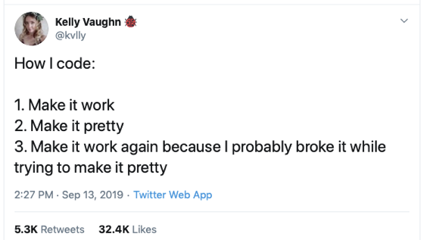
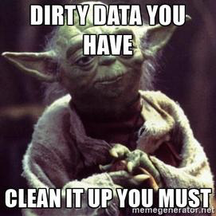
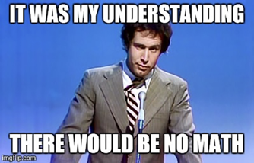
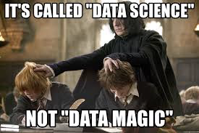

Slide 20
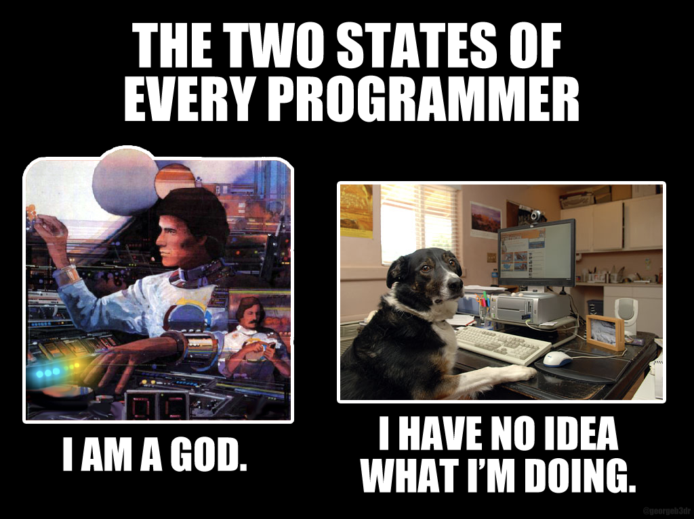
Source unknown

