Slide 1
The General Linear Model - ANOVA Part 1 (Video 4)
Unit Coordinator: Dr Danna R. Gifford (danna.gifford@manchester.ac.uk)
Original author: Prof Andrew J. Stewart (drandrewjstewart@gmail.com)

Slide 2
Factorial ANOVA
So far we have looked at ANOVA for designs when we have one factor which is between participants (i.e., each participant appears in only one condition), and for designs when we have one factor that is repeated measures (each participant appears in all conditions). These are examples of 1-way ANOVA.
Now we’re going to look at factorial ANOVA - this is for cases where we have more than one factor and we might be interested in how the factors interact with each other. If we have two factors, we will build a 2-way ANOVA, three factors, a 3-way ANOVA etc.

Slide 3
Factorial ANOVA
Imagine we have 2 factors. Factor 1 with two levels, Factor 2 with three. Our analysis might reveal a main effect of Factor 1 (i.e., a difference between the two levels), a main effect of Factor 2 (i.e., a difference between the three levels) or an interaction between the two…..
To examine what might be going on, we build a 2 x 3 ANOVA. The first number corresponds to the first factor and the number of levels it has (2) while the second corresponds to the second factor and the number of levels it has (3).
Following are examples of ‘perfect’ patterns of effects...

Slide 4
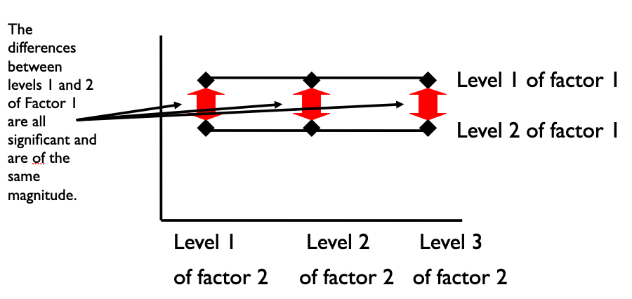
Main effect of Factor 1, no main effect of Factor 2 and no interaction

Slide 5
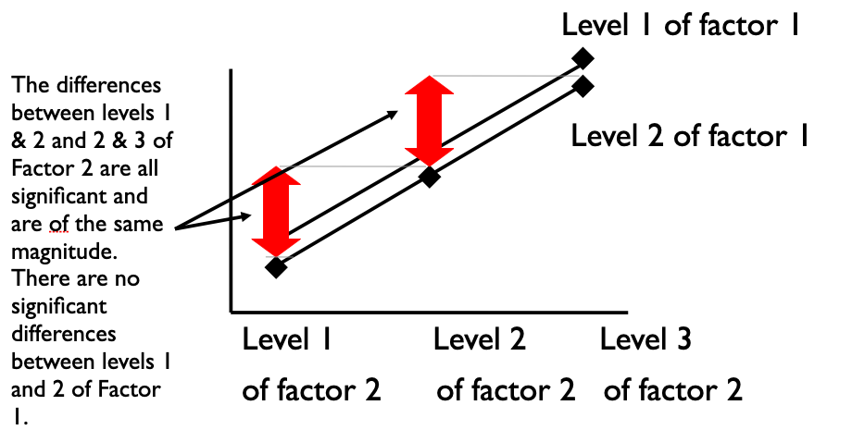
No main effect of Factor 1, main effect of Factor 2 and no interaction

Slide 6
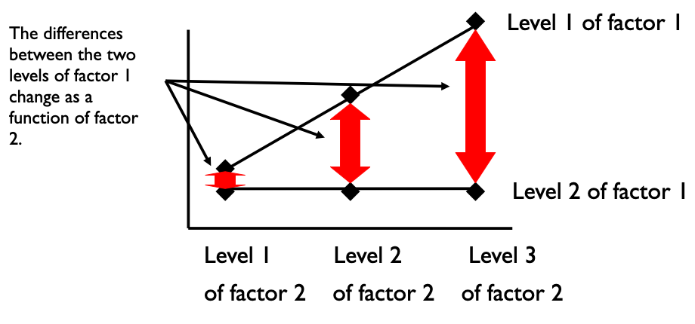
Main effect of Factor 1, main effect of Factor 2 and an interaction

Slide 7
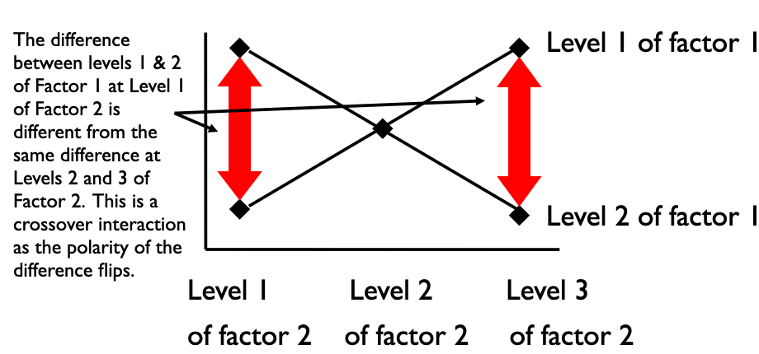
No main effect of Factor 1, no main effect of Factor 2 but an interaction

Slide 8
Example Factorial ANOVA
Imagine the case where we’re interested in the effect of positive vs. negative contexts on how quickly (in milliseconds) people respond to positive vs negative sentences. We think there might be a priming effect (i.e., people are quicker to respond to positive sentences after positive contexts vs. after negative contexts - and vice versa).
So, we have two factors, each with two levels. This is what’s known as a full factorial design where every subject participates in every condition.

Slide 9
Reading in our Data
factorial_data <- read_csv("https://raw.githubusercontent.com/ajstewartlang/11_glm_anova_pt1/master/data/factorial_data.csv")
head(factorial_data)
# A tibble: 6 x 5
Subject Item RT Sentence Context
<dbl> <dbl> <dbl> <chr> <chr>
1 1 3 1270 Positive Negative
2 1 7 739 Positive Negative
3 1 11 982 Positive Negative
4 1 15 1291 Positive Negative
5 1 19 1734 Positive Negative
6 1 23 1757 Positive Negative

Slide 10
Tidying our Data
factorial_data_tidied <- factorial_data %>%
mutate(Sentence = factor(Sentence), Context = factor(Context))
head(factorial_data_tidied)
# A tibble: 6 x 5
Subject Item RT Sentence Context
<dbl> <dbl> <dbl> <fct> <fct>
1 1 3 1270 Positive Negative
2 1 7 739 Positive Negative
3 1 11 982 Positive Negative
4 1 15 1291 Positive Negative
5 1 19 1734 Positive Negative
6 1 23 1757 Positive Negative

Slide 11
Summarising our Data
factorial_data_tidied %>%
group_by(Context, Sentence) %>%
summarise(mean_rt = mean(RT), sd_rt = sd(RT))
# A tibble: 4 x 4
# Groups: Context [2]
Context Sentence mean_rt sd_rt
<fct> <fct> <dbl> <dbl>
1 Negative Negative 1474. 729.
2 Negative Positive NA NA What’s happening here?
3 Positive Negative NA NA
4 Positive Positive 1579. 841.

Slide 12
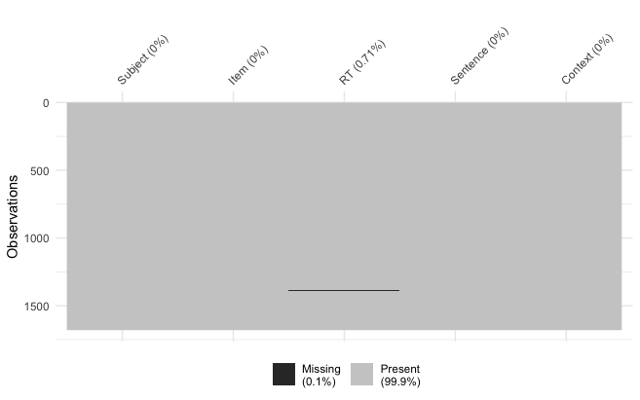
Do we have missing data?
vis_miss(factorial_data_tidied)

Slide 13
Ignoring Missing Data
factorial_data_tidied %>%
group_by(Context, Sentence) %>%
summarise(mean_rt = mean(RT, na.rm = TRUE), sd_rt = sd(RT, na.rm = TRUE))
# A tibble: 4 x 4
# Groups: Context [2]
Context Sentence mean_rt sd_rt
<fct> <fct> <dbl> <dbl>
1 Negative Negative 1474. 729.
2 Negative Positive 1595. 887.
3 Positive Negative 1633. 877.
4 Positive Positive 1579. 841.

Slide 14
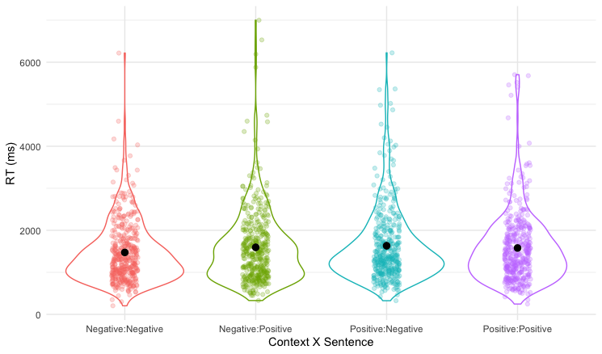
Visualising our Data

Slide 15
Modelling our Data - F1
model_subjects <- aov_4(RT ~ Context * Sentence + (1 + Context * Sentence | Subject), data = factorial_data_tidied, na.rm = TRUE)
anova(model_subjects)
Anova Table (Type 3 tests)
Response: RT
num Df den Df MSE F ges Pr(>F)
Context 1 59 90195 3.1767 0.0060231 0.07984 .
Sentence 1 59 124547 0.6283 0.0016524 0.43114
Context:Sentence 1 59 93889 4.5967 0.0090449 0.03616 *
---
Signif. codes: 0 ‘***’ 0.001 ‘**’ 0.01 ‘*’ 0.05 ‘.’ 0.1 ‘ ’ 1

Slide 16
Modelling our Data - F2
model_items <- aov_4(RT ~ Context * Sentence + (1 + Context * Sentence | Item), data = factorial_data_tidied, na.rm = TRUE)
anova(model_items)
Anova Table (Type 3 tests)
Response: RT
num Df den Df MSE F ges Pr(>F)
Context 1 27 39844 4.0013 0.0080150 0.05561 .
Sentence 1 27 203164 0.1221 0.0012553 0.72951
Context:Sentence 1 27 40168 5.7687 0.0116070 0.02346 *
---
Signif. codes: 0 ‘***’ 0.001 ‘**’ 0.01 ‘*’ 0.05 ‘.’ 0.1 ‘ ’ 1

Slide 17
Interpreting our Model
emmeans(model_subjects, pairwise ~ Context * Sentence, adjust = "none")
$emmeans
Context Sentence emmean SE df lower.CL upper.CL
Negative Negative 1474 57.8 138 1360 1588
Positive Negative 1628 57.8 138 1514 1742
Negative Positive 1595 57.8 138 1481 1709
Positive Positive 1579 57.8 138 1465 1693
Warning: EMMs are biased unless design is perfectly balanced
Confidence level used: 0.95
$contrasts
contrast estimate SE df t.ratio p.value
Negative Negative - Positive Negative -153.9 55.4 118 -2.779 0.0064
Negative Negative - Negative Positive -120.9 60.3 116 -2.004 0.0474
Negative Negative - Positive Positive -105.2 59.8 115 -1.759 0.0813
Positive Negative - Negative Positive 33.0 59.8 115 0.551 0.5824
Positive Negative - Positive Positive 48.7 60.3 116 0.807 0.4213
Negative Positive - Positive Positive 15.7 55.4 118 0.284 0.7772
These are the two key comparisons.

Slide 18
Interpreting our Model
We conducted a 2 (Context: Positive vs. Negative) x 2 (Sentence: Positive vs. Negative) repeated measures ANOVA to investigate the influence of Context valence on reaction times to Sentences of Positive or Negative valence. The ANOVA revealed no effect of Sentence (F < 1), no effect of Context (F(1, 59) = 3.18, p = .080, ηG² = .006), but an interaction between Sentence and Context (F(1, 59) = 4.60, p = .036, ηG² = .009).
The interaction was interpreted by conducting Bonferroni-corrected pairwise companions. These comparisons revealed that the interaction was driven by Negative Sentences being processed faster in Negative vs. Positive Contexts (1,474 ms. vs. 1,628 ms., t(118) = 2.78, p = .012) while Positive Sentences were read at similar speeds in Negative vs. Positive Contexts (1,595 ms. vs. 1,579 ms., t(118) = .284, p = 1).

Slide 19
Reporting ANOVA
Say what type of ANOVA it was, say what factors you had (and with labels for each level).
Report the results of main effects first, then interactions.
Report F values, exact p-values, effect sizes, and confidence intervals.
Remember to interpret interactions further - such as with contrasts or pairwise comparisons.
When you have main effects, say which direction the effect goes.
Avoid sillies - e.g., mixing up < and > or saying p = .000

