Slide 1
The General Linear Model - ANOVA Part 1 (Video 2)
Dr Andrew J. Stewart
E: drandrewjstewart@gmail.com
T: @ajstewart_lang
G: ajstewartlang

Slide 2
The Packages
There is a built in ANOVA function in R, called aov(), but you shouldn’t use it - it’s not easy to build models for repeated measures design, and the default is to use Type I Sums of Squares in the model output. This can make things tricky when you have factorial designs with interactions.
library(tidyverse) #load the tidyverse packages
library(afex) #load afex for running ANOVA
library(emmeans) #load emmeans for running pairwise comparisons

Slide 3
Example ANOVA
We have 45 participants in a between participants design where we are interested in the effect of beverage consumed on ability on a motor task. Our experimental factor (beverage type) has 3 levels. These are Water vs. Single Espresso vs. Double Espresso, and Ability is our DV measured on a continuous scale.
my_data <- read_csv("https://raw.githubusercontent.com/ajstewartlang/11_glm_anova_pt1/master/data/cond.csv")

Slide 4
Example ANOVA
head(my_data)
# A tibble: 6 x 3
Participant Condition Ability
<dbl> <chr> <dbl>
1 1 Water 4.82
2 2 Water 5.41
3 3 Water 5.73
4 4 Water 4.36
5 5 Water 5.47
6 6 Water 5.50
We need to ensure that R recognises that our Condition variable is a factor so let’s change that.

Slide 5
Tidying our Data
my_data_tidied <- my_data %>%
mutate(Condition = factor(Condition))
head(my_data_tidied)
# A tibble: 6 x 3
Participant Condition Ability
<dbl> <fct> <dbl>
1 1 Water 4.82
2 2 Water 5.41
3 3 Water 5.73
4 4 Water 4.36
5 5 Water 5.47
6 6 Water 5.50

Slide 6
Summarising our Data
my_data_tidied %>%
group_by(Condition) %>%
summarise(mean = mean(Ability), sd = sd(Ability))
# A tibble: 3 x 3
Condition mean sd
<fct> <dbl> <dbl>
1 Double Espresso 8.89 0.467
2 Single Espresso 6.99 0.419
3 Water 5.17 0.362

Slide 7
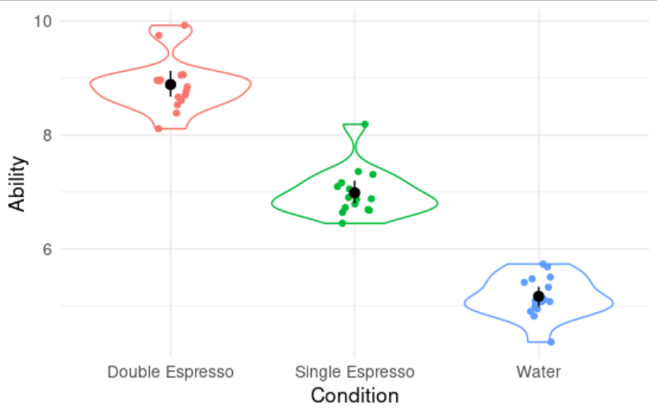
Visualising our Data
my_data_tidied %>%
ggplot(aes(x = Condition, y = Ability, colour = Condition)) +
geom_violin() +
geom_jitter(width = .1) +
guides(colour = FALSE) +
stat_summary(fun.data = "mean_cl_boot", colour = "black") +
theme(text = element_text(size = 13)) +
theme_minimal()

Slide 8
Modelling our Data
model <- aov_4(Ability ~ Condition + (1 | Participant), data = my_data_tidied)
summary(model)
Anova Table (Type 3 tests)
Response: Ability
num Df den Df MSE F ges Pr(>F)
Condition 2 42 0.17484 297.05 0.93397 < 2.2e-16 ***
---
Signif. codes: 0 ‘***’ 0.001 ‘**’ 0.01 ‘*’ 0.05 ‘.’ 0.1 ‘ ’ 1

Slide 9
Our Effect Size Measure
The effect size is measured by ges which stands for generalised effect size or generalised eta squared. For designs with more than one factor it can be a useful indicator of how much variance in the dependent variable can be explained by each factor (plus any interactions between factors).
Anova Table (Type 3 tests)
Response: Ability
num Df den Df MSE F ges Pr(>F)
Condition 2 42 0.17484 297.05 0.93397 < 2.2e-16 ***
---
Signif. codes: 0 ‘***’ 0.001 ‘**’ 0.01 ‘*’ 0.05 ‘.’ 0.1 ‘ ’ 1

Slide 10
Interpreting our Model
To determine what's driving the effect we can use emmeans::emmeans() to run pairwise comparisons (note, default is Tukey correction).
emmeans(model, pairwise ~ Condition)
$emmeans
Condition emmean SE df lower.CL upper.CL
Double Espresso 8.89 0.108 42 8.67 9.10
Single Espresso 6.99 0.108 42 6.77 7.20
Water 5.17 0.108 42 4.95 5.38
Confidence level used: 0.95
$contrasts
contrast estimate SE df t.ratio p.value
Double Espresso - Single Espresso 1.90 0.153 42 12.453 <.0001
Double Espresso - Water 3.72 0.153 42 24.372 <.0001
Single Espresso - Water 1.82 0.153 42 11.920 <.0001
P value adjustment: tukey method for comparing a family of 3 estimates

Slide 11
Interpreting our Model
We found a significant effect of Beverage type (F (2,42) = 297.05, p < .001, generalised η² = .93). Tukey comparisons revealed that the Water group performed significantly worse than the Single Espresso Group (p < .001), that the Water group performed significantly worse than the Double Espresso Group (p < .001), and that the Single Espresso Group performed significantly worse than the Double Espresso Group (p < .001).
In other words, drinking some coffee improves motor performance relative to drinking water, and drinking a lot of coffee improves motor performance even more.

