Slide 1
The General Linear Model - ANOVA Part 2
Dr Andrew J. Stewart
E: drandrewjstewart@gmail.com
T: @ajstewart_lang
G: ajstewartlang

Slide 2
Previously
We examined using the afex package for 1-way ANOVA for between subjects and within subjects (repeated measures) designs.
We used the emmeans package for running follow-up tests and discussed issues around the need to correct for multiple comparisons (familywise error).
We examined how to build models for factorial ANOVA and how to interpret interaction effects using emmeans.

Slide 3
Analysis of Covariance (ANCOVA)
ANCOVA can be thought of as a mix of ANOVA and regression (both of which are the GLM at their core).
One of our examples from the previous workshop looked at how double espresso vs. single espresso vs. water drinking (our IV) might influence motor performance (our DV).
Imagine we sampled from a new group of participants - and we think another factor that we are not manipulating (time spent playing computer games) might also influence the DV.
What we want is to be able to see the effect on our DV of our IV after we have removed the influence of computer game playing frequency.

Slide 4
Analysis of Covariance (ANCOVA)
Now, imagine we have a measure of computer games frequency - perhaps hours per week people play computer games.
So, in addition to manipulating the type of beverage we’re giving people (i.e., double espresso vs. single espresso vs. water) we also measure how often they play computer games.
Let’s do a plot first with our DV (Motor Ability) on the y-axis, and our covariate (Gaming Frequency) on the x-axis.

Slide 5
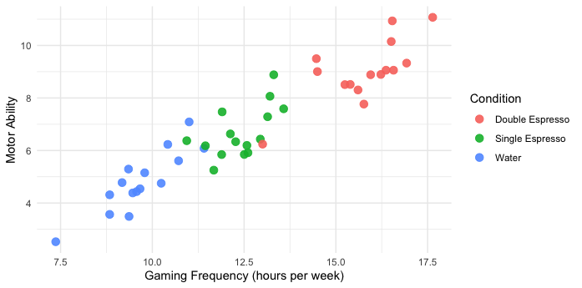
So we can see there’s a relationship between our DV (Motor Ability) and our covariate (Gaming Frequency).
We can also see our Gaming Ability groups appear to be clustering in our data by Condition.

Slide 6
Let’s run a 1-way between participants ANOVA and initially ignore the covariate.
anova_model <-aov_4(Ability ~ Condition + (1 | Participant), data = my_data)
anova(anova_model)
Anova Table (Type 3 tests)
Response: Ability
num Df den Df MSE F ges Pr(>F)
Condition 2 42 1.2422 53.432 0.71786 2.882e-12 ***
---
Signif. codes: 0 ‘***’ 0.001 ‘**’ 0.01 ‘*’ 0.05 ‘.’ 0.1 ‘ ’ 1
The factor Condition is significant with an F = 53.432. We might then follow this up with some pairwise comparisons.

Slide 7
> emmeans(anova_model, pairwise ~ Condition)
$emmeans
Condition emmean SE df lower.CL upper.CL
Double Espresso 9.02 0.288 42 8.43 9.60
Single Espresso 6.69 0.288 42 6.11 7.27
Water 4.82 0.288 42 4.24 5.40
Confidence level used: 0.95
$contrasts
contrast estimate SE df t.ratio p.value
Double Espresso - Single Espresso 2.33 0.407 42 5.720 <.0001
Double Espresso - Water 4.20 0.407 42 10.317 <.0001
Single Espresso - Water 1.87 0.407 42 4.597 0.0001
P value adjustment: tukey method for comparing a family of 3 estimates
We might then conclude we have a significant effect of Condition, and that each group differs from each other condition with the Double Espresso group scoring highest on the task, then the Single Espresso group, and then the Water group scoring lowest.

Slide 8
But now let’s control for the effect of our co-variate.
model_ancova <- aov_4(Ability ~ Gaming + Condition + (1 | Participant), data = my_data, factorize = FALSE)
anova(model_ancova)
Anova Table (Type 3 tests)
Response: Ability
num Df den Df MSE F ges Pr(>F)
Gaming 1 41 0.55171 53.5636 0.56643 5.87e-09 ***
Condition 2 41 0.55171 0.8771 0.04103 0.4236
---
Signif. codes: 0 ‘***’ 0.001 ‘**’ 0.01 ‘*’ 0.05 ‘.’ 0.1 ‘ ’ 1
The factor Condition is now not significant with an F < 1. However, our covariate Gaming Frequency is significant. Adding the covariate to our model means a lot of the variance we previously attributed to our experimental factor is actually explained by the covariate.

Slide 9
Adjusted Means
The mean for each group of our experimental factor (Condition) is adjusted to take into consideration the influence of our covariate within that group.
> emmeans(model_ancova, pairwise ~ Condition)
$emmeans
Condition emmean SE df lower.CL upper.CL
Double Espresso 6.32 0.415 41 5.48 7.16
Single Espresso 6.87 0.193 41 6.48 7.26
Water 7.33 0.393 41 6.53 8.12
These adjusted means contrast with the unadjusted ones which are:
Condition Mean
1 Double Espresso 9.02
2 Single Espresso 6.69
3 Water 4.82

Slide 10
Base R aov() vs. afex::aov_4()
Note, if we had used the aov() function the F-tests would have been conducted using Type 1 (sequential) Sums of Squares. For Type III, we need to use the aov_4() function from the afex package.
Type I Sum of Squares is calculated sequentially - e.g., first for Factor A main effect, then for Factor B main effect, then for the interaction. The order in which they are calculated matters and can be misleading for unbalanced design or cases where predictors are correlated. Total SS is the sum of the individual effect SS.
Type II Sum of Squares assumes no interaction(s) when testing main effects or higher order interaction(s) when testing lower order interaction(s).
Type III Sum of Squares tests for effects adjusted for the presence of the other effects (so does not depend on the order of terms).
Much debate about which one is ‘correct’ - each has their own purpose - for factorial designs where you’re interested in testing an interaction (or when your predictors correlate), Type III is most commonly used.

Slide 11
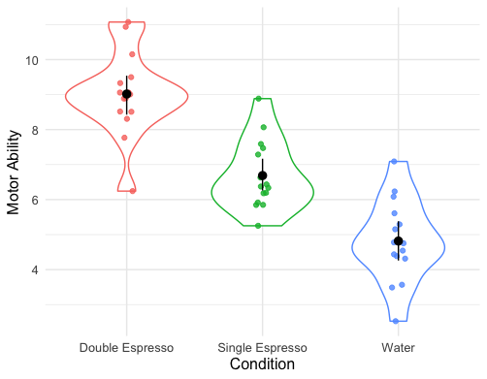
AN(C)OVA as a special case of regression
Let’s return to the example we looked at for ANCOVA - and let’s forget the co-variate for a moment.
We looked at how double espresso vs. single espresso vs. water drinking (our IV) might influence people’s gaming ability (our DV).

Slide 12
AN(C)OVA as a special case of regression
First we use dummy (treatment) coding for the levels of our experimental factor.
my_data <- my_data %>%
mutate(Condition = fct_relevel(Condition,
levels = c("Water", "Double Espresso", "Single Espresso")))
contrasts(my_data$Condition)
Double Espresso Single Espresso
Water 0 0
Double Espresso 1 0
Single Espresso 0 1
Ability = Intercept + β1(Double Espresso) + β2(Single Espresso)
The Intercept is our reference category (Water) with coding (0, 0), while the coding for Double Espresso is (1, 0) and for Single Espresso (0, 1)

Slide 13
AN(C)OVA as a special case of regression
Ability = Intercept + β1(Double Espresso) + β2(Single Espresso)
We want to calculate β1 and β2.
model_lm <- lm(Ability ~ Condition, data = my_data)
model_lm
Call:
lm(formula = Ability ~ Condition, data = my_data)
Coefficients:
(Intercept) ConditionDouble Espresso ConditionSingle Espresso
4.817 4.199 1.871
The intercept is 4.817 (which is the mean of our Water group), β1 is 4.199, and β2 is 1.871

Slide 14
AN(C)OVA as a special case of regression
To work out the mean Ability of our Double Espresso Group, we use the coding for the Double Espresso group (1, 0) with our equation:
Ability = Intercept + β1(Double Espresso) + β2(Single Espresso)
Ability = 4.817 + 4.199(1) + 1.871(0)
Ability = 4.817 + 4.199
Ability = 9.016
To work out the mean Ability of our Single Espresso Group, we use the coding for the Single Espresso group (0, 1) with our equation:
Ability = 4.817 + 4.199(0) + 1.871(1)
Ability = 4.817 + 1.871
Ability = 6.688

Slide 15
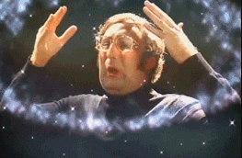
AN(C)OVA as a special case of regression
Which are the exact same means generated by the ANOVA…

Slide 16
AN(C)OVA as a special case of regression
We can do ANCOVA like this too - let’s consider our co-variate of Gaming frequency…
The adjusted means from the ANCOVA (which take into consideration the influence of the covariate) were:
Water Group = 7.33
Double Espresso Group = 6.32
Single Espresso Group = 6.87

Slide 17
AN(C)OVA as a special case of regression
Ability = Intercept + β1(Gaming) + β2(Double Espresso) + β3(Single Espresso)
Add the covariate to our model before the experimental factor:
model_ancova <- lm(Ability ~ Gaming + Condition, data = my_data)
model_ancova
Call:
lm(formula = Ability ~ Gaming + Condition, data = my_data)
Coefficients:
(Intercept) Gaming ConditionDouble Espresso ConditionSingle Espresso
-3.4498 0.8538 -1.0085 -0.4563

Slide 18
AN(C)OVA as a special case of regression
The β2 and β3 coefficients tell us the difference between each group mean (i.e., the adjusted mean) compared to the reference Group (Water) when taking into account the covariate of Gaming frequency:
β2 is the difference between the Double Espresso and Water group adjusted means (= -1.0085) while β3 is the difference between the Single Espresso and Water group adjusted means (= -0.4563)

Slide 19
AN(C)OVA as a special case of regression
Let’s check - the following are the adjusted means output by the ANCOVA model:
Water Group = 7.33
Double Espresso Group = 6.32
Single Espresso Group = 6.87
Difference between the Water and Double Espresso Group is 1.01 and the difference between the Water and Single Espresso Group is 0.46.

Slide 20
AN(C)OVA as a special case of regression
We can work out the mean of our reference group (Water) by plugging in the values to our equation - note that Gaming is not a factor and we need to enter the mean of this variable (which is 12.62296).
Ability = Intercept + β1(Gaming) + β2(Double Espresso) + β3(Single Espresso)
Ability = -3.4498 + 0.8538(12.62296) + (- 1.0085)(0) + (-0.4563)(0)
Ability = -3.4498 + 10.777
Ability = 7.33
7.33 is the adjusted mean for the Water group…which is what we had from calling the emmeans() function following the ANCOVA…

Slide 21
AN(C)OVA as a special case of regression
You can now build ANOVA models in R for different kinds of designs, add between participant covariates, factor out the influence of these covariates, and you also know why AN(C)OVA is a special case of regression (with dummy coding of variables).
Actually, many statistical models can be built as a variation of the linear model!

Slide 22
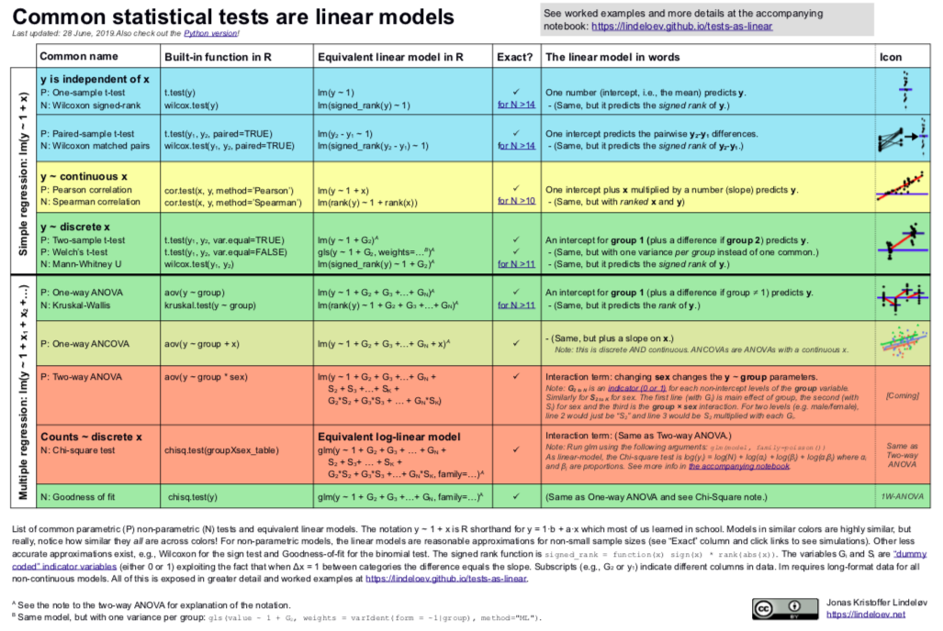
A great overview by Jonas Kristoffer Lindeløv.
https://lindeloev.github.io/tests-as-linear/#1_the_simplicity_underlying_common_tests

