Slide 1
Mixed Models Part 1
Dr Andrew J. Stewart
E: drandrewjstewart@gmail.com
T: @ajstewart_lang
G: ajstewartlang

Slide 2
In this workshop...
We will take our first look at (generalised) linear mixed models - (G)LMMs.
(G)LMMs allow for models with a combination of fixed and random effects (intercepts and slopes).
We’ll focus on designs with one factor of several levels, and 2 x 2 designs for continuous data.
We’ll also examine of measures of model fit, and using emmeans() to interpret interactions in factorial designs.

Slide 3
Why linear mixed models?
(G)LMMs are more flexible than ANOVA, allow for multiple simultaneous random effects (e.g., subjects and items), subject and item covariates, nesting, unbalanced designs, cope with missing data, allow you to model both continuous and categorical IVs and DVs, operate over trial-level data, provide a good balance of Type I and Type II error, and allow you to determine the best statistical models to fit to your data that make the most theoretical sense...

Slide 4
Recap - linear modelling
> gender_height_data
# A tibble: 8 x 3
subject gender height
<int> <fct> <dbl>
1 1 male 170
2 2 male 180
3 3 male 175
4 4 male 185
5 5 female 160
6 6 female 170
7 7 female 165
8 8 female 165
Here we have a measure of height for 4 males and 4 females. Can gender be used to predict height?

Slide 5
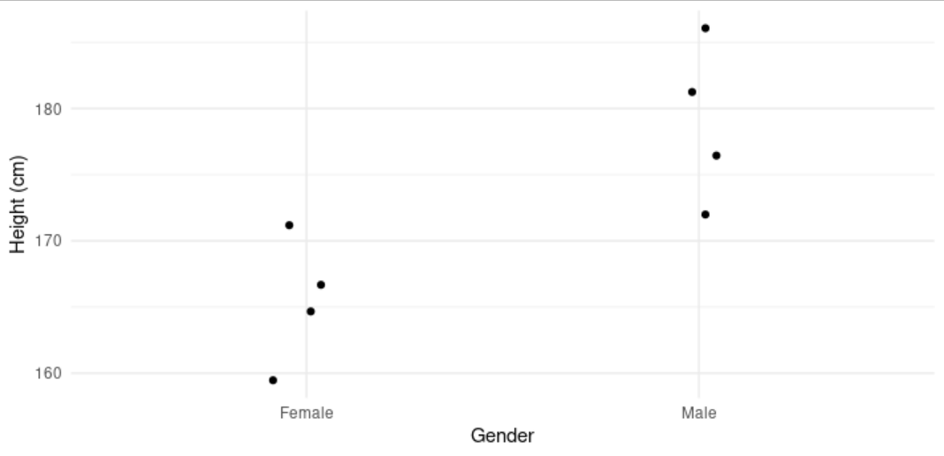
It certainly looks like Males (on average) are taller than Females (on average).
Let’s fit a linear model using the lm() function.
height_model <- lm(height ~ gender, data = gender_height_data)

Slide 6
> summary(height_model)
Call:
lm(formula = height ~ gender, data = gender_height_data)
Residuals:
Min 1Q Median 3Q Max
-7.500 -3.125 0.000 3.125 7.500
Coefficients:
Estimate Std. Error t value Pr(>|t|)
(Intercept) 165.000 2.700 61.104 1.29e-09 ***
gendermale 12.500 3.819 3.273 0.017 *
---
Signif. codes: 0 ‘***’ 0.001 ‘**’ 0.01 ‘*’ 0.05 ‘.’ 0.1 ‘ ’ 1
Residual standard error: 5.401 on 6 degrees of freedom
Multiple R-squared: 0.641, Adjusted R-squared: 0.5812
F-statistic: 10.71 on 1 and 6 DF, p-value: 0.01696
We can see here that Gender is a significant predictor (p = 0.017)

Slide 7
> summary(height_model)
Call:
lm(formula = height ~ gender, data = gender_height_data)
Residuals:
Min 1Q Median 3Q Max
-7.500 -3.125 0.000 3.125 7.500
Coefficients:
Estimate Std. Error t value Pr(>|t|)
(Intercept) 165.000 2.700 61.104 1.29e-09 ***
gendermale 12.500 3.819 3.273 0.017 *
---
Signif. codes: 0 ‘***’ 0.001 ‘**’ 0.01 ‘*’ 0.05 ‘.’ 0.1 ‘ ’ 1
Residual standard error: 5.401 on 6 degrees of freedom
Multiple R-squared: 0.641, Adjusted R-squared: 0.5812
F-statistic: 10.71 on 1 and 6 DF, p-value: 0.01696
The Intercept (165) corresponds to the mean height of our reference category (Female).
The gendermale coefficient (12.5) is the difference between our reference category (Intercept) and our Males.
Females were taken as the reference category (i.e., the intercept) simply because R chooses this on an alphabetical basis.

Slide 8
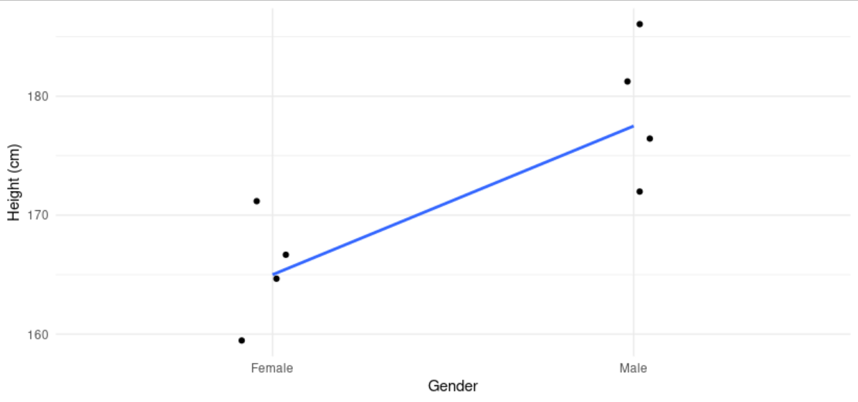

Slide 9
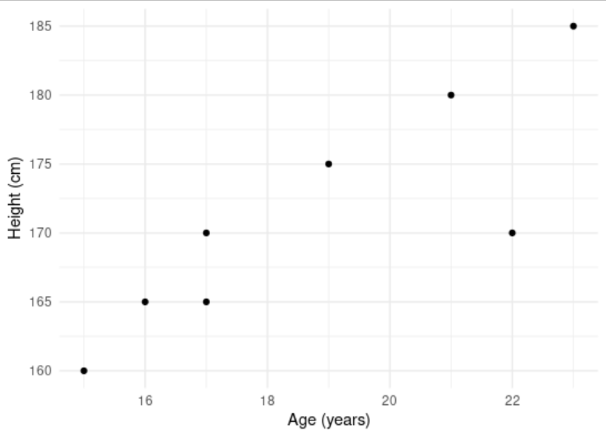
How about with a non-categorical predictor?
Here we have age and height data - can age predict someone’s height in our dataset?
> age_height_data
# A tibble: 8 x 3
subject age height
<int> <dbl> <dbl>
1 1 22 170
2 2 21 180
3 3 19 175
4 4 23 185
5 5 15 160
6 6 17 170
7 7 16 165
8 8 17 165

Slide 10
Let’s build a model...
> age_model <- lm(height ~ age, data = age_height_data)
> summary(age_model)
Call:
lm(formula = height ~ age, data = age_height_data)
Residuals:
Min 1Q Median 3Q Max
-9.045 -2.104 1.646 3.201 3.557
Coefficients:
Estimate Std. Error t value Pr(>|t|)
(Intercept) 126.281 11.411 11.067 3.24e-05 ***
age 2.398 0.602 3.984 0.00725 **
---
Signif. codes: 0 ‘***’ 0.001 ‘**’ 0.01 ‘*’ 0.05 ‘.’ 0.1 ‘ ’ 1
Residual standard error: 4.721 on 6 degrees of freedom
Multiple R-squared: 0.7257, Adjusted R-squared: 0.6799
F-statistic: 15.87 on 1 and 6 DF, p-value: 0.007252
For every increase in Age by 1, Height increases by 2.398. But of course, we know this relationship likely breaks down at a certain age - but for the data we have, we can fit a linear function.

Slide 11
Linear Mixed Models in R
For mixed effects linear modelling in R, we need to install the package {lme4}. We also want the {lmerTest} package and the {emmeans} package.
> library(lme4)
> library(lmerTest)
> library(emmeans)
The {lme4} package is for model building, the {lmerTest} package is for p-value estimates of our model parameters, and the {emmeans} package will allow us to run follow-up tests on our models.

Slide 12
Linear mixed models
What happens when we have many observations per person that we want to model?
Imagine we are interested in how a person’s reaction time varies whether they’re responding to Large or Small target items.
We observe the same 10 people each responding to 5 Large and 5 Small target items.
We have 10 observations per person. These observations are not independent of each other as (which is an assumption of a linear model).

Slide 13
Linear mixed models
We can get around the lack of independence by treating participants as a random effect such that each participant has their own individual reaction time baseline.
This gives us a separate random intercept value for each participant - in other words, our model can account for individual variation.
This is a mixed effects model:
rt ~ condition + (1 | subject) + error
This is our random effect term and models each subject having a different random intercept.

Slide 14
Linear mixed models
Imagine also that we have different Target Items (e.g., 10 different items that were presented in either in Large or Small format).
Each Target Item might have been a little different. One particular Target might just be responded to more quickly (regardless of what condition it was in) - in other words, the Target Items will also have different baselines.

Slide 15
Linear mixed models
We can capture the random effect of Item in the same way that we did for participants:
rt ~ condition + (1 | subject) + (1 | item) + error
We now have two random effects and are modelling each Subject and each Item having their own individual intercept.

Slide 16
Fixed vs. Random Effects
Fixed Effect
Data has been gathered from all the levels of the factor that are of interest. (Typically your experimental factors and maybe factors like age group - young vs. old for example).
Random Effect
The factor has many possible levels, interest is in all possible levels, but only a random sample of levels is included in the data. (Typically participants and items). Typically need > 5 levels in order to estimate effects.

Slide 17
Linear mixed models
> mixed_model_data
# A tibble: 400 x 4
subject item condition rt
<fct> <fct> <fct> <int>
1 1 1 small 908
2 1 2 small 884
3 1 3 small 849
4 1 4 small 722
5 1 5 small 1090
6 2 1 small 890
7 2 2 small 703
8 2 3 small 781
9 2 4 small 942
10 2 5 small 898
# … with 390 more rows
mixed_model_data %>%
group_by(condition) %>%
summarise(mean_rt = mean(rt), sd_rt = sd(rt))
# A tibble: 2 x 3
condition mean_rt sd_rt
<fct> <dbl> <dbl>
1 large 854. 87.8
2 small 804. 97.5

Slide 18
mixed_model <- lmer(rt ~ condition + (1 | subject) + (1 | item),
data = mixed_model_data)
summary(mixed_model)
Linear mixed model fit by REML. t-tests use Satterthwaite's method ['lmerModLmerTest']
Formula: rt ~ condition + (1 | subject) + (1 | item)
Data: mixed_model_data
REML criterion at convergence: 4696.8
Scaled residuals:
Min 1Q Median 3Q Max
-2.5385 -0.6366 -0.1475 0.6054 2.6043
Random effects:
Groups Name Variance Std.Dev.
subject (Intercept) 1240.3 35.22
item (Intercept) 442.8 21.04
Residual 7126.7 84.42
Number of obs: 400, groups: subject, 10; item, 5
Fixed effects:
Estimate Std. Error df t value Pr(>|t|)
(Intercept) 854.140 15.755 12.166 54.213 6.99e-16 ***
conditionsmall -49.780 8.442 385.000 -5.897 8.12e-09 ***
---
Signif. codes: 0 ‘***’ 0.001 ‘**’ 0.01 ‘*’ 0.05 ‘.’ 0.1 ‘ ’ 1
Correlation of Fixed Effects:
(Intr)
conditnsmll -0.268
More variability in subjects than in items.
The intercept corresponds to the RT to the Large Condition (854 ms) - going from Large to Small contexts decreases RT by around 50 ms.

Slide 19
Fixed effects:
Estimate Std. Error df t value Pr(>|t|)
(Intercept) 854.140 15.755 12.166 54.213 6.99e-16 ***
conditionsmall -49.780 8.442 385.000 -5.897 8.12e-09 ***
---
Signif. codes: 0 ‘***’ 0.001 ‘**’ 0.01 ‘*’ 0.05 ‘.’ 0.1 ‘ ’ 1
We can see that the experimental condition is significant as we see the p-value associated with the t-test on the parameter is significant (p <.001).
We can also compare this model with our fixed effect of condition with a model which doesn’t have this fixed effect. If the difference between the two models is significant, then we can conclude that the fixed effect is significant.
mixed_model_null <- lmer(rt ~ (1 | subject) + (1 | item),
data = mixed_model_data)

Slide 20
Comparing Models Using LRT
We can use the Likelihood Ratio Test (LRT) to compare our model with the fixed effect of Condition to the model without.
anova(mixed_model, mixed_model_null)
Data: mixed_model_data
Models:
mixed_model_null: rt ~ (1 | subject) + (1 | item)
mixed_model: rt ~ condition + (1 | subject) + (1 | item)
npar AIC BIC logLik deviance Chisq Df Pr(>Chisq)
mixed_model_null 4 4751.5 4767.5 -2371.8 4743.5
mixed_model 5 4720.1 4740.1 -2355.1 4710.1 33.368 1 7.626e-09 ***
---
Signif. codes: 0 ‘***’ 0.001 ‘**’ 0.01 ‘*’ 0.05 ‘.’ 0.1 ‘ ’ 1

Slide 21
Data: mixed_model_data
Models:
mixed_model_null: rt ~ (1 | subject) + (1 | item)
mixed_model: rt ~ condition + (1 | subject) + (1 | item)
npar AIC BIC logLik deviance Chisq Df Pr(>Chisq)
mixed_model_null 4 4751.5 4767.5 -2371.8 4743.5
mixed_model 5 4720.1 4740.1 -2355.1 4710.1 33.368 1 7.626e-09 ***
---
Signif. codes: 0 ‘***’ 0.001 ‘**’ 0.01 ‘*’ 0.05 ‘.’ 0.1 ‘ ’ 1
We see the Likelihood Ratio Test is significant - note the AIC, BIC, and deviance values are all lower for the model with our fixed effect. Deviance is the same as the residual sum of squares in linear models.
LRTs should only be conducted with nested models - i.e., when one model is a subset of the other.

Slide 22
Modelling differences in the magnitude of our effect
So far we have accounted for the possibility that our subjects and items might have different reaction time baselines - that some people are faster at responding that others (which is why we introduced the separate random intercepts).
But what if the magnitude of the effect of Condition is different for different subjects, and also what if the magnitude of the effect of Condition is different for different items?

Slide 23
So far we are assuming constant magnitudes of the effect across subjects and items
coef(mixed_model)
$subject
(Intercept) conditionsmall
1 896.2420 -49.78
2 872.6334 -49.78
3 858.2934 -49.78
4 901.0512 -49.78
5 874.9943 -49.78
6 839.7562 -49.78
7 842.9915 -49.78
8 801.1955 -49.78
9 841.2427 -49.78
10 812.9998 -49.78
$item
(Intercept) conditionsmall
1 868.8340 -49.78
2 833.9098 -49.78
3 852.9328 -49.78
4 837.1982 -49.78
5 877.8252 -49.78
The different intercepts for each subjects and for each item take into account individual baseline differences.
However, this doesn’t take into account the fact our effect might be bigger for some subjects than for others (and for some items than for others). In other words, the slopes are all currently the same (-49.78).

Slide 24
Let’s model the variability in the magnitude of the effect
mixed_model_slopes <- lmer(rt ~ condition +
(1 + condition | subject) +
(1 + condition | item),
data = mixed_model_data)
These modified terms tell the model to expect different intercepts for condition (which we had before) as well as differing slopes as a function of the factor condition. Remember, these are our random effects.

Slide 25
Now let’s look at the coefficients in our model
coef(mixed_model_slopes)
$subject
(Intercept) conditionsmall
1 881.8123 -11.07787
2 866.2407 -32.46840
3 858.8051 -57.03899
4 888.3678 -26.08780
5 869.7440 -41.46898
6 843.8967 -58.48443
7 847.1946 -62.21594
8 814.3650 -69.96477
9 846.9626 -69.07433
10 824.0112 -69.91850
$item
(Intercept) conditionsmall
1 868.9277 -51.97957
2 838.7420 -59.38390
3 844.5847 -28.36271
4 846.8623 -72.12582
5 871.5834 -37.04801
The slopes between the two levels of our condition differ for each subject...
...and also for each item.

Slide 26
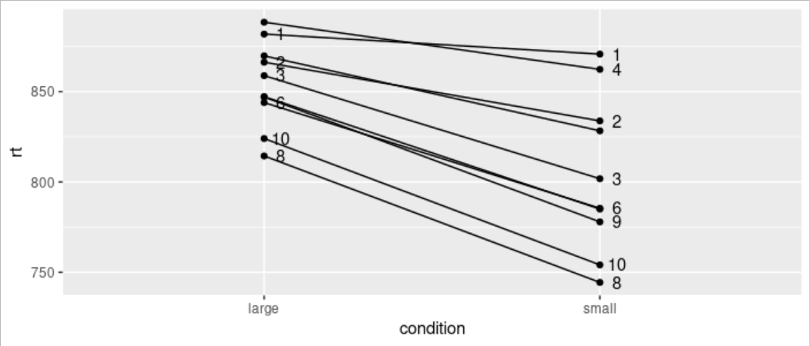
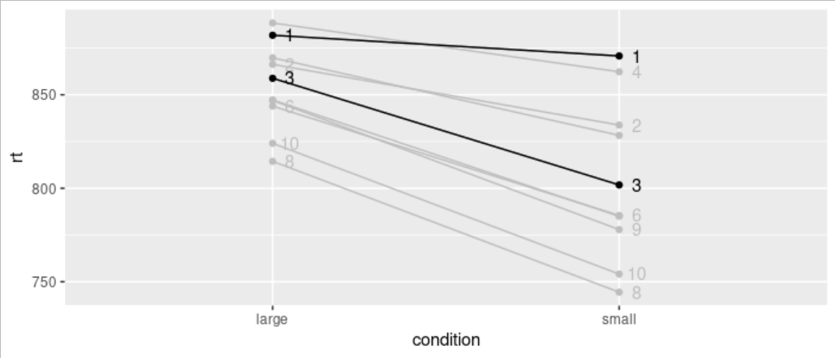
Plotting the individual intercepts and slopes for subjects
Let's just look at subjects 1 and 3 - for subject 1 we can see the difference between conditions looks pretty small compared to the difference for subject 3.

Slide 27
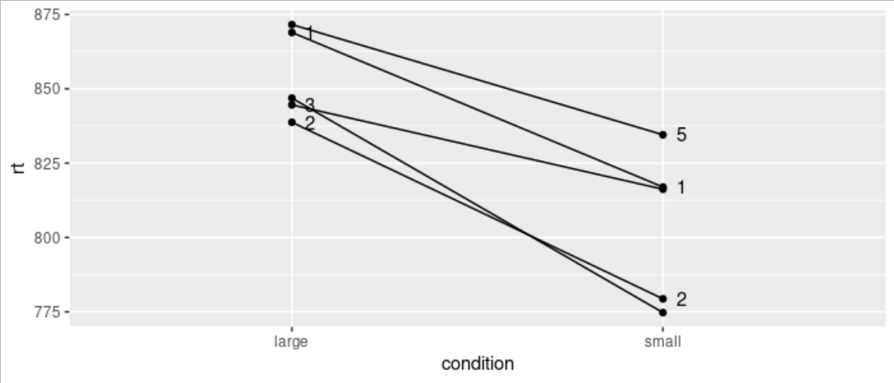
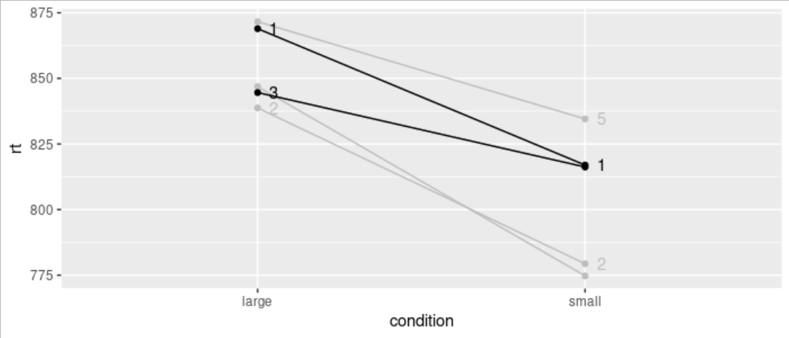
Plotting the individual intercepts and slopes for items
Let's just look at items 1 and 3 - for these items, the reaction times for the `small` condition are pretty much the same - but for the `large` condition item 1 is about 25 ms. slower than for item 3.

Slide 28
Partial Pooling in LMMs
LMMs use partial pooling to estimate the parameters of the model coefficients.
Partial pooling takes account of the individual slopes and intercepts for each level of the random effect structure, but also the slope and intercept of the overall model (which ignores how things vary from one participant to the next).
The use of partial pooling is one reason why LMMs are so powerful - they can cope with missing data (by being sensitive to properties of the overall dataset) and are not too affected by extreme data points (because they know these are quite unlikely in the context of the larger dataset - shrinkage reduces the influence of these extreme values on your parameter estimates).
Have a look at this great blogpost by Tristan Mahr: https://www.tjmahr.com/plotting-partial-pooling-in-mixed-effects-models/

Slide 30
One Factor Design Example
Imagine we measured 24 subjects’ gaze duration while reading a sentence that appeared in one of three conditions - Negative, Neutral, and Positive. We had 24 items. The study is repeated measures (so everyone saw every condition).
head(tidied_factor_1_data)
# A tibble: 6 x 4
subject item condition gaze
<fct> <fct> <fct> <dbl>
1 S1 I1 Neutral 867
2 S1 I2 Positive 1061
3 S1 I3 Negative 771
4 S1 I4 Neutral 626
5 S1 I5 Positive 1283
6 S1 I6 Negative 846

Slide 31
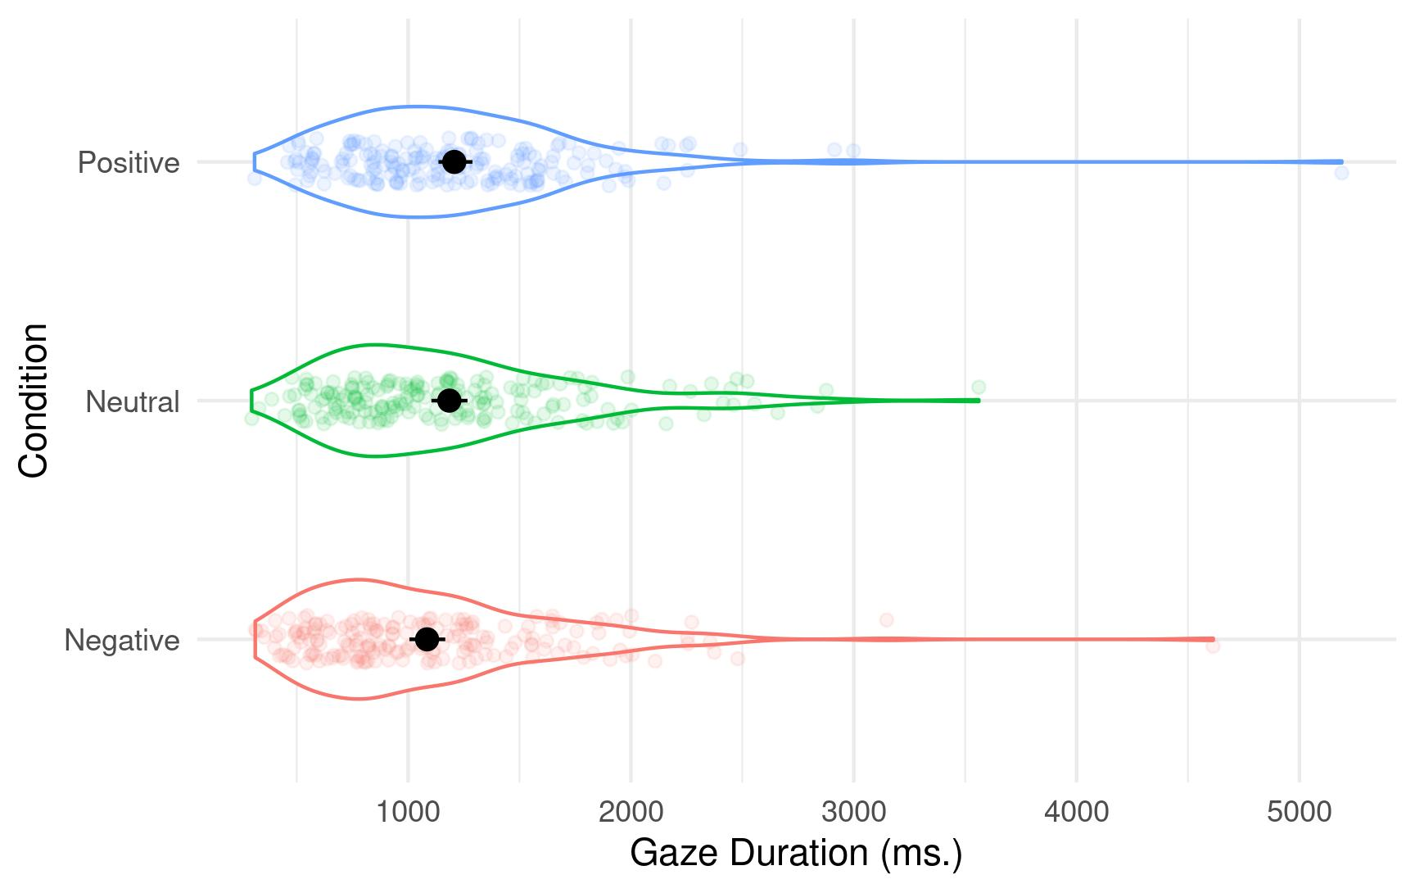
One Factor Design Example

Slide 32
Building our model - attempt 1
factor_1_model <- lmer(gaze ~ condition + (1 + condition | subject) +
(1 + condition | item), data = tidied_factor_1_data)
boundary (singular) fit: see ?isSingular
The warning we receive suggests we might be trying to estimate more parameters that can be estimated using the data set of the size we have. In other words, our model may be too complex. One solution would be to ignore the warning - especially if there is a strong theoretical reason to model all of the terms. Another solution would be to simplify the random effects structure until the warning goes away.

Slide 33
Building our model - attempt 2
factor_1_model <- lmer(gaze ~ condition + (1 | subject) + (1 | item),
data = tidied_factor_1_data)
If we drop both random slopes, we end up with a model that doesn’t generate the warning. We can then use the check_model() function from the {performance} package to check our model assumptions.
check_model(factor_1_model)

Slide 34
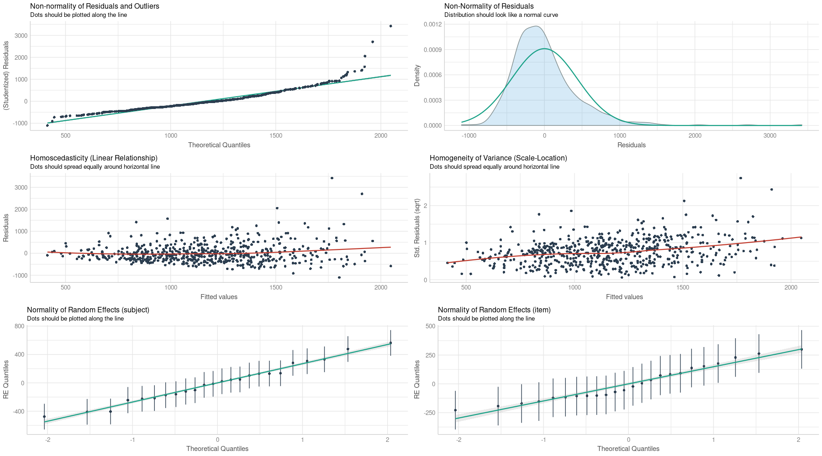
Checking our assumptions

Slide 35
Interpreting our model
summary(factor_1_model)
Linear mixed model fit by REML. t-tests use Satterthwaite's method ['lmerModLmerTest']
Formula: gaze ~ condition + (1 | subject) + (1 | item)
Data: tidied_factor_1_data
REML criterion at convergence: 8713.1
Scaled residuals:
Min 1Q Median 3Q Max
-2.4240 -0.6246 -0.1505 0.4069 7.5250
Random effects:
Groups Name Variance Std.Dev.
subject (Intercept) 81340 285.2
item (Intercept) 29586 172.0
Residual 206838 454.8
Number of obs: 574, groups: subject, 24; item, 24
Fixed effects:
Estimate Std. Error df t value Pr(>|t|)
(Intercept) 1083.90 75.53 45.12 14.350 < 2e-16 ***
conditionNeutral 100.84 46.55 525.13 2.166 0.03073 *
conditionPositive 123.40 46.48 525.09 2.655 0.00818 **
---
Signif. codes: 0 ‘***’ 0.001 ‘**’ 0.01 ‘*’ 0.05 ‘.’ 0.1 ‘ ’ 1
Correlation of Fixed Effects:
(Intr) cndtnN
conditnNtrl -0.308
conditnPstv -0.309 0.501
These tests compare the Intercept to first the Neural condition, then to the Positive.

Slide 36
LRT
So the summary on the previous slide tells us only part of the story. Let’s compare the model with the fixed effect of condition to a model without.
factor_1_model_null <- lmer(gaze ~ (1 | subject) + (1 | item),
data = tidied_factor_1_data)
anova(factor_1_model, factor_1_model_null)
Data: tidied_factor_1_data
Models:
factor_1_model_null: gaze ~ (1 | subject) + (1 | item)
factor_1_model: gaze ~ condition + (1 | subject) + (1 | item)
npar AIC BIC logLik deviance Chisq Df Pr(>Chisq)
factor_1_model_null 4 8758.1 8775.6 -4375.1 8750.1
factor_1_model 6 8754.2 8780.3 -4371.1 8742.2 7.9515 2 0.01877 *
---
Signif. codes: 0 ‘***’ 0.001 ‘**’ 0.01 ‘*’ 0.05 ‘.’ 0.1 ‘ ’ 1
The models differ - factor_1_model has lower deviance (lower residual sum of squares).

Slide 37
Which level(s) of our factor differ(s) from which other level(s)?
We’re going to use the emmeans() function from the {emmeans} package.
emmeans(factor_1_model, pairwise ~ condition)
$emmeans
condition emmean SE df lower.CL upper.CL
Negative 1084 75.5 45.1 932 1236
Neutral 1185 75.5 45.1 1033 1337
Positive 1207 75.5 45.0 1055 1359
Degrees-of-freedom method: kenward-roger
Confidence level used: 0.95
$contrasts
contrast estimate SE df t.ratio p.value
Negative - Neutral -100.8 46.5 525 -2.166 0.0780
Negative - Positive -123.4 46.5 525 -2.655 0.0222
Neutral - Positive -22.6 46.5 525 -0.485 0.8783
Degrees-of-freedom method: kenward-roger
P value adjustment: tukey method for comparing a family of 3 estimates
Note, with Tukey corrected multiple comparisons only the Negative vs. Positive comparison is significant.

Slide 38
A few points to note...
Models can only be compared to each other using the LRT if they are nested - in other words, if one model is a subset of the other. Models with different fixed and random effects structures cannot be compared in this way - use AIC or BIC comparisons.
AIC is the Akaike Information Criterion and measures how much ‘information’ is not captured by our model (values that are lower are better).
Absolute AIC values cannot be interpreted - they have to be compared with the AIC value of another model. AIC penalises the addition of new parameters in a model - but not as much as BIC.

