Slide 1
Mixed Models Part 2
Unit Coordinator: Dr Danna R. Gifford (danna.gifford@manchester.ac.uk)
Original author: Prof Andrew J. Stewart (drandrewjstewart@gmail.com)

Slide 2
Recap (and overview of this session)
Previously we looked at mixed models and examined how they were related to (but more flexible) than models built using the general linear model.
We built mixed models for designs involving one factor, and looked at how we decide what kind of random effects structure to build.
We also spent some time looking at how best to interpret the results of mixed models, and how to test whether the assumptions underlying our mixed models have been met.
In this session we’re going to look at mixed models for factorial designs, generalised mixed models for where our outcome (dependent) variable is not continuous, and models for cases where our outcome variable is ordinal (e.g., as you might get from using a Likert scale).

Slide 3
LMMs for factorial designs
We have a 2 x 2 repeated measures design. The first factor is Context (Negative vs. Positive) and the second is Sentence Type (Negative vs. Positive). The DV is reading time duration to a Target Sentence (measured in ms.). We have 60 subjects, and 28 items.
head(tidied_factorial_data)
# A tibble: 6 x 5
subject item RT context sentence
<fct> <fct> <dbl> <fct> <fct>
1 1 3 1270 Negative Positive
2 1 7 739 Negative Positive
3 1 11 982 Negative Positive
4 1 15 1291 Negative Positive
5 1 19 1734 Negative Positive
6 1 23 1757 Negative Positive

Slide 4
str(tidied_factorial_data)
tibble [1,680 × 5] (S3: tbl_df/tbl/data.frame)
$ subject : Factor w/ 60 levels "1","2","3","4",..: 1 1 1 1 1 1 1 2 2 2 ...
$ item : Factor w/ 28 levels "1","2","3","4",..: 3 7 11 15 19 23 27 4 8 12 ...
$ RT : num [1:1680] 1270 739 982 1291 1734 ...
$ context : Factor w/ 2 levels "Negative","Positive": 1 1 1 1 1 1 1 1 1 1 ...
$ sentence: Factor w/ 2 levels "Negative","Positive": 2 2 2 2 2 2 2 2 2 2 …
tidied_factorial_data %>%
group_by(context, sentence) %>%
summarise(mean_rt = mean(RT), sd_rt = sd(RT))
# A tibble: 4 x 4
# Groups: context [2]
context sentence mean_rt sd_rt
<fct> <fct> <dbl> <dbl>
1 Negative Negative 1474. 729.
2 Negative Positive NA NA
3 Positive Negative NA NA
4 Positive Positive 1579. 841.
So what’s going on here?

Slide 5
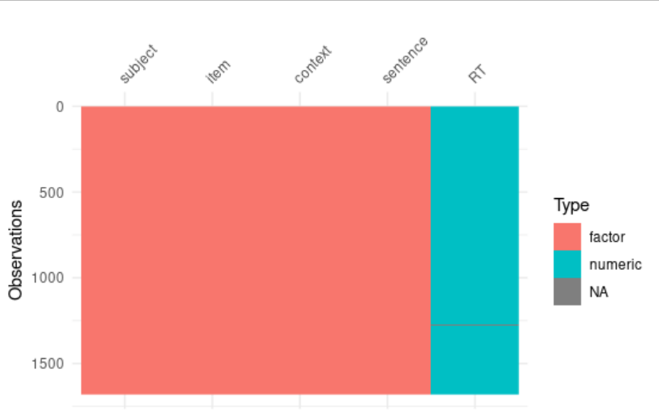
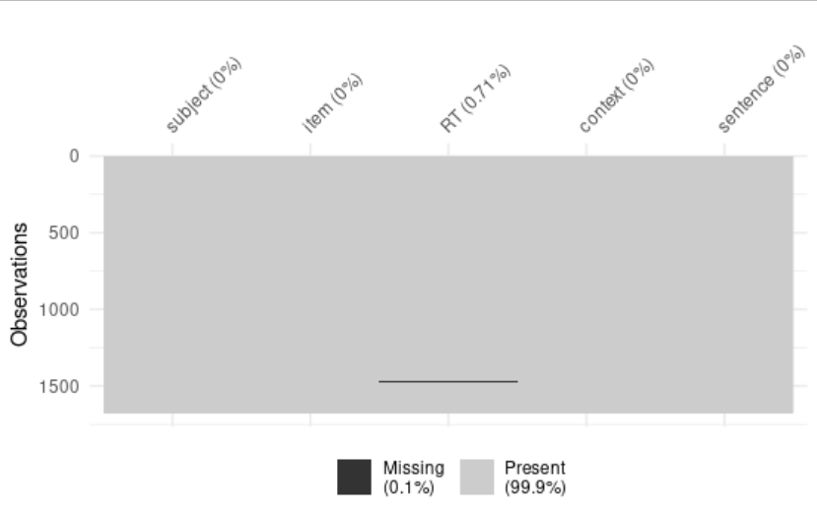
Using {visdat}
vis_dat(tidied_factorial_data)
vis_miss(tidied_factorial_data)

Slide 6
Let’s filter out missing data (NAs)
tidied_factorial_data %>%
filter(!is.na(RT)) %>%
group_by(context, sentence) %>%
summarise(mean_rt = mean(RT), sd_rt = sd(RT))
# A tibble: 4 x 4
# Groups: context [2]
context sentence mean_rt sd_rt
<fct> <fct> <dbl> <dbl>
1 Negative Negative 1474. 729.
2 Negative Positive 1595. 887.
3 Positive Negative 1633. 877.
4 Positive Positive 1579. 841.

Slide 7
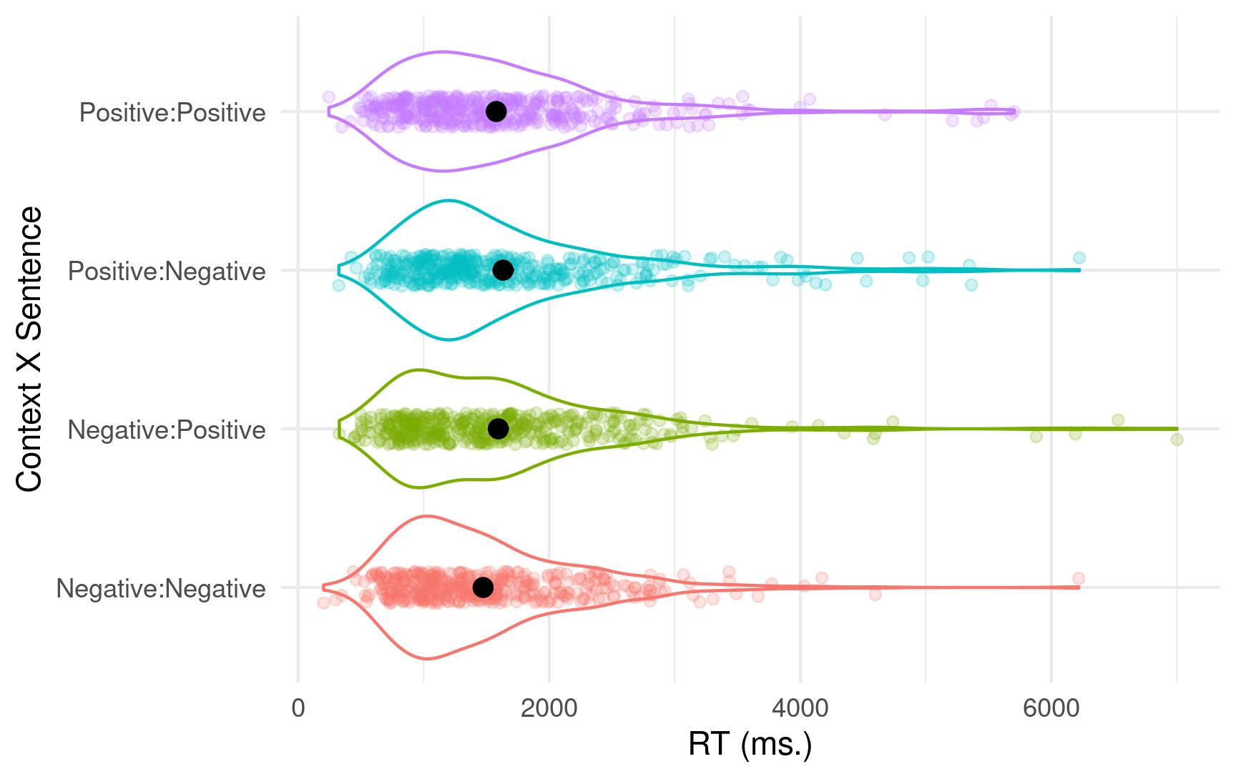

Slide 8
Setting up our contrasts
By default, R uses dummy or treatment coding for the different experimental factors. Recall how we used this type of coding when we examined ANOVA as a special case of the linear model. However, for mixed models this default coding can make parameter estimates harder to understand (and can result in misinterpretation of main vs. simple effects). For factors with 2 levels, we can use sum/deviation coding - this means that the intercept for the overall model will be equal to the grand mean (i.e., the mean of all our conditions).
contrasts(tidied_factorial_data$context) <- matrix(c(.5, -.5))
contrasts(tidied_factorial_data$sentence) <- matrix(c(.5, -.5))

Slide 9
Building our model - attempt 1
factorial_model <- lmer(RT ~ context * sentence +
(1 + context * sentence | subject) +
(1 + context * sentence | item),
data = tidied_factorial_data)
This is a maximal model in which we try to model the most complex random effects structure we can. The fixed effect context * sentence corresponds to an effect of context, an effect of sentence, and the interaction between the two. It is a more succinct way of writing context + sentence + context : sentence.

Slide 10
Building our model - attempt 2
Warning message:
In checkConv(attr(opt, "derivs"), opt$par, ctrl = control$checkConv, :
Model failed to converge with max|grad| = 0.005999 (tol = 0.002, component 1)
Let’s simplify the random effects structure by dropping the interaction term for the subjects random effect.
factorial_model <- lmer(RT ~ context * sentence +
(1 + context + sentence | subject) +
(1 + context * sentence | item),
data = tidied_factorial_data)

Slide 11
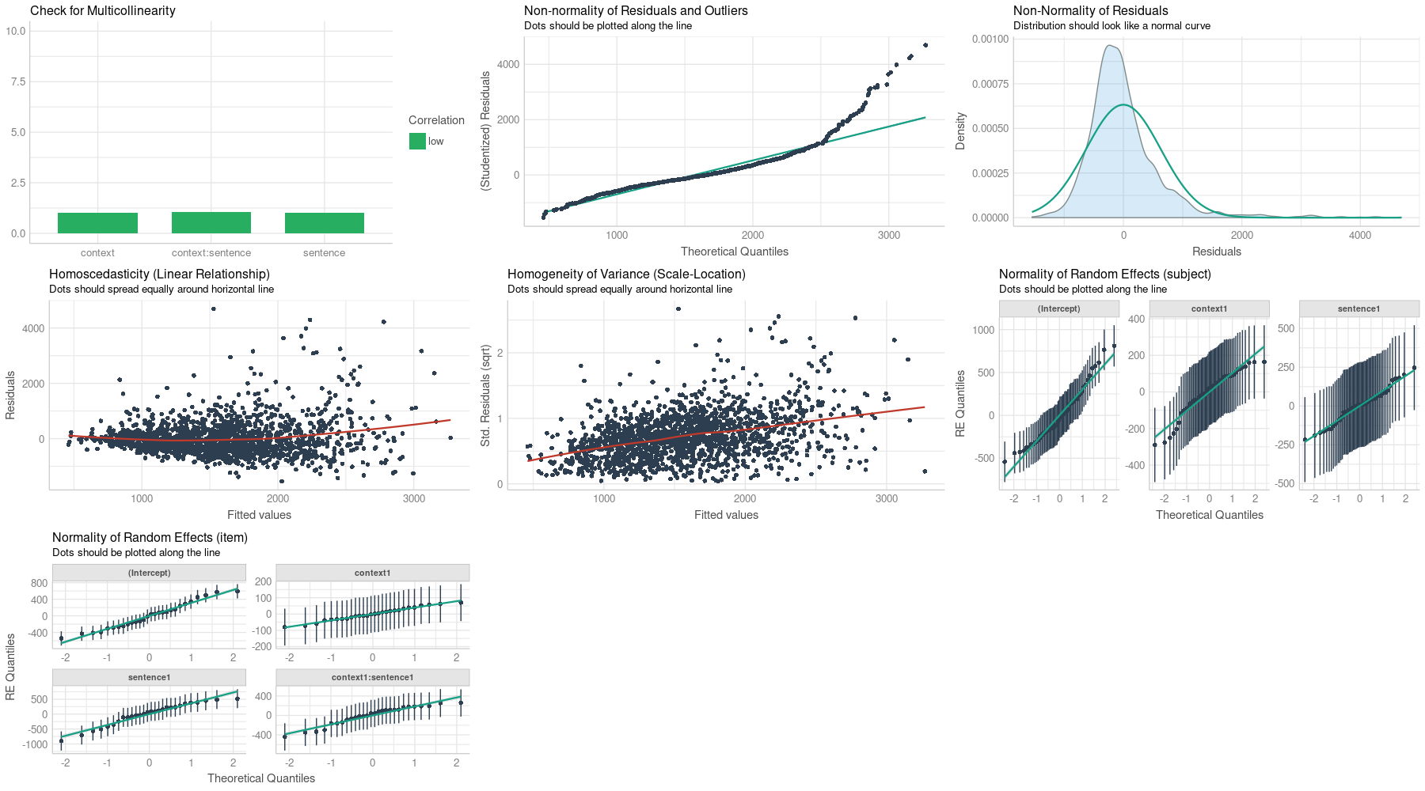
Checking our assumptions

Slide 12
Interpreting the interaction
We can use the emmeans() function to run pairwise comparisons in order to determine what is driving the interaction:
emmeans(factorial_model, pairwise ~ context*sentence, adjust = "none")
$emmeans
context sentence emmean SE df lower.CL upper.CL
Negative Negative 1474 80.9 38.9 1310 1638
Positive Negative 1627 99.0 43.9 1428 1827
Negative Positive 1595 96.5 37.1 1399 1790
Positive Positive 1579 90.2 48.4 1398 1761
Degrees-of-freedom method: kenward-roger
Confidence level used: 0.95
$contrasts
contrast estimate SE df t.ratio p.value
Negative Negative - Positive Negative -153.1 51.7 28.4 -2.960 0.0061
Negative Negative - Negative Positive -120.6 90.3 29.1 -1.335 0.1922
Negative Negative - Positive Positive -105.2 92.0 29.0 -1.144 0.2621
Positive Negative - Negative Positive 32.5 97.1 31.4 0.335 0.7399
Positive Negative - Positive Positive 47.9 98.3 28.4 0.487 0.6301
Negative Positive - Positive Positive 15.4 59.9 28.7 0.256 0.7996
Degrees-of-freedom method: kenward-roger
We can see the interaction is being driven by reading times to Negative sentences in Negative vs. Positive contexts. Let’s look again at the plot and descriptives...

Slide 13
context sentence mean_rt sd_rt
<fct> <fct> <dbl> <dbl>
1 Negative Negative 1474. 729.
2 Negative Positive 1595. 887.
3 Positive Negative 1633. 877.
4 Positive Positive 1579. 841.

Slide 14
Interpreting our model
summary(factorial_model)
Linear mixed model fit by REML. t-tests use Satterthwaite's method ['lmerModLmerTest']
Formula: RT ~ context * sentence + (1 + context + sentence | subject) +
(1 + context * sentence | item)
Data: tidied_factorial_data
REML criterion at convergence: 26628.6
Scaled residuals:
Min 1Q Median 3Q Max
-2.3460 -0.5439 -0.1563 0.3202 7.1297
Random effects:
Groups Name Variance Std.Dev. Corr
subject (Intercept) 106850 326.88
context1 21848 147.81 -0.68
sentence1 28914 170.04 -0.08 -0.28
item (Intercept) 105902 325.43
context1 4919 70.14 0.27
sentence1 163485 404.33 -0.02 -0.11
context1:sentence1 56612 237.93 -0.71 -0.81 -0.21
Residual 432879 657.94
Number of obs: 1668, groups: subject, 60; item, 28
Fixed effects:
Estimate Std. Error df t value Pr(>|t|)
(Intercept) 1568.68 76.31 50.04 20.556 <2e-16 ***
context1 -68.87 39.77 31.62 -1.732 0.0931 .
sentence1 -36.35 85.81 29.71 -0.424 0.6749
context1:sentence1 -168.45 78.68 26.32 -2.141 0.0417 *
---
Signif. codes: 0 ‘***’ 0.001 ‘**’ 0.01 ‘*’ 0.05 ‘.’ 0.1 ‘ ’ 1
Correlation of Fixed Effects:
(Intr) cntxt1 sntnc1
context1 -0.109
sentence1 -0.025 -0.070
cntxt1:snt1 -0.327 -0.147 -0.112
Our fixed effect parameter estimates. The interaction is significant (p = .0417)

Slide 15
Writing up the results
The analyses were carried out using the lme4 package (Bates, Maechler, Bolker, & Walker, 2015) to fit the linear mixed models for the reading time measure in R version 3.6.3 (R Development Core Team, 2020). Deviation coding was used for each of the two experimental factors (Barr et al., 2013). Pairwise comparisons conducted with the emmeans package (Lenth, 2018) were used to investigate the interaction for the reading time measure. Below we report regression coefficient estimates, standard errors, dfs, t-values, and p-values for the intercept and fixed effects.Degrees of freedom were approximated using the Kenward-Roger method. Restricted maximum likelihood estimation was used for the reporting of parameters. For pairwise comparisons we report the t-values and p-values.
 | Estimate | SE | df | t-value | p-value
Intercept | 1568.68 | 76.31 | 50.04 | 20.556 | <2e-16
Context | -68.87 | 39.77 | 31.62 | -1.732 | 0.0931
Sentence | -36.35 | 85.81 | 29.71 | -0.424 | 0.6749
Context x Sentence | -168.45 | 78.68 | 26.32 | -2.141 | 0.0417

Slide 16
Writing up the results
When reporting the results of LMMs, it is important to provide all the information that someone would need to reproduce your analysis exactly. It’s important to provide versions for R and the packages you’re using so that exactly the same version of R and associated packages can be used by someone else. You can use sessionInfo() to generate a list of the packages (plus their version numbers) loaded in your R environment.
We’re in a world where many journals now ask for your analysis code and data to be uploaded as supplementary material.
One of the best ways to ensure reproducibility is to use Binder - and link to your Binderised script in your journal submission.

Slide 17
Addressing convergence errors
If you receive convergence errors, it means your are likely trying to estimate too many parameters than your data will allow. You need to simplify the random effects structure until you are able to estimate the parameters you want to. One way to do this is to simplify the random effects terms that explain the least amount of variance - assessed using the summary() function.
You could also systematically, one by one, drop interaction terms, then individual terms from your random effects structure until you are able to fit a model to your data. But you want to avoid random effects with just random intercepts (i.e., no slopes) as that can inflate the Type 1 error rate (Barr et al., 2013).

Slide 18
A few other things...
You can add participant and item covariates as fixed effects, and you can have a variety of continuous and categorical variables in your LMM. LMMs are very flexible.
You’ll find that sometimes several models fit your data - you can run likelihood comparison test on nested models to determine which is the best fit. If you have a selection where not one is statistically better than the others, choose the model that makes most theoretical sense.

Slide 19
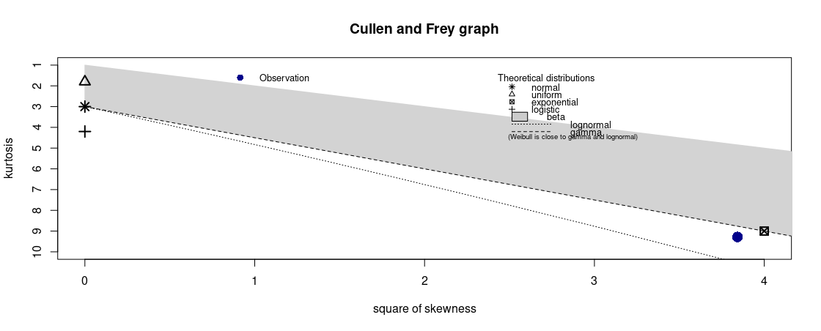
Other distributions
Looking at the 2 x 2 factorial data again, we can plot the response variable on a Cullen and Frey graph using the {fitdistrplus} package and the descdist() function.
descdist(tidied_factorial_data$RT)

Slide 20
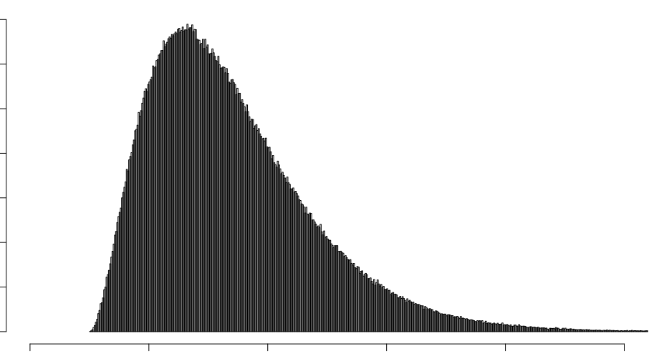
An Example of The Gamma Distribution

Slide 21
Maybe we should have built a model assuming sampling from the Gamma distribution?
Reaction time data very often follow the Gamma distribution (see Kliegl et al. 2010, Lo & Andrews, 2015, for discussion).
Gamma mixed models are often harder to fit and frequently require a simpler random effects structure. You can build them using the glmer() function and specify family = Gamma)
Kliegl, R., Masson, M. E. J., and Richter, E. M. (2010). A linear mixed model analysis of masked repetition priming. Visual Cognition,18, 655–681.
Lo, S., and Andrews, S. (2015). To transform or not to transform: using generalized linear mixed models to analyse reaction time data. Frontiers in Psychology, 6:1171.

Slide 22
A few other things...
Sometimes you’ll find yourself trying to fit an over-parameterised model - this is one whether you are trying to estimate more components of the model than your data/design supports.
In {lme4}, you’ll receive a “singular fit” error if your model appears over-parameterised - one solution is simplify the random effects structure (usually by removing random slopes) in a way that makes theoretical sense until you arrive at a model that fits (but doesn’t overfit) your data.
Having said that, if the random effects structure makes complete theoretical sense then you might not want to simplify it. Often it’s a judgement call.
Read more in “Parsimonious mixed models” by Bates et al.: https://arxiv.org/abs/1506.04967

Slide 24
What if your DV isn’t a continuous variable?
In this section and the next we’ll take a look at how you might build mixed models for variables that are binomial (e.g., zeros and ones) and ordinal (as might be found with Likert-scale data).
In eye movement work, in addition to reading time we also the number of times people re-read a region of text - these types of eye-movements are called “regressions”. For any one person reading a region of text, they either re-read it, or they don’t. Thus, the data are binomial/binary (not continuous). In our data sets containing a measure of eye-movement regressions, 1 corresponds to a region of text being re-read, 0 to it not being re-read.

Slide 25
Binomial data
In an eye-movement study we measured readers’ regressions as they read sentences. We had sentences conveying three different types of meaning (Negative vs. Neutral vs. Positive). For each, we measured whether people did or did not make a regressive eye-movement. This is our DV and is coded as 0 or 1. We had 24 subjects and 24 items.
str(tidied_regressions_data)
tibble [553 × 4] (S3: tbl_df/tbl/data.frame)
$ Subject : Factor w/ 24 levels "S1","S10","S11",..: 1 1 1 1 1 1 1 1 1 1 ...
$ Item : Factor w/ 24 levels "I1","I10","I11",..: 12 18 19 20 21 22 23 24 2 3 ...
$ Condition: Factor w/ 3 levels "Negative","Neutral",..: 3 1 2 3 1 2 3 1 2 3 ...
$ DV : num [1:553] 0 0 0 0 0 1 0 0 0 0 …

Slide 26
Binomial data
head(tidied_regressions_data)
# A tibble: 6 x 4
Subject Item Condition DV
<fct> <fct> <fct> <dbl>
1 S1 I2 Positive 0
2 S1 I3 Negative 0
3 S1 I4 Neutral 0
4 S1 I5 Positive 0
5 S1 I6 Negative 0
6 S1 I7 Neutral 1
tidied_regressions_data %>%
group_by(Condition) %>%
summarise(mean_DV = mean(DV), sd_DV = sd(DV))
# A tibble: 3 x 3
Condition mean_DV sd_DV
<fct> <dbl> <dbl>
1 Negative 0.247 0.433
2 Neutral 0.265 0.443
3 Positive 0.269 0.445

Slide 27
Building our model - attempt 1
Rather than build a linear mixed model, we build a generalised linear mixed model using the glmer() function in the {lme4} package. Instead of parameters being tested with a t-test, they are compared against the z-distribution. With glmer() we need to specify the distribution that our data come from. In this case, our data are binomial so we specify our model as follows:
binomial_model <- glmer(DV ~ Condition +
(1 + Condition | Subject) +
(1 + Condition | Item),
data = tidied_regressions_data, family = binomial)
In this case, the maximal model (i.e., with random slopes for both our random effects) fails to converge so we simplify it.

Slide 28
Building our model - attempt 2
So we end up having to drop random slopes from the subject random effect, and the item random effect entirely to be able to build a model that converges (and isn’t overfitted).
binomial_model <- glmer(DV ~ Condition + (1 | Subject),
data = tidied_regressions_data,
family = binomial)

Slide 29
Building our model - attempt 2
summary(binomial_model)
Generalized linear mixed model fit by maximum likelihood (Laplace Approximation) [glmerMod]
Family: binomial ( logit )
Formula: DV ~ condition + (1 | subject)
Data: tidied_regressions_data
AIC BIC logLik deviance df.resid
603.7 621.0 -297.9 595.7 549
Scaled residuals:
Min 1Q Median 3Q Max
-1.3096 -0.6118 -0.4044 0.7636 3.1872
Random effects:
Groups Name Variance Std.Dev.
subject (Intercept) 0.8363 0.9145
Number of obs: 553, groups: subject, 24
Fixed effects:
Estimate Std. Error z value Pr(>|z|)
(Intercept) -1.3096 0.2647 -4.947 7.55e-07 ***
ConditionNeutral 0.1093 0.2539 0.431 0.667
ConditionPositive 0.1162 0.2515 0.462 0.644
---
Signif. codes: 0 ‘***’ 0.001 ‘**’ 0.01 ‘*’ 0.05 ‘.’ 0.1 ‘ ’ 1
Correlation of Fixed Effects:
(Intr) cndtnN
conditnNtrl -0.485
conditnPstv -0.488 0.507
There’s not much going on here!

Slide 30
Taking a closer look at our data...
We don’t actually have a huge amount of data, and about three times as many trials where we have zero regressions relative to there being a regression.
tidied_regressions_data %>%
group_by(Condition, DV) %>%
summarise(n())
# A tibble: 6 x 3
# Groups: Condition [3]
condition DV `n()`
<fct> <dbl> <int>
1 Negative 0 140
2 Negative 1 46
3 Neutral 0 133
4 Neutral 1 48
5 Positive 0 136
6 Positive 1 50

Slide 31
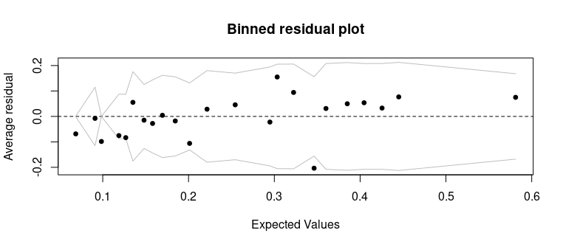
Checking our model assumptions
Instead of checking for normality of residuals, with a generalised linear mixed model using binomial data we build a binned residual plot using the binnedplot() function from {arm}. We expect 95% of residuals to fall between the jagged lines (+- 2SEs).
binnedplot(fitted(binomial_model), resid(binomial_model, type = "response"))

Slide 33
Modelling ordinal data
Often we might collect data using a Likert scale. These data are ordinal and so we should use the cumulative-link mixed model function clmm() from the package {ordinal}. Works similarly to LMMs in {lme4} but with one or two minor syntax changes…
An example: we had 42 participants rate images of sports on a scale of 0-10 corresponding to how much they liked each one. Before each rating measure, they saw a video of a sport that matched or mismatched the one they then had to rate (with a neutral video as baseline).

Slide 34
Modelling ordinal data
We want to know whether people’s ratings were influenced by whether or not the sport they rated matched the one they had just seen. Our data file is called ordinal_data_tidied.
We have Subject, and SportType as our random effects.
VideoCondition corresponds to our condition - with the levels “Match”, “Mismatch”, and “Neutral”.
Our DV is the column “Ratings”. We need to ensure our DV is coded as an ordered factor using:
ordinal_data_tidied$Ratings <- as.ordered(ordinal_data_tidied$Ratings)

Slide 35
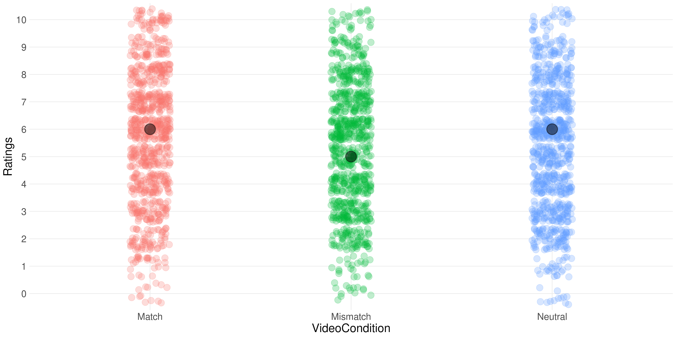
Plotting our data

Slide 36
Building our model
We can build an ordinal mixed model using the clmm() function. Here we model a fixed effect of VideoCondition, and random effects of Subject and SportType.
ordinal_model <- clmm(Ratings ~ VideoCondition +
(1 + VideoCondition | Subject) +
(1 + VideoCondition | SportType),
data = ordinal_data_tidied)
Here we drop the fixed effect to build a null mode - note we make the intercept explicit:
ordinal_model_null <- clmm(Ratings ~ 1 +
(1 + VideoCondition | Subject) +
(1 + VideoCondition | SportType),
data = ordinal_data_tidied)

Slide 37
Comparing the two models
anova(ordinal_model, ordinal_model_null)
no.par AIC logLik LR.stat df Pr(>Chisq)
ordinal_model_null 22 10829 -5392.6
ordinal_model 24 10826 -5389.0 7.3433 2 0.02543 *
---
Signif. codes: 0 ‘***’ 0.001 ‘**’ 0.01 ‘*’ 0.05 ‘.’ 0.1 ‘ ’ 1
We see the two models differ from each other - the model with the fixed effect has the lower AIC value.

Slide 38
Interpreting our model
We can use the emmeans() function to run our pairwise comparisons in order to tell which level of our VideoCondition factor differs from which other level(s).
emmeans(ordinal_model, pairwise ~ VideoCondition)
$emmeans
VideoCondition emmean SE df asymp.LCL asymp.UCL
Match 0.609 0.262 Inf 0.0948 1.123
Mismatch 0.294 0.243 Inf -0.1832 0.771
Neutral 0.319 0.245 Inf -0.1624 0.800
Confidence level used: 0.95
$contrasts
contrast estimate SE df z.ratio p.value
Match - Mismatch 0.3148 0.1019 Inf 3.088 0.0057
Match - Neutral 0.2902 0.1025 Inf 2.832 0.0129
Mismatch - Neutral -0.0245 0.0855 Inf -0.287 0.9556
P value adjustment: tukey method for comparing a family of 3 estimates
We can see that the Match vs Mismatch conditions differ from each other, as do the Match vs. Neutral conditions.We can conclude that people’s ratings for how much they liked a particular sport was influenced by whether they had just seen a video depicting the sport. When the video and sport matched, they give the sport a higher rating when when the video and sport mismatched.

Slide 39
Summary
GLMMs are super flexible and much better than building models using data that are aggregated.
But, you do need to be careful that you’re building the right kind of model given your design and your outcome variable.
Make sure you use appropriate coding when you’re looking at main effects and interactions - many published papers don’t.
Always visualise your data before building any model.
When several possible models can be built - consider which model(s) makes most sense given the theoretical framework you’re testing in your experiment.
When writing up the results of mixed models, ensure to specify all the detail necessary for someone else to re-create *exactly* the same analysis as you have run.

