Slide 1
Experimental Power (and why it matters)
Dr Andrew J. Stewart
Fellow of the Software Sustainability Institute
E: drandrewjstewart@gmail.com
T: @ajstewart_lang
G: ajstewartlang

Slide 2
Understanding Statistics
Imagine a test in which 95% of people without a medical condition will be correctly diagnosed as not having it (specificity = 0.95).
Imagine the test is able to correctly diagnose 4 out of the 5 people who do have the medical condition (sensitivity = 0.8).
Imagine the prevalence of the medical condition in the population is 1%.
Colquhoun, D. (2014). An investigation of the false discovery rate and the misinterpretation of p-values. DOI: 10.1098/rsos.140216

Slide 3
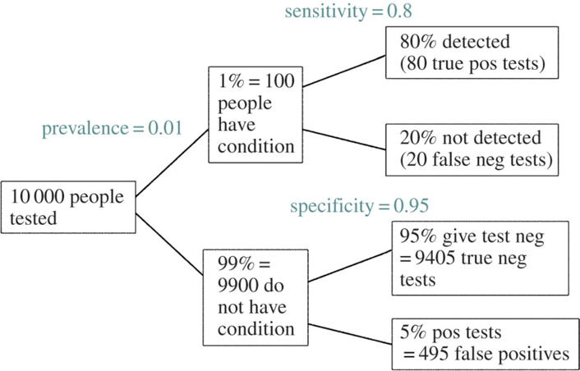
Colquhoun, D. (2014). An investigation of the false discovery rate and the misinterpretation of p-values. DOI: 10.1098/rsos.140216

Slide 4
The results of the test suggest 575 people have the condition. But 495 of these are false positives. So 86% of the people who produced a positive result actually don’t have the condition.

Slide 5
Traditional NHST basics...
For a design with two experimental groups:
  Null hypothesis (H0) - there is no statistically significant difference between those experimental groups.
  Experimental hypothesis (H1) - there is a statistically significant difference between two experimental groups.
We typically reject H0 that if we find that the result of a statistical test comparing the two experimental groups is p < 0.05 (this is the typical alpha (α) level researchers choose).

Slide 6
What is statistical significance?
Suppose that a treatment and a placebo are allocated at random to a group of people. We measure the mean response to each treatment, and wish to know whether or not the observed difference between the means is real (not zero), or whether it could plausibly have arisen by chance. If the result of a significance test is p = 0.05, we can make the following statement:
If there were actually no effect (if the true difference between means were zero) then the probability of observing a value for the difference equal to, or greater than, that actually observed would be p = 0.05. In other words there is a 5% chance of seeing a difference at least as big as we have done, by chance alone.

Slide 7
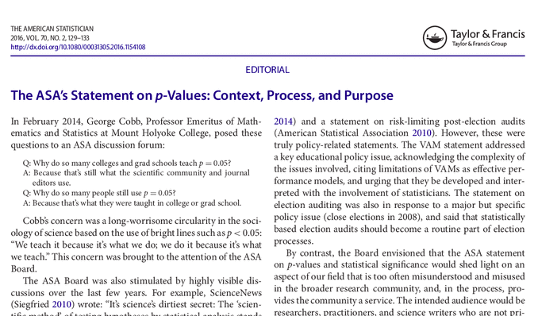
Many scientists would not be able to correctly define what is meant by a p-value...worrying!
In 2016 the American Statistical Association had to publish a paper reminding researchers what can be concluded from p-values and what cannot...

Slide 8
ASA Principles on p-values
p-values can indicate how incompatible the data are with a specified statistical model.
p-values do not measure the probability that the studied hypothesis is true, or the probability that the data were produced by random chance alone.
Scientific conclusions and business or policy decisions should not be based only on whether a p-value passes a specific threshold.
Proper inference requires full reporting and transparency.
A p-value, or statistical significance, does not measure the size of an effect or the importance of a result.
By itself, a p-value does not provide a good measure of evidence regarding a model or hypothesis.
Ronald L. Wasserstein & Nicole A. Lazar (2016) The ASA's Statement on p-Values: Context, Process, and Purpose, The American Statistician, 70:2, 129-133, DOI: 10.1080/00031305.2016.1154108

Slide 9
Type I and Type II Errors
With an α-level of 0.05, we have a 5% chance of falsely rejecting the null hypothesis (H0).
Falsely rejecting H0 is known as a Type I error (i.e., thinking we have found a difference when these isn’t one).
There are also Type II errors which involve failing to find a difference when one is actually present.
Most of what you have been taught previously will probably have involved trying to avoid Type I errors.

Slide 10
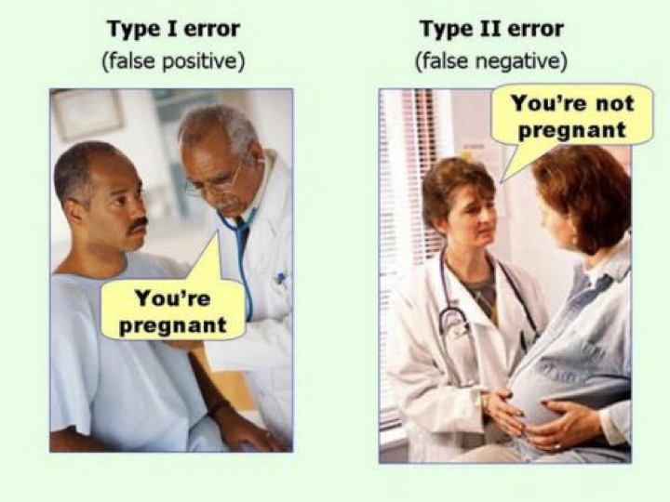
Type I and Type II Errors

Slide 11
Type I and Type II Errors
Controlling for Type II errors is as important as controlling for Type I errors. The probability of a Type II error is known as Beta (β).
The probability of arriving at a Type II error (not finding a difference where there is one) is related to the experimental power of your design.
For any experiment, Power = 1 - β

Slide 12
Is Power That Big a Deal?
Cohen (1992) describes why power is such a big deal (and what can happen if experiments do not have sufficient power). Low powered studies have a lowered chance of finding a real effect, and along with QRPs also a higher chance of suggesting an effect is present when it is not.
Reports the results of a review of 1960 volume of Journal of Abnormal and Social Psychology that he conducted at the time and the results of a Sedlmeier and Gigerenzer (1989) review of a 1984 volume of of the same journal.
In 1960, the average power of the experiments reported in JASP to detect medium effect sizes was 0.48. In 1984, it was 0.25 (in other words only a 25% chance of finding an effect even if it was there!)

Slide 13
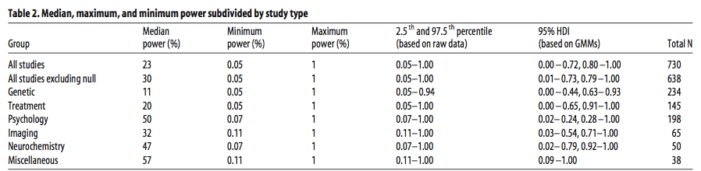
Is Power That Big a Deal?
Button et al. (2013), Nature Reviews Neuroscience, small sample size undermines the reliability of neuroscience. Nord et al., (2017), Journal of Neuroscience, highlight wide heterogeneity in power in neuroscience studies.

Slide 14
Cohen’s d
Power (1-β) is related to:
  sample size (i.e., N)
  effect size
  α
Cohen (1992) proposes that a reasonable level of Power to aim for should be around 0.8
Power of 0.8 (with a β of 0.20), alongside an α of 0.05 results in a β:α ratio of 4:1 in terms of the risk associated with respective errors.
 | Small Effect | Medium Effect | Large Effect
Cohen’s d | 0.2 | 0.5 | 0.8
Pearson’s r | 0.1 | 0.3 | 0.5

Slide 15
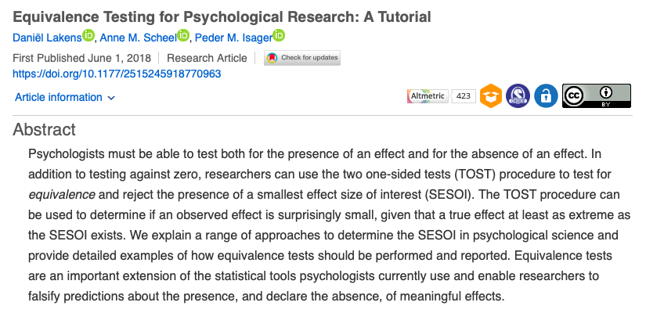
Equivalence Testing
https://journals.sagepub.com/doi/full/10.1177/2515245918770963

Slide 16
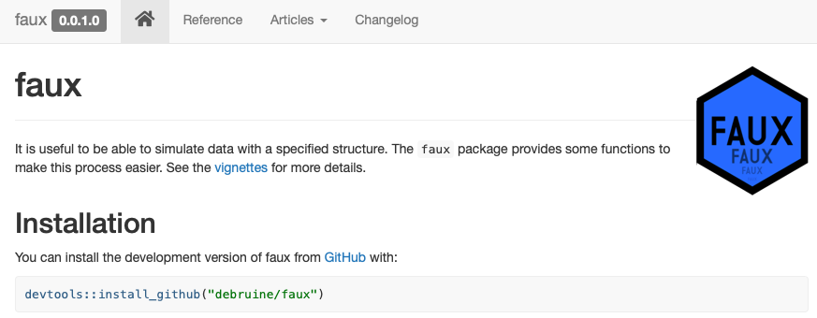
Data Simulation

Slide 17
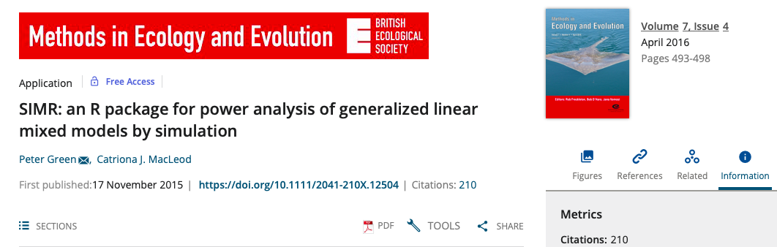
Data Simulation

Slide 18
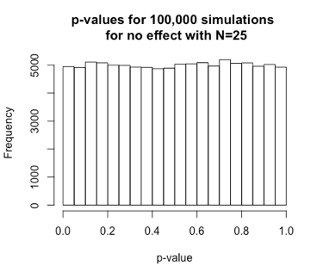
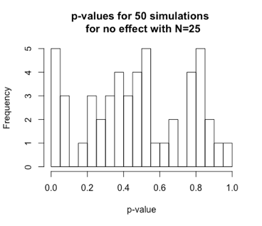
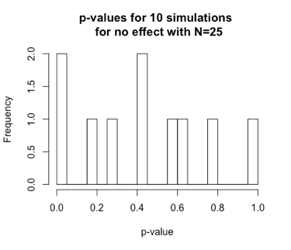
Data Simulation - When No Real Effect Exists

Slide 19
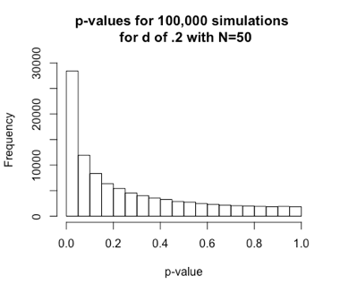
Real Effects Will NOT Always Replicate
Assuming p < .05 alpha, N=50 gives us around 30% power, which means that 70% of the time we’ll miss the effect (even though it is present).

Slide 20
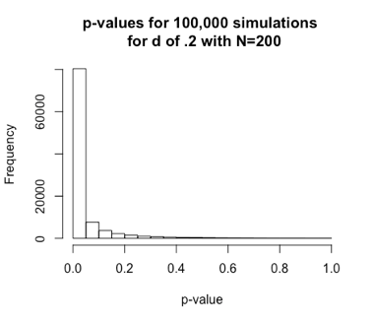
Real Effects Will NOT Always Replicate
N=200 gives us around 80% power, which means that 20% of the time we’ll miss finding the effect (even though it is present).

Slide 21
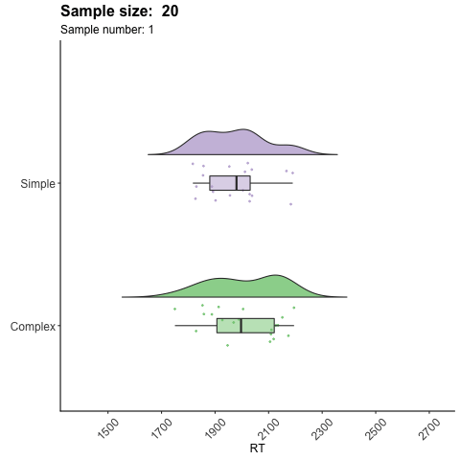
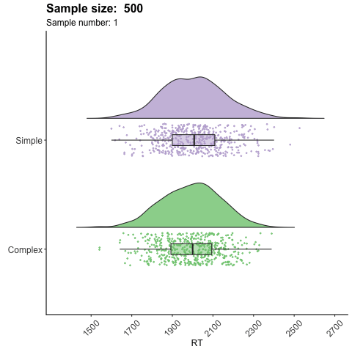
The Problem of Sampling Bias
Samples for conditions “Simple” and “Complex” are drawn from the same population. Due to sampling error, with small samples (e.g., N=20) we might conclude there could be a difference between A and B where there isn’t one (as you can see with the N=500 samples). Enter QRPs...

Slide 22
Summary
Power is important - underpowered experiments are a waste of time (often yours!), money, and resources such as lab space etc.
Underpowered experiments combined with questionable research practices (QRPs) and publication bias results in a literature that is full of research articles that are wrong.
The scientific theories/models you’re testing need to allow you to determine what the minimal effect size of interest is - and it is this minimal effect size that you need to power your experiment to find.
Even in a high powered study (e.g., 80%) sometimes you will fail to find an effect even though it is present - and with NHST just because you might have an absence of evidence for an effect, this is not the same as having evidence of the effect not being there. When our test is not-significant, we cannot conclude an effect is not there - just that we don’t have the support to conclude that it is there.

