Slide 1
The Open Research Movement
Dr Danna Gifford (unit coordinator 2023)
E: danna.gifford@manchester.ac.uk
T:@dannagifford

Slide 2
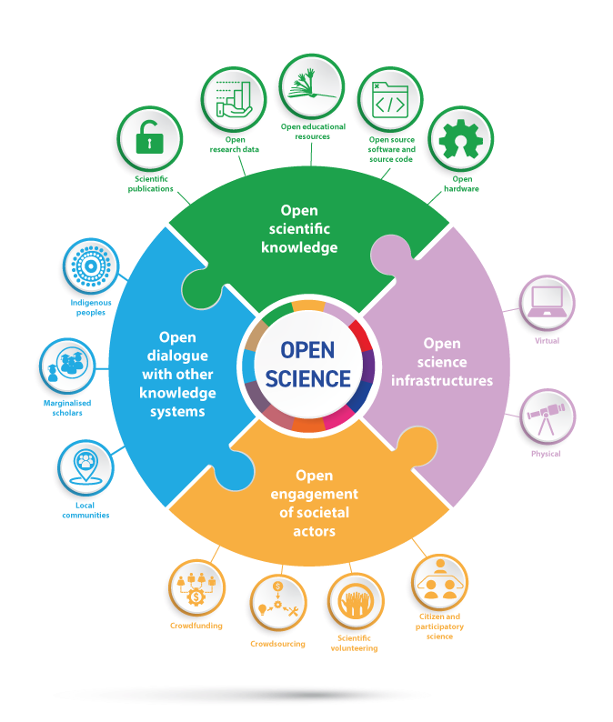
Introduction to the Open Research Movement
The Open Research movement, often referred to as Open Science or Open Scholarship, is a global initiative aimed at transforming traditional research practices.
Driven by a set of core principles, it emphasizes openness, transparency, and collaboration throughout the research process.
In this workshop, we will delve into the key aspects and benefits of the Open Research movement.

Slide 3
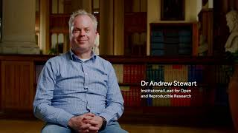
Introduction to the Open Research Movement
Listen to Andrew Stewart (Institutional Lead for Open and Reproducible Research) speak about the benefits and challenges of conducting Open Research

Slide 4

Key Principles - Open Access
Open Access is a cornerstone of the Open Research movement. It advocates for the unrestricted availability of research publications, data, and findings to the public.
Researchers and institutions are encouraged to make their work freely accessible through various means, such as open-access journals, preprint servers, and institutional repositories.
Open Access promotes the democratization of knowledge by removing financial barriers to access, enabling anyone with an internet connection to benefit from research findings.

Slide 5

Key Principles - Open Data
Open Data is the practice of openly sharing research data, allowing others in the scientific community and beyond to access, scrutinize, and build upon it.
Researchers are encouraged to provide well-documented datasets alongside their publications.
This openness not only enhances the reproducibility of research but also fosters innovation, as diverse perspectives can be applied to existing datasets to answer new questions or explore new hypotheses.

Slide 6

Key Principles - Open Collaboration
Open Collaboration is a fundamental tenet of the Open Research movement. It encourages researchers to collaborate across disciplines, institutions, and geographical boundaries.
By breaking down silos and fostering interdisciplinary teamwork, Open Collaboration can lead to more comprehensive and innovative research outcomes.
Initiatives such as open-source software development and collaborative research platforms play a crucial role in facilitating these collaborations.

Slide 7
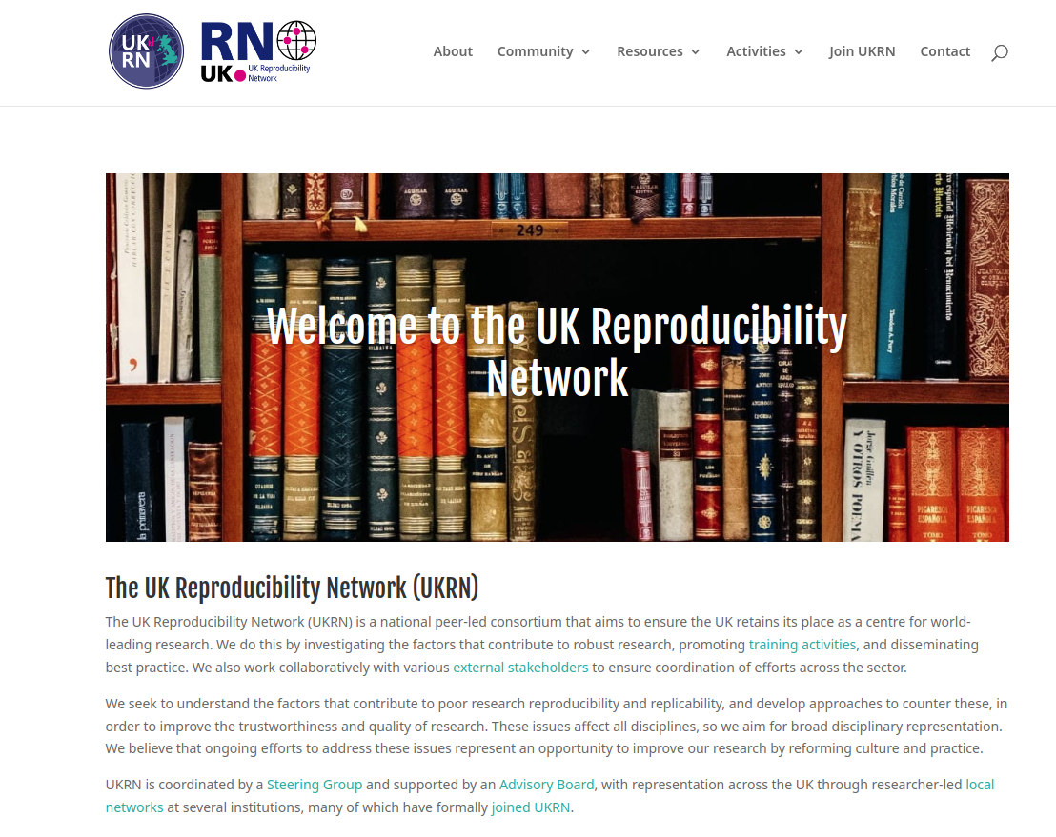
Visit https://www.ukrn.org/
to learn more about the UK Reproducibility Network

Slide 8
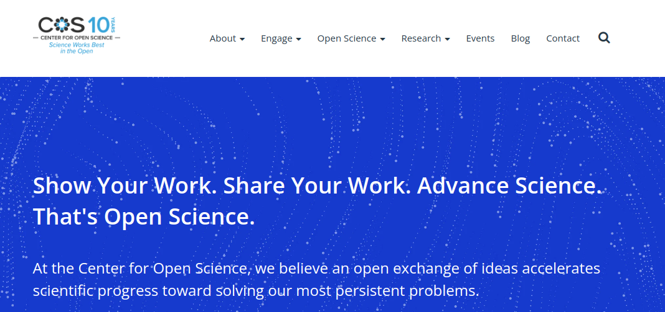
Visit https://www.cos.io/
to learn more about the Center for Open Science

Slide 9
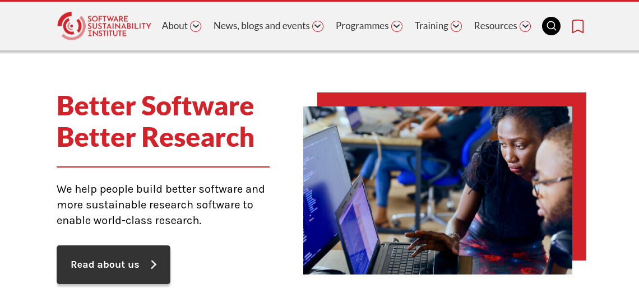
Visit https://www.software.ac.uk/
to learn more about the Software Sustainability Institute

Slide 10

Advantages - Reproducibility
One of the central advantages of Open Research is reproducibility. By making research methods, data, and code openly available, researchers can ensure that their work is transparent and accessible.
This transparency allows other researchers to validate and reproduce findings, enhancing the credibility and reliability of scientific research.
Reproducibility is essential for building a solid foundation of knowledge upon which future research can be built.

Slide 11

Advantages - Innovation
Innovation thrives in the open research environment. Openly accessible data, findings, and collaborative opportunities enable researchers to leverage existing work to drive new discoveries and advancements.
The ability to build upon the work of others accelerates the pace of innovation and can lead to breakthroughs in various fields, from medicine to technology.

Slide 12

Advantages- Democratizing Access
Open Research promotes accessibility by making research outputs available to a broader audience, including individuals outside the academic community.
Policymakers, educators, and the general public can benefit from access to research findings, leading to evidence-based decision-making and societal progress.
This accessibility has the potential to bridge the gap between academic research and practical applications in the real world.

Slide 13
Challenges and Future Directions
While the Open Research movement has made significant progress, it faces several challenges on its path to widespread adoption.
These challenges include securing sustainable funding for open-access publishing, addressing data privacy concerns, and fostering cultural shifts within academia that prioritize openness and collaboration.
However, the future of Open Research looks promising, with more funding agencies, institutions, and individual researchers embracing its principles.

Slide 14
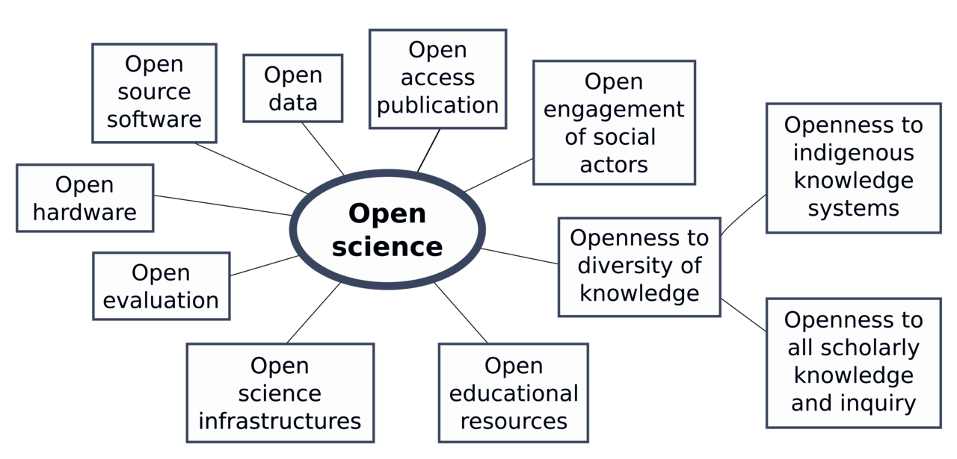
How to conduct open & reproducible science?

Slide 15
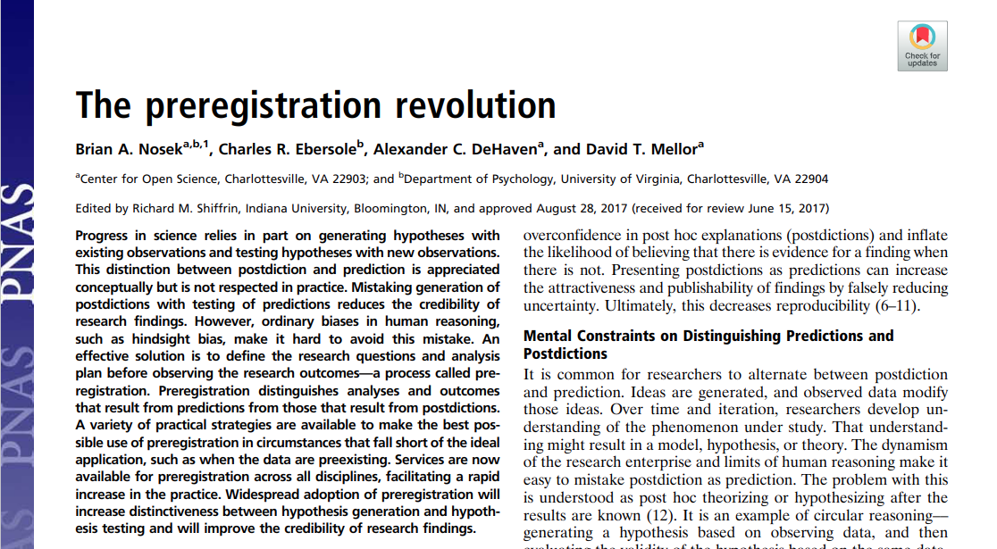
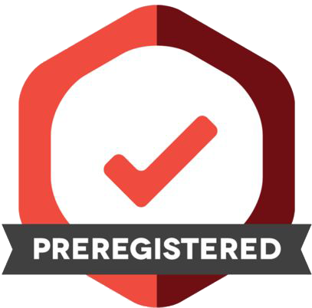
Before – Pre-registration
https://www.pnas.org/doi/epdf/10.1073/pnas.1708274114
Preregistration: Specifying a research plan in advance and submitting it to a registry
(e.g. https://osf.io/)
Separates research into hypothesis-generating (exploratory) and hypothesis-testing (confirmatory) phases.
Improves research quality and transparency.
Aids in clear reporting of the study.
Benefits others who may want to build on the research.

Slide 16
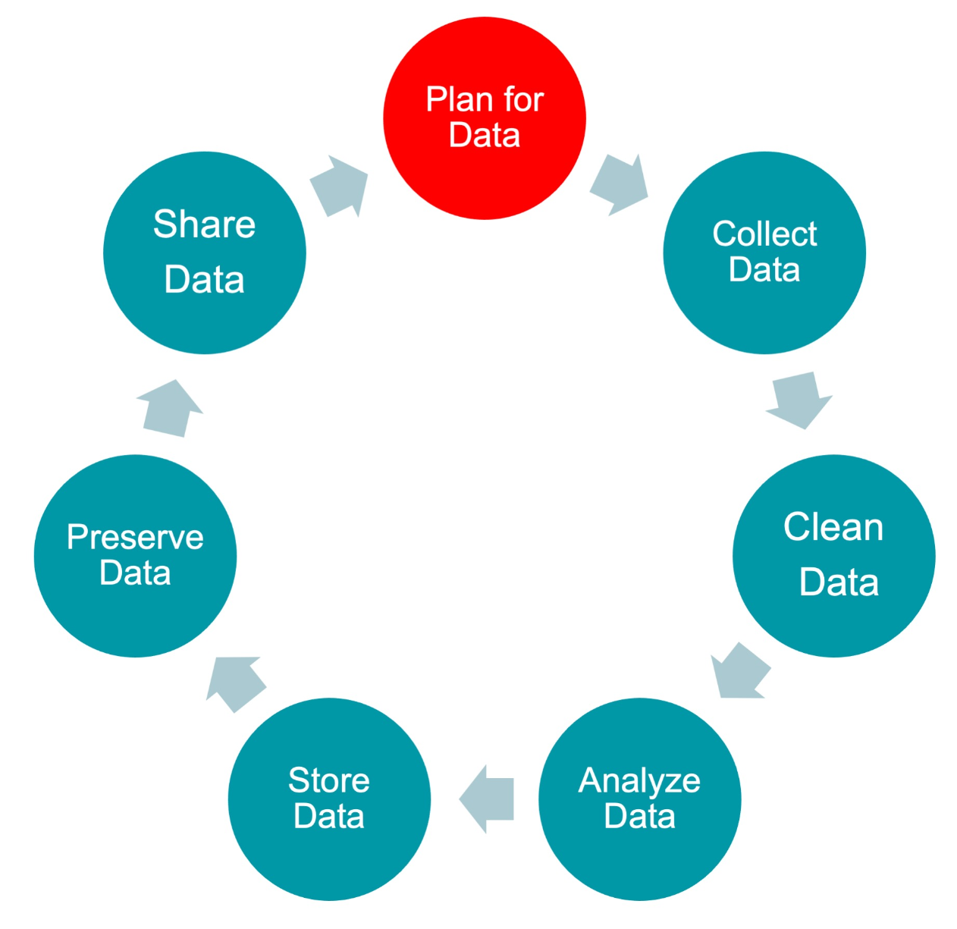
Before – Having a data management plan
Organizes data handling processes
Defines types and storage of data
Ensures data security and integrity
Facilitates data sharing and future research access
Required by most funding bodies
https://www.library.manchester.ac.uk/services/research/research-data-management/planning/
https://www.dcc.ac.uk/guidance/how-guides/develop-data-plan

Slide 17
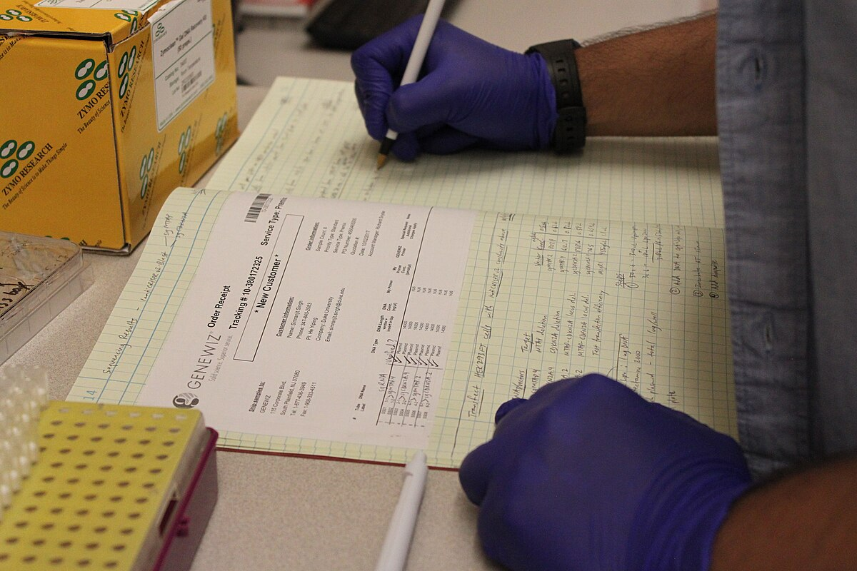
During – Documenting methods & data
Do not rely on (fallible) human memory to accurately recall details of experiments and results!
Keeping a good lab book ensures data integrity
Record details such as dates, names of individuals you've received materials from, exact approaches and calculations for experiments performed
Ensures accurate capture of protocol information
Facilitates communication of findings (when it comes time to write up)
Traditional lab book, Katherine Stember (CC BY 4.0)

Slide 18
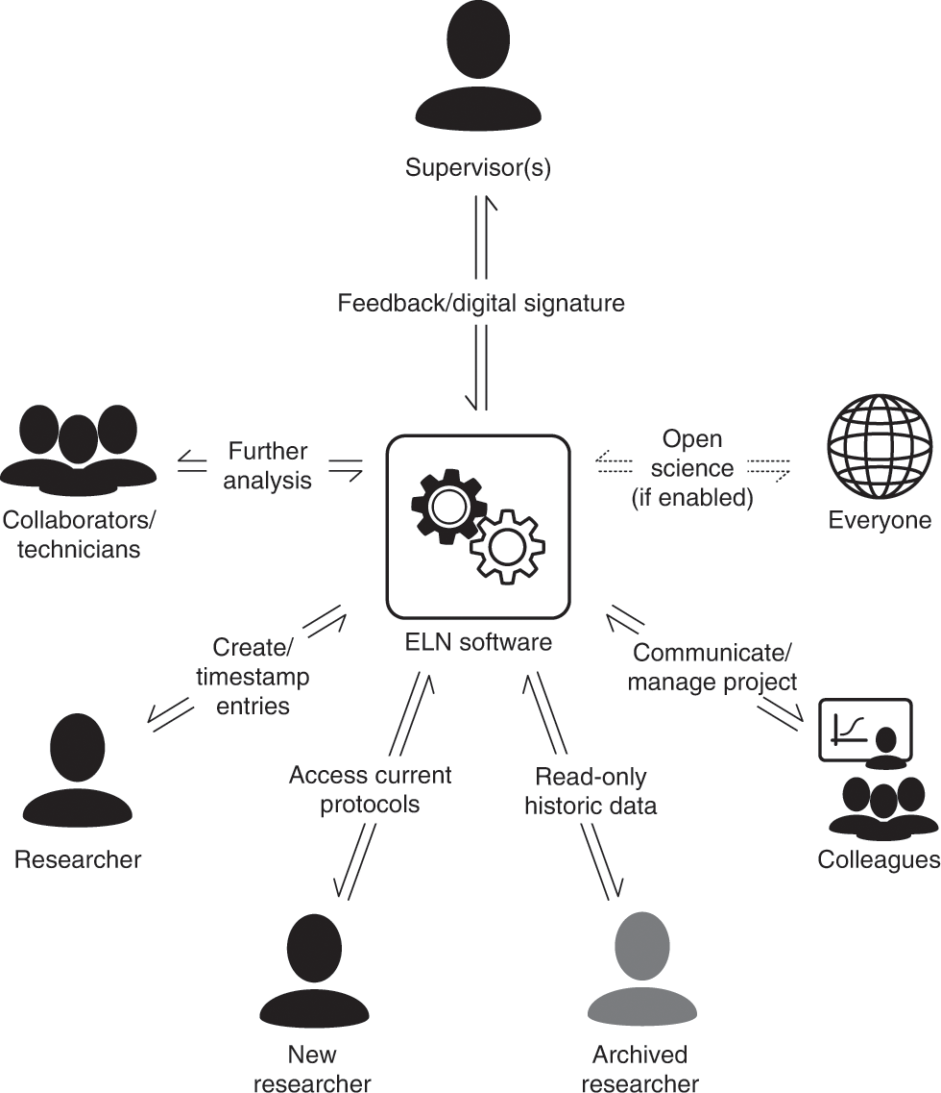
Electronic laboratory notebooks (ELNs)
Keeps laboratory notes, protocols etc. and data together
Supports training and collaboration
Data backup
Supervisor oversight
https://www.nature.com/articles/s41596-021-00645-8

Slide 19

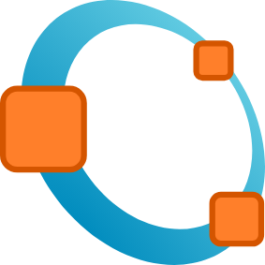





During – Using open source software
Transparent and accessible code, making it easier for others to verify and replicate research results
Usually free to use, promoting inclusivity by ensuring that tools are accessible to all researchers
Can modify and customize open source software to suit their specific research needs, leading to a more flexible and adaptable scientific environment

Slide 20
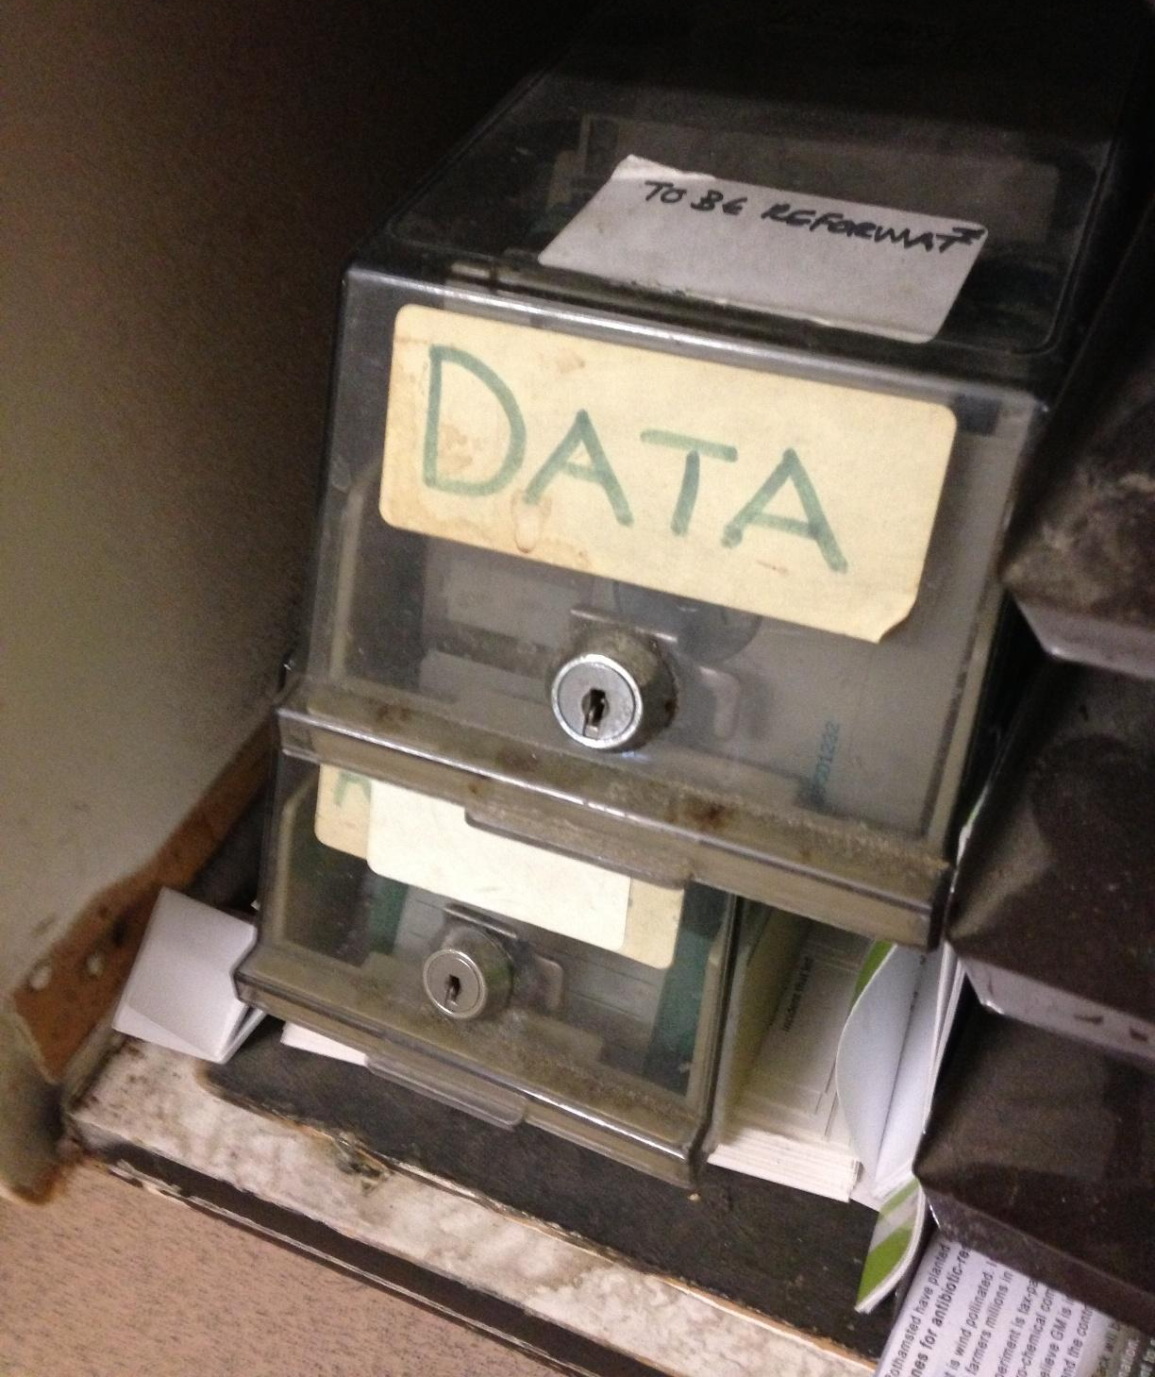
After – Using data repositories
Data repositories support open science by centralizing data storage and sharing.
e.g. Figshare, Dryad, Zendoo
Field-specific or data type-specific repositories cater to specific data requirements.
E.g. NCBI, ENA
Moving away from 'available on request' statements in papers, or data stored with manuscripts, which journals may not indefinitely maintain
Not an example of an open data repository!
Photo by Janet McKnight (CC BY 2.0)

Slide 21
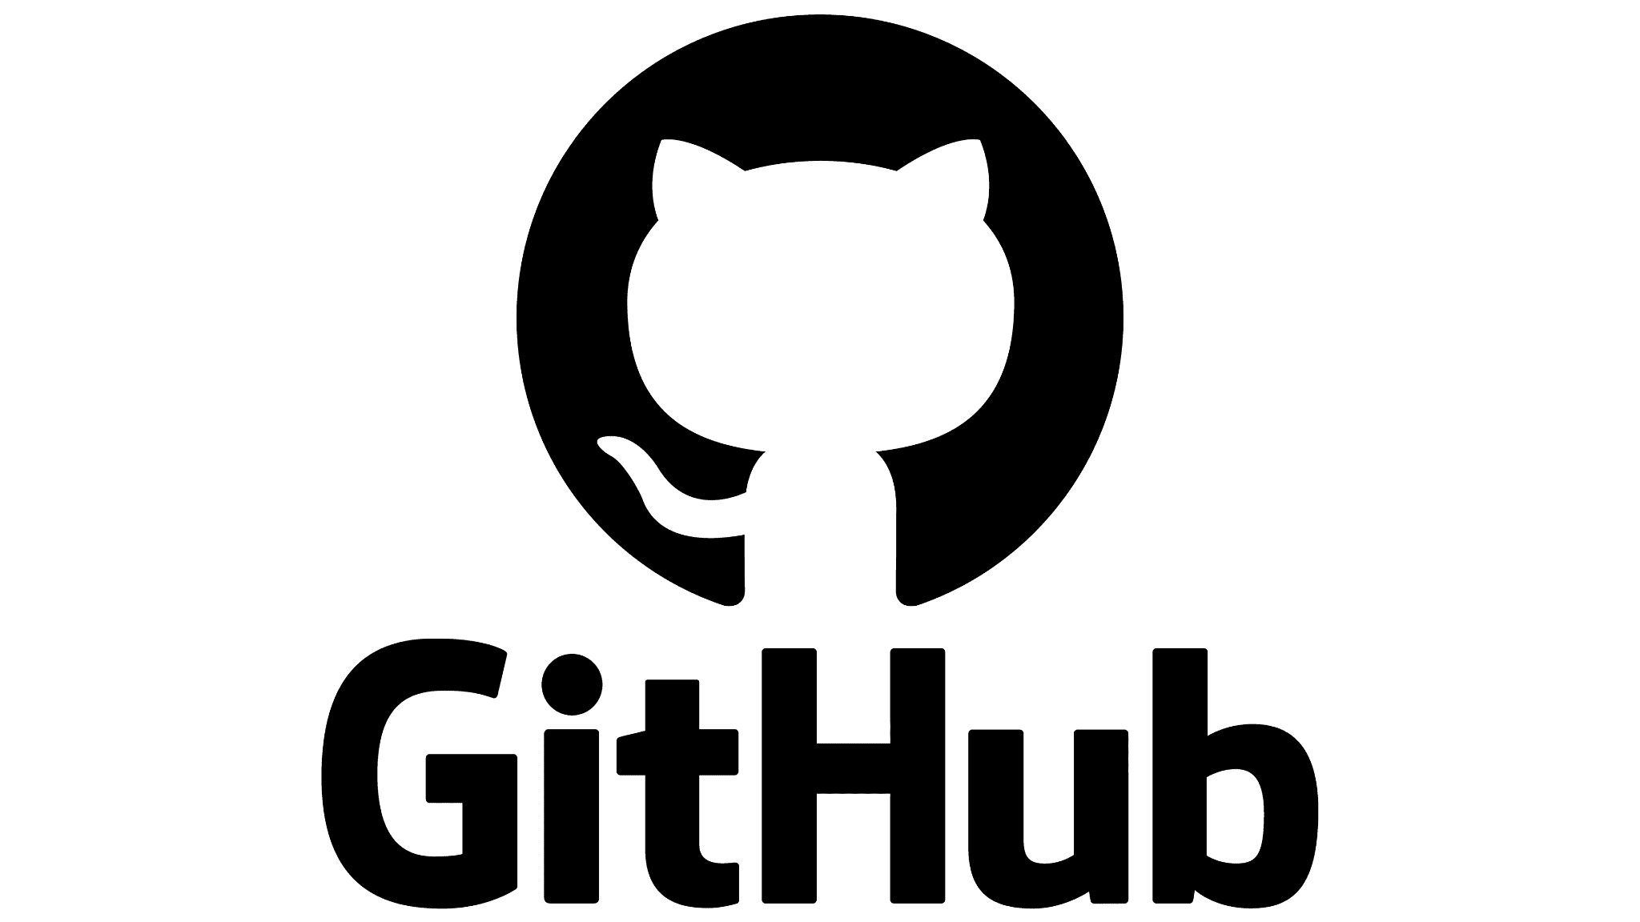

After – Using software repositories
If your research generates software, you should store it in a software repository
Centralized storage and sharing for research code, promoting transparency and collaboration (e.g. GitHub, Sourceforge)
Improved research reproducibility and version control
Searching of code databases
Centralised bug reporting
Encourages open sharing, knowledge exchange, and research advancement

Slide 22




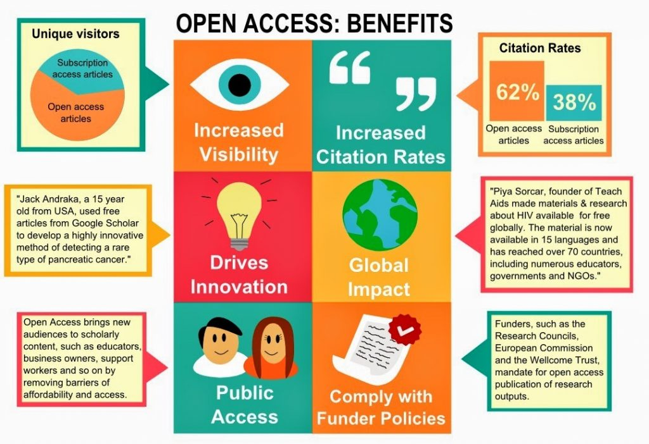
After – Preprints and open access publishing
Preprints provide swift sharing of research findings before peer review
Open access ensures free and unrestricted access to research papers
  Gold open access = immediately and freely available to the public upon publication, but cost £ to publish
  Green open access = "author accepted manuscript" posted in a repository, or made available by publisher after an embargo period.
Both promote collaboration, early feedback, and broad knowledge dissemination in the scientific community

Slide 23
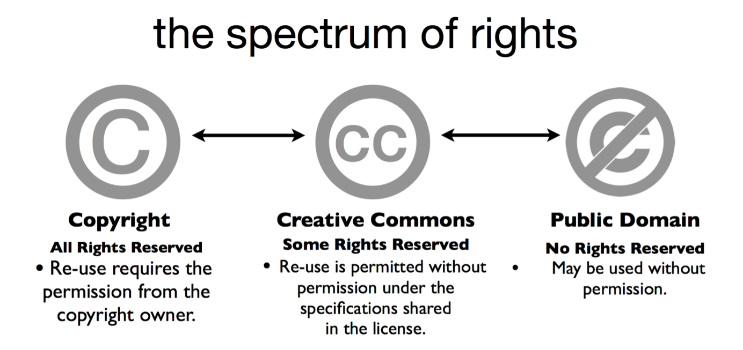




After – Open licencing and content reuse
Consider publishing your work in journals that support Creative Commons licence options:
  CC BY 4.0—reuse with attribution (like citation!)
  CC0—"no rights reserved" or public domain
Allows work to be adapted and reused
Journals that support CC BY 4.0:
PLOS Biology, eLife, PeerJ, BMC Biology, Scientific Reports, Nature Communications (& other open access titles published by Nature Publishing Group)
Optional attributes of CC licences
Attribution
Non-commercial
Share-alike
No derivative works

Slide 24
Open Research at The University of Manchester
The University of Manchester is an active participant in the Open Research Movement, demonstrating a strong commitment to openness, transparency, and collaboration in research practices.
The University has embraced Open Access publishing, making a significant portion of its research output freely available to the public, thereby increasing the accessibility of knowledge.
Moreover, it actively encourages researchers to share their datasets openly, promoting the principles of Open Data.

Slide 25
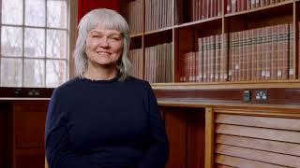
Initiatives at The University of Manchester
Listen to Professor Colette Pagan (UoM Vice-President for Research) speak about resources and initiatives undertaken at The University of Manchester

Slide 26
Initiatives at The University of Manchester
The University of Manchester fosters interdisciplinary collaborations and provides support for researchers to engage in open science initiatives, thus contributing to the ethos of Open Collaboration.
It is committed to supporting researchers in their open research endeavors, ensuring that the benefits of the Open Research movement are realized within its academic community.
By championing these principles and actively participating in the Open Research Movement, the University is not only advancing the credibility and reproducibility of research but also fostering a culture of innovation and knowledge sharing within its academic community and beyond.

Slide 27

The Office for Open Research at UoM
The Office for Open Research represents a substantial investment in the future of publishing, data, and open knowledge by the University of Manchester.
It is a central hub for Open Research initiatives, positioning the institution at the forefront of this global movement.
The Office fosters open dialogue with the research community, allowing for the clear delineation of Open Research goals and the accommodation of the diverse needs of various research communities.
Watch this video about the services offered by the Office for Open Research

Slide 28
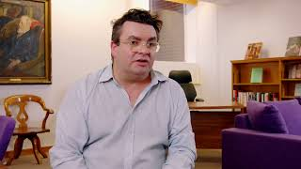
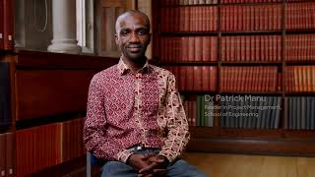
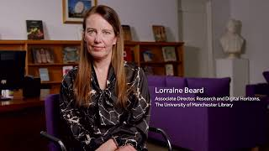
The Office for Open Research at UoM
Listen to Professor Christopher Pressler from the Office for Open Research speak about its role at in promoting and supporting Open Research at The University of Manchester
Listen to Dr Patrick Manu speak about the process of open research and open research practices
Listen to Lorraine Beard speak the Open Research Service Partnership and maintaining responsible metrics for research

Slide 29
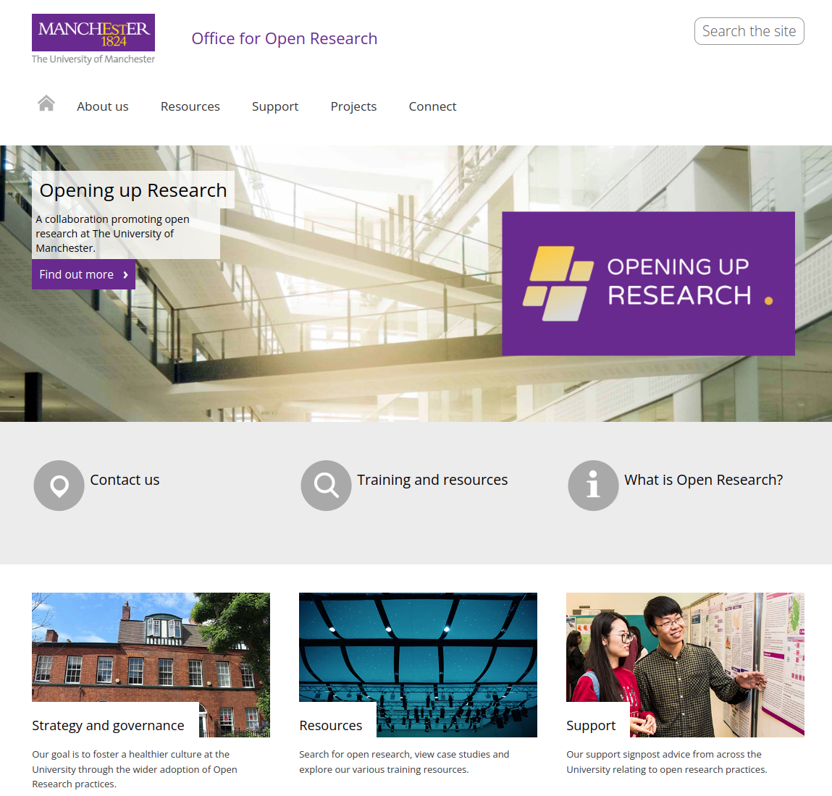
Visit https://www.openresearch.manchester.ac.uk/
to learn more about the resources available for supporting Open Research at UoM from the Office for Open Research

