Slide 1
Linear Modelling 2
Starting point:
Clarity about what is your response variable and what are explanatory variables
Scientific questions about the relationship between response and explanatory variables
Data in a long-form dataframe or tibble

Slide 2
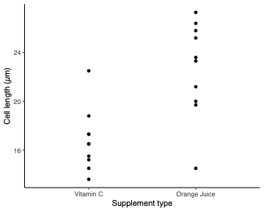
Example Experiment – variables
Classic experiment giving vitamin C to look at tooth growth in guinea pigs
Two variables:
  Cell length (continuous numeric)
  Type of supplement: vitamin C versus orange juice (categorical)
Roles in experiment
  Response variable
    What we care about
    What we measured
    Want to know if it responds to explanatory variables
    Not set as part of experiment
    Biological and technical ‘noise’ in the measurement
  Explanatory variable
    Something we can manipulate
    What we manipulated
    Want to know if it affects the response variable
    Set precisely as part of the experiment
    Little or no ‘noise’ in the value
Crampton, E. W. (1947).
Clarity about what is your response variable and what are explanatory variables

Slide 3
Example Experiment – questions
Classic experiment giving vitamin C to look at tooth growth in guinea pigs
Two variables:
  Cell length
  Type of supplement: vitamin C versus orange juice
Questions
  Does cell length depend on supplement type?
  How much does cell length change with supplement type?
  What’s the expected cell length with Vitamin C?
  How sure are we of the answers?
Crampton, E. W. (1947).
Scientific questions about the relationship between response and explanatory variables
Clarity about what is your response variable and what are explanatory variables

Slide 4
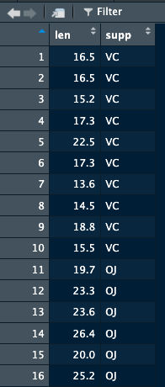
Example Experiment – data
Classic experiment giving vitamin C to look at tooth growth in guinea pigs
Two variables:
  Cell length
  Type of supplement: vitamin C versus orange juice
Questions
  Does cell length depend on supplement type?
  How much does cell length change with supplement type?
  What’s the expected cell length with Vitamin C
  How sure are we of the answers?
Crampton, E. W. (1947).
> ToothGrowth2
Data in a long-form dataframe or tibble
Scientific questions about the relationship between response and explanatory variables
Clarity about what is your response variable and what are explanatory variables

Slide 5
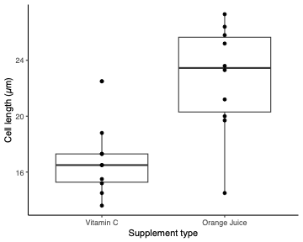
Example Experiment – answering questions
Classic experiment giving vitamin C to look at tooth growth in guinea pigs
Two variables:
  Cell length
  Type of supplement: vitamin C versus orange juice
Questions
  Does cell length depend on supplement type?
  How much does cell length change with supplement type?
  What’s the expected cell length with Vitamin C
  How sure are we of the answers?
Put lines through the data – can answer the questions:
  Is the difference between the supplements significantly different from zero?
  What is the difference between the supplements?
  What’s the estimate for Vitamin C?
  What’s the uncertainty estimate on any of the above?
Crampton, E. W. (1947).
Data in a long-form dataframe or tibble
Scientific questions about the relationship between response and explanatory variables
Clarity about what is your response variable and what are explanatory variables

Slide 6
Example Experiment – Do the analysis
Classic experiment giving vitamin C to look at tooth growth in guinea pigs
Two variables:
  Cell length
  Type of supplement: vitamin C versus orange juice
> model <- lm(len ~ supp, data = ToothGrowth2)
Minimises the squared distance from points to line
  Only ‘error’ in the response variable
  Distance from the line the ‘residual’
  Returns the value for one and the difference to the other
> summary(model)
Crampton, E. W. (1947).
Data in a long-form dataframe or tibble
Scientific questions about the relationship between response and explanatory variables
Clarity about what is your response variable and what are explanatory variables

Slide 7
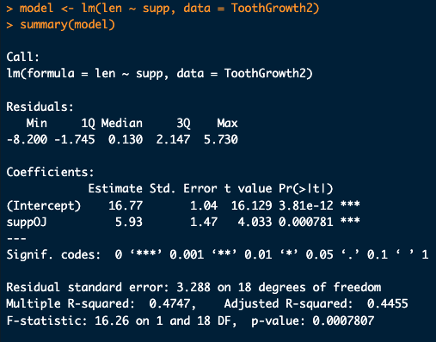
Example Experiment – Do the analysis
Classic experiment giving vitamin C to look at tooth growth in guinea pigs
Crampton, E. W. (1947).

Slide 8
Example Experiment – Do the analysis
Classic experiment giving vitamin C to look at tooth growth in guinea pigs
Two variables:
  Cell length
  Type of supplement: vitamin C versus orange juice
  Is the difference between the supplements significantly different from zero?
  What is the difference between the supplements?
  What’s the estimate for Vitamin C?
  What’s the uncertainty estimate on any of the above?
Crampton, E. W. (1947).
Questions
  Does cell length depend on supplement type? Yes, P = 7.8 x 10⁻⁴
  How much does cell length change with supplement type? 5.9 µm
  What’s the expected cell length with Vitamin C 17 µm
  How sure are we of the answers? 5.9 ±1.5 µm and 17 µm ±1.0 SE

Slide 9
Example Experiment – report it
Classic experiment giving vitamin C to look at tooth growth in guinea pigs
Two variables:
  Cell length
  Type of supplement: vitamin C versus orange juice
Get the right units
Give the uncertainty
2 or 3 significant figures sufficient – only report what’s needed
Describe it as an Analysis of Variance,
  specifically 1-way analysis of variance – only one explanatory variable (could add more!)
  or just a linear model (many other sorts too)
Crampton, E. W. (1947).
Questions
  Does cell length depend on supplement type? Yes, P = 7.8 x 10⁻⁴
  How much does cell length change with supplement type? 5.9 µm
  What’s the expected cell length with Vitamin C 17 µm
  How sure are we of the answers? 5.9 ±1.5 µm and 17 µm ±1.0 SE

Slide 10
Crampton, E. W. The growth of the odontoblasts of the incisor tooth as a criterion of the vitamin C intake of the guinea pig. J Nutr 33, 491-504 (1947). https://doi.org/10.1093/jn/33.5.491

