Slide 1
Linear Modelling 3
Starting point:
Clarity about what is your response variable and what are explanatory variables
Scientific questions about the relationship between response and explanatory variables
Data in a long-form dataframe or tibble

Slide 2
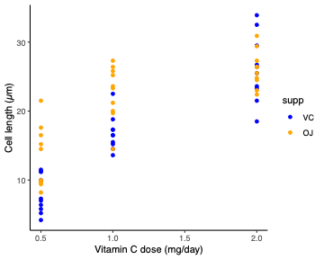
Example Experiment – variables
Classic experiment giving vitamin C to look at tooth growth in guinea pigs
Three variables:
  Cell length (numeric, continuous)
  Vitamin C dose (numeric, continuous)
  Type of supplement: vitamin C versus orange juice (categorical)
Roles in experiment
  Response variable
    What we care about
    What we measured
    Want to know if it responds to explanatory variables
    Not set as part of experiment
    Biological and technical ‘noise’ in the measurement
  Explanatory variable
    Something we can manipulate
    What we manipulated
    Want to know if it affects the response variable
    Set precisely as part of the experiment
    Little or no ‘noise’ in the value
Crampton, E. W. (1947).
Clarity about what is your response variable and what are explanatory variables

Slide 3
Example Experiment – questions
Classic experiment giving vitamin C to look at tooth growth in guinea pigs
Three variables:
  Cell length (numeric, continuous)
  Vitamin C dose (numeric, continuous)
  Type of supplement: vitamin C versus orange juice (categorical)
Three variables:
  Cell length
  Vitamin C dose
  Type of supplement: vitamin C versus orange juice
Questions
  Does the cell length response to dose depend on supplement type?
  Does cell length depend on dose?
  Does cell length depend on supplement type?
  How much does cell length change with dose for each supplement?
  …
Crampton, E. W. (1947).
Scientific questions about the relationship between response and explanatory variables
Clarity about what is your response variable and what are explanatory variables

Slide 4
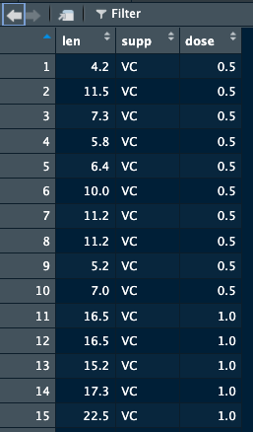
Example Experiment – data
Classic experiment giving vitamin C to look at tooth growth in guinea pigs
Three variables:
  Cell length (numeric, continuous)
  Vitamin C dose (numeric, continuous)
  Type of supplement: vitamin C versus orange juice (categorical)
Three variables:
  Cell length
  Vitamin C dose
  Type of supplement: vitamin C versus orange juice
Questions
  Does the cell length response to dose depend on supplement type?
  Does cell length depend on dose?
  Does cell length depend on supplement type?
  How much does cell length change with dose for each supplement?
  …
Crampton, E. W. (1947).
> ToothGrowth
Data in a long-form dataframe or tibble
Scientific questions about the relationship between response and explanatory variables
Clarity about what is your response variable and what are explanatory variables

Slide 5
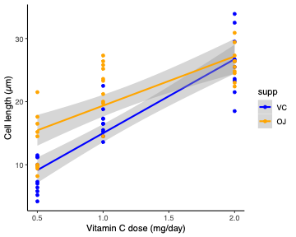
Example Experiment – answering questions
Classic experiment giving vitamin C to look at tooth growth in guinea pigs
Three variables:
  Cell length (numeric, continuous)
  Vitamin C dose (numeric, continuous)
  Type of supplement: vitamin C versus orange juice (categorical)
Three variables:
  Cell length
  Vitamin C dose
  Type of supplement: vitamin C versus orange juice
Questions
  Does the cell length response to dose depend on supplement type?
  Does cell length depend on dose?
  Does cell length depend on supplement type?
  How much does cell length change with dose for each supplement?
  …
Put lines through the data – can answer the questions:
  Are the lines significantly different from one another?
    Are the slopes of each line significantly different from one another?
    Are the intercepts of each line significantly different from one another?
  What are the slope and intercept of each line?
  …
Crampton, E. W. (1947).
Data in a long-form dataframe or tibble
Scientific questions about the relationship between response and explanatory variables
Clarity about what is your response variable and what are explanatory variables

Slide 6
Example Experiment – Do the analysis
Classic experiment giving vitamin C to look at tooth growth in guinea pigs
Three variables:
  Cell length (numeric, continuous)
  Vitamin C dose (numeric, continuous)
  Type of supplement: vitamin C versus orange juice (categorical)
Three variables:
  Cell length
  Vitamin C dose
  Type of supplement: vitamin C versus orange juice
> model <- lm(len ~ supp * dose, data = ToothGrowth)
Minimises the squared distance from points to lines
  Only ‘error’ in the response variable
  Distance from the line the ‘residual’
  Returns the value for one line and the differences to the other
> summary(model)
Crampton, E. W. (1947).
Data in a long-form dataframe or tibble
Scientific questions about the relationship between response and explanatory variables
Clarity about what is your response variable and what are explanatory variables

Slide 7
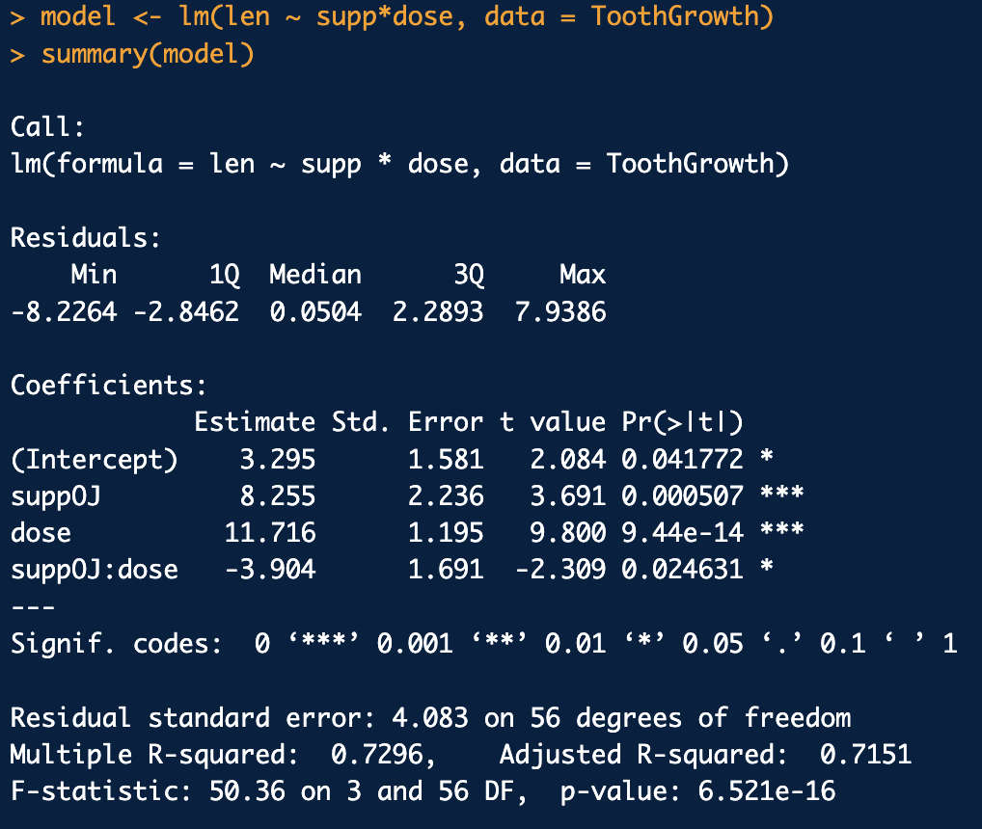
Example Experiment – Do the analysis
Classic experiment giving vitamin C to look at tooth growth in guinea pigs
Crampton, E. W. (1947).

Slide 8
Example Experiment – Do the analysis
Classic experiment giving vitamin C to look at tooth growth in guinea pigs
Three variables:
  Cell length (numeric, continuous)
  Vitamin C dose (numeric, continuous)
  Type of supplement: vitamin C versus orange juice (categorical)
Three variables:
  Cell length
  Vitamin C dose
  Type of supplement: vitamin C versus orange juice
  Are the lines significantly different from one another?
    Are the slopes of each line significantly different from one another?
    Are the intercepts of each line significantly different from one another?
  What are the slope and intercept of each line?
  …
Crampton, E. W. (1947).
Questions
  Does the cell length response to dose depend on supplement type? Yes, P = 0.025
  Does cell length depend on dose?
  Does cell length depend on supplement type?
  How much does cell length change with dose for each supplement? Need to look closely
  …

Slide 9
Example Experiment – Do the analysis
Classic experiment giving vitamin C to look at tooth growth in guinea pigs
Three variables:
  Cell length (numeric, continuous)
  Vitamin C dose (numeric, continuous)
  Type of supplement: vitamin C versus orange juice (categorical)
Three variables:
  Cell length
  Vitamin C dose
  Type of supplement: vitamin C versus orange juice
Called a linear model, because it all just adds up in a linear way (not just because we’re fitting straight lines!)
    ŷ_{i} = β₀ + β₁ x₁ + β₂ x₂ + β₃ x₁ x₂
Crampton, E. W. (1947).
When x is a categorical variable, works like a binary: 1 = ‘it’s in this category’ 0 = ‘it’s in another category’
So for vitamin C (supp = “VC” i.e. x₁ = 0) and dose = 1mg/day (i.e. x₂ = 1)
  ŷ_{i} = Intercept + suppOJ x 0 + dose x 1 + suppOJ:dose x 0 x 1
  = 3.295 + 0 + 11.716 + 0 = 15. 011
(‘Dummy variable’)
Check with plot!
How much does cell length change with dose for each supplement? Need to look closely

Slide 10
Example Experiment – Do the analysis
Classic experiment giving vitamin C to look at tooth growth in guinea pigs
Three variables:
  Cell length (numeric, continuous)
  Vitamin C dose (numeric, continuous)
  Type of supplement: vitamin C versus orange juice (categorical)
Three variables:
  Cell length
  Vitamin C dose
  Type of supplement: vitamin C versus orange juice
Called a linear model, because it all just adds up in a linear way (not just because we’re fitting straight lines!)
    ŷ_{i} = β₀ + β₁ x₁ + β₂ x₂ + β₃ x₁ x₂
Crampton, E. W. (1947).
When x is a categorical variable, works like a binary: 1 = ‘it’s in this category’ 0 = ‘it’s in another category’
So for OJ (supp = “OJ” i.e. x₁ = 1) and dose =1mg/day (x₂ = 1)
  ŷ_{i} = Intercept + suppOJ x 1 + dose x 1 + suppOJ:dose x 1 x 1
  = 3.295 + 8.255 + 11.716 + -3.94 = 19.326
Check with plot!
How much does cell length change with dose for each supplement? Need to look closely

Slide 11
Example Experiment – Do the analysis
Classic experiment giving vitamin C to look at tooth growth in guinea pigs
Three variables:
  Cell length (numeric, continuous)
  Vitamin C dose (numeric, continuous)
  Type of supplement: vitamin C versus orange juice (categorical)
Three variables:
  Cell length
  Vitamin C dose
  Type of supplement: vitamin C versus orange juice
How much does cell length change with dose for each supplement? Need to look closely
Crampton, E. W. (1947).
When the supplement is vitamin C, the change with dose is 12 µl /(mg/day)
When the supplement is OJ, the change with dose is 11.7 -3.9 = 7.8 µl /(mg/day)
Vitamin C (‘VC’) is described as the ‘reference level’ of the categorical variable (supp)
Change with relevel() or factor() functions
Check with plot!
Describe it as an Analysis of Co-Variance, ANCOVA, or just a linear model (many other sorts too)

Slide 12
Crampton, E. W. The growth of the odontoblasts of the incisor tooth as a criterion of the vitamin C intake of the guinea pig. J Nutr 33, 491-504 (1947). https://doi.org/10.1093/jn/33.5.491

