Slide 1
Mixed effects Modelling 1 – getting started
Starting point:
Clarity about what is your response variable and what are explanatory variables – which are fixed and which random
Scientific questions about the relationship between response and explanatory variables
Data in a long-form dataframe or tibble
Data in a long-form dataframe or tibble

Slide 2
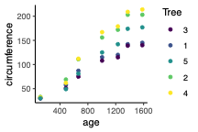
Example Experiment – variables
Growth of orange trees
Three variables:
  Circumference (numeric, continuous)
  Age (numeric, continuous, fixed)
  Tree (numeric, categorical, random)
Roles in experiment
  Response variable
    What we care about
    What we measured
    Want to know if it responds to explanatory variables
    Not set as part of experiment
    Biological and technical ‘noise’ in the measurement
  Explanatory variable – fixed
    Something we can manipulate
    What we manipulated
    Want to know if it affects the response variable
    Set precisely as part of the experiment
    Little or no ‘noise’ in the value
  Explanatory variable – random
    Something we have done or picked or sampled
    What we sampled from
    Want to know how it affects the response variable
    Set as part of the experiment
    No ‘noise’ in the value
Clarity about what is your response variable and what are explanatory variables – which are fixed and which random

Slide 3
Example Experiment – questions
Growth of orange trees
Three variables:
  Circumference (numeric, continuous)
  Age (numeric, continuous, fixed)
  Tree (numeric, categorical, random)
Questions
  How do orange trees grow?
A bit too vague
Scientific questions about the relationship between response and explanatory variables
Clarity about what is your response variable and what are explanatory variables – which are fixed and which random

Slide 4
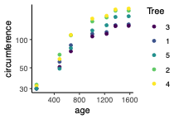
Example Experiment – data
Growth of orange trees
Three variables:
  Circumference (numeric, continuous)
  Age (numeric, continuous, fixed)
  Tree (numeric, categorical, random)
Questions
  How do orange trees grow?
A bit too vague
Data looks a bit problematic
  Doesn’t seem very linear
  Really bunched at low levels and spread out at high ones
Don’t start reading up on non-linear modelling just yet
‘Heteroscedasticity’ – a problem
Try looking at the data on a logarithmic scale
Can be appropriate for growth
  If grows a certain % per time, rather than a certain distance
  Body size is never negative
  Can sort out non-normality as well as heteroscedasticity
  Often try to be more precise when measuring small things
A log scale is a whole lot better
(though heteroscedasticity not completely sorted)
Scientific questions about the relationship between response and explanatory variables
Clarity about what is your response variable and what are explanatory variables – which are fixed and which random

Slide 5
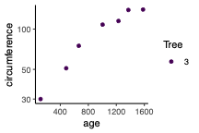
Example Experiment – subset
Three variables:
  Circumference (numeric, continuous)
  Age (numeric, continuous, fixed)
  Tree (numeric, categorical, random)
Questions
  How do orange trees grow?
A bit too vague
Data still looks curvy
  Try fitting a quadratic curve – ask does logarithmic growth slow with age?
Start with one level of the random effect
> model <- lm(log(circumference) ~ age + I(age^2), data = Orange3)
> summary(model)
Scientific questions about the relationship between response and explanatory variables
Clarity about what is your response variable and what are explanatory variables – which are fixed and which random

Slide 6
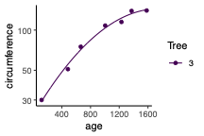
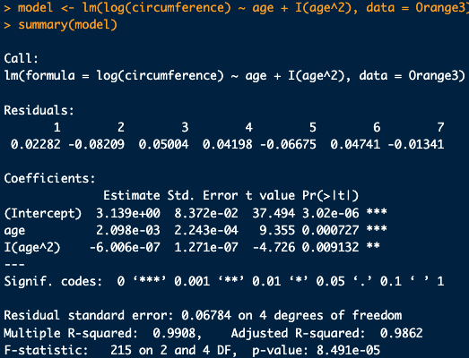
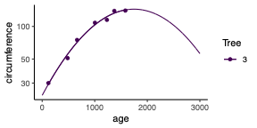
Example Experiment – subset
Growth of orange trees
Fits nicely
Good if just want parameters or hypothesis tests
Does logarithmic growth slow with age?
Yes, logarithmic growth slows with age P = 0.009
  Bad if want to extrapolate

