Slide 1
Linear Modelling 1
Starting point:
Clarity about what is your response variable and what are explanatory variables
Scientific questions about the relationship between response and explanatory variables
Data in a long-form dataframe or tibble

Slide 2
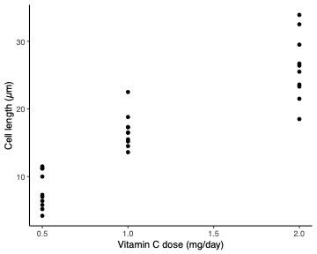
Example Experiment – variables
Classic experiment giving vitamin C to look at tooth growth in guinea pigs
Two variables:
  Cell length (numeric, continuous)
  Vitamin C dose (numeric, continuous)
Two variables:
  Cell length
  Vitamin C dose
Roles in experiment
  Response variable
    What we care about
    What we measured
    Want to know if it responds to explanatory variables
    Not set as part of experiment
    Biological and technical ‘noise’ in the measurement
  Explanatory variable
    Something we can control
    What we manipulated
    Want to know if it affects the response variable
    Set precisely as part of the experiment
    Little or no ‘noise’ in the value
Crampton, E. W. (1947).
Clarity about what is your response variable and what are explanatory variables

Slide 3
Example Experiment – questions
Classic experiment giving vitamin C to look at tooth growth in guinea pigs
Two variables:
  Cell length (numeric, continuous)
  Vitamin C dose (numeric, continuous)
Questions
  Does cell length depend on vitamin C dose?
  How much does cell length change with dose?
  It would be cruel to deprive them of vitamin C entirely – Predict how much growth without any?
  How sure are we of the answers?
Crampton, E. W. (1947).
Scientific questions about the relationship between response and explanatory variables
Clarity about what is your response variable and what are explanatory variables

Slide 4
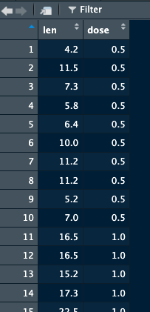
Example Experiment – data
Classic experiment giving vitamin C to look at tooth growth in guinea pigs
Two variables:
  Cell length (numeric, continuous)
  Vitamin C dose (numeric, continuous)
Questions
  Does cell length depend on vitamin C dose?
  How much does cell length change with dose?
  It would be cruel to deprive them of vitamin C entirely – Predict how much growth without any?
  How sure are we of the answers?
Crampton, E. W. (1947).
> ToothGrowth1
Data in a long-form dataframe or tibble
Scientific questions about the relationship between response and explanatory variables
Clarity about what is your response variable and what are explanatory variables

Slide 5
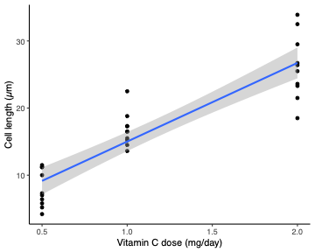
Example Experiment – answering questions
Classic experiment giving vitamin C to look at tooth growth in guinea pigs
Two variables:
  Cell length (numeric, continuous)
  Vitamin C dose (numeric, continuous)
Questions
  Does cell length depend on vitamin C dose?
  How much does cell length change with dose?
  It would be cruel to deprive them of vitamin C entirely – Predict how much growth without any?
  How sure are we of the answers?
Put a line through the data – can answer the questions:
  Does the line have a slope significantly different from zero?
  What’s the slope of the line?
  What’s the intercept of the line?
  What’s the uncertainty estimate on any of the above?
Crampton, E. W. (1947).
Data in a long-form dataframe or tibble
Scientific questions about the relationship between response and explanatory variables
Clarity about what is your response variable and what are explanatory variables

Slide 6
Example Experiment – Do the analysis
Classic experiment giving vitamin C to look at tooth growth in guinea pigs
Two variables:
  Cell length (numeric, continuous)
  Vitamin C dose (numeric, continuous)
> model <- lm(len ~ dose, data = ToothGrowth1)
Minimises the squared distance from points to line
  Only ‘error’ in the response variable
  Distance from the line the ‘residual’
  Returns the slope and intercept of the line
> summary(model)
Crampton, E. W. (1947).
Data in a long-form dataframe or tibble
Scientific questions about the relationship between response and explanatory variables
Clarity about what is your response variable and what are explanatory variables

Slide 7
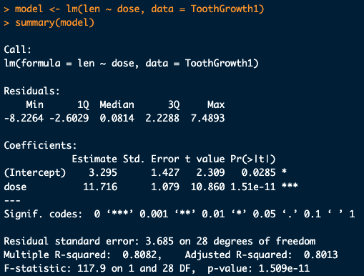
Example Experiment – Do the analysis
Classic experiment giving vitamin C to look at tooth growth in guinea pigs
Crampton, E. W. (1947).

Slide 8
Example Experiment – Do the analysis
Classic experiment giving vitamin C to look at tooth growth in guinea pigs
Two variables:
  Cell length (numeric, continuous)
  Vitamin C dose (numeric, continuous)
  Does the line have a slope significantly different from zero?
  What’s the slope of the line?
  What’s the intercept of the line?
  What’s the uncertainty estimate on any of the above?
Crampton, E. W. (1947).
Questions
  Does cell length depend on vitamin C dose? Yes, P = 1.5 x 10⁻¹¹
  How much does cell length change with dose? 12 µm/(mg/day)
  It would be cruel to deprive them of vitamin C entirely – Predict how much growth without any? 3.3 µm
  How sure are we of the answers? 12 ± 1.1 µm/(mg/day) and 3.3 ± 1.4 µm SE gives grey area in plot

Slide 9
Example Experiment – Report it
Classic experiment giving vitamin C to look at tooth growth in guinea pigs
Two variables:
  Cell length (numeric, continuous)
  Vitamin C dose (numeric, continuous)
Get the right units
Give the uncertainty
2 or 3 significant figures sufficient – only report what’s needed
Describe it as a linear regression,
  Only one explanatory variable, if added more would be a multiple regression
  or just a linear model (many other sorts too)
Crampton, E. W. (1947).
Questions
  Does cell length depend on vitamin C dose? Yes, P = 1.5 x 10⁻¹¹
  How much does cell length change with dose? 12 µm/(mg/day)
  It would be cruel to deprive them of vitamin C entirely – Predict how much growth without any? 3.3 µm
  How sure are we of the answers? 12 ± 1.1 µm/(mg/day) and 3.3 ± 1.4 µm SE gives grey area in plot

Slide 10
Crampton, E. W. The growth of the odontoblasts of the incisor tooth as a criterion of the vitamin C intake of the guinea pig. J Nutr 33, 491-504 (1947). https://doi.org/10.1093/jn/33.5.491

