Slide 1
Mixed effects Modelling 3 – checking
Starting point:
Fitted mixed-effects model
Scientific questions about the relationship between response and explanatory variables

Slide 2
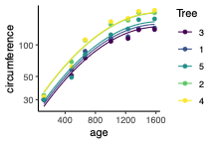
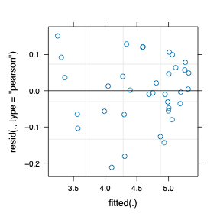
Example Experiment – variables
Growth of orange trees
Three variables:
  Circumference (numeric, continuous)
  Age (numeric, continuous, fixed)
  Tree (numeric, categorical, random)
Data looked a bit problematic
  Didn’t seem very linear
  Really bunched at low levels and spread out at high ones
Addressed with log transform
> plot(model)
Is the model ok?
Not too horrible
If so, is that curviness real?

Slide 3
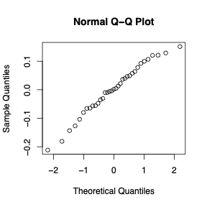
Example Experiment – variables
Growth of orange trees
Three variables:
  Circumference (numeric, continuous)
  Age (numeric, continuous, fixed)
  Tree (numeric, categorical, random)
Data looked a bit problematic
  Didn’t seem very linear
  Really bunched at low levels and spread out at high ones
Addressed with log transform
> qqnorm(resid(model))
Not too horrible
Is the model ok?
If so, is that curviness real?

Slide 4
Example Experiment – variables
Growth of orange trees
Three variables:
  Circumference (numeric, continuous)
  Age (numeric, continuous, fixed)
  Tree (numeric, categorical, random)
Data looked a bit problematic
  Didn’t seem very linear
  Really bunched at low levels and spread out at high ones
Addressed with log transform
Not too horrible
Is the model ok?
If so, is that curviness real?

Slide 5
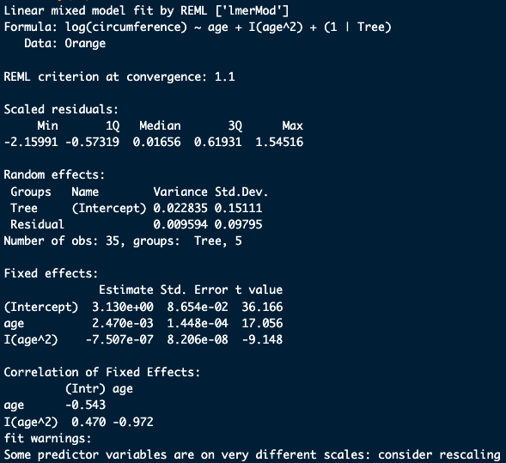
Example Experiment – variables
Growth of orange trees
Three variables:
  Circumference (numeric, continuous)
  Age (numeric, continuous, fixed)
  Tree (numeric, categorical, random)
> summary(model)

Slide 6
Example Experiment – questions
Growth of orange trees
Three variables:
  Circumference (numeric, continuous)
  Age (numeric, continuous, fixed)
  Tree (numeric, categorical, random)
> summary(model)
No Wald tests of fixed effects!
    Deliberate choice (see https://is.gd/glmmFAQ)
    Are approximations (e.g. via emmeans, lmerTest)
Take alternative approach
    Compare to a reduced model (without the curvature)
    Test difference via likelihood ratio test, or AIC
m1 <- lmer(log(circumference) ~ age + I(age^2) + (1|Tree), data = Orange)
m2 <- lmer(log(circumference) ~ age + (1|Tree), data = Orange)
anova(m1,m2)

Slide 7
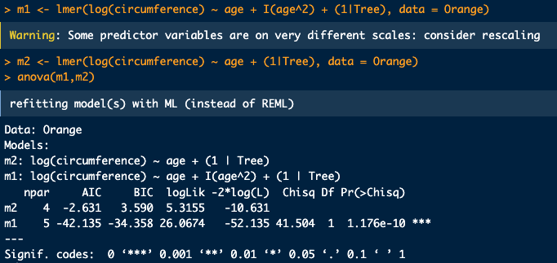
Example Experiment – questions
Growth of orange trees
Three variables:
  Circumference (numeric, continuous)
  Age (numeric, continuous, fixed)
  Tree (numeric, categorical, random)
Expect log likelihood to go up with more complex model
But does it go up more than we expect? Yes P =1.2 x 10⁻¹⁰
This is a ‘Likelihood Ratio Test’

Slide 8
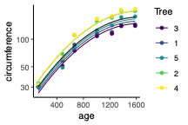
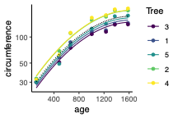
Example Experiment – questions
Growth of orange trees
Three variables:
  Circumference (numeric, continuous)
  Age (numeric, continuous, fixed)
  Tree (numeric, categorical, random)
AIC (Akaike Information Criterion) gives balance of numbers of parameters and goodness of fit – lower is better (can be positive or negative)
Usually agrees with LRT (tends to prefer slightly more complex models)
Good for comparing a set of models

Slide 9
Example Experiment – questions
Growth of orange trees
Three variables:
  Circumference (numeric, continuous)
  Age (numeric, continuous, fixed)
  Tree (numeric, categorical, random)
Is the model ok?
Not too horrible
If so, is that curviness real?
Yes, P = 1.2 x 10⁻¹⁰
Go on to use the model, e.g. for understanding what an average tree will do (black line)

