Slide 1
Generalized Linear Modelling 2 – fitting
Starting point:
Clarity about what is your response variable and what are explanatory variables
Clarity about how you expect your response variable to be distributed
Scientific questions about the relationship between response and explanatory variables
Data in a long-form dataframe or tibble

Slide 2
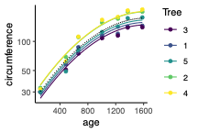
Types of response variable
Have considered different kinds of explanatory variable
  Numeric, categorical, fixed, random
Have silently assumed things about the response variable
  Numeric, continuous
  Normally distributed (have at least checked that one)
What if I’m counting pigeons in my garden?
  Counts: Numeric, categorical – integers only
  Don’t know how many pigeons there could be
  Never negative
  Is an average number (e.g. 2)

Slide 3
Types of response variable
What if I’m counting pigeons in my garden?
  Counts: Numeric, categorical – integers only
  Don’t know how many pigeons there could be
  Never negative
  Is an average number (e.g. 2)

Slide 4
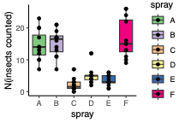
Types of response variable
What if I’m counting insects in a field?
  Counts: Numeric, categorical – integers only
  Don’t know how many insects there could be
  Never negative
  Is an average number (don’t know what it is)
Poisson models
Two variables (response and explanatory):
  Number of insects (categorical numeric)
  Type of spray (categorical)
Beall, G. The Transformation of Data from Entomological Field Experiments so that the Analysis of Variance Becomes Applicable. Biometrika 32 (1942). 10.2307/2332128

Slide 5
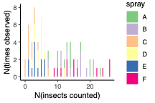
Generalized linear models
What if I’m counting insects in a field?
  Counts: Numeric, categorical – integers only
  Don’t know how many insects there could be
  Never negative
  Is an average number (don’t know what it is)
Poisson models
Two variables (response and explanatory):
  Number of insects (categorical numeric)
  Type of spray (categorical)
Questions (typical for a 1-way ANOVA)
  Does number of insects depend on spray used?
  How much does insect count change with spray used?
  What’s the expected count for spray A?
  How sure are we of the answers?
> model <- glm(count ~ spray, family = “poisson”, data = InsectSprays)
> summary(model)

Slide 6
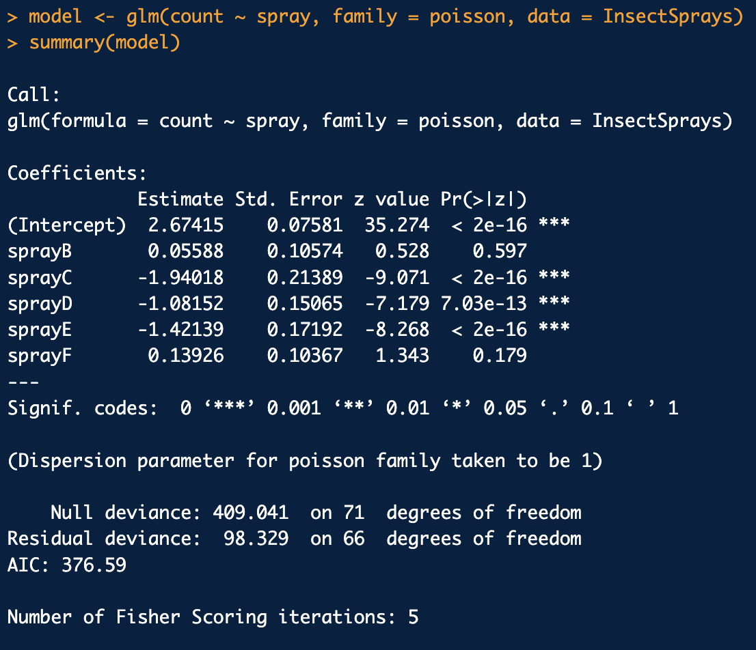
Generalised linear models
What if I’m counting insects in a field?
  Counts: Numeric, categorical – integers only
  Don’t know how many insects there could be
  Never negative
  Is an average number (don’t know what it is)
Poisson models
Two variables (response and explanatory):
  Number of insects (categorical numeric)
  Type of spray (categorical)
Check residual deviance

Slide 7
Generalized linear models
What if I’m counting insects in a field?
  Counts: Numeric, categorical – integers only
  Don’t know how many insects there could be
  Never negative
  Is an average number (don’t know what it is)
Poisson models
Two variables (response and explanatory):
  Number of insects (categorical numeric)
  Type of spray (categorical)
Check residual deviance
Moderate over-dispersion
For these purposes ‘deviance’ means pretty much the same as ‘variance’
Expect the residuals to have a Poisson distribution where mean = variance
So expect residual deviance to equal the residual degrees of freedom
Dispersion parameter is just the ratio residual deviance / residual df
i.e. dispersion parameter here is 98/66 = 1.5
library(DHARMa)
Use to test over-dispersion
Use for diagnostics plots

Slide 8
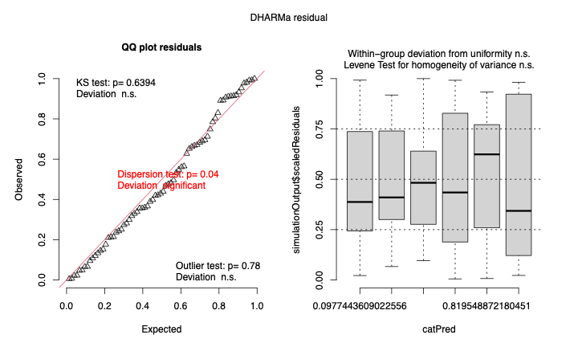
Generalized linear models
What if I’m counting insects in a field?
  Counts: Numeric, categorical – integers only
  Don’t know how many insects there could be
  Never negative
  Is an average number (don’t know what it is)
Poisson models
Two variables (response and explanatory):
  Number of insects (categorical numeric)
  Type of spray (categorical)
Check residual deviance
Moderate over-dispersion
library(DHARMa)
Use to test over-dispersion
Use for diagnostics plots
plot(simulateResiduals(model))

Slide 9
Generalized linear models
What if I’m counting insects in a field?
  Counts: Numeric, categorical – integers only
  Don’t know how many insects there could be
  Never negative
  Is an average number (don’t know what it is)
Poisson models
Two variables (response and explanatory):
  Number of insects (categorical numeric)
  Type of spray (categorical)

Slide 10
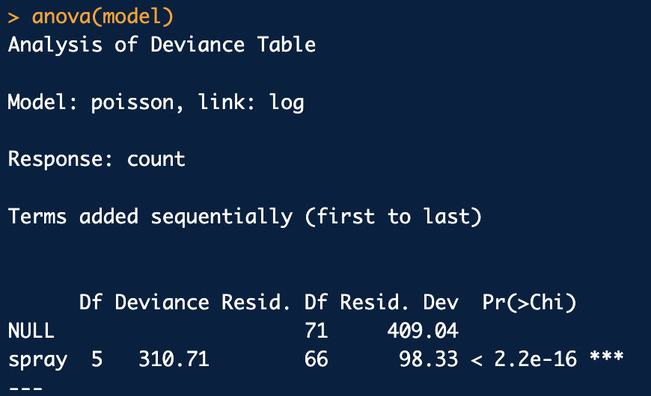
Generalized linear models
What if I’m counting insects in a field?
  Counts: Numeric, categorical – integers only
  Don’t know how many insects there could be
  Never negative
  Is an average number (don’t know what it is)
Poisson models
Two variables (response and explanatory):
  Number of insects (categorical numeric)
  Type of spray (categorical)
Is there variation among sprays?
Wald tests only compare each of the others to spray A
Want one test of whether spray matters
anova(model)
How much variation?
Linear model so numbers add up
    ŷ_{i} = β₀ + β₁ x₁
So expect spray A to be 2.67, spray E to be 2.67 – 1.42 = 1.25 etc.

Slide 11
Generalized linear models
What if I’m counting insects in a field?
  Counts: Numeric, categorical – integers only
  Don’t know how many insects there could be
  Never negative
  Is an average number (don’t know what it is)
Poisson models
Two variables (response and explanatory):
  Number of insects (categorical numeric)
  Type of spray (categorical)
Coefficients are on a log scale
How much variation?
Linear model so numbers add up
    ŷ_{i} = β₀ + β₁ x₁
So expect spray A to be 2.67, spray E to be 2.67 – 1.42 = 1.25 etc.
Signs are right, but numbers aren’t counts

Slide 12
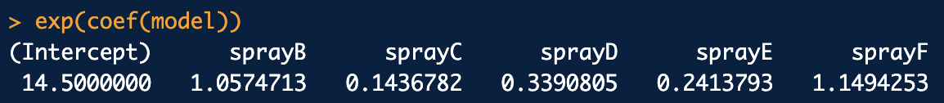
Generalized linear models
What if I’m counting insects in a field?
  Counts: Numeric, categorical – integers only
  Don’t know how many insects there could be
  Never negative
  Is an average number (don’t know what it is)
Poisson models
Two variables (response and explanatory):
  Number of insects (categorical numeric)
  Type of spray (categorical)
To reverse the log transform need to exponentiate:
    exp(coef(model))
How much variation?
Linear model so numbers should add up
    ŷ_{i} = β₀ + β₁ x₁
So expect 14.5 insects with spray A
Expect spray E to give exp(1.25) = 3.5
    ( or 14.5 * 0.24 = 3.5 )
So expect spray A to be 2.67, spray E to be 2.67 – 1.42 = 1.25 etc.
Can get predictions on count scale directly using
    predict(model, type = “response”)
Signs are right, but numbers aren’t counts

Slide 13
Generalized linear models
What if I’m counting insects in a field?
  Counts: Numeric, categorical – integers only
  Don’t know how many insects there could be
  Never negative
  Is an average number (don’t know what it is)
Poisson models
Two variables (response and explanatory):
  Number of insects (categorical numeric)
  Type of spray (categorical)
Questions (typical for a 1-way ANOVA)
  Does number of insects depend on spray used? Yes, P < 2.2 x 10⁻¹⁶

Slide 14
Generalized linear models
What if I’m counting insects in a field?
  Counts: Numeric, categorical – integers only
  Don’t know how many insects there could be
  Never negative
  Is an average number (don’t know what it is)
Poisson models
Two variables (response and explanatory):
  Number of insects (categorical numeric)
  Type of spray (categorical)
Questions (typical for a 1-way ANOVA)
  Does number of insects depend on spray used? Yes, P < 2.2 x 10⁻¹⁶
  How much does insect count change with spray used? Spray E cuts insects to 24% of that in A

Slide 15
Generalized linear models
What if I’m counting insects in a field?
  Counts: Numeric, categorical – integers only
  Don’t know how many insects there could be
  Never negative
  Is an average number (don’t know what it is)
Poisson models
Two variables (response and explanatory):
  Number of insects (categorical numeric)
  Type of spray (categorical)
Questions (typical for a 1-way ANOVA)
  Does number of insects depend on spray used? Yes, P < 2.2 x 10⁻¹⁶
  How much does insect count change with spray used ? Spray E cuts insects to 24% of that in A
  What’s the expected count for spray A? 14.5 insects (can only count integers, but this is the expected average)

Slide 16
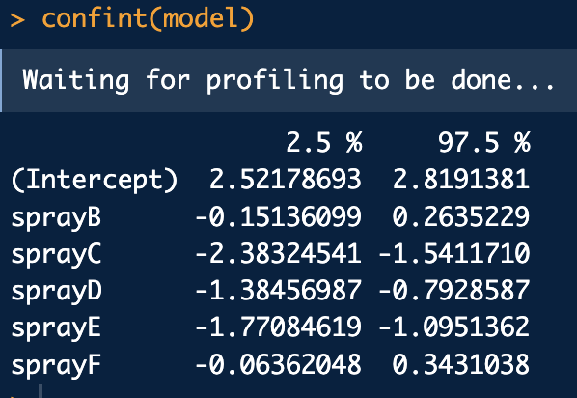
Generalized linear models
What if I’m counting insects in a field?
  Counts: Numeric, categorical – integers only
  Don’t know how many insects there could be
  Never negative
  Is an average number (don’t know what it is)
Poisson models
Two variables (response and explanatory):
  Number of insects (categorical numeric)
  Type of spray (categorical)
Questions (typical for a 1-way ANOVA)
  Does number of insects depend on spray used? Yes, P < 2.2 x 10⁻¹⁶
  How much does insect count change with spray used ? Spray E cuts insects to 24% of that in A
  What’s the expected count for spray A? 14.5 insects (can only count integers, but this is the expected average)
  How sure are we of the answers? SE and CI on the link scale so CI is exp(2.5) – exp(2.8) i.e. 14.5 (12.5 – 16.8 95% CI)

Slide 17
Generalized linear models
What if I’m counting insects in a field?
  Counts: Numeric, categorical – integers only
  Don’t know how many insects there could be
  Never negative
  Is an average number (don’t know what it is)
Poisson models
Two variables (response and explanatory):
  Number of insects (categorical numeric)
  Type of spray (categorical)
Questions (typical for a 1-way ANOVA)
  Does number of insects depend on spray used? Yes, P < 2.2 x 10⁻¹⁶
  How much does insect count change with spray used ? Spray E cuts insects to 24% of that in A
  What’s the expected count for spray A? 14.5 insects (can only count integers, but this is the expected average)
  How sure are we of the answers? SE and CI on the link scale so CI is exp(2.5) – exp(2.8) i.e. 14.5 (12.5 – 16.8 95% CI)
Take the very similar approach to other families
  e.g. binomial
But what if checks fail?
  (as they did, marginally, here)

Slide 18
Generalized linear models
But what if checks fail?
  (as they did, marginally, here)
Poisson models
Think again what your model knows about
  Is there something missing?
  Known explanatory variables (covariates) that aren’t modelled
Possibilities here
  Different insect species have different sensitivity (aphids versus moths)
  Some fields are windier than others
  Some fields are closer to insect-rich habitats than others
Adding in such covariates likely to deal with over-dispersion
Under-dispersion rarer – could be something problematic with the experiment (non-independence, confounding)
  All the fields with one spray were either close or far away from a source of insects
Only when done your best with the model and it’s still over/under dispersed
  Fit an extra parameter to account for it
Various options
  family = quasipoisson
  Negative binomial

Slide 19
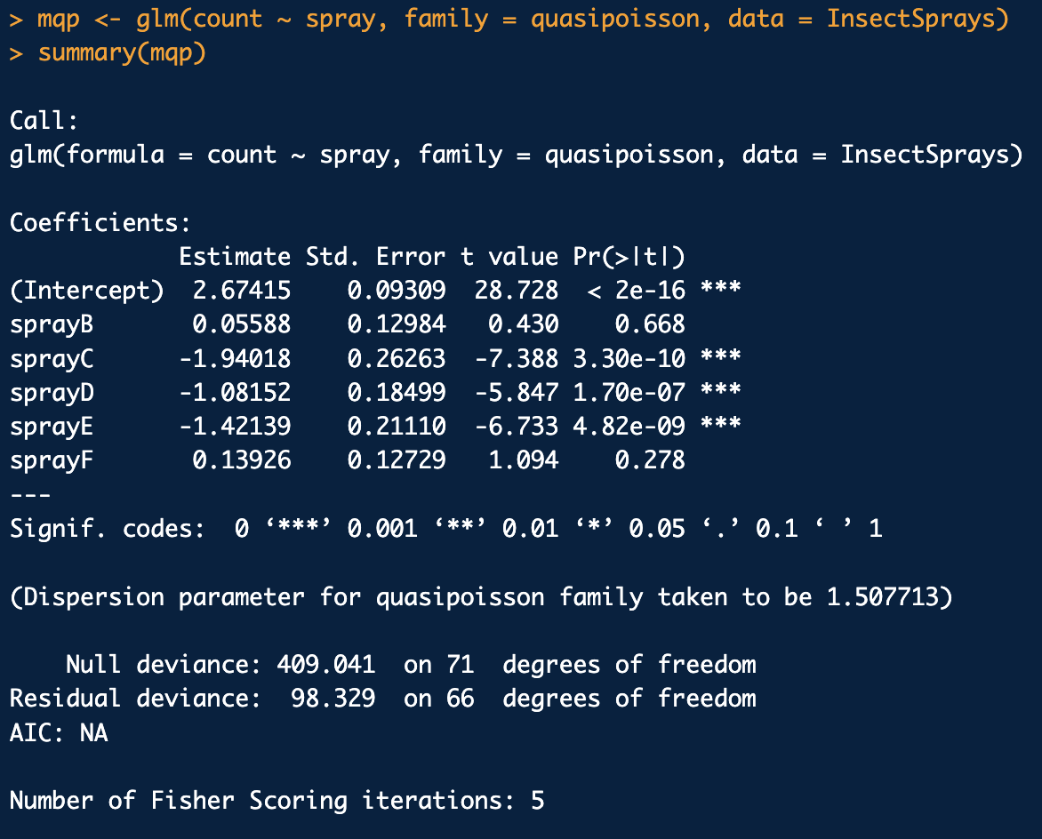
Generalized linear models
Various options
  family = quasipoisson
  Negative binomial
Poisson models
glm(count ~ spray, family = “poisson”)
glm(count ~ spray, family = “quasipoisson”)
Very similar outcome

