Slide 1
RandomForests
Starting point:
Clarity about what is your response variable and what are explanatory variables
Clarity about how you expect your response variable to be distributed
Scientific questions about the relationship between response and explanatory variables
Data in a long-form dataframe or tibble

Slide 2
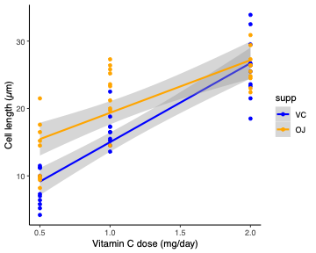
Linear models can’t do everything
Get very complicated with interactions among more than three fixed effects
  Interactions in y ~ x₁ * x₂ * x₃ is hard enough to interpret
  what if have hundreds of explanatory variables? (e.g. ‘omics)
Overly complex if just want to make a prediction on new data
  May not want parameters or their errors
  e.g. if just need best guess at a categorical response
Data may not have a well defined response distribution
  Whether normal or otherwise
Response and explanatory variables may not have clear parametric relationships
  Whether linear or nonlinear, which is possible too
Linear modelling is surprisingly robust to failing to meet assumptions,
But sometimes need something else

Slide 3
Linear models can’t do everything
Get very complicated with interactions among more than three fixed effects
  Interactions in y ~ x₁ * x₂ * x₃ is hard enough to interpret
  what if have hundreds of explanatory variables? (e.g. ‘omics)
Overly complex if just want to make a prediction on new data
  May not want parameters or their errors
  e.g. if just need best guess at a categorical response
Data may not have a well defined response distribution
  Whether normal or otherwise
Response and explanatory variables may not have clear parametric relationships
  Whether linear or nonlinear, which is possible too
Linear modelling is surprisingly robust to failing to meet assumptions,
But sometimes need something else
Machine learning
  Wide range of tools and approaches, usually without some of the issues above
  Different tradition from computer science not statistics – ‘Statistics without the proofs’
  Practically often ‘just another model’ implemented in R, similar to linear models
  Not without assumptions, pitfalls or limitations, but different!

Slide 4
Linear models can’t do everything
Machine learning
  Wide range of tools and approaches, usually without some of the issues above
  Different tradition from computer science not statistics – ‘Statistics without the proofs’
  Practically often ‘just another model’ implemented in R, similar to linear models
  Not without assumptions, pitfalls or limitations, but different!
Linear Models | Random Forests
Usually single response | Usually single response
Usually limited number of independent explanatory variables | Many explanatory variables
Limited numbers of pre-defined interactions possible | Very flexible interactions among large numbers of variables
Strong assumptions (linearity, independence, homoscedasticity, error distribution) | Limited assumptions about data, can be continuous, categorical, outliers ok
Very explicit interpretation of parameters | Hard to interpret workings of model
Hypothesis testing strong | Hypothesis testing weak

Slide 5
Linear models can’t do everything
Machine learning
  Wide range of tools and approaches, usually without some of the issues above
  Different tradition from computer science not statistics – ‘Statistics without the proofs’
  Practically often ‘just another model’ implemented in R, similar to linear models
  Not without assumptions, pitfalls or limitations, but different!
Linear Models | Random Forests
Usually single response | Usually single response
Usually limited number of independent explanatory variables | Many explanatory variables
Limited numbers of pre-defined interactions possible | Very flexible interactions among large numbers of variables
Strong assumptions (linearity, independence, homoscedasticity, error distribution) | Limited assumptions about data, can be continuous, categorical, outliers ok
Very explicit interpretation of parameters | Hard to interpret workings of model
Hypothesis testing strong | Hypothesis testing weak
“If our goal as a field is to use data to solve problems, then we need to move away from exclusive dependence on data models and adopt a more diverse set of tools.”
Breiman, L. Statistical Modeling: The Two Cultures (with comments and a rejoinder by the author). Statistical Science 16 (2001). 10.1214/ss/1009213726

Slide 6
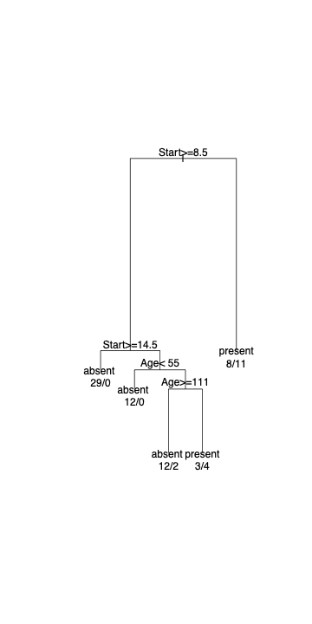
What is a random forest?
Machine learning
  Wide range of tools and approaches, usually without some of the issues above
  Different tradition from computer science not statistics – ‘Statistics without the proofs’
  Practically often ‘just another model’ implemented in R, similar to linear models
  Not without assumptions, pitfalls or limitations, but different!
Tree-based method
  Split response variable into two on the basis of an explanatory variable
  Pick the split that minimizes the variability of the response in the subsets produced
  Keep splitting until you run out of data! (or come up against a stopping criterion)
    Really efficient algorithms to do this
Kyphosis data
  Children who have had Corrective Spinal Surgery
  What determines if they end up with a curved spine (kyphosis – absent/present)?
  Explanatory variables: Start (top vertebra operated on), Age (in months)
Very flexible
  Would work exactly the same if response was >2 categories (e.g. none, some, lots), or continuous (curvature angle)
Can be extended beyond one tree
  Different (random selection of) Explanatory variables
  Different (random) subsets of data
  Combine with a voting system (for which data point goes to which outcome)
  Do for hundreds or thousands of trees – get random forests™
Breiman, L. Random forests. Machine Learning 45, 5-32 (2001). 10.1023/A:1010933404324

Slide 7
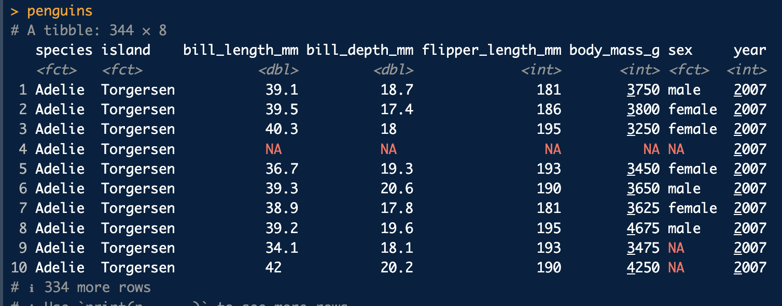
Fitting a random forest
Back to the penguins
  Fit a model to decide which species a penguin is based on its measurements
‘Only’ 7 variables in addition to species
  Would be pretty complicated to fit a linear model to predict species (multinomial variable)
  Don’t care about specific parameters, just want to be able to be sure of species from measurements – is it possible?
rf <- randomForest(species ~ ., data = penguins |> na.omit())
Very similar syntax to linear models
  dot represents ‘all the other variables’
  Need to get rid of missing values somehow (see also na.roughfix and rfImpute)

Slide 8
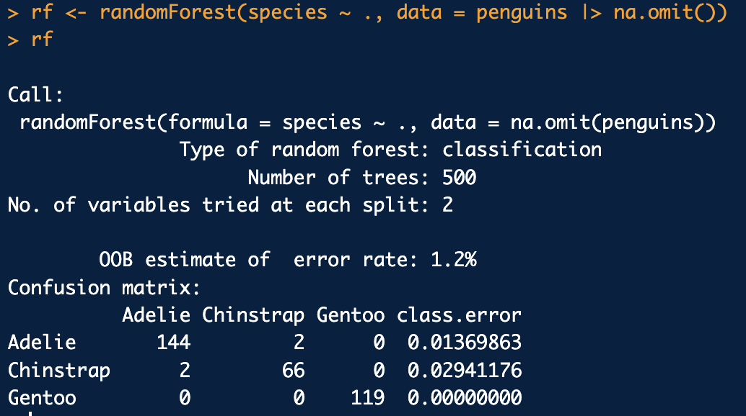
Understanding a random forest
Back to the penguins
  Fit a model to decide which species a penguin is based on its measurements
rf <- randomForest(species ~ ., data = penguins |> na.omit())
OOB = “out of bag”
  i.e. based on data not directly used to build the tree
  Shouldn’t be ‘over-fitted’

Slide 9
Understanding a random forest
Back to the penguins
  Fit a model to decide which species a penguin is based on its measurements
rf <- randomForest(species ~ ., data = penguins |> na.omit())
OOB = “out of bag”
  i.e. based on data not directly used to build the tree
  Shouldn’t be ‘over-fitted’
  1.2% pretty low for an error rate
Sometimes mixes up Chinstrap and Adelie
  Usually doesn’t
  Always gets Gentoo
Seems pretty good, should we believe it?
  Split into training and test sets
  Fit model on training set, test how model works on test set

Slide 10
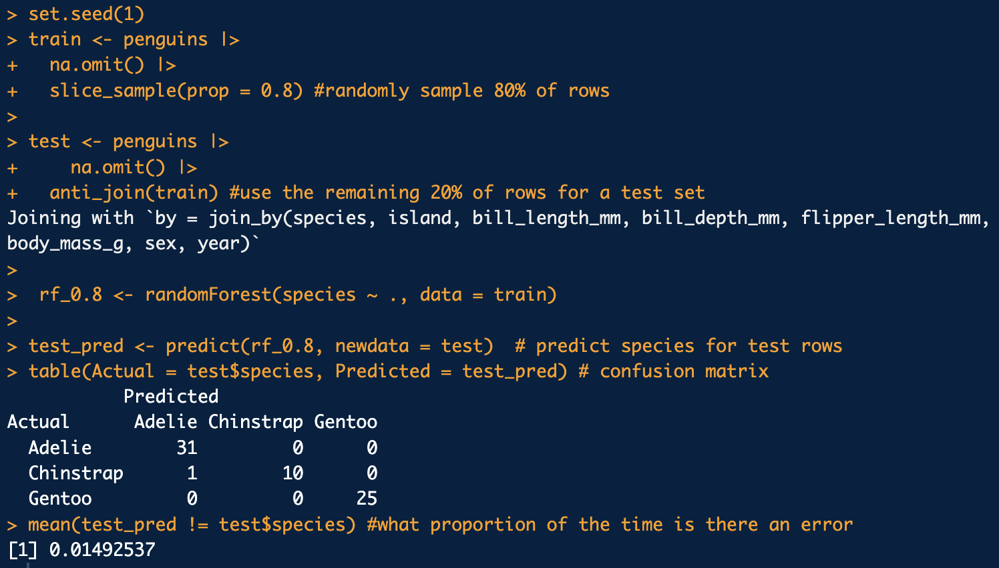
Understanding a random forest
Back to the penguins
  Fit a model to decide which species a penguin is based on its measurements
rf <- randomForest(species ~ ., data = penguins |> na.omit())
OOB = “out of bag”
  i.e. based on data not directly used to build the tree
  Shouldn’t be ‘over-fitted’
  1.2% pretty low for an error rate
Sometimes mixes up Chinstrap and Adelie
  Usually doesn’t
  Always gets Gentoo
Seems pretty good, should we believe it?
  Split into training and test sets
  Fit model on training set, test how model works on test set

Slide 11
Understanding a random forest
Back to the penguins
  Fit a model to decide which species a penguin is based on its measurements
rf <- randomForest(species ~ ., data = penguins |> na.omit())
OOB = “out of bag”
  i.e. based on data not directly used to build the tree
  Shouldn’t be ‘over-fitted’
  1.2% pretty low for an error rate
Sometimes mixes up Chinstrap and Adelie
  Usually doesn’t
  Always gets Gentoo
Seems pretty good, should we believe it?
  Split into training and test sets
  Fit model on training set, test how model works on test set

Slide 12
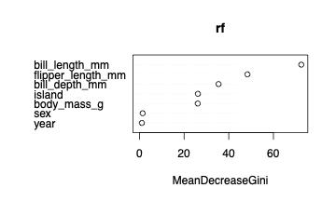
Understanding a random forest
Back to the penguins
  Fit a model to decide which species a penguin is based on its measurements
rf <- randomForest(species ~ ., data = penguins |> na.omit())
OOB = “out of bag”
  i.e. based on data not directly used to build the tree
  Shouldn’t be ‘over-fitted’
  1.2% pretty low for an error rate
Sometimes mixes up Chinstrap and Adelie
  Usually doesn’t
  Always gets Gentoo
Seems pretty good, should we believe it?
  Split into training and test sets
  Fit model on training set, test how model works on test set
varImpPlot(rf)
1.5% error (only one actual misclassification)
  Still very low – is doing a good job
Bill length most important for determining species
  Reassuring that sex and year aren’t important
  Are other/better measures of importance

Slide 13
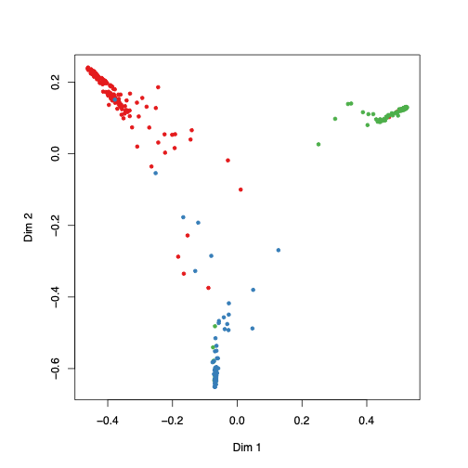
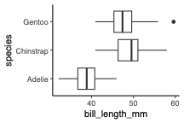
Understanding a random forest
Back to the penguins
  Fit a model to decide which species a penguin is based on its measurements
rf <- randomForest(species ~ ., data = penguins |> na.omit())
varImpPlot(rf)
OOB = “out of bag”
  i.e. based on data not directly used to build the tree
  Shouldn’t be ‘over-fitted’
  1.2% pretty low for an error rate
Sometimes mixes up Chinstrap and Adelie
  Usually doesn’t
  Always gets Gentoo
Gentoo
Adelie
Seems pretty good, should we believe it?
  Split into training and test sets
  Fit model on training set, test how model works on test set
Chinstrap
1.5% error (only one actual misclassification)
  Still very low – is doing a good job
Bill length on its own doesn’t get far
  Can’t really see how it’s working
  Black box model
  Different ways of looking deeper: Boruta, randomForestExplainer, pdp…
Bill length most important for determining species
  Reassuring that sex and year aren’t important
  Are other/better measures of importance

