Slide 1
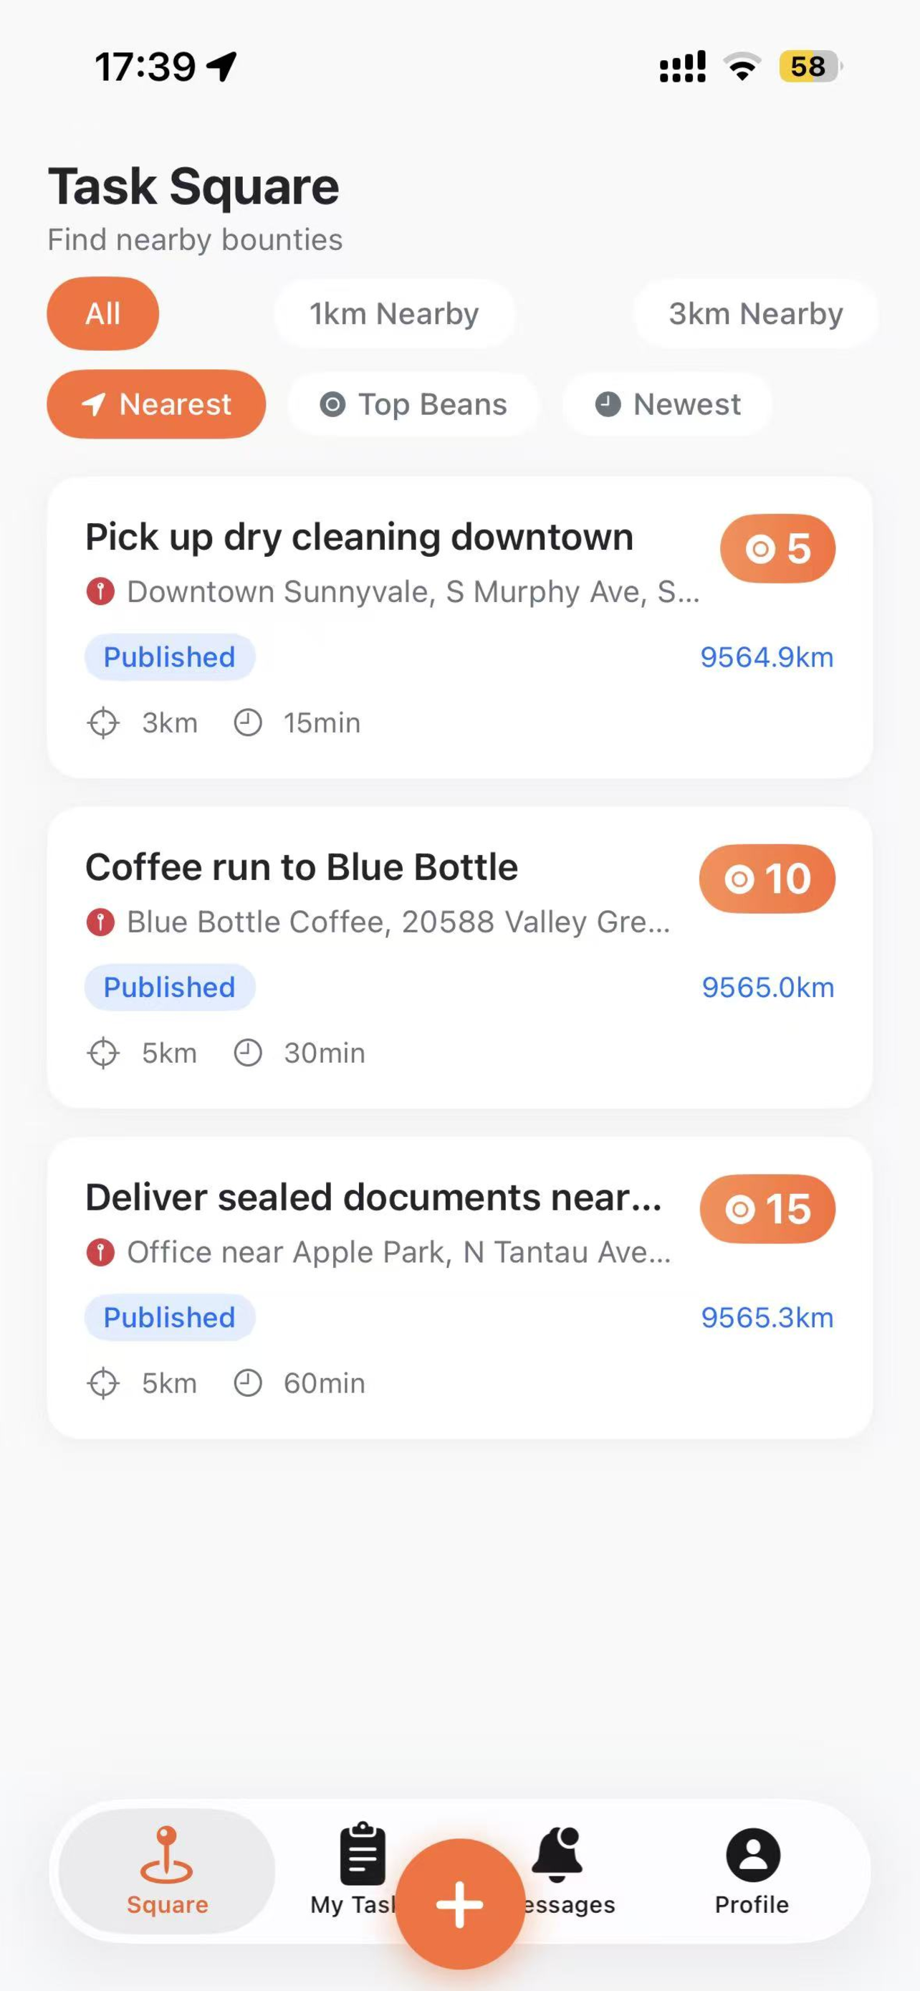
SeekerHub
Post a task near you.
A hunter nearby gets it done.
A location-based bounty marketplace for hyper-local errands —
post, claim, prove, and get paid in Beans.
iOS · App Store (in review) · gotseeker.com · 2026

Slide 2
Hyper-local help is still broken
Everyday errands depend on knowing the right person — or on heavyweight platforms built for big jobs.
Small favors, big friction
No trust without a handshake
Platforms price you out
Queueing, pickups, quick photo checks — 5-minute tasks with no simple way to delegate to someone right next to you.
Sending a stranger to do something for you requires evidence and accountability that group chats and classifieds can't provide.
Gig platforms vet supply heavily and take large cuts on large jobs; micro-tasks don't fit their model.

Slide 3
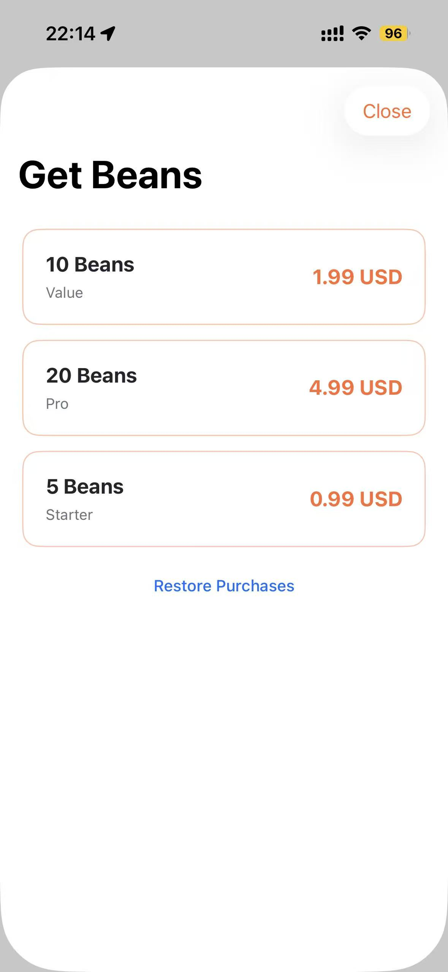
A bounty marketplace in your pocket
SeekerHub matches a task with the nearest available hunter — the stake is escrowed in Beans the moment the task goes live.
1
Describe & stake
Title, location pin, radius, deadline — beans are atomically reserved on publish.
2
The nearest hunter claims
Live feed sorted by distance / bounty / newest; one-tap claim, no bidding.
3
Photo proof settles it
Evidence is GPS-checked against the task radius; confirm releases the bounty instantly.

Slide 4
How it works
One loop, two roles. Earned Beans can be spent posting your own tasks — the economy circulates.
01
02
03
04
Post
Claim
Prove
Get paid
→
→
→
Stake a bean bounty on a map pin with a radius and a deadline.
The nearest hunter takes it — atomic claim, no double-grab.
Up to 3 photos with GPS, validated inside the task radius.
Confirmation releases the bounty to the hunter's wallet instantly.

Slide 5
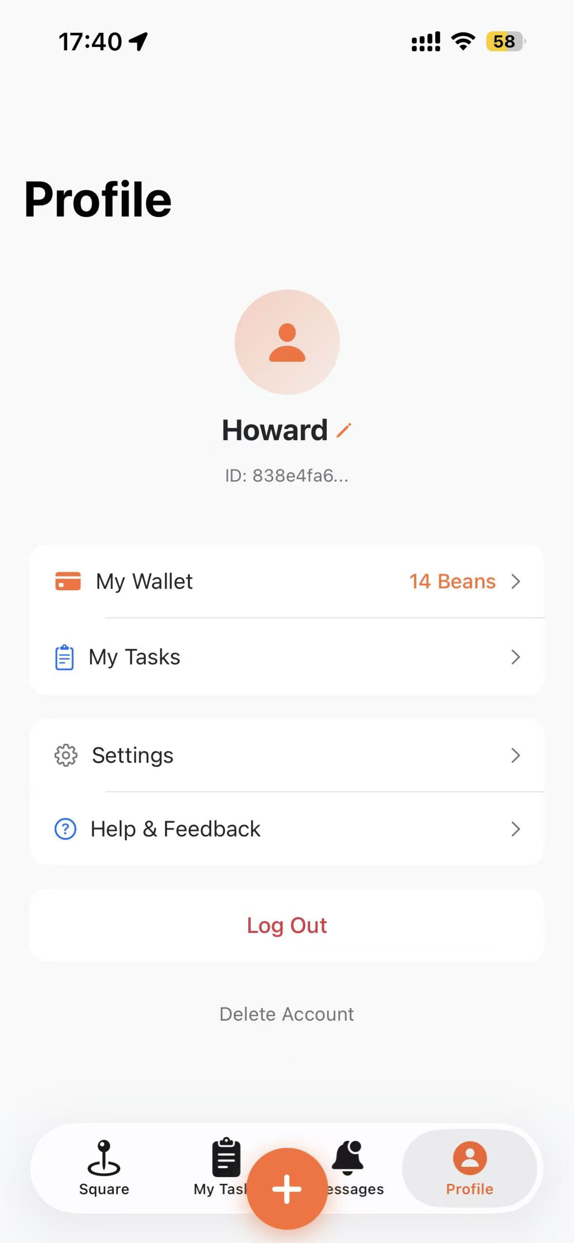
Inside the app
Task Square — live feed sorted by distance
Wallet — dual ledger: purchased & earned Beans
Top-up — Apple In-App Purchase, 3 SKUs

Slide 6
The Beans economy
Starter
$0.99
A self-circulating economy
5 Beans
Poster buys Beans (Apple IAP)
Value
consumable SKUs — Guideline 3.1.1 compliant
$1.99
10 Beans
Beans are staked on publish
atomic reservation, refunded if cancelled unclaimed
Pro
$4.99
Hunter completes → earns
20 Beans
confirmed bounty lands in the earned ledger
Earned Beans fund new posts
+5 Beans welcome gift for every new account — enough to post your first task.
supply and demand recycle inside the community
Beans are stakes, not currency: not withdrawable, not transferable. The platform never holds user funds.

Slide 7
Trust is the product
Every mechanic is designed so a stranger transaction feels as safe as asking a friend.
Photo + GPS evidence
Apple-verified payments
Up to 3 photos, server-side geo-fence check, 24h auto-confirm protects hunters.
StoreKit 2 JWS validated against the Apple Root CA; idempotent by transaction id.
GDPR by default
No tracking, no leaks
First-launch consent, in-app policy pages, one-tap account deletion with 30-day purge.
Privacy manifest with valid Required-Reason declarations; chat URLs blocked; platform-only image hosting.

Slide 8
Built to ship, built to last
61
175
7
3
end-to-end checks green
countries & regions
push notification events
IAP SKUs verified
beans conservation, forged-JWS rejection, geo-fence, restore
App Store distribution from a HK edge node
token-based APNs, production gateway
consumable, JWS-signed, idempotent
SwiftUI + StoreKit 2 → Go API (Gin) on Tencent Cloud HK → SQLite + Redis + COS → CI/CD with version-checked deploys & auto-rollback
healthz reports the exact deployed git SHA — every release is verifiable in production.

Slide 9
Where SeekerHub fits
TaskRabbit
Fiverr / Upwork
Field Agent
Vetted pros, big jobs, 15%+ cut
Remote, project-based
Crowdsourced photo audits only
No vetting wall — anyone nearby can claim a 5-minute task.
Local & immediate: LBS radius, minutes-level deadlines.
Open task types and free-form pricing, same evidence rigor.
Our wedge: two-sided density inside a small radius + a photo-anchored trust chain. Everyone can earn and everyone can post — the marketplace bootstraps itself.

Slide 10
From launch to real-money escrow
V1.0
V1.1
V1.2
V2.0
Global launch
Operations
Growth
Real money
In App Store review — beans economy, geo-fenced tasks, evidence, chat, APNs
Content moderation, analytics, rewards center (earned-bean redemption)
Ratings & reputation, hunter levels, referral beans
Stripe Connect escrow split (HK entity) — beans become posting stakes
SeekerHub · gotseeker.com · App Store (in review)

