Slide 1
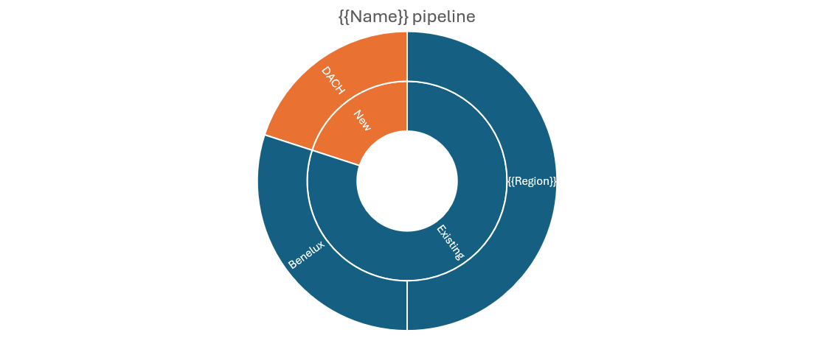
Pipeline for {{Name}}

