Slide 1

Mental Health Support Web Application
By
2111CS040025 R. DANIEL NICOLAS
2111CS040003 M. ABHISHEK
2111CS040004 ABHINAY GOUD
Under the Guidance of
Mr. P. Ravindra
Head of the Department
Cyber Security and IoT
Department of Cyber Security
School of Engineering
Malla Reddy University
Hyderabad, Telangana, INDIA

Slide 2
Contents:
1. Abstract
2. Introduction
3. System Analysis
4. Architectural Design

Slide 3
1. Abstract
More than one billion individuals worldwide face mental health challenges like anxiety and depression, but stigma, lack of resources, or just living far away may be some reasons why many never get the care they need. The World Health Organization reports that over 75% of people living with mental health disorders do not get appropriate treatment; this clearly reflects how it is graver than ever that better solutions are found. The Mental Health Support Web Application aims to bridge that gap. It is a scalable anonymous, and easily approachable platform that offers mental health support through an intelligent chatbot. The chatbot detects emotional states and provides coping mechanisms personalized for its users all the while giving real-time emotional support via machine learning and natural language processing. In a discreet and anonymous manner, the user will gain access to some practical, scientifically supported self-care advice and emergency supplies whenever required. This platform offers self-assessment tests, journaling, and relaxation techniques that include mindfulness and breathing exercises. It's safe and private to communicate, with the ability to refer users needing further assistance to licensed mental health specialists. The aim of the web application is to bring mental health support to a greater audience to lessen the effects that untreated mental health issues may bring about on people's emotional well-being.

Slide 4
2. Introduction
2.1 Problem Definition & Description
Increasing prevalence of mental health issues.
Limited access to support due to stigma, financial constraints, and a shortage of mental health professionals.
Hesitation to seek help leads to undiagnosed conditions and worsening mental well-being.
Need for an accessible, private, and intelligent solution for managing mental health.
Project Description:
The Mental Health Support Web Application provides accessible mental health assistance through Peace Pal, an AI chatbot powered by the Groq API with the llama-3.3-70b-versatile model. It offers real-time emotional support, personalized coping strategies, and self-assessment tests to gauge mental well-being. Users can access wellness tools like journaling, mindfulness, and breathing exercises, with referrals to licensed professionals if needed. The platform ensures privacy with anonymous interactions and secure data storage. Built using Flask/Python (backend), SQLAlchemy(Database) and HTML templates (frontend), it employs TOML for secure API key management and virtual environments for dependency management.

Slide 5
2. Introduction
2.2 Objectives of the Project
Develop an accessible, secure, and intelligent mental health support platform.
Utilize AI to deliver personalized emotional support, self-assessments, and coping strategies.
Ensure user privacy and provide referrals for professional help when needed.
2.3 Aim
To design and develop a comprehensive mental health support web application that utilizes an AI-powered chatbot to offer real-time emotional support, personalized coping strategies, and self-assessment tools. The platform aims to promote mental well-being through interactive features such as journaling, mindfulness exercises, and referrals to licensed professionals. Additionally, the application prioritizes user privacy and security, ensuring anonymous interactions and secure data management while providing a supportive and accessible space for users to manage their mental health effectively.

Slide 6
3. System Analysis
Existing System
Mental Health Helplines and Hotlines: Provide real-time support but may lack personalization and long-term engagement.
Mobile Mental Health Apps (e.g., Calm, Headspace): Offer guided meditations and relaxation techniques but often lack conversational AI for personalized support.
AI Chatbots (e.g., Wysa, Woebot): Provide mental health assistance using AI but may have limited emotional intelligence and personalization.
Teletherapy Platforms (e.g., BetterHelp, Talkspace): Connect users with licensed therapists but can be expensive and lack anonymity.
Online Self-Assessment Tools: Help users evaluate their mental health but often lack follow-up support and coping strategies.
Community Forums (e.g., Reddit, 7 Cups): Offer peer support but may have unreliable advice and privacy concerns.
These systems address certain aspects of mental health support but often fall short in delivering a fully integrated, personalized, and secure experience.

Slide 7
3. System Analysis
Proposed System:
AI Chatbot (Peace Pal): Provides real-time emotional support using the Groq API with the LLaMA model.
Personalized Recommendations: Offers coping mechanisms based on users' emotional states.
Session-Based Chat: Saves conversation history with a scrollable interface for easy reference.
Self-Assessment Tests: Helps users gauge their mental well-being with tailored coping strategies.
Wellness Tools: Includes journaling, mindfulness exercises, and breathing techniques.
Licensed Professional Referrals: Connects users to therapists when necessary.
Privacy and Security: Ensures anonymous interactions and secure data storage.
Technology Stack: Uses Flask for the backend, HTML for the frontend, TOML for API key management, and virtual environments for dependency management.

Slide 8
4. Architectural Design
a
The Mental Health Support Web Application follows a client-server architecture, enabling smooth interaction between users and the AI chatbot (Peace Pal). The system consists of a web-based user interface, a Flask backend server, a database for storing user interactions, and third-party integrations for the Groq API with the LLaMA model. The frontend uses HTML templates to deliver an intuitive chat experience, while the backend handles session management, self-assessment results, and secure data storage. Additionally, a TOML configuration file manages secure API key storage, and virtual environments ensure efficient dependency management.
4.1 System Components
User Interface (Frontend):
Built using HTML templates for an interactive and user-friendly experience.
Provides access to features such as chat, self-assessments, journaling, and relaxation tools.
Displays real-time chatbot responses with a scrollable chat interface.

Slide 9
4. Architectural Design
AI Chatbot (Peace Pal):
Developed using the Groq API with the LLaMA model for natural language processing.
Analyzes user inputs to provide emotional support and personalized coping strategies.
Stores session-based conversation history for continuity.
Backend Server:
Built using the Flask framework to handle business logic and API interactions.
Manages session-based message persistence for ongoing user conversations.
Processes self-assessment results and provides relevant recommendations.
Database:
Stores user conversation histories, self-assessment results, and journaling entries.
Maintains user privacy by storing data securely with encryption.
Supports session management to retrieve past interactions.
Self-Assessment Module:
Provides quizzes and tests to evaluate users’ mental well-being.
Analyzes responses to offer tailored recommendations and coping strategies.
Saves assessment results for future reference.

Slide 10
4. Architectural Design
Wellness Tools:
Includes features such as journaling, mindfulness exercises, and breathing techniques.
Helps users manage stress and monitor their emotional health.
Integrates with the chatbot to suggest exercises based on emotional state.
Referral System:
Connects users with licensed mental health professionals when advanced support is needed.
Provides recommendations based on self-assessment results and chatbot interactions.
Security and Privacy Measures:
Ensures anonymous user interactions.
Uses TOML configuration files for secure API key management.
Employs encryption for storing sensitive user data.
API Key Management:
Utilizes a TOML file to securely store the Groq API key.
Protects API credentials from unauthorized access.
.

Slide 11
4. Architectural Design
4.3 Workflow Overview
Step 1 : User interacts with the web application and logs in/ signs up.
Step 2 : Database securely stores user information.
Step 3 : Backend server manages sessions and processes data. A dashboard pops up
Step 4 : AI chatbot provides emotional support.
Step 5 : Self-assessment quizzes offer personalized recommendations.
Step 6 : Wellness tools support mental health.
Step 7 : Referral system links users with professionals.
Step 8 : Security ensures anonymous interactions.
Step 9 : API keys are securely stored.
Step 10 : Virtual environments manage dependencies.
.

Slide 12
4. Architectural Design
4.3 Workflow Overview
Step 1: Driver Requests Assistance
The driver searches for nearby mechanics, towing services, or other roadside assistance providers.
The app matches the request with available providers based on proximity and availability.
Step 2: Mechanic/Towing Service Accepts Request
The mechanic or service provider receives the service request.
They can accept or decline based on their availability.
Step 3: Real-Time Tracking & Assistance
Both driver and service provider can track each other’s live location.
The driver receives ETA updates and can communicate with the provider.
Step 4: Service Completion & Feedback
The driver confirms service completion.
Users can rate and review mechanics and service providers for future users.

Slide 13
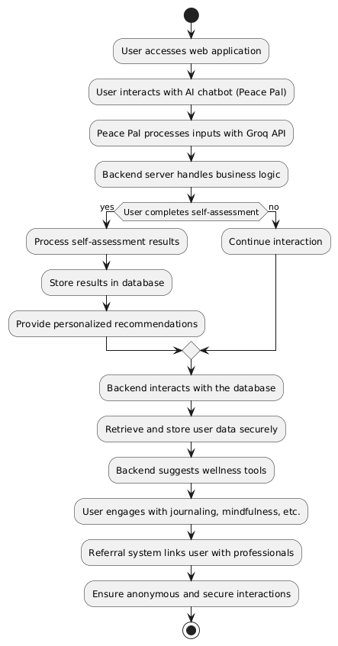
4. Architectural Design
4.4 System Flow Diagram

Slide 14
Thank You

