Slide 1
Chapter 4
Numerical Computation(finding suitable model to raw data )
Yu-Wei, Chen
Happy Chinese New Year of Rooster

Slide 2
Outline
4.0 Overview
4.1 Overﬂow and Underﬂow
4.2 Poor Conditioning
4.3 Gradient-Based Optimization
4.4 Beyond the Gradient: Jacobian and Hessian Matrices
4.5 Constrained Optimization
4.6 Example: Linear Least Squares
4.7 Case study: KKT
4.8 Summery

Slide 3
Overview
Machine learning’s algorithms usually require a high amount of numerical computation. The two commonly used numerical operation are listed left. In addition to knowing more on this topic, I attached some bonus case study.
Common operations
Optimization -- ﬁnding the value of an argument that minimizes or maximizes a function.
Solving systems of linear equations.

Slide 4
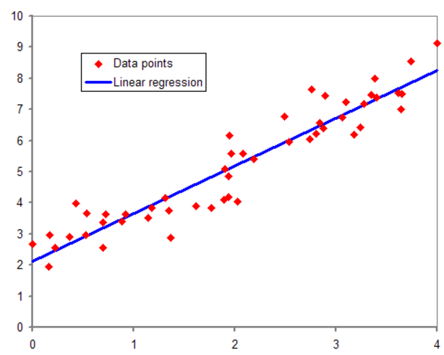
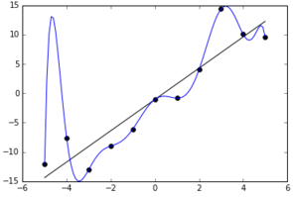
Little story on Regression Analysis
Three kinds of Estimation
Method of Moment
Ordinary least square estimation
Maximum likelihood estimation
Overfitting dilemma

Slide 5
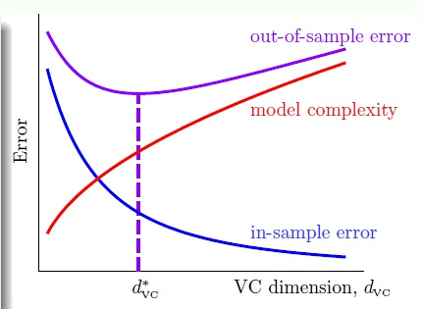
4.1 Overﬂow and Underﬂow
Underﬂow
Occurs when numbers near zero are rounded to zero.
Overﬂow occurs
When numbers with large magnitude are approximated as
∞ or −∞
Over-fitting
Too complicated(excessive power)
Noise loud
Limited data
Notes:
Underflow – around 0

Slide 6

4.2 Poor Conditioning(幫助評估矩陣效果)
Conditioning refers to how rapidly a function changes with respect to small changes in its inputs.
Poor conditioning means the solution is not solid enough to be used
In linear Algebra
Kapa is intrinsic property of the matrix itself, change or not
Refer to : Condition Number

Slide 7

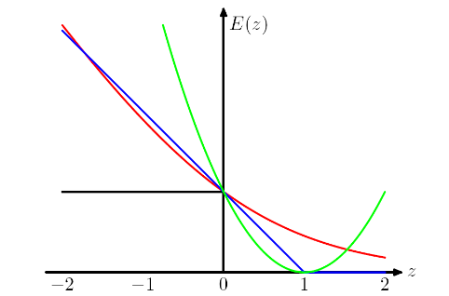
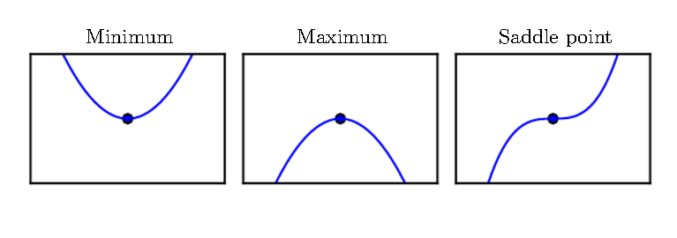
4.3 Gradient-Based Optimization (Loss Fn.)
Github : Given a prediction (p) and
a label (y), a loss function loss function measures the discrepancy between the algorithm's prediction and the desired output.
Regularizer
Yi: true value
Xi: prediction
Θ is a based variable
Hint : in Calculus, finding the max, min

Slide 8
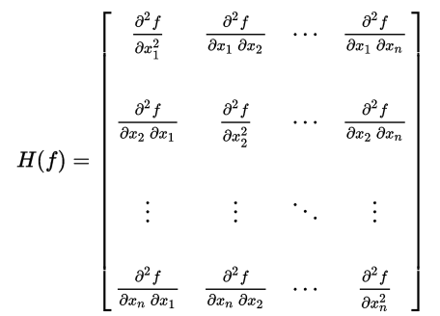
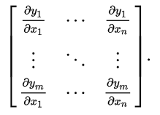
4.4 Beyond the Gradient: Jacobian and Hessian Matrices
Hessian Matrices
Someone just call this the Determinant of 2nd derivative equation
M x M
Jacobian Matrix
1st derivative function
M x N

Slide 9
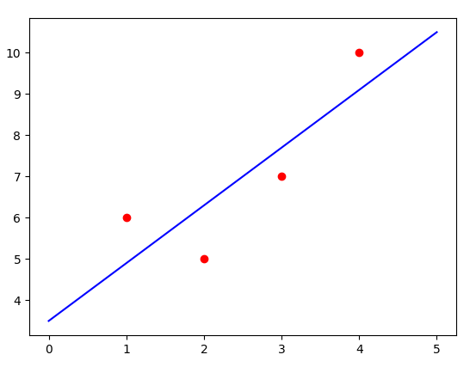
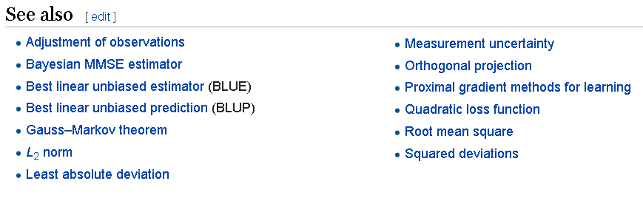
4.5 Constrained Optimization

Slide 10

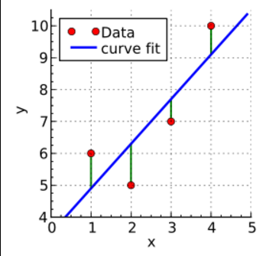


4.6 Example: Linear Least Squares
A regression model as
Where
Least square estimate β is

Slide 11

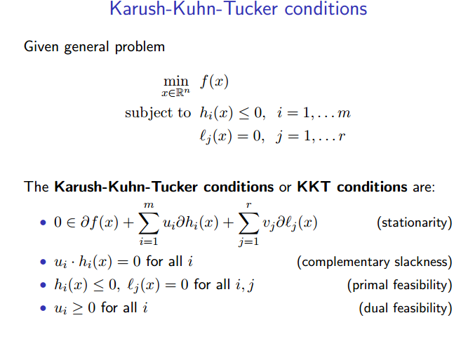

4.7 Case study: KKT(限制優化)
Karush-Kuhn-Tucker Conditions
KKT multipliers

Slide 12
4.8 Summery
Optimization algorithms
1st order (use Jacobian matrix)
2nd order (use Hessian matrix)
Lipschitz continuous … specialize for deep learning
convex optimization -- used only as a subroutine of some deep learning algorithms
Deep learning algorithms tend to lack guarantees because the family of functions used in deep learning is quite complicated. The dominant approach to optimization is to design optimization algorithms for a limited family of functions.

